Slide 1

Microbe Mission (B/C)
Colin Barber

Slide 2
Before we begin...
Please...ask questions throughout! I have also left time at the end for questions and discussion
We have a diverse crowd--I’ll try to touch on things that are important to everyone
I can be reached at ccb225@cornell.edu if you need anything Microbe Mission-related

Slide 3
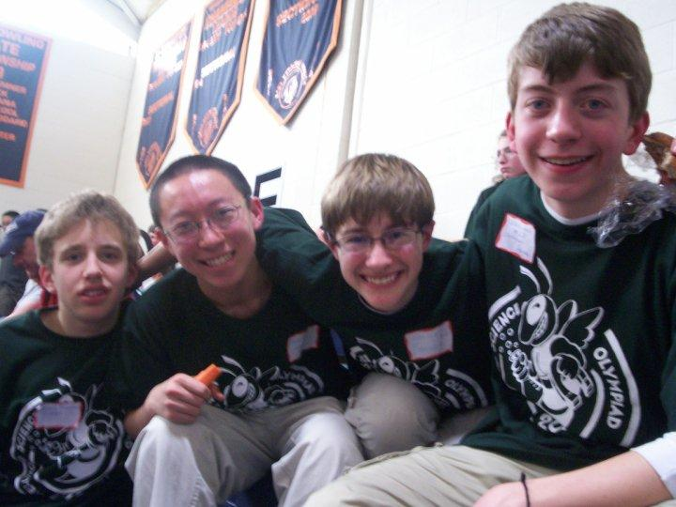
Who am I?
Competitor from 2008-2013
Current senior at Cornell
First executive board for Science Olympiad at Cornell
Applying for PhD programs right now

Slide 4
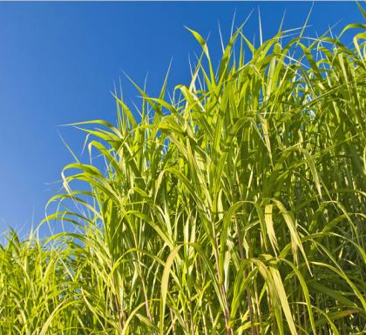
Why microbiology?
Prokaryotic life - ½ of Earth’s biomass at 550x10¹² kg
Bacteria alone comprise >1000 phyla (compare to a couple hundred for eukaryotes)
Microbes play essential roles in:
  Disease and health
  Nutrient cycling
  Industry

Slide 5
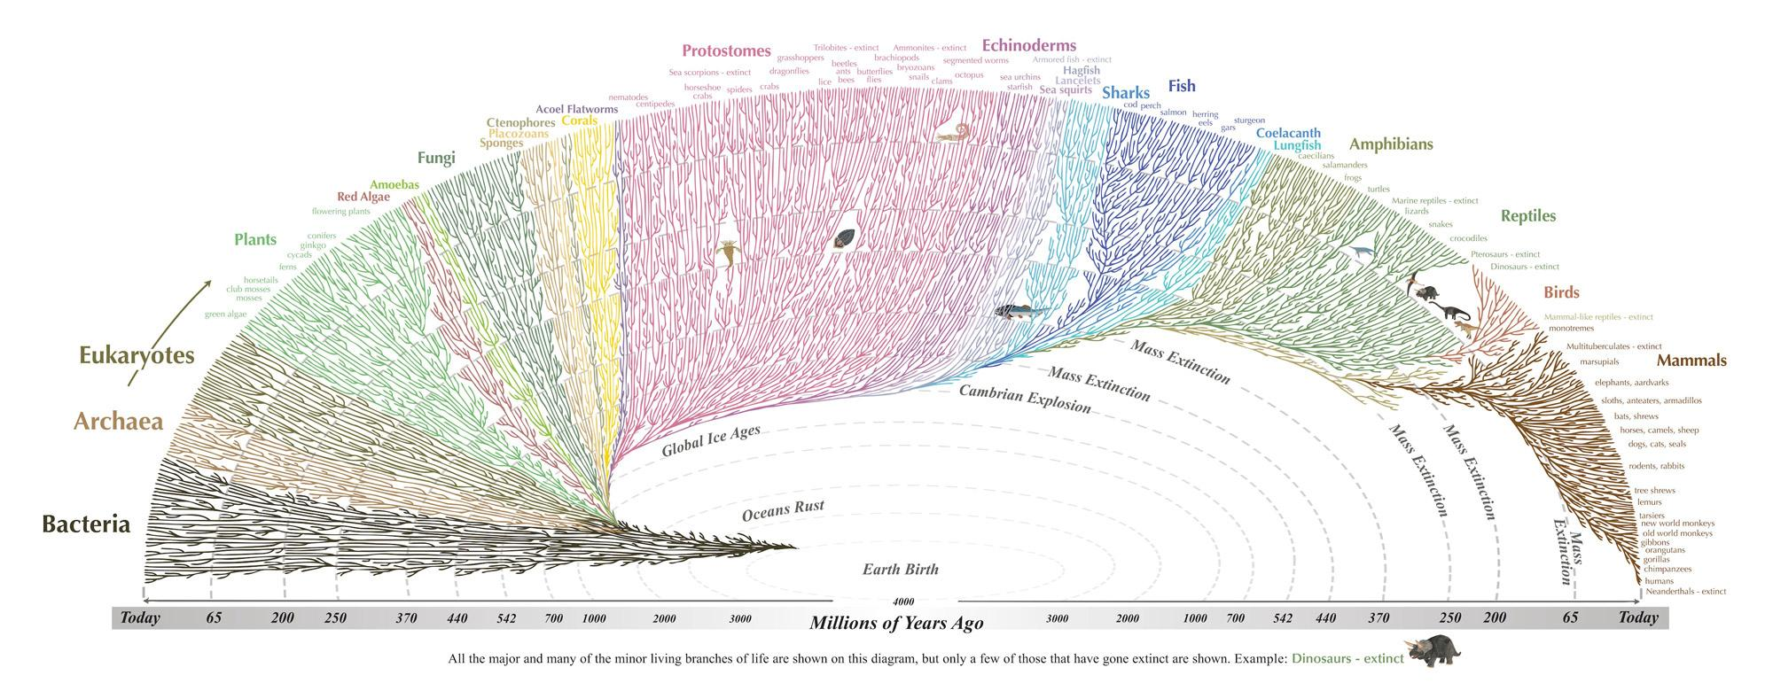

Slide 6
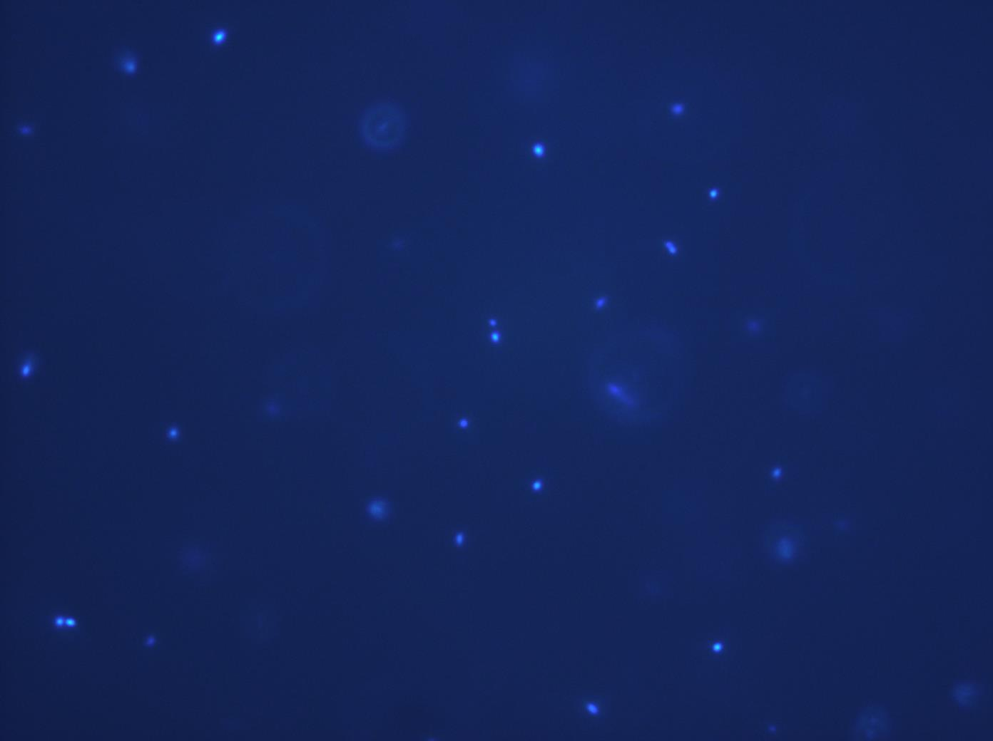
Microbiology is a highly mysterious field
Microbiology encompasses the vast majority of genetic diversity
Members from ~10 or so prokaryotic phyla have been cultured
And all this time, I’ve ignored viruses and eukaryotic microbes!

Slide 7
So what does this have to do with Microbe Mission?

Slide 8
The rules are a balancing act
Microbiology is a diverse field as we saw
Subfields:
  Medical
  Industrial
  Food
  Ecology
  Environmental
The event must have focus
How we explore microbiology:
  Highlight important cases in each subfield
  Basic lab technique
  Basic cellular physiology
  Fundamental understanding of microbial diversity

Slide 9
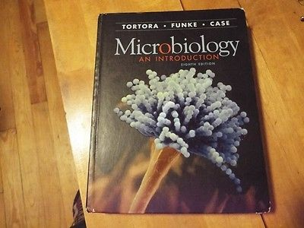
How did I prepare for Microbes?
I read textbooks
  Tortora, Funke, Case Introduction to Microbiology
  Brock Biology of Microorganisms
I wrote tests
  The best way to learn the material is to...test someone else

Slide 10
As a competitor (2010-2012), what did I find?
Tests have (almost universally) a medical focus!
  What about the other subfields?
Tests are focused primarily on rote memorization
Little emphasis on drawing conclusions
CONCLUSION
FACTS

Slide 11
My goals as a state supervisor
Reinforce the importance of environmental microbiology
Emphasis on solving microbiological problems
  Disease
  Ability to make predictions about microbes in a sample
  How to use lab equipment to gain knowledge
CONCLUSION
FACTS

Slide 12
Let’s break it down even further

Slide 13
Environmental and evolutionary microbiology
Rule 3c is EXTREMELY broad!
A few key questions
  What are the defining characteristics of each group identified in the rules?
  What kinds of environments do they inhabit?
  What relationships do they have with neighboring organisms?
  Endosymbiotic theory
Examples
(1) Cell wall? Organelles present/absent? Membrane structure? Ribosomal structure?
(2) Can they live anaerobically? Do they inhabit extreme environments? Are they an important component of soils, seawater, etc.?
(3) Symbioses: nitrogen-fixing bacteria, mycorrhizal fungi, lichens, gut inhabitants, etc.
(4) What organelles are thought to be of microbial origin and WHY?

Slide 14
Disease
Ex. A patient presents with shortness of breath, nausea, and tingling sensations all over her body within a couple hours of eating thoroughly-cooked shellfish. Name a microbial disease that may be afflicting the patient and its causative agent.
Causative agent of every disease on the disease list
For every disease, ask: how does it work?
  Should be able to solve problems using disease knowledge
  But, this is NOT Disease Detectives!

Slide 15
What’s in a sample?
Need to know fundamental characteristics of each microbial group
Need to know what they DO
  Who can live without oxygen? Who does photosynthesis? Who must live intracellularly?
Ex. You leave nitrogen- and carbon-free medium on a well-lit windowsill after inoculating with seawater. Which microbial group do you expect to dominate your sample after several days?

Slide 16
How do we use lab equipment?
Microscopy
  What are the major microscope types, and what are they used for?
  Picture analysis
Growth curves
  Interpretation of optical density data
Div C: The Gram stain
Ex. You want to visualize movement of a particular protein in your favorite bacterium, Colinella barberensis. Can you use a transmission electron microscope for this?

Slide 17
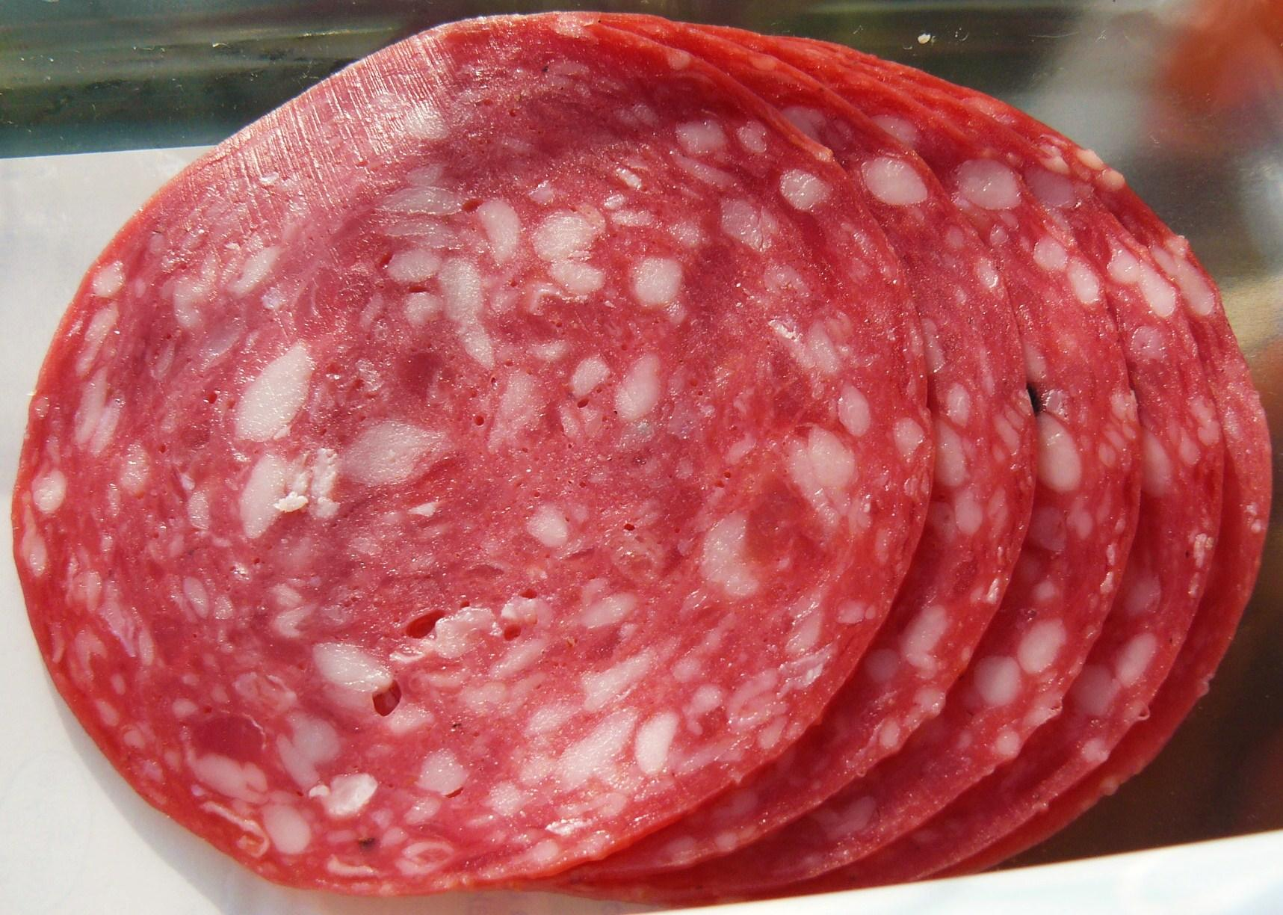
The remainder of the rules
Food microbiology
  Major food fermentations
  Spoilage is tricky
Div C only:
  Cellular morphology
  Spores and cysts

Slide 18
Long story made much shorter...
In addition to having rote knowledge of microbiology, MUST be able to apply it to novel situations!
For coaches: Get (especially biology) students thinking about how to solve problems!
For test writers: Be creative - how can we get students to draw connections between and conclusions from a broad knowledge of microbiology?

Slide 19
Questions and discussion

