Slide 1
Standards Based Mathematics Instruction for Tier I
Title 1 Directors’ Conference
March 10-12, 2009
Morgantown, WV

Slide 2
Trading Horses
Independently solve the problem located on your table.
Be ready to justify your solution.
Notes:
Participants will solve the problem independently.
After several minutes, instruct the participants to reach a table consensus.
Allow time for groups to share their solutions and justification of the solution and process.

Slide 3
Trading Horses
A man bought a horse for $50.
He sold it for $60.
Then he bought the horse for $70.
He sold it again for $80.
What is the financial outcome of these transactions? (Ignore cost of feed for horse, cost of boarding etc.)
Notes:
Display problem during the discussion.

Slide 4
Instructional Strategies
Task to engage students with mathematics at the beginning of class
Problem was given a title.
Quiet independent work time was provided.
Mathematical thinking was shared with a partner or small group.
Group mathematical thinking shared with the entire group.
Notes:
Task to engage students with mathematics at the beginning of class.
Engage the students at the beginning of class with a problem the challenges their thinking.
Problem was given a title.
In language arts the title gives an indication of the subject matter of the piece of literature. The title of a “story” problem provides students with a context for the problem.
Quiet independent work time was provided.
Some students need to quiet time to think. This allows time to process their thoughts without the distraction of talking.
Mathematical thinking was shared with a partner or small group.
Sharing thinking with a small group provides students the opportunity to clarify their thinking in a safe environment.
Group mathematical thinking shared with the entire group.
There is safety in numbers. An entire “group” owns the solution.

Slide 5
Standards Based Mathematics Instruction for Tier I
John Ford, WVDE Coordinator, Title I Mathematics
Lynn Baker, WVDE Coordinator, Math Science Partnership

Slide 6
Goals for Session
Actively engage in mathematics
Build an understanding of Tier 1 instruction
Use research-based instructional strategies
Identify components of quality mathematics lessons

Slide 7
NCTM-Intervention Lenses
Learning Significant Mathematics
Knowing the Mathematics
Assessment and Data Gathering
Quality Planning and Delivery
Alignment
Notes:
As we move from mathematics for all to mathematics for every student, NCTM has identified several lenses for us to look through as we design instruction within the RtI model
Learning Significant Mathematics—all students are entitled to learn significant mathematics. What guarantees the learning of every student? What provides the mathematical power that every student should expect? This is the lens that determines the shape of the other lenses.
Knowing the Mathematics- Teachers need a deep understanding of the mathematics they teach, its form and its structure, its developmental nature and its power in order to make effective decisions in the math instruction of their students. Teachers make decisions as to the order concepts are taught, strategies used, which manipulatives will help students develop an understanding of the concept, and when to use technology to further a student’s understanding.
Assessment and Data Gathering—How do we know the understanding that every student brings to the situation? What information determines the goal setting? It is important for teachers to make informed decisions. We want to collect important data. Which pieces of data will give us the needed information to make decisions about the instructional process. It is not a good use of time to simply collect data for the sake of collecting data. What are you going to do with the data once you have gathered it. If it is going to be compiled into a large box, just in case you may need it, your time would be better spent with another learning task. Data should also come from multiple sources including teacher observation.
Quality Planning and Delivery—Is the planning and delivery transparent? Are they flexible enough to address the needs of every student? This is often assumed, but it can fall into the “one-size-fits-all” category. Teachers should be using research-based strategies to deliver instruction to their students.
Alignment—1) chronology—intervention must be timely 2) curriculum—intervention materials need to compliment the materials used in the classroom 3) pedagogy—strategies for intervention must be based on specific needs 4) standards and goals—intervention materials should reflect the nature and intent of the mathematical standards and goals.
These lenses should be used not only to frame classroom instruction in Tier I, but should be used to impact all components of the RtI process.

Slide 8

Quality Lesson Design
WV CSOs/ Assessment
Launch
Explore
Summarize
    Research-based Strategies
    Vocabulary Instruction
    Formative Assessment
    Differentiation Strategies
Notes:
We need to begin with the WV CSOs and the assessment of the lesson. This is supported by the work of Jay McTighe and Grant Wiggins in their work with Understanding By Design. We need to begin our planning with the end in mind.
The WV CSOs drive our classroom instruction. When we speak of the CORE, we are referring to our Content Standards and Objectives not the textbook. The textbook is one of many resources we may use during our classroom instruction. With the revisions of our content standards, it is difficult if not impossible to develop a student’s understanding of the concepts of one objective within one lesson. There are multiple learning targets in each of our CSOs. Students’ mastery of an objective will take place throughout the year.
Once you have determined the purpose of the lesson, you need to focus on the assessment. How will you know if the students achieved the goal you set for this lesson? What behaviors will you observe?, What type of discussions do you want to hear? Assessment will take different forms. This assessment will drive future instruction in mathematics.
Next our thoughts turn to the delivery of the lesson.
The Launch is the introduction of the lesson. How will you get the students’ attention? This section may include a review of the students’ prior knowledge, a selection of children’s literature such as Spaghetti and Meatballs for All, by Marilyn Burns, or a problem to solve. The teacher wants to “hook” the students into wanting to learn more. The Launch is more than a “bell ringer or sponge.” It is the Velcro on which students attach new knowledge.
William Bender, an authority on Differentiated Instruction in the area of mathematic, states “…instruction in math will be built almost entirely on prerequisite learned skills rather than on maturational-based knowledge.” What does this mean to a mathematics teacher? If a student does not have prior knowledge to attach the new concepts, the teacher must construct the this knowledge.
Explore: This section of the lesson is the main section of the lesson. It is probably the longest of the three sections. This is where the students develop new knowledge and skills. Students should be actively engaged in doing mathematics instead of passively watching others do mathematics. This section may include: inquiry-based tasks, vocabulary development, research-based instructional strategies and collaborative learning experiences.
Summarize: This section of the lesson design is a valuable component. It is frequently overlooked because teachers “run out of time.” Summarization is a research-based strategy that has been proven to be effective in classroom instruction. Classroom teachers need to monitor the flow of the instruction in order to allow time for summarization. This is the part of the lesson in which teachers insure that students have understood the mathematical concepts developed in the lesson. It is important to identify misconceptions early in the instructional process.
Speaking of misconceptions. Misconceptions are created by the students. For example all rectangles have two long sides the same and two short sides the same with four right angles. This misconception may have been created by students because the examples of rectangles that were provided to the students always looked this way. Were examples of squares shown to the students as examples of rectangles. Misconceptions are difficult to “correct” because students have ownership of the them. They created them. So they will frequently create a new misconception in order to correct their old one. They do not want to give it up. Teachers need to always be watching for misconceptions. This will enable us to correct the students’ thinking early in the concept development process.

Slide 9

Tier 1 Universal Instruction
Quality Lesson Design
WV CSOs/ Assessment
Launch
Notes:
The Launch is the introduction of the lesson. How will you get the students attention? This section may include a review of the student’s prior knowledge, a selection of children’s literature, a problem for them to solve. The teacher wants to “hook” them into wanting to learn more. The Launch is more than a “bell ringer or sponge.” It is the Velcro on which students attach new knowledge.

Slide 10

Crossing the River
Notes:
Introduce classroom management strategy (Red, Green, Yellow)
Each group will receive a set of colored table tents. [I use cups in the classroom.]
Green—Everything is fine. Our group does not need any help to continue.
Yellow—Our group needs help from the teacher, but we are able to continue.
Red—Emergency-Our group is not able to proceed. We need the teacher’s help before we can continue.

Slide 11
Crossing the River
Eight adults and two children need to cross a river, and they have one small boat available to help them. The boat can hold either one adult, or one or two children. Everyone in the group is able to row the boat. How many one-way trips does it take for the eight adults and two children to cross the river?
Use the chart paper to record your thinking.
Notes:
After posing the problem, make sure all participants understand who is allowed in the boat. Answer any questions.
(Linda and Lynn will monitor the group, assisting, questioning, and making notes on the index cards.) This observational technique will be shared later. Teachers will have the opportunity to make a folder to use in their classrooms this fall.)
Debrief at the conclusion of this lesson. Highlight the role of the student, teacher, task.
What makes this task a good task to use to get to know your students as mathematicians?
Share what we learned about the teachers as mathematicians.

Slide 12
Crossing the River
What do you KNOW for sure? | What do you WANT to do, figure out, find out? | Are there any special CONDITIONS?
Show how you solved the problem using pictures, numbers and words.
Notes:
Each table has a chart on their table. As a group take a moment and answer each of these questions. Some responses may apply to more than one question.

Slide 13
Crossing the River
Eight adults and two children need to cross a river, and they have one small boat available to help them. The boat can hold either one adult, or one or two children. Everyone in the group is able to row the boat. How many one-way trips does it take for the eight adults and two children to cross the river?
Use the chart paper to record your thinking.
Notes:
After posing the problem, make sure all participants understand who is allowed in the boat. Answer any questions.
(Linda and Lynn will monitor the group, assisting, questioning, and making notes on the index cards.) This observational technique will be shared later. Teachers will have the opportunity to make a folder to use in their classrooms this fall.)
Debrief at the conclusion of this lesson. Highlight the role of the student, teacher, task.
What makes this task a good task to use to get to know your students as mathematicians?
Share what we learned about the teachers as mathematicians.

Slide 14
Tier 1 Universal Instruction
Quality Lesson Design
WV CSOs/ Assessment
Launch
Explore
Notes:
Explore-Student are actively engaged in doing math.
The participants will be completing the Crossing the River problem at this time. Facilitators will circulate the room and ask probing questions as needed.

Slide 15
Tier 1 Universal Instruction
Quality Lesson Design
WV CSOs/ Assessment
Launch
Explore
Summarize
Notes:
Summarize: Debrief this lesson. Each group should share the process they used to find the solution to this problem.

Slide 16
Quality Lesson Design
WV CSOs/ Assessment
Launch
Explore
Summarize
    Research-based Strategies
    Vocabulary Instruction
    Formative Assessment
    Differentiation Strategies
Notes:
Debrief this lesson as a whole. Identify the various components. Multiple points of entry, formative assessment, differentiation. Etc…

Slide 17
Resources

Slide 18
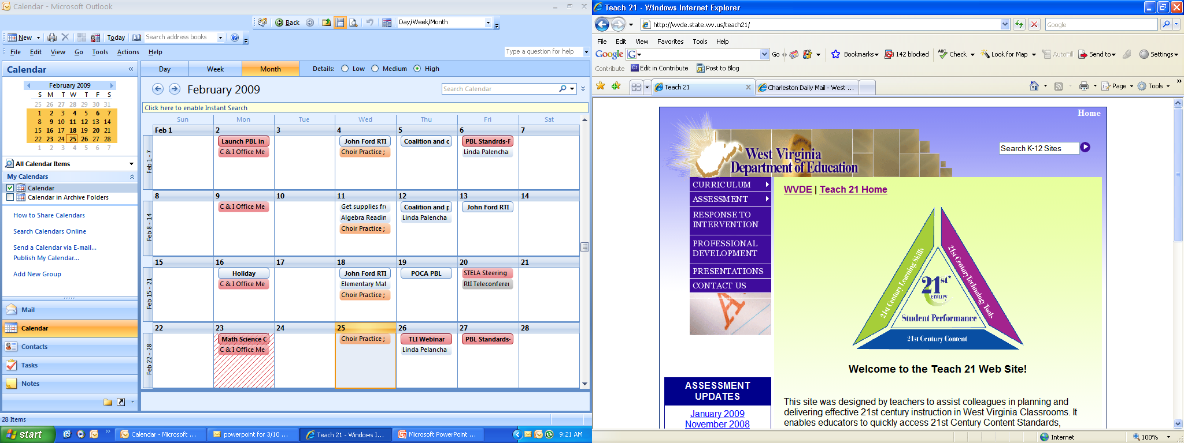
Teach21 – RTI Site
http://wvde.state.wv.us/teach21
Notes:
Teach 21 site
Share the strategy bank.
Instructional Guides etc….
IMA

Slide 19
Contact Information
John Ford, Coordinator
Title I, Mathematics
jford@access.k12.wv.us
Lynn Baker, Coordinator
Office of Instruction
lhbaker@access.k12.wv.us
Notes:
Thank you for joining us today. If you have any questions about the information you heard today, please contact either or both of us at the email addresses noted on the slide. Again, thank you and we look forward to sharing more information about RTI for mathematics in the future.

