Slide 1


Placement Process
Into 7th Grade Math
Presented: January 22, 2015
Dr. Christopher Herte
Mathematics/Science Supervisor 5-8

Slide 2
Math Placement
What are the placement criteria for grade seven courses?

Slide 3
Placement Criteria for
Pre-Algebra 7 & Algebra I Pt. 1
Unit Test averages ( 45%) the four marking periods
Cumulative Assessment ( 25%) placement test
Measures of Academic Progress-MAP ( 25%)
Work Habits/Study Skills ( 5%) assessed by the teacher using a district-developed rubric
These criteria will make up the final summary score
that determines the student’s mathematics placement.

Slide 4
Placement Criteria for Algebra I Honors
Unit Test averages ( 35%) the four marking periods
Cumulative Assessment ( 20%) Pre-Algebra 6
Measures of Academic Progress-MAP ( 20%)
IOWA Algebra Aptitude Test ( 20%)
Work Habits/Study Skills ( 5%) determined by the teacher using a district developed rubric
These criteria will make up the final summary score
that determines the student’s mathematics placement.

Slide 5
Unit Test Averages
Unit tests are common assessments for all students in grade 6 in the same course
Concepts are reviewed. The end of chapter tests are a great resource for practice and review.

Slide 6
Cumulative Assessment
Scheduled for March 30th and March 31st
Cumulative Assessment is a common assessment for all students in their course.
Concepts are reviewed and a review packet is distributed to students
Important for students to pull all concepts together

Slide 7
Measures of Academic Progress -MAP
Scheduled for April 20, 21
Computerized adaptive test
Untimed assessment
Sets learning paths for Odyssey
Charts your child’s academic growth from year to year
The information helps to guide instruction and to make placement decisions

Slide 8
Iowa Algebra Aptitude Test
Scheduled for April 30th (Make ups 5/1)
Helps determine the readiness of students for Algebra I Honors
Four sections, each section is timed and takes 10 or less minutes to complete.
Total of 63 questions, calculators may not be used.

Slide 9
Work Habits/Study Skills
What are the Work Habits/ Study Skills?

Slide 10
Work Habits/ Study Skills
Reviewed with students
Based on a District developed rubric

Slide 11
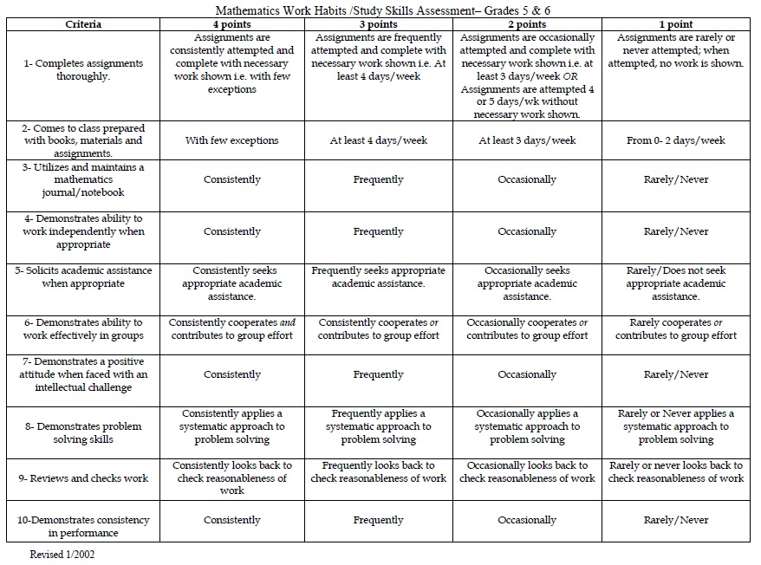
Notes:
The District Rubric for Work Habits/Study Skills that is utilized in grades 5-7.

Slide 12
Math Placement
How will I be informed of my child’s placement in grade 7?
You will receive a Summary Sheet which should be mailed from LMS on May 21. It will provide the details illustrated on the next two slides.

Slide 13
Data Summary Sheet
• Montgomery Township Schools •
Math Placement Data Sheet
Seventh Grade Math Placement for 2015-2016
May 2015
Student’s Name:
Cumulative Assessment = (25% of Summary Score)
(Math 6)
MAP Assessment = (25% of Summary Score)
(Out of 285 points)
Grade Six Test Average = (45% of Summary Score)
(Test Average of 4 marking periods)
Work Habits/Study Skills Assessment = (5% of Summary Score)
Summary Score = (out of 100 points)
Math Placement =
Placement Cutoffs:
Pre-Algebra 7: Summary Scores from 0 – 82
Algebra I Part 1: Summary Scores from 83 - 100
Notes:
Data Summary Sheet, mailed to parents in July of each year, provides the summary details that comprise the placement in Seventh Grade mathematics.

Slide 14
Data Summary Sheet
• Montgomery Township Schools •
Math Placement Data Sheet
Seventh Grade Math Placement for 2015-2016
May 2015
Student’s Name:
Cumulative Assessment = (20% of Summary Score)
(Pre-Algebra 6)
Iowa Algebra Aptitude Test = (20% of Summary Score)
MAP Assessment = (20% of Summary Score)
(Out of 285 points)
Grade Six Test Average = (35% of Summary Score)
(Test Average of 4 marking periods)
Work Habits/Study Skills Assessment = (5% of Summary Score)
Summary Score = (out of 100 points)
Math Placement =
Placement Cutoffs:
Algebra I Part 1: Summary Scores from 0 – 86
Algebra I Honors: Summary Scores from 87 - 100
Notes:
Data Summary Sheet, mailed to parents in July of each year, provides the summary details that comprise the placement in Seventh Grade mathematics.

Slide 15
Waiver Option
The student’s performance summary score and placement will be included in the May 21 mailing.
Parents and students can consider the waiver option if and only if a student’s summary score is within 3 points of the score needed for the requested placement.
Waivers must be submitted to the UMS main office no later than June 5, 2015.
There will be no proficiency testing over the summer.
Notes:
Each course will have a placement score that will be based on a student’s performance on all the criteria.
The student’s performance and placement will be included in the end of year report card mailing.

Slide 16
Math Sequences
What are the common math sequences?
The next slide illustrates the common math sequences. Students can also accelerate, once they enter the High School, if they choose. There are several opportunities for this once a student enters High School. More information on these opportunities (Option II) can be found in the HS Program of Studies available on the HS website.

Slide 17
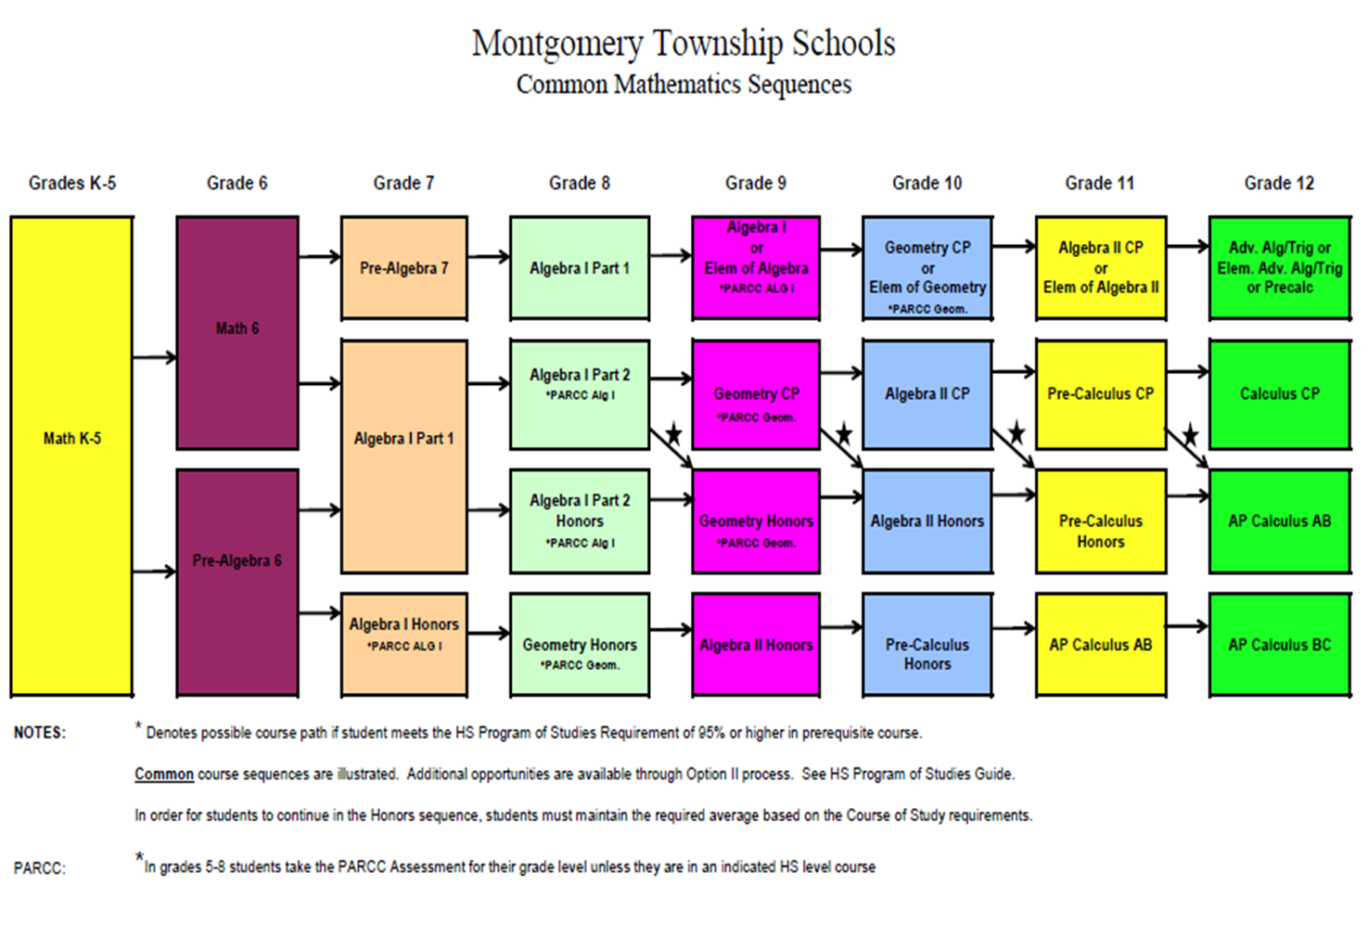

Notes:
Common Math Course Sequences. Other sequences are possible through acceleration and doubling up in Geometry & Algebra II.

Slide 18
Pre-Algebra 7
A course aligned with the Common Core Standards that emphasizes problem-solving and critical thinking while developing necessary concepts for the further study of algebra in a high school level course.
Emphasis is placed upon the development and understanding of pre-algebraic and algebraic skills and their use in application and problem solving.
Course topic sections include operations with integers, and rational numbers, factors, exponents, algebraic expressions, solving one and multi-step equations and inequalities, ratio, proportions, percents, probability, and geometry.

Slide 19
Algebra I Part 1
A full-year course that develops the first half of the study of high school Algebra I. Students develop skills in problem solving and critical thinking through real-world and mathematical problems.
Course topic sections include writing, simplifying, and evaluating algebraic expressions. Modeling, writing, and solving algebraic equations and functions. Graphing and representing linear equations in a variety of forms. Creating, analyzing, and making linear predictions with scatter plots is developed. Additional Common Core topics are also taught (Geometry, Statistics)

Slide 20
Algebra I Honors
A full year rigorous honors course that develops all the concepts and skills of high school Algebra I.
Topics include: expressions, polynomials, radicals, exponents, linear and non-linear functions, quadratic equations, systems of equations and inequalities, probability and data analysis.

Slide 21

Placement Timeline
March 30th , 31st - Cumulative Assessment (Grade 6)
April 20 & 21 -MAP Math Testing
April 30th (5/1 Makeups) – IOWA Algebra Aptitude Test
May 21 – Placement information mailed from LMS
June 5th – Waiver form deadline to be submitted to UMS main office
Summer – New student testing (dates to be posted)
Notes:
Check these dates

Slide 22


Your Questions
Please remember to return your feedback sheets before leaving this meeting.
Thank you so much.
Dr. Christopher Herte
Mathematics/Science Supervisor 5-8
cherte@mtsd.us

