Slide 1
PARCC Results:
Year One
<insert District name>
<insert date of presentation>
Measuring College and Career Readiness

Slide 2

Vision for public education in New Jersey
“New Jersey will educate all students to prepare them to lead productive, fulfilling lives. Through a public education system that is seamlessly aligned from pre-school to college, students will gain the requisite academic knowledge and technical and critical thinking skills for life and work in the 21st century.”
Notes:
In 2008, the New Jersey High School Redesign Steering Committee finalized their report. Their work involved educators and stakeholders from across the state and had focused subcommittees on Special Education, Career and Technical Education, and the Abbott districts. After nearly a year, they formulated the above vision statement to guide what has become nearly a decade’s worth of work to deliver on this vision.

Slide 3
Raising standards
College and Career Ready Standards
“Align New Jersey high school standards and graduation requirements to college and workforce entry requirements.” – NJ High School Redesign Steering Committee (HSRSC - 2008)
New Jersey has adopted standards that “are widely recognized as appropriate standards for college and career readiness.” - College and Career Ready Taskforce (CCRT - 2012)
2009: New Jersey adopted higher course taking requirements for all students.
2010: New Jersey adopted the Common Core State Standards in English Language Arts and Mathematics.
Notes:
The High School Redesign Taskforce noted that while New Jersey’s standards were high, that they were not aligned with college entrance requirements. In 2009, the New Jersey State Board of Education adopted new course taking requirements for a regular high school diploma, such as four years of English and three years of Math – including Algebra I, Geometry, and Algebra II content. In 2010, the state board adopted the Common Core State Standards in language arts and math which are widely understood to be higher standards than New Jersey’s prior standards, focused more on the kinds of skills and knowledge that students will need after they leave high school. In 2012, the College and Career Ready Taskforce reviewed the work to-date and confirmed this impression of the standards.

Slide 4
Next steps:
Replace HSPA
“Currently the New Jersey High School Proficiency Assessment (HSPA) does not measure college or work readiness…Further, New Jersey colleges and universities do not use scores from the HSPA for admissions or placement, because the test does not reflect postsecondary placement requirements.” (HSRSC - 2008)
Notes:
But also in 2008, the High School Redesign Taskforce courageously stated that New Jersey’s old high school assessment – the High School Proficiency Assessment or HSPA – wasn’t measuring college or career readiness. And that it was all but ignored by colleges.

Slide 5
Improving student
Assessment
A System of Aligned Assessments
“Replace HSPA with a series of end of course assessments in math… and a proficiency exam in language arts literacy that are aligned with the expectations of higher education and the workplace.” (HSRSC - 2008)
Current tests should be “replaced with a system of end-of-course assessments.” (CCRT - 2012)
2015: New Jersey adopted the Partnership for Assessment of Readiness for College and Careers (PARCC) assessments in English Language Arts/Literacy and Mathematics.
Notes:
Their recommendation was clear. New Jersey should replace HSPA with a series of end of course assessments in English and math. And those assessments should be aligned with the expectations of college entrance requirements and the workforce. The College and Career Ready Taskforce again confirmed this direction in 2012. As a result, New Jersey joined the Partnership for Assessment of Readiness for College and Careers (PARCC) and gave the first PARCC assessments in 2015.

Slide 6
New jersey’s statewide assessment program
In 2015, New Jersey adopted the Partnership for Assessment of Readiness for College and Careers (PARCC) to replace HSPA and previous assessments in the elementary and middle school in language arts and mathematics.
Students took PARCC English Language Arts and Literacy Assessments (ELA/L) in grades 3 – 11.
Students took PARCC Mathematics Assessments in grades 3 – 8 and End of Course Assessments in Algebra I, Geometry, and Algebra II.
Notes:
The PARCC assessments replaced our old assessments – the NJASK and the HSPA in language arts and math. Students began taking these assessments in third grade, as is required by federal law. As a result of a waiver won by the New Jersey Department of Education, students taking advanced coursework in middle school did not have to take two math tests. Instead, they took the assessment that was most closely aligned with their coursework. For example, a student in 8th grade who was taking Algebra I as a course was permitted to only take the Algebra I test and did not also have to take the 8th grade math test.

Slide 7
PARCC Performance levels
Level 1: Not yet meeting grade-level expectations
Level 2: Partially meeting grade-level expectations
Level 3: Approaching grade-level expectations
Level 4: Meeting grade-level expectations
Level 5: Exceeding grade-level expectations
Notes:
In PARCC, student outcomes are divided into five performance levels. Level One describes student work in the assessment that does not yet meeting the grade-level expectations or the course expectations. Level Two describes student work that is partially meeting grade-level expectations. Level Three describes student work that is approaching grade-level expectations. Level Four describes work that meets grade-level expectations. Level Five describes work that exceeds grade-level expectations.
It’s important to recognize however that while PARCC is a meaningful assessment of student learning that provides useful information about a student, that New Jersey has been and remains committed to using multiple metrics in assessing student progress and attainment. Decisions about student placement in the next grade level or course have always been made by school districts and should always be fully informed by multiple sources of information, including teacher recommendations and parent input.

Slide 8
New Jersey’s 2015 PARCC Outcomes
English language arts/literacy
 | Not Yet Meeting (Level 1) | Partially Meeting (Level 2) | Approaching Expectations (Level 3) | Meeting Expectations (Level 4) | Exceeding Expectations (Level 5) | % >= Level 4
Grade 3 | 15% | 18% | 24% | 39% | 5% | 44%
Grade 4 | 8% | 15% | 27% | 39% | 12% | 51%
Grade 5 | 7% | 15% | 26% | 45% | 6% | 52%
Grade 6 | 8% | 16% | 28% | 40% | 9% | 49%
Grade 7 | 11% | 15% | 23% | 34% | 18% | 52%
Grade 8 | 12% | 15% | 22% | 39% | 13% | 52%
Grade 9 | 18% | 19% | 24% | 30% | 10% | 40%
Grade 10 | 25% | 18% | 20% | 26% | 11% | 37%
Grade 11 | 17% | 19% | 24% | 30% | 11% | 41%
Note: Numbers may not sum to 100% due to rounding.
Notes:
Here are the statewide results of the first year of PARCC assessments in English Language Arts and Literacy. In third grade, 15% did not yet meet expectations, 18% partially met expectations, 24% approached expectations, 39% met the expectations of the grade-level or the course, and 5% exceeded expectations. Approximately 44% either met or exceeded the expectations of third grade language arts.
As we begin to unpack this data, we will look closely at the students in the Approaching Expectations category to see what types of changes need to be made to our curriculum and instructional practices. Perhaps these students missed out on an important concept?
<please note: some of these numbers have changed since the preliminary release of the PARCC data in October 2015>

Slide 9
New Jersey’s 2015 PARCC Outcomes
Mathematics
 | Not Yet Meeting (Level 1) | Partially Meeting (Level 2) | Approaching Expectations (Level 3) | Meeting Expectations (Level 4) | Exceeding Expectations (Level 5) | % >= Level 4
Grade 3 | 8% | 19% | 28% | 37% | 8% | 45%
Grade 4 | 7% | 22% | 30% | 36% | 4% | 41%
Grade 5 | 6% | 21% | 32% | 35% | 6% | 41%
Grade 6 | 8% | 21% | 30% | 35% | 6% | 41%
Grade 7 | 8% | 22% | 33% | 33% | 4% | 37%
Grade 8* | 22% | 26% | 28% | 23% | 1% | 24%
Algebra I | 14% | 25% | 25% | 33% | 3% | 36%
Geometry | 12% | 36% | 30% | 20% | 3% | 22%
Algebra II | 32% | 25% | 20% | 22% | 2% | 24%
* Note: Approximately 30,000 New Jersey students participated in the PARCC Algebra I assessment while in middle school. Thus, PARCC Math 8 outcomes are not representative of grade 8 performance as a whole.
Note: Numbers may not sum to 100% due to rounding.
Notes:
And here are the statewide results of the first year of the PARCC math outcomes.
There are some important things to note. As mentioned above, students took the assessment most closely aligned with their content in middle school. Thus, New Jersey’s eighth grade outcomes are not representative of eighth grade as a whole. Approximately 30,000 middle school students took the Algebra I assessment instead of the grade level assessment. Therefore, eighth grade math outcomes are artificially low as more advanced students were tested in Algebra I.
Also important to note is that as a state, we do see stronger performance in our earlier grades. This is a positive outcome as much of math skills and knowledge builds upon the prior years. Thus, it is not surprising to see weaker outcomes in our higher grade levels who have not benefitted from many years of full implementation of our new standards. Also important to keep in mind that we’ve never tested the course content of geometry and Algebra II statewide before. Thus, our math supervisors and educators have not had a tool to judge the alignment of advanced math courses to our standards before.
<please note: some of these numbers have changed since the preliminary release of the PARCC data in October 2015>

Slide 10
PARCC Outcomes in context
2015 PARCC ELA/L Grade 4 | 51%
2013 NAEP Reading Grade 4 | 42%
2015 PARCC Math Grade 4 | 41%
2013 NAEP Math Grade 4 | 49%
2015 SAT: 44% met College and Career Ready Benchmark
2015 ACT: 43% met College and Career Ready Benchmark.
2015 PARCC ELA/L Grade 8 | 52%
2013 NAEP Reading Grade 8 | 46%
2015 PARCC ELA/L Grade 11 | 41%
2013 NAEP Reading Grade 12 | 41%
2015 PARCC Algebra I | 36%
2011 ADP Algebra I | 35%
NAEP: National Assessment of Educational Progress https://nces.ed.gov/nationsreportcard/
ADP: American Diploma Project http://www.achieve.org/adp-network
Notes:
In the first year of a new assessment, there is always a tendency to want to compare it to the prior assessment. But those comparisons are inappropriate. As mentioned above, our old assessment was not measuring college and career readiness while the PARCC assessments are designed to. Thus, comparing PARCC to HSPA is like comparing apples to oranges. PARCC is a new baseline. It’s a new starting point from which we will measure our growth.
However, there are a few third-party, independent assessments that have been validated against college and career readiness that New Jersey students have participated in in the past. The SAT for instance has established a composite score of 1550 as its college readiness benchmark. In 2015, 80% of New Jersey’s seniors took that assessment and 44% met that benchmark. In 2015, 43% of the student who took the ACT met its benchmark. In the red boxes, you’ll see that 41% of New Jersey’s seniors met the National Assessment of Educational Progress (the NAEP assessment) benchmark.
And in the blue box, you’ll see the outcome of New Jersey’s old Algebra I test, given as part of the American Diploma Project. In 2011, 35% of New Jersey’s students met the expectation of that assessment, compared with 36% of the students who took the PARCC assessment in 2015.
When compared against these external tests, we think that New Jersey’s first year of PARCC results trends appropriately and has resulted in an accurate first year measure of New Jersey’s college and career readiness. We fully expect the percentage of students meeting or exceeding expectations to rise in 2016 as students and educators become more fully informed about the format of the test and as educators align their curriculum and instructional practices more closely with the standards.
<in case you’re curious: grade 8 math NAEP outcomes are not presented here because we do not feel that PARCC grade 8 math outcomes are representative of the state and should be compared to the NAEP outcomes. Likewise, grade 12 NAEP math outcomes are not directly comparable to any of the high school end-of-course assessments, such as Algebra I, and are also not presented.>

Slide 11
End-of-course Math Outcomes,
% Meeting/Exceeding Expectations
 | ADP Algebra I (2011) |  | PARCC Algebra I (2015) |  | PARCC Geometry (2015) |  | PARCC Algebra II (2015)
 | Count | % | Count | % | Count | % | Count | %
Grade 6 | 39 | 79% | 66 | 92%
Grade 7 | 3,001 | 94% | 3,536 | 93%
Grade 8 | 29,715 | 70% | 27,498 | 72% | 2,973 | 92% | 459 | 73%
Grade 9 | 61,177 | 21% | 53,656 | 18% | 20,279 | 47% | 4,720 | 70%
Grade 10 | 8,969 | 5% | 5,542 | 4% | 41,930 | 8% | 20,710 | 39%
Grade 11 | 2,182 | 4% | 1,398 | 4% | 5,895 | 2% | 32,092 | 7%
Notes:
Before turning to our specific district results, I’d like to discuss some important disaggregation of data that the New Jersey Department of Education has done regarding grade-level outcomes for the end-of-course math assessments. The first set of columns presents the outcomes from the 2011 administration of the Algebra I test. The count column contains the number of testers. The percent column contains the percentage of students who met the expectations. In 2011, in grade 8, approximately 30,000 students took the old Algebra I test and 70% of them met expectations. In 2015, in the PARCC assessment, the outcomes are roughly the same – approximately 28,000 students took the PARCC assessment in grade 8 and 72% of them met expectations. In fact, the 2015 PARCC Algebra I outcomes are remarkable in their near consistency to the old Algebra I assessment at each grade level. A key takeaway is that New Jersey seems to be appropriately identifying students who are capable of taking advanced math in middle school.
But of particular concern is that only 18% of the nearly 54,000 students who took PARCC Algebra I in ninth grade met expectations. This suggests a need for a more concerted effort to ensure that freshman year math courses are fully aligned with the content of the Algebra I standards.
<guiding question for further analysis: what trends do you see in your Algebra I outcomes by grade level? What percent of your grade 8 Algebra I results met/exceeded expectations?>

Slide 12
Algebra I Parcc outcomes and course grades
 | PARCC Algebra I (2015) |  | Percent “C” or higher in Algebra I course AY1415
 | Count | % Meeting or Exceeding | Count* | % >= C
Grade 6 | 66 | 92% | 62 | 100%
Grade 7 | 3,536 | 93% | 3,305 | 94%
Grade 8 | 27,498 | 72% | 24,944 | 89%
Grade 9 | 53,656 | 18% | 44,923 | 67%
Grade 10 | 5,542 | 4% | 3,170 | 48%
Grade 11 | 1,398 | 4% | 623 | 46%
Looking for mismatches between outcomes and expectations is an important first step, i.e., roughly 18% of freshman met or exceeded expectations in PARCC Algebra I yet 67% received Cs or better in their course.
* Based on an overall 84% match rate at a student-level between NJSMART course roster collection and PARCC Algebra I assessment data.
Notes:
Drilling down a bit further. This chart has linked the PARCC Algebra I outcomes to course grades that districts provide to the Department. The grades of roughly 84% of the students who took the Algebra I assessment in 2015 could be linked to the assessment data. The first columns of this chart are repeated from the previous slide and show that approximately 18% of the students who took Algebra I in freshman year met or exceeded the expectations of the assessment, while approximately 67% of the freshman received a C or better in their Algebra I course. Again, this underscores the need for us to evaluate the content of our Algebra I courses, the expectations that we have for student competency, and the alignment of our instruction and instructional resources.
<guiding questions for further analysis: how do your PARCC algebra I outcomes compare with the grades that students received? Are there differences by grade levels? Are there differences by course title in the high school? What are some next steps the district can take to identify students that need extra support to succeed in Algebra I?>

Slide 13
<Insert District name>’s
2015 PARCC GRADE-LEVEL Outcomes
English language arts/literacy
 | Count of Valid Test Scores | Not Yet Meeting (Level 1) | Partially Meeting (Level 2) | Approaching Expectations (Level 3) | Meeting Expectations (Level 4) | Exceeding Expectation (Level 5) | District % >= Level 4 | NJ % >= Level 4
Grade 3 |  |  |  |  |  |  |  | 44%
Grade 4 |  |  |  |  |  |  |  | 51%
Grade 5 |  |  |  |  |  |  |  | 52%
Grade 6 |  |  |  |  |  |  |  | 49%
Grade 7 |  |  |  |  |  |  |  | 52%
Grade 8 |  |  |  |  |  |  |  | 52%
Grade 9 |  |  |  |  |  |  |  | 40%
Grade 10 |  |  |  |  |  |  |  | 37%
Grade 11 |  |  |  |  |  |  |  | 41%
Notes:
<fill in your district’s results. DO NOT INCLUDE RESULTS IF THE NUMBER OF VALID TEST SCORES IS LESS THAN 11>
This chart shows the district level outcomes for the first year of the PARCC assessment in each of the grade levels for English Language Arts and Literacy. The first column includes the count of valid test scores in the district.
<read grade three outcomes, such as: you’ll note that xx students in grade three received valid test scores, xx% are not yet meeting expectations…. XX% of third graders in this district met or exceeded grade level expectations compared to 44% of the third grade students statewide>
<note in discussing this slide where the data may not be representative of the district due to low participation in a particular grade level by comparing the valid test count to an approximate count of students enrolled in the grade level.>

Slide 14
<Insert District name>’s
2015 PARCC GRADE-LEVEL Outcomes mathematics
 | Count of Valid Test Scores | Not Yet Meeting (Level 1) | Partially Meeting (Level 2) | Approaching Expectations (Level 3) | Meeting Expectations (Level 4) | Exceeding Expectation (Level 5) | District % >= Level 4 | NJ % >= Level 4
Grade 3 |  |  |  |  |  |  |  | 45%
Grade 4 |  |  |  |  |  |  |  | 41%
Grade 5 |  |  |  |  |  |  |  | 41%
Grade 6 |  |  |  |  |  |  |  | 41%
Grade 7 |  |  |  |  |  |  |  | 37%
Grade 8* |  |  |  |  |  |  |  | 24%
Algebra I |  |  |  |  |  |  |  | 36%
Geometry |  |  |  |  |  |  |  | 22%
Algebra II |  |  |  |  |  |  |  | 24%
Notes:
<fill in your district’s results. DO NOT INCLUDE RESULTS IF THE NUMBER OF VALID TEST SCORES IS LESS THAN 11>
This chart shows the district level outcomes for the first year of the PARCC assessment in each of the grade levels and courses for math. The first column includes the count of valid test scores in the district.
<read grade three outcomes, such as: you’ll note that xx students in grade three received valid test scores, xx% are not yet meeting expectations…. XX% of third graders in this district met or exceeded grade level expectations compared to 45% of the third grade students statewide>
<also note in discussing this slide where the data may not be representative of the district due to low participation in a particular grade level by comparing the valid test count to an approximate count of students enrolled in the grade level.>
<note in discussing this data the extent to which grade level 8 math outcomes may not be representative of the larger grade eight outcomes due to student participation in Algebra I districts. For some districts, these comments may need to extend to grade 7 if students took Algebra I in that grade. For other districts, grade 8 outcomes may in fact represent grade level outcomes because very few students took Algebra I in the middle school. Use the test counts to assist you in drawing inferences about how representative this data is for your district>

Slide 15
SCHOOL LEVEL RESULTS
Notes:
<At the end of this presentation are a series of slides for you to choose from to describe school level results, if desired>

Slide 16
Questions to Guide PARCC Data Reflection
How will we use PARCC data to identify strengths and gaps that exist in curriculum and instruction?
How will we use PARCC data to inform the conversations of our educators?
What can we learn about where additional professional resources are needed to meet the learning needs of all students?
Notes:
In the next several months, we as a district will undertake an effort to learn what we can from the first year PARCC results. Of most importance is using this data to inform our understanding of our strengths and gaps in our curriculum and instructional practices. We’ve been working to implement our new standards in earnest for approximately two to three years and this is the first set of assessments that are aligned to those standards. Unlike our prior assessments, PARCC will provide the district with the ability to analyze our students’ outcomes at standards level. Thus, we’ll be able to reflect on our particular strengths and weaknesses.
<if the district has begun to formulate these plans, speak further about them!>
Also new in the PARCC assessment is the release of real test questions with real student work that has been annotated by the scores. Thus, for the first time, we can look at the test questions, review student work together and understand how the student work met or did not meet the expectations. Using these test questions will help our teachers understand the standards for students more fully. For many teachers, seeing how their students are assessed brings great clarity to what the standards actually mean.
<if the district has undertaken efforts or planned efforts to share the test questions in professional learning communities, say more here!>
Finally, a central goal will be to think about the types of supports that our educators need… what types of professional learning opportunities, what types of instructional resources are needed.
We believe that doing this work well will likely take us many months as we will engage teachers, supervisors, principals and others.

Slide 17
Year One data analysis Plan: Drilling down
District and School Level Data: Math, ELA, reading and writing, and also by grade levels
Disaggregated data, by subgroups
Student-level analysis
Disaggregated data by categories, (i.e., standards sub-claims)
Item analysis
Notes:
As the district unpacks the PARCC data, we’ll undertake several explorations into the data. Obviously the first we’ve begun tonight in talking about our district and school results at grade level in math and language arts.
We will also be able to look at our student performance in reading and writing separately for the first time with what are called sub-scale scores.
Next, we’ll disaggregate our outcomes by various subgroups to understand the performance of students with different learning needs.
We’ll also be able to look at our outcomes in different categories, such as how our students did in analyzing fiction versus non-fiction. Those are called the subclaims in the standards.
We look forward to conducting an item analysis as well. An item is a test question. Drilling down and looking at district, school, and even student-level results on individual test questions can help us identify what we’re doing well and where we can grow.
Finally, we’ll be able to look at the performance of individual students to note their individual strengths and areas to grow.

Slide 18
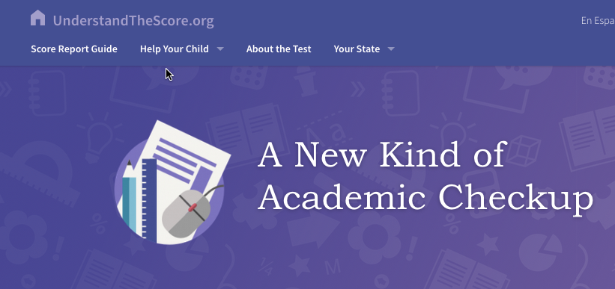
Resources for Parents
http://understandthescore.org/
Notes:
Before we conclude, I’d like to mention a set of resources that have been developed for parents to help them understand the new score reports. They can be found at the website listed above.

Slide 19
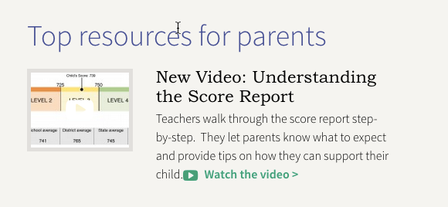
Video: Understanding the score report
http://understandthescore.org/
Notes:
There is a video there that will walk parents thru the report.
<if the district has the technical capacity, consider showing the video. It’s approximately 4.5 minutes long>

Slide 20
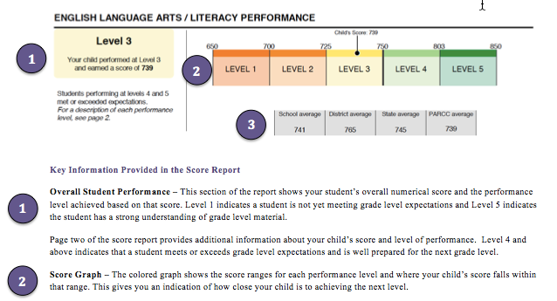
Parent Guide to the Score Reports
http://www.parcconline.org/resources/educator-resources
Notes:
Also, a guide to the score report has been developed.

Slide 21
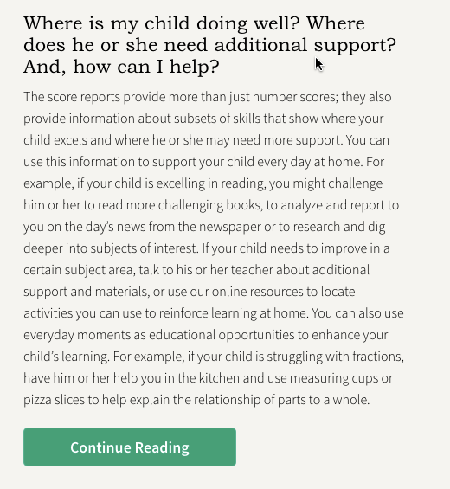
How to help your child
http://understandthescore.org/
Notes:
Some ideas about next steps parents can take are also provided.

Slide 22

Additional resources for parents
http://understandthescore.org/
Notes:
As well as helpful tools to use at home.

Slide 23
<delete this slide>
Notes:
<If you choose to discuss school-level results, the slides that follow offer some options for how to present the data>

Slide 24
<Insert District name>’s
2015 PARCC School & Grade-Level Outcomes
English language arts/literacy
 | Grade 3 % >= Level 4 | Grade 4 % >= Level 4 | Grade 5 % >= Level 4 | Grade 6 % >= Level 4 | Grade 7 % >= Level 4 | Grade 8 % >= Level 4 | Grade 9 % >= Level 4 | Grade 10 % >= Level 4 | Grade 11 % >= Level 4
School A
School B
School C
School D
School E
School F
School G
School H
District
Notes:
<This chart can be used to show the percentage of students who are meeting or exceeding expectations in schools across the district, with a comparison to the district wide percentage. DO NOT PRESENT RESULTS FOR SCHOOLS/GRADE LEVELS WITH A VALID TEST COUNT LESS THAN 11>
This chart shows the school level outcomes for the first year of the PARCC assessment in each of the grade levels for English Language Arts and Literacy. The last row includes the district totals.

Slide 25
<Insert District name>’s
2015 PARCC School & Grade-Level Outcomes mathematics
 | Grade 3 % >= Level 4 | Grade 4 % >= Level 4 | Grade 5 % >= Level 4 | Grade 6 % >= Level 4 | Grade 7 % >= Level 4 | Grade 8 % >= Level 4 | Algebra I % >= Level 4 | Geometry % >= Level 4 | Algebra II % >= Level 4
School A
School B
School C
School D
School E
School F
School G
School H
District
Notes:
<This chart can be used to show the percentage of students who are meeting or exceeding expectations in schools across the district, with a comparison to the district wide percentage. DO NOT PRESENT RESULTS FOR SCHOOLS/GRADE LEVELS WITH A VALID TEST COUNT LESS THAN 11>
This chart shows the school level outcomes for the first year of the PARCC assessment in each of the grade levels and courses for math. The last row includes the districtwide percentages.

Slide 26
<Insert School name>’s
2015 PARCC GRADE-LEVEL Outcomes
English language arts/literacy
 | Count of Valid Test Scores | Not Yet Meeting (Level 1) | Partially Meeting (Level 2) | Approaching Expectations (Level 3) | Meeting Expectations (Level 4) | Exceeding Expectation (Level 5) | School % >= Level 4 | District % >= Level 4
Grade 3
Grade 4
Grade 5
Grade 6
Grade 7
Grade 8
Grade 9
Grade 10
Grade 11
Notes:
<use this chart – and duplicate as needed – to show results for one school at a time in each of the five performance levels. Delete the rows for grade levels or tests that do not exist in this school. DO NOT PRESENT RESULTS FOR GRADE LEVELS THAT HAVE LESS THAN 11 VALID TEST SCORES>
This chart shows individual school outcomes for the first year of the PARCC assessment in each of the grade levels for English Language Arts and Literacy in this school.

Slide 27
<Insert SCHOOL name>’s
2015 PARCC GRADE-LEVEL Outcomes mathematics
 | Count of Valid Test Scores | Not Yet Meeting (Level 1) | Partially Meeting (Level 2) | Approaching Expectations (Level 3) | Meeting Expectations (Level 4) | Exceeding Expectation (Level 5) | School % >= Level 4 | District % >= Level 4
Grade 3
Grade 4
Grade 5
Grade 6
Grade 7
Grade 8*
Algebra I
Geometry
Algebra II
Notes:
<use this chart – and duplicate as needed – to show results for one school at a time in each of the five performance levels. Delete the rows for grade levels or tests that do not exist in this school. DO NOT PRESENT RESULTS FOR GRADE LEVELS THAT HAVE LESS THAN 11 VALID TEST SCORES>
This chart shows individual school outcomes for the first year of the PARCC assessment in each of the grade levels for math.
<Remember to pay close attention to the percentage of 8th grade students taking Algebra I in either 7th or 8th grade>

Slide 28
<Insert Districts name>’s
2015 PARCC Subgroup Outcomes
English language arts/literacy
 | Count of Valid Test Scores | Not Yet Meeting (Level 1) | Partially Meeting (Level 2) | Approaching Expectations (Level 3) | Meeting Expectations (Level 4) | Exceeding Expectation (Level 5) | District % >= Level 4
Subgroup
Subgroup
Subgroup
Subgroup
Subgroup
Subgroup
Subgroup
Subgroup
Subgroup
Subgroup
Notes:
<This chart can be used to show subgroup outcomes across the district, if desired. Fill in the name of the subgroup in the rows. DO NOT PRESENT DATA FOR SUBGROUPS THAT HAVE LESS THAN 11 VALID TEST SCORES>
This chart shows subgroup outcomes across the district for the first year of the PARCC assessment for each of the subgroups for English Language Arts and Literacy.

Slide 29
<Insert district name>’s
2015 PARCC Subgroup Outcomes mathematics
 | Count of Valid Test Scores | Not Yet Meeting (Level 1) | Partially Meeting (Level 2) | Approaching Expectations (Level 3) | Meeting Expectations (Level 4) | Exceeding Expectation (Level 5) | District % >= Level 4
Subgroup
Subgroup
Subgroup
Subgroup
Subgroup
Subgroup
Subgroup
Subgroup
Subgroup
Subgroup
Notes:
<This chart can be used to show subgroup outcomes across the district, if desired. Fill in the name of the subgroup in the rows. DO NOT PRESENT DATA FOR SUBGROUPS THAT HAVE LESS THAN 11 VALID TEST SCORES>
This chart shows subgroup outcomes for the first year of the PARCC assessment for each of the subgroups for math.

