Slide 1
Differentiation in Mathematics

Slide 2
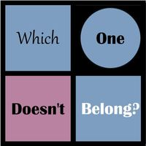
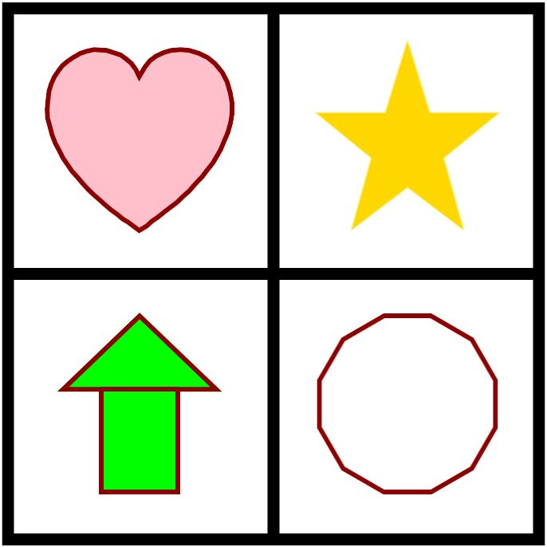
Retrieved from http://wodb.ca/shapes.html

Slide 3

Student Outcomes
Differentiation isn’t as effective without quality universal instruction.
Don’t differentiate for differentiation’s sake. Be intentional in your planning.
Know the purpose of differentiation.
Plan for the desired student outcomes.
Adjust based on student data and outcomes.

Slide 4
Defining Differentiation

Slide 5

How would you define differentiation?

Slide 6
Differentiated Instruction
“At its most basic level, differentiating instruction means “shaking up” what goes on in the classroom so that students have multiple options for taking in information, making sense of ideas, and expressing what they learn.”
Carol Ann Tomlinson from HOW TO Differentiate Instruction IN Mixed-Ability Classrooms -2nd Edition

Slide 7
Differentiated Instruction and The Equity Issue
The National Council of Teachers of Mathematics says this about equity in Principles and Standards for School Mathematics (2000):
“Equity does not mean every student should receive identical instruction; instead, it demands that reasonable and appropriate accommodations be made as needed to promote access and attainment for all students.”

Slide 8
Differentiated Instruction
“It is a comprehensive and flexible process that includes the planning, preparation and delivery of instruction to address the diversity of students’ learning needs within the classroom. Through DI, teachers take into account who they teach, what they teach, where they teach, and how they teach.”
National Professional Resources, Inc.

Slide 9
Differentiation is NOT…
Individualizing every assignment for every student.

Slide 10

Universal Instruction
ALL students must have access to the full intent of their grade-level content (Access and Equity, NCTM). Opportunity to learn remains one of the best predictors of student learning (Closing the Opportunity Gap, NCTM).
Research/Evidence-based strategies must occur.
Components of Universal Design for Learning (UDL) should be routine.
ALL students need to be held to high expectations from their teachers.

Slide 11
Critical Components of Differentiation
Get to know your students.
  Abilities
  Interests
  Learning styles
Community building throughout the year.
Assessing students regularly.
  End of unit tests
  Pretests
  Exit cards
  Roaming checklists
  Short quizzes
Using proven instructional strategies.

Slide 12
Math Autobiography Activity

Slide 13

Teachers Help Break Down Barriers by…
Attending to language.
Reducing math anxiety.
Creating a math-rich classroom.
Increasing instructional support.

Slide 14
Teacher Roles in Differentiation

Slide 15
Four Teacher Roles
Know your students.
Know your standards.
Manage your classroom.
Manage your content and strategies.

Slide 16
Know Your Students
Utilize formative assessment data to determine where your students are with the content.
Make use of the student Quantile Scores and resources.
Know the accommodation needs for students on IEPs and 504s.
Know what groups of students work well together.
Some students have needs beyond differentiation.
Teach the whole child.

Slide 17
Know Your Standards
Teach grade level standards.
Understand the progression of the content.
RESOURCES:
Educators’ Guides
Support for CCRS

Slide 18
Manage Your Classroom
When managing your classroom, think about:
Classroom space with tables, desks, flexible seating, storage.
The culture and climate you establish.
Routines.
The grouping of students and collaborative space.
Time with individual students.
Whole-class and individual work.
The time students are deeply engaged in a task.
When students are asked to do the thinking and discourse.
The type of learning students are doing (PBL, flipped classrooms, etc.).

Slide 19
Manage Your Strategies and Content
CEC and CEEDAR Center’s High-Leverage Practices for Special Education
NCTM’s Eight Teaching Principles
John Hattie’s Visible Learning and Highly Effective Strategies

Slide 20
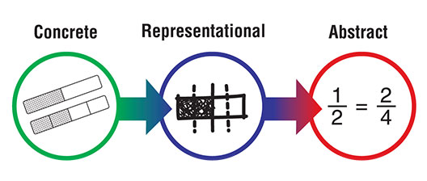
Manage Your Strategies and Content
Notes:
Use CRAMATH Handout, and CRA Planning Document
*This strategy is about bringing context to mathematics and making a concrete connection.

Slide 21
Manage Your Strategies and Content
Reflection questions on the content:
What makes a mathematics task easy or hard, and for whom?
How can we provide support for students who struggle while challenging those who are more advanced?
How can teachers integrate effective differentiation despite limited planning time?

Slide 22
Manage your Strategies and Content
Be respectful to the full intent of the content.
Make the content accessible.
Ensure the content is challenging for ALL students.
Respond to student needs.
Collaborate with other teachers.

Slide 23
Differentiation Cycle
Reflect
Adjust
Implement Gradually

Slide 24
Strategies for Differentiation

Slide 25
Strategy: Flexible Grouping
Much like differentiation as a whole, grouping should be done purposefully. Groups are formed around a specific purpose and reconfigured when a new purpose is identified.
Notes:
The grouping can last for a day, an activity, a unit, a month. The grouping keeps students from being labeled and allows them to work with a variety of their peers. Grouping can revolve around a learning goal, interest, behavior, learning style, product. Groups could be heterogenous or homogenous in nature. Groups should not be more than 4. Groups can also be randomized.

Slide 26
Strategy: Open Questioning
Start with a typical textbook problem.
Use the answer as the launching pad for the problem.
Notes:
Turning a question around activity

Slide 27
Strategy: Open Questioning
Open Question | Closed Question
The answer is 4, what is the question? | 2+2=?

Slide 28
Strategy: Chunking
Take a task which seems to be unmanageable and break the problem into manageable pieces.
Chunking skill is a learned skill and is not often naturally learned.
Notes:
Elementary: https://tasks.illustrativemathematics.org/content-standards/4/OA/A/3/tasks/1289
Middle School: https://tasks.illustrativemathematics.org/content-standards/7/RP/A/2/tasks/1983

Slide 29
Strategy: Scaffolding
Understand the problem.
Devise a plan.
Carry out the plan.
Reflect on the outcome.
Notes:
Probing questions for the outcome:
Is there another way to solve the problem?
How would you describe your thinking so that a peer could follow your problem solving process?
Is there another problem you can now solve because you have completed this task?
How is the problem the same or different from other problems you have solved?
What new problem can you create that could be solved in this same manner?
*With the probing questions being asked at the end, connections are being made within the context of the problem and to other areas in mathematics.

Slide 30
Strategy: Parallel Tasks
Give students choice between two problems of the same nature.
As time progresses, students often pick the problem which is more appropriate to their skill level.
Notes:
Parallel task sheets for elementary, middle and high school

Slide 31
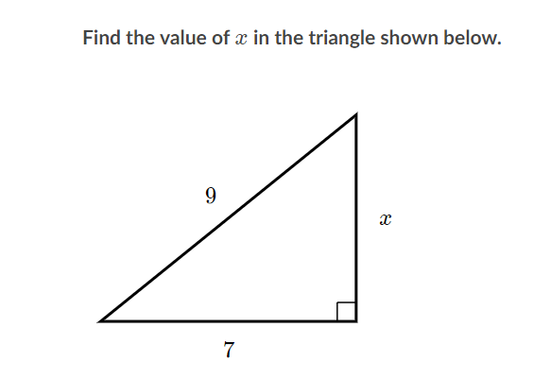
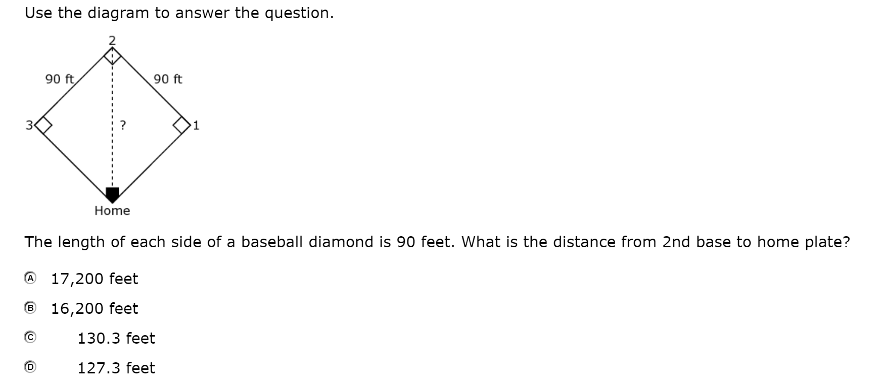
Strategy: Control the Difficulty
Wrong examples
Notes:
In these two different examples, the skills of the Pythagorean Theorem are addressed. The example on the left does not address the intent or depth of the standard. The mathematical habits of mind are not being deeply assessed. In the example on the right, the full intent of the standards are being address and mathematical habits of mind are being activated. Controlling the difficulty does not mean limiting accesses to the depth of the standards or the habits of mind. It may mean scaffolding or working with more friendly numbers.

Slide 32
Strategy: Control the Difficulty
Tips:
Start with the full intent of the standard in mind.
The procedures and the outcome will not change.
Numbers will perhaps change.

Slide 33
Ways to Sustain Differentiation
Know where you already provide differentiation.
Recognize where you are in providing differentiation.
Start small and build with the first two ideas in mind.
Anticipate.
Expect surprises.
Let students help.
Work with parents.
Find sources of professional development.
Be reflective.
Keep doing the great things you do!

Slide 34
References
Cash, R. M. (2017). Advancing Differentiation: Thinking and Learning for the 21st Century. Minneapolis, MN: Free Spirit Publishing, Inc.
Fattig, M. L., & Tormey Taylor, M. (2008). Co-Teaching in the Differentiated Classroom: Successful Collaboration, Lesson Design, and Classroom Management. San Francisco, CA: John Wiley & Sons, Inc.
Gartland, K., & Dacey, L. (2009). Math for All: Differentiating Instruction. Sausalito: Math Solutions.
Little, C., Hauser, S., & Corbishley, J. (2009). Constructing Complexity for Differentiated Learning. Mathematics Teaching in the Middle School.
Murray, M., & Jorgensen, J. (2007). The Differentiated Math Classroom: A Guide for Teachers, K-8. Portsmouth, NH: Heinemann.
National Council of Teachers of Mathematics. (2012, February). Closing the Opportunity Myth. Retrieved from National Council of Teachers of Mathematics Website: https://www.nctm.org/Standards-and-Positions/Position-Statements/Closing-the-Opportunity-Gap-in-Mathematics-Education/
National Council of Teachers of Mathematics. (2014). Principles to Action: Ensuring Mathematical Success for All. Reston, VA: The National Council of Teachers of Mathematics, Inc. .
Small, M. (2017). Good Questions: Great Ways to Differentiate Mathematics Instruction in the Standards-Based Classroom. Toronto, ON, Canada: Teachers College Press.
Small, M., & Amy, L. (2010). More Good Questions: Great Ways to Differentiate Secondary Mathematics Instruction. Toronto, ON, Canada: Teachers College Press.
Sousa, D. (2015). How the Brain Learns Mathematics. Thousand Oaks, CA: SAGE Publications Ltd.

Slide 35

Joseph Mastracci
Coordinator
WVDE Office of Special Education
jmastracci@k12.wv.us
Jessica Houck
Math Coach
Mingo County Schools
jhouck@k12.wv.us

