Slide 1
Claim 2: Problem Solving
The Smarter Balanced summative mathematics assessment and its relationship to instruction
Notes:
Hello and welcome to the OSPI video series on the Smarter Balanced assessment claims and their relationship to instruction.
This video focuses on Claim 2: Problem Solving.
We hope this video increases your understanding of Claim 2 and its relationship to the Washington State K—12 Learning Standards for mathematics.

Slide 2
What is Claim 2?
Addresses students’ ability to solve a range of well-posed problems.
  In context
  Pure mathematics
Students must develop a pathway to the solution that may not be readily apparent.
Notes:
Claim 2 addresses students’ ability to solve a range of well-posed problems. These problems can be presented in context, or they can appear in purely mathematical terms. Students must select mathematical concepts and procedures from the standards and use problem-solving strategies to arrive at an answer.
Claim 2 problem-solving items are more than just “word problems.” Problem solving requires students to consider the problem and think about a solution pathway prior to doing any work. Claim 2 items cannot be solved by just applying a procedure or looking for key words that tell the student how to answer the question. Students must develop their own pathway to solve a problem, a pathway that may need to be adjusted as the student works toward an answer. True problem solving items take time. In the Smarter Balanced assessment, Claim 2 items are expected to take a well-taught student from 2 to 5 minutes to solve a problem in grades 3—5 and up to 10 minutes at the high school level.

Slide 3
More Information
More information about problem solving for Claim 2 is available in the Mathematics Content Specifications, online at http://www.smarterbalanced.org/smarter-balanced-assessments/
Notes:
More information about problem solving for Claim 2 is available in the Mathematics Content Specifications, online at this website.

Slide 4
Claim 2 requires use of content in the Standards
Making sense of problems and solving them is at the heart of doing mathematics.
Content for Claim 2 can come from on-grade-level or below skills.
Some content lends itself easily to problem solving.
Notes:
Making sense of problems and solving them is at the heart of doing mathematics. Mathematical content used in Claim 2 problem solving situations can come from on-grade-level or below skills, as described in the standards. Any content in the standards can be used in problem-solving situations but some content lends itself more easily to problem solving. Other content supports problem solving rather than being its focus.

Slide 5
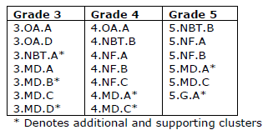
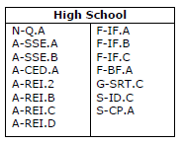
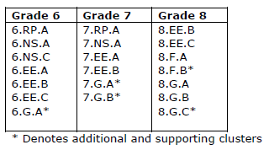
Primary problem solving emphases by grade
Notes:
Clusters are the best way to understand the mathematical content students use to solve problems. These tables represent clusters that lend themselves, and should be emphasized, when problem solving in grades 3—8 and high school.
Emphases are placed on the fraction and four operations clusters at grades 3—5. Content from measurement and data clusters should support the development of problem solving skills in these areas. The emphases at grades 6 and 7 are clusters in ratio and proportion, number sense, and equations and expressions. At grade 8, the emphases shifts to include functions and geometry clusters. By high school, clusters within algebra and functions are the primary emphases, with support coming from number and quantity, geometry, and statistics clusters.

Slide 6
More Information on Claim 2
More information about using mathematical content in problem solving situations is in the Claim 2 documents, online at http://www.smarterbalanced.org/smarter-balanced-assessments/#item
Look under “Mathematics” in the Item/Task Specifications section.
Notes:
More information about using mathematical content in problem solving situations is in the Claim 2 documents, online at this website. Look under “Mathematics” in the Item/Task Specifications section.

Slide 7
Claim 2 is based on the Mathematical Practices
Mathematical Practices 1, 5, 7, and 8 are foundational support for Claim 2
  1. Make sense of problems and persevere in solving them
  5. Use appropriate tools strategically
  7. Look for and make use of structure
  8. Look for and express regularity in repeated reasoning
Notes:
Mathematical Practices 1, 5, 7, and 8 are the foundational support for Claim 2. These practices ask students to:
make sense of problems and persevere in solving them,
Use appropriate tools strategically,
Look for and make use of structure, and
Look for and express regularity in repeated reasoning.
Engagement in a rich problem-solving process in the classroom will help students develop expertise in each of these areas. Before students begin they will need to make sense of what the problem is saying. As students become strategic about solving problems, they will begin to look for and make use of structure and repeated reasoning. In time, they will know where and when to use the tools that are available to them. Understanding that persevering is part of the problem-solving process will result when students encounter problems that require a deep level of engagement, problems that don’t immediately have a solution pathway or that take several minutes to solve.

Slide 8
Additional information on Claim 2 and the Mathematical Practices
The Smarter Balanced Content Specifications, with additional information on how these practices inform Claim 2, is available online at http://www.smarterbalanced.org/smarter-balanced-assessments/
Notes:
The Smarter Balanced Content Specifications, with additional information on how these practices inform Claim 2, is available online at this website.

Slide 9
Problem Solving: A variety of skills
Claim 2 has four targets, built upon the foundation of four mathematical practices.
The four targets are the same for all grades.
Each target describes a skill that is important to the problem solving process.
Notes:
The mathematical practices also lay the foundation for the four Claim 2 targets. These four targets are the same for all grades. Each target describes a different skill that is important in the problem solving process; getting an answer is not the only skill students should be developing. Students must be able to use tools to aid in solving a problem, understand what the answer means in terms of the problem situation, and identify, organize, and see connections among information in a problem solving situation.

Slide 10
Target A: Solve well-posed problems
Apply mathematics to solve well-posed problems in pure mathematics and arising in everyday life, society, and the workplace.
Problems should be completely formulated.
Notes:
The first target is:
Apply mathematics to solve well-posed problems in pure mathematics and arising in everyday life, society, and the workplace.
In Claim 2, the problems should be completely formulated, without extraneous information or the need to gather additional information.

Slide 11
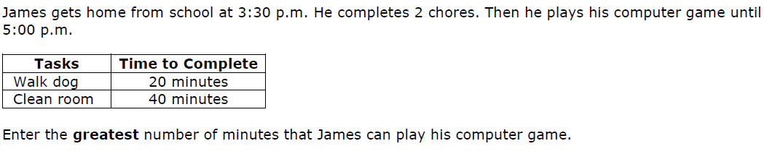
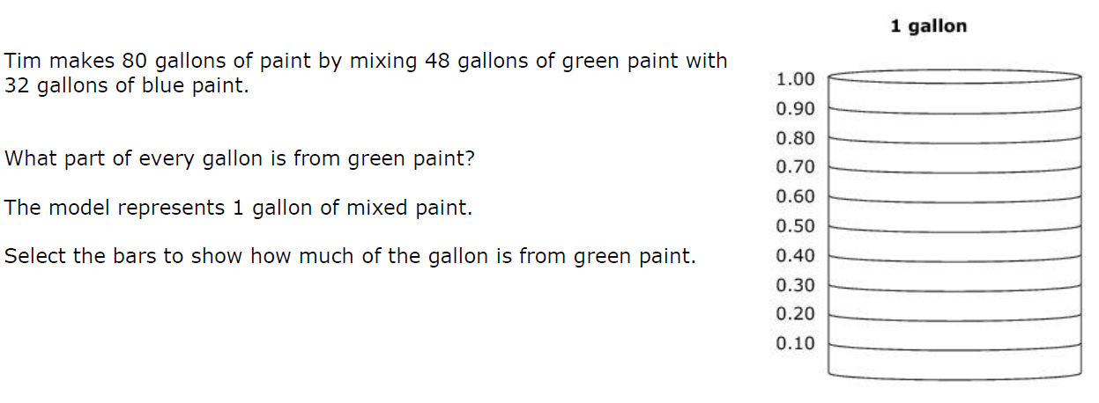
Grade 3
Grade 7
Notes:
These Grade 3 and 7 examples show items that primarily asks students to solve a well-posed problem. Take a moment to consider how students might approach these problems to determine an answer.

Slide 12
Target B: Use of tools
Select and use appropriate tools strategically.
Tools may include:
  Graph paper
  Protractors, compasses, calculators
  Formulae
  Other “tools” mathematicians use to help them solve problems.
Notes:
The second target is:
Select and use appropriate tools strategically.
Students may use graph paper, protractors, compasses, calculators, formulae, or other “tools” mathematicians use to help them solve problems.

Slide 13
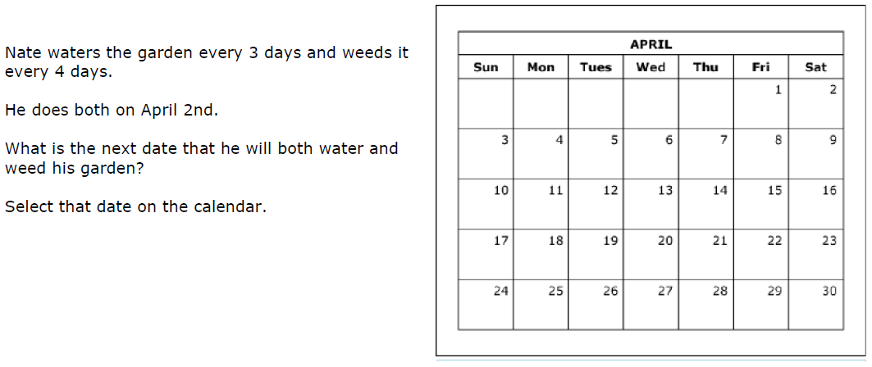
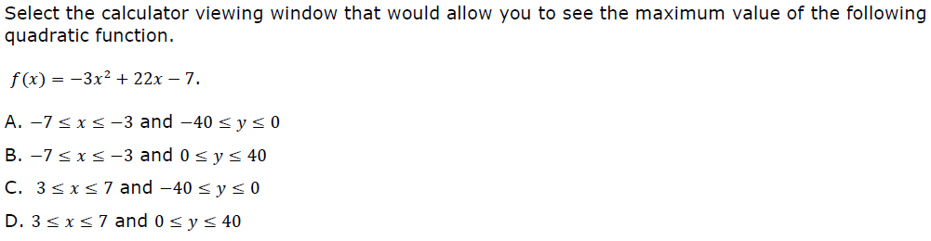
Grade 6
High School
Notes:
These Grade 6 and high school examples show items that primarily asks students to use appropriate tools.

Slide 14
Target C: Interpret results in context
Interpret results in the context of a situation.
Students interpret their solution based on the problem’s context.
Notes:
The third target is:
Interpret results in the context of a situation.
In these items, students must link their solution method back to the problem’s context. In early grades, this might require students to decide how to interpret the answer to a division problem, based on the problem’s context. The classic example is understanding that the number of buses needed in a given situation could not be 4 ½. In later grades, this might require students to limit the domain of a function to positive integers based on a problem’s context. For instance the student understands that negative values in a quadratic function modeling a basketball shot have no meaning in context.

Slide 15
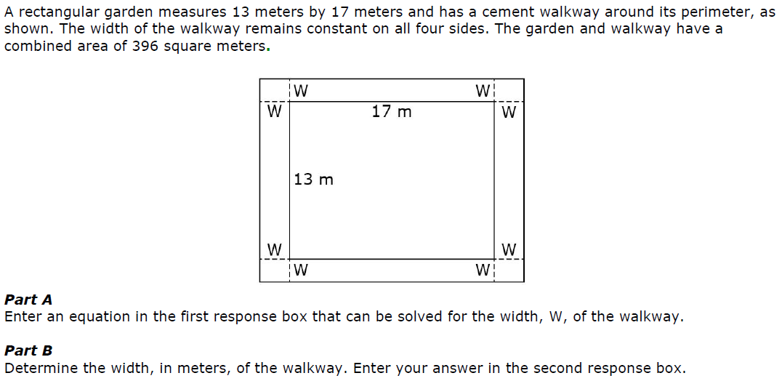
Grade 4
High School
Notes:
These Grade 4 and high school examples show items that primarily asks students to relate their answer back to the context of the problem. Take a moment to determine how students must return to the context of the problems to interpret their answers.

Slide 16
Target D: Identify quantities and map relationships
Identify important quantities in a practical situation and map their relationships (e.g., using diagrams, two-way tables, graphs, flowcharts, or formulas).
Students must determine the relationship between two quantities given in a problem and then solve it.
Notes:
The fourth target is:
Identify important quantities in a practical situation and map their relationships (e.g., using diagrams, two-way tables, graphs, flowcharts, or formulas).
These items may ask students to use mathematical models to understand the relationship between quantities. For example, a student may be given two or more figures and have to decide how the figures are related in a problem scenario. Other items may ask students to find a relationship between two quantities that are presented within a problem. These relationships can be shown as equations, number lines, graphs, or functions.

Slide 17
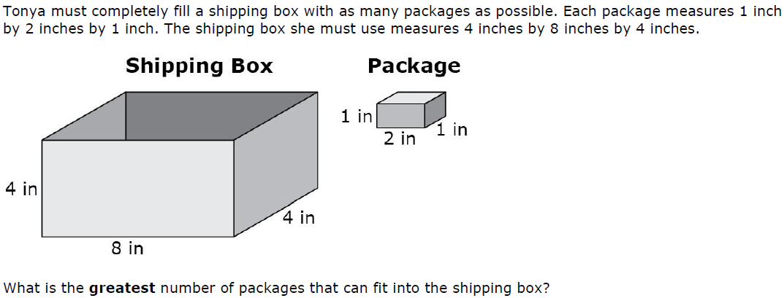
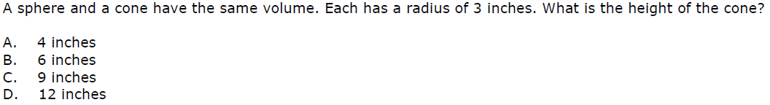
Grade 5
Grade 8
Notes:
These Grade 5 and 8 examples show items that primarily asks students to identify relationships among important quantities. Take a moment to identify the quantities in each problem and their relationship to each other.

Slide 18
More information on Claim 2 examples
More example Claim 2 items for each target are available in the Claim 2 item specifications, online at http://www.smarterbalanced.org/smarter-balanced-assessments/#item
Look under “Mathematics” in the Item/Task Specifications section.
Notes:
More example Claim 2 items for each target are available in the Claim 2 item specifications, online at this website. Look under “Mathematics” in the Item/Task Specifications section.

Slide 19
How Claim 2 informs assessment
Claim 2 describes skills that make up the problem solving process.
Students will encounter situation situations they have not seen before.
Students can enter the problem using a variety of strategies.
Claim 2 are well-posed. Claim 4 are “messy.”
Together Claim 2 and 4 account for one-fourth of the summative assessment.
Notes:
The Claim 2 targets describe the skills that make up the problem solving process. Items are written to provide evidence on a student’s ability with one or more of these targets. Additionally, items may provide evidence about a student’s ability with the procedural or conceptual mathematical skills necessary to solve a problem.
Problem solving requires a high level of cognitive demand. In order to truly problem solve, students will encounter situations and questions that they have not practiced or been shown a procedure to solve. Item development is flexible to allow for a wide variety of problems in Claim 2. Item writers must combine the skills described in the Claim 2 targets with content described in the standards. This is why there are no set task models in the Claim 2 documents, only descriptions and example items.
Educators and item writers must think deeply about Claim 2 items to ensure students can enter the problem using a variety of strategies. Items for Claim 2 must be carefully reviewed to ensure that the problem is not simply procedural as would be found in Claim 1.
Claim 2 assesses problem solving in well-posed situations. Claim 4 also assesses problem solving, but in more “messy,” real-world situations. Because of their strong connection to problem solving, Claims 2 and 4 are combined into a single score for reporting on the summative assessment.
Approximately one-sixth of the computer-adaptive portion of the Smarter Balanced assessment will consist of Claims 2 and 4 items combined. Claim 2 and Claim 4 also make up approximately two-thirds of a performance task. Altogether, approximately one-fourth of the summative assessment assesses these problem solving and modeling/data analysis skills.

Slide 20
More information on Claim 2 assessment
More information on Claim 2 on the summative assessment, both the computer-adaptive and the performance task portions, is available in the Test Blueprints, online at http://www.smarterbalanced.org/smarter-balanced-assessments/
Notes:
More information on Claim 2 on the summative assessment, both the computer-adaptive and the performance task portions, is available in the Test Blueprints, online at this website.

Slide 21
How Claim 2 informs instruction
Key themes for problem-solving instruction
  Grades 3—5: Fractions and the four basic operations
  Grades 6—7: Ratios and proportions, number systems, and equations and expressions
  Grade 8: Equations and expressions, functions, and geometry
  High School: Algebra and functions
Notes:
In grades 3—5, the key themes of fraction and the four basic operations should figure prominently in problem solving. For grades 6 and 7, problem solving should support the concepts of ratios and proportions, number systems, and equations and expressions. In grade 8, expressions and equations continue to be a theme for problem solving, and functions and geometry become important as well.
For high school, algebra and function content should figure prominently in problem solving situations. It is important to note at the high school level that Claim 2 items may cover content that is not assessed in Claim 1.

Slide 22
How Claim 2 informs instruction
Claim 2 target can help teachers understand the skills students should develop related to problem solving.
Classroom instruction and assessment should not be limited by large-scale assessment restrictions.
Problem solving helps deepen conceptual understanding and procedural fluency.
Productive struggle develops a positive mindset.
Applying all of the related math practices develops a strong foundation for problem solving.
Notes:
Problem solving is more than just getting an answer to a problem. The targets described in the Claim 2 documents can help teachers develop an understanding of the variety of skills students should be developing related to problem solving. Instruction should attend to all of these skills and provide opportunities for students to develop them.
Classroom instruction and assessment should not be limited by the Claim 2 documents; these documents show only some ways to assess problem solving. The examples in the Claim 2 documents do not cover the entire range of content students should be using when engaging in problem solving. Rather, instruction should focus on applying the mathematics described in the standards and practices to varied problem solving situations.
Problem solving should be one part of a rich educational experience. Students should not be required to “master” the conceptual understanding and procedural fluency prior to problem solving. It is in working with mathematical content in a variety of ways that students truly learn both the skills related to problem solving as well as deepen their understanding of the mathematics described in the standards.
The math practices should guide classroom assessment and instruction. Likely the most important is making sense of problems and persevering. This is often referred to as “productive struggle.” Students must be given opportunities to develop a positive mindset toward engaging with a non-routine problem, or a problem that takes more than just a few seconds to solve. Attending to mathematical practice related to tools, including technology, can help students develop their problem solving skills by allowing the tool to complete more procedural tasks, freeing the student to engage in higher-level thinking skills. Structure and repeated reasoning are key components for solving problems. Solving simpler problems or identifying when a problem has a similar structure as another problem are skills students should develop to help them solve a wide variety of problem situations. All these should be connected to and build on the skills and knowledge described in the standards.

Slide 23
Further help
Specific Claim 1, 3, and 4 videos are available on the website to get a more complete picture of each claim and the skills students should develop through focused instruction.
Notes:
We hope this brief introduction to Claim 2 gives you greater insight into assessing students’ problem solving abilities, as described in the Washington State K—12 Learning Standards and mathematical practices.
We encourage you to view the videos for Claims 1, 3, and 4 to get a more complete picture of the skills and practices students should develop. Thank you.

