Slide 1
CHAPTER 1
Essential Mathematics

Slide 2
1-1 THE LANGUAGE OF MATHEMATICS
In math, you will study many different sets.
A well defined set makes it possible to determine whether an item is a member of that set.
A set whose elements cannot be counted or listed is called an infinite set. If all the elements of a set can be counted or listed, it is called a finite set.

Slide 3
1.1 – THE LANGUAGE OF MATHEMATICS
Term | Example
Description Notation (In words) | “the set of all natural numbers”
Roster Notation (Lists those in group) | S= {1,2,3….}
Set-Builder Notation | {xǀ x is a natural number}

Slide 4
More Terms
Subset
If every element of set A is also an element of set B, then A is called a subset of B. Every set is a subset of itself.
*Example

Slide 5
Empty Set/Null Set
A set containing no elements. The null set is a subset of every set.
Solution Set
All the elements that make an equation true

Slide 6
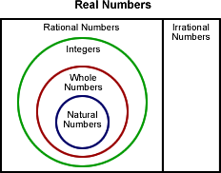
1.2 – REAL NUMBERS

Slide 7
Provide a set for each type of number
Natural Numbers
Whole Numbers
Integers

Slide 8
RATIONAL AND IRRATIONAL NUMBERS
A rational number is one that can be expressed as a ratio of two integers.
An irrational number cannot be expressed as a ratio of two integers and is a nonterminating, nonrepeating decimal.
The set of rational and irrational numbers make up the set of real numbers.

Slide 9
COORDINATE/GRAPH
All real numbers can be graphed on a number line, That number that corresponds to a point on a number line is called the coordinate of the point.
Each real number corresponds with exactly one point on a number line. The point that corresponds to a number is called the graph of the number.

Slide 10
INEQUALITY/ABSOLUTE VALUE
A mathematical sentence that contains one of the symbols < , >, ≤ , or ≥ is called an inequality.
The absolute value of a number is the distance that number is from zero on the number line.

Slide 11
EXAMPLES
Graph each set of numbers on a number line (separately)
The set of integers from -2 to 3 inclusive.
The set of real numbers -2 to 3 inclusive.
{all real numbers less than or equal to 2}
{all real numbers greater than -2}

Slide 12


1.3 – UNION AND INTERSECTION OF SETS
Union - – when two or more sets are used to form a new set
Intersection - - contains the elements that are common to both sets
A’ - “The complement of A” – the set of elements not in A

Slide 13
Examples
A = {2, 4, 6, 8, 10} B = {4, 6, 8} C = {0, 1, 2, 3}
A and B
B and C
C’
B or C
A or C

Slide 14
Compound Inequalities
Find the solution set for x>-1 and x<4.
Find the solution set for x>4 or x<-1

Slide 15
1.4 – ADDITION AND SUBTRACTION
Rules for adding integers.
If the numbers have the same sign, add the absolute values and use the sign of the addends
Subtracting Integers.
If the numbers have different signs, subtract the absolute values and use the sign of the addend with the greater absolute value.

Slide 16
EXAMPLES
Solve when a= -32 and b=19
a+b b-a a-b
Jeremy had $295.48 in his bank account. He deposited a check for $196.68 and withdrew $65.00. How much is his account now?

Slide 17
1.5 – MULTIPLICATION AND DIVISION
(+)(+) =
(-)(+) =
(+)(-) =
(-)(-) =
(-)(-)(-) =
(-)(-)(-)(-) =
Evaluate –ab when a=-1 and b=2

Slide 18
1.7 DISTRIBUTIVE PROPERTY AND PROPERTIES OF EXPONENTS
The distributive property relates addition and multiplication. It states that a factor outside parentheses can be used to multiply each term within the parentheses.
For any real numbers,a,b, and c
a(b+c)= ab+ac

Slide 19
PROPERTIES OF EXPONENTS(MULTIPLICATION)
For all real numbers a and b, if m and n are integers, then
a^{m}·a^{n} =a^{m+n}
(a^{m}) ^{n} =a^{mn}
(ab)^{m} =a^{m}b^{m}

Slide 20
PROPERTIES OF EXPONENTS FOR DIVISION
For all real numbers a and b, if m and n are integers then
a^{m}/a^{n} = a^{m-n}
(a/b)^{m} = a^{m}/b^{m}

Slide 21
EXAMPLES

Slide 22
1.8 – EXPONENTS AND SCIENTIFIC NOTATION
Exponents can be negative numbers.
For every nonzero real number a , if n is an integer, than a^{-n}=1/a^{n}
If you use the quotient property you obtain a³/a⁴ = a³⁻⁴=a⁻¹

Slide 23
SCIENTIFIC NOTATION
To save time and space to be able to write and compute large numbers easily, the system of scientific notation was developed.
The method of scientific notation uses powers of 10 to write in a more concise manner.

Slide 24
EXAMPLES
Simplify
a⁹ ÷ a⁻⁴
x⁴ ∙ x⁻³
(c²) ⁻⁵
Write in Scientific Notation
496,000,000
.00059

Slide 25
CHAPTER 2
ESSENTIAL ALGEBRA AND STATISTICS

Slide 26
2.1 – PATTERNS AND ITERATIONS
Definitions
A pattern, or sequence, is an arrangement of numbers in a particular order.
The term iteration is used to describe a process that is repeated over and over.

Slide 27
Determine the rule and the next three terms in each sequence.
1. 4, 12, 20, 28, ____, ____, ____
2. 2, 6, 18, 54, ____, ____, ____
3. 100, -50, 25, -12.5, ____, ____, ____

Slide 28
2.2 – THE COORDINATE PLANE, RELATIONS, AND FUNCTIONS
The grid system is called the coordinate plane.
It is divided into four regions called quadrants.
The point where the x-axis and y-axis cross is called the origin.

Slide 29
DEFINITIONS CONTINUED
Relation – a set of ordered pairs
{(1,2),(3,4),(5,6)}
Domain – x-values {1, 3, 5}
Range – y-values {2, 4, 6}
Function – when the x-values do not repeat
Vertical Line Test: When a vertical line is drawn through the graph of a relation, the graph is not a function if the vertical line intersects the graph in more than one point.

Slide 30
EXAMPLES
Determine whether (2,2),(0,0),(2,-2),(4,4), (4,-4) is a function using the vertical line test.
Evaluate the function
f(x)= 3x+2;f(6)

Slide 31
2.3 LINEAR FUNCTIONS
Equations in two variables that can be written in the form y= ax + b, where a and b are constants, are called linear equations.
Graphs of such equations are straight lines, and such functions are called linear functions.

Slide 32
EXAMPLES
Graph y=2x+3
Choose at least three values for x and calculate the corresponding y-values. Make a table to show the ordered pairs.
Graph the relation and determine if it’s a function.
x=2

Slide 33
2.4 – SOLVE ONE-STEP EQUATIONS
You can use opposite, or inverse operations to get a variable alone on one side of an equation.
Addition Property of Equality
For all real numbers, a, b, and c, if a=b, then a +c=b+c and c+a=c+b.
Multiplication Property of Equality
For all real numbers a, b, and c, if a=b, then ac=bc and ca=cb.

Slide 34
Opposite Operations
+ -
- +
x ÷
÷ x

Slide 35
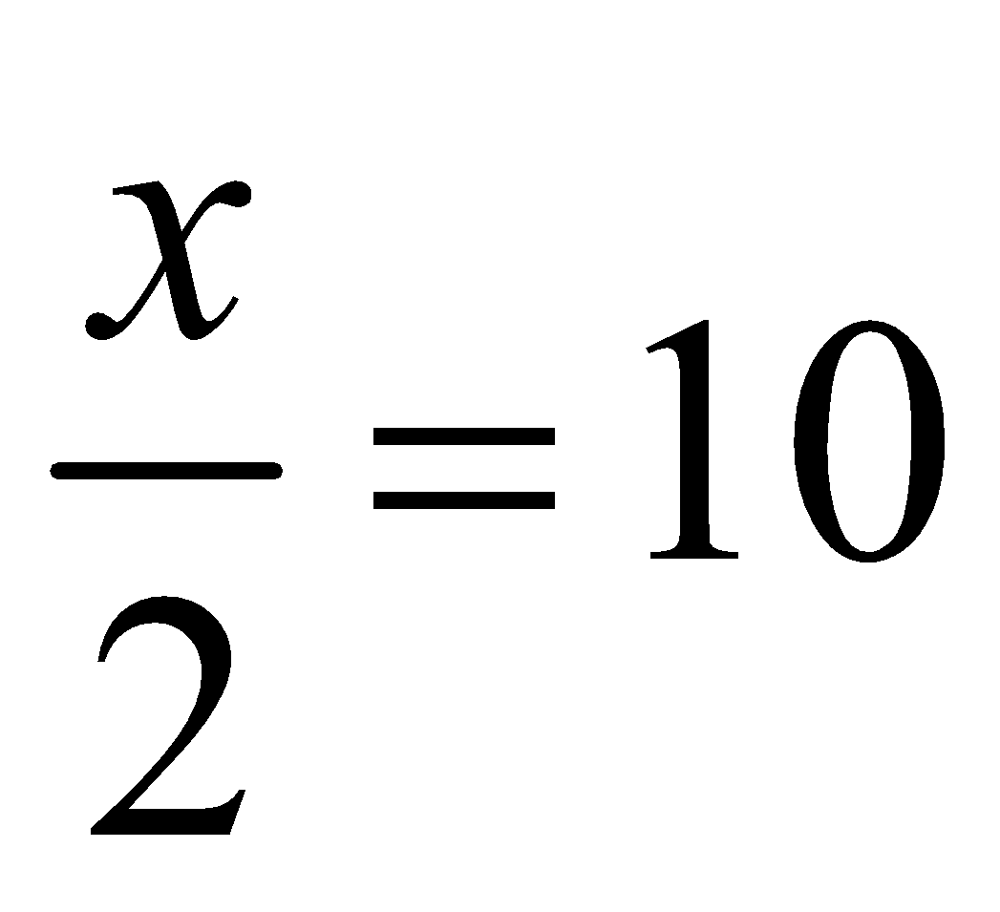
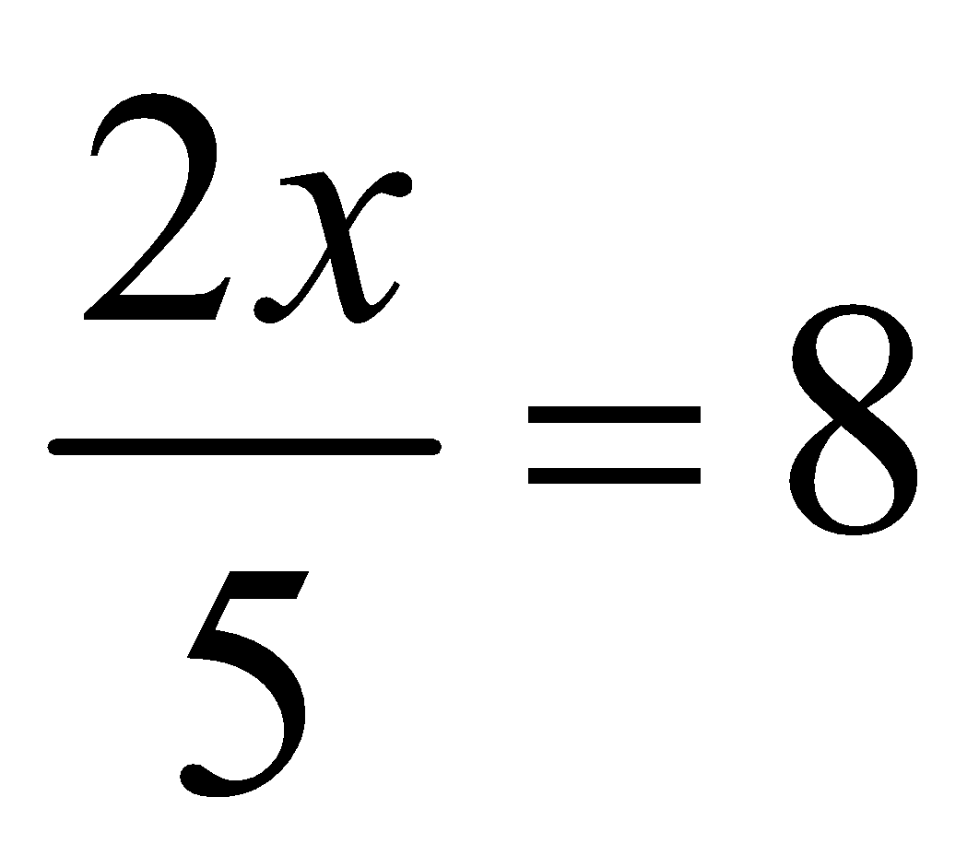
EXAMPLES
1. x + 6 = 7 4. 5x = 15
2. x – 2 = 3 5.
3. 3 + x = 5 6.

Slide 36
Translating Words to Equations
Key words for each operation:
Addition – more than, increased, sum
Subtraction – less than, decreased, difference
Multiplication – twice, times, product
Division – half, divided by, quotient

Slide 37
Examples
The product of a number and 12 is 15 more than 45.
When a number is increased by 31, the result is the square of 3.

Slide 38
2.5 Solving Multi-Step Equations
Use Distributive Property.
Combine like terms on each side of the equal sign.
+/- Variable to left side.
+/- Constant to right side.
x/÷ to solve

Slide 39
EXAMPLES
3x + 8 = 17
x – 4 = 2x + 8
-2(x – 3) = 8
x+5= 2x-3
6(2x-1) = -36 + 6

Slide 40
2.6 SOLVE LINEAR INEQUALITIES
Inequalities are used to indicate the order of comparison between two quantities.
A linear inequality is an inequality only in x or y.
Addition Property of Inequality - adding the same number to both sides of an inequality maintains the order of the inequality.

Slide 41
THE EXCEPTION
Multiplication Property of Inequality –multiplying by a positive number maintains the order of the inequality.
Multiplying by a negative number reverses the order of the inequality(flip the sign).

Slide 42
LINEAR INEQUALITY IN TWO VARIABLES
A solution to a linear inequality in two variables, such 2x + y < 4, is an ordered pair that makes the inequality true.
The graph of all such solutions is a region called a half-plane.

Slide 43
EXAMPLES
Solve each inequality and graph on a number line
3x+10 < 4
23 > 8-5y
Graph each inequality using a table of values
y < 4x
y > -2x

Slide 44
2-7 DATA AND MEASURES OF CENTRAL TENDENCY
Statistics is a branch of mathematics that involves the study of data.
The purpose of a statistical study is to reach a conclusion or make a decision about an entire group called a population.
A sample is a representative part of a population.

Slide 45
KEY TERMS TO MEASURE DATA
The mean is the arithmetic average.
The median is the middle of the values of the data.
The mode is the number that occurs the most in the set of data.

Slide 46
EXAMPLE
The SAT math scores for 8 high school students are listed below.
539 541 576 505 548 576 565 558
Find the mean
Find the median
Find the mode

Slide 47
6.1 – SLOPE OF A LINE AND SLOPE INTERCEPT FORM
Slope is the ratio of the vertical change to the horizontal change of a line.
m = rise = y₂ – y₁
run x₂ – x₁

Slide 48
Find the slope of the line that contains points (-1,2) and (3, -4)
Graph the line that passes through (1,1) and has slope -3/4.

Slide 49
SLOPE-INTERCEPT FORM
Slope-intercept form is written
y = mx + b
Where m represents the slope and b represents the y-intercept.

Slide 50
EXAMPLES
What is the slope and the y-intercept of the following lines?
y = -2x + 1
y = x – 2
5x + 6y = 6

Slide 51
6.2 – PARALLEL AND PERPENDICULAR LINES
Two lines are parallel if they have the same slope and different y-intercepts.
(same m and different b)
Two lines are perpendicular if they have opposite, reciprocal slopes.
Two lines are intersecting if they are neither parallel or perpendicular.

Slide 52
EXAMPLES
Find the slope of the line parallel to the
given line and a line perpendicular to the
given line.
Line containing the points (-2, 5) and (0, -1)
Line containing the points (4, -1) and (-5, -1)
y = ½ x - 4

Slide 53
Determine whether each pair of lines is parallel, perpendicular, or neither.
3x + 2y = 5
2y = -3x + 6

Slide 54
2b. 2x – y = 8
3y = -x + 2

Slide 55
2c. 6y = -4x + 7
6x – 4y = 8

Slide 56
6.3 WRITE EQUATIONS FOR LINES
Point-slope form
y – y₁= m(x – x₁)
Used when you know a point on the line and the slope of the line
Also used if you know the coordinates of two points on the line.

Slide 57
EXAMPLES
Write an equation of the line with a slope of -2 and containing point P(-1,3)
Write an equation for the line that contains the points A(1,-3) and B(3,2)

Slide 58
6-4 SYSTEMS OF EQUATIONS(BY GRAPHING)
Two linear equations with the same two variables form a system of equations.
The solution of a system of equations is the ordered pair that makes both equations true.
When graphing two linear equations, the point of intersection is the solution of the system.
If the two lines are parallel lines(same slope) the system has no solution.

Slide 59
STEPS FOR SOLVING BY GRAPHING
1. Transform both equations so they are in slope-intercept form
2. Graph both lines on the coordinate plane if they are different lines.
3. Find the point of intersection(if possible).
4. Check the point by inserting it back into both original equations.

Slide 60
EXAMPLE 1
y = x
y= -x

Slide 61
EXAMPLE 2
y = -2x + 1
y = -3x + 4

Slide 62
EXAMPLE 3
y = (½)x + 3
2y = x - 2

Slide 63
6-5 SOLVE SYSTEMS BY SUBSTITUTION
Substitution is an algebraic method that can be used to solve systems of equations.
This method is useful when one equation has already been solved for one of the variables.

Slide 64
STEPS FOR SUBSTITUTION
Solve one of the equations of the system for one of the variables.
Substitute the resulting expression for that variable in the other equation.
Solve the equation for the one variable that is left.
Take the value of the variable and solve for the variable you do not know the value of.

Slide 65
EXAMPLE 1
Solve the systems of equations using substitution.
x = 5y
x – 3y = 6

Slide 66
EXAMPLE 2
3x – y = 6
x + 2y = 2

Slide 67
EXAMPLE 3
x + 3y = 7
-2x + 4y =6

Slide 68
EXAMPLE 4
2x + 3y = 6
4x + 6y =6

Slide 69
EXAMPLE 5
4x – 2y = 10
-2x + y = -5

Slide 70
EXAMPLE 6
An appliance store delivers large appliances using vans and trucks. When loaded, each van holds 4 appliances and each truck holds 6. If 42 appliances are delivered and 8 vehicles are full, how many vans and trucks are used?

Slide 71
6-6 SOLVING SYSTEMS BY ELIMINATION
Another algebraic method for solving a system of equations is the addition/subtraction method or elimination.
Steps to follow when using the method
Add or subtract to cancel out one variable
Solve the remaining equation
Substitute back into the original equation and solve for the second variable
Check using both original equations

Slide 72
EXAMPLES
x – y = -5
x + y = 15
2x + 7y = -5
-5x + 7y= -12

Slide 73
WHEN TO MULTIPLY
When a variable cannot be eliminated by simply adding or subtracting, you need to multiply one or both of the equations to be able to do so.

Slide 74
EXAMPLES
x – 5y = 0
-2x + 3y = -7
3x - 4y = 10
-2x + 3y = -7

Slide 75
2.6 LINEAR INEQUALITIES
Graph like y = mx + b
Start with the b on the y-axis
Then slope is rise/run.
Type of line.
>, < 🡪 Dashed line
≥, ≤ 🡪 Solid Line
Shading
>, ≥ 🡪 Shade for the top of the y-axis
<, ≤ 🡪 Shade for the bottom of the y-axis

Slide 76
5.3-PROBABILITY AND AREA

Slide 78
CHAPTER 11
Polynomials

Slide 79
11-1 ADD AND SUBTRACT POLYNOMIALS
Polynomials - expressions with several terms that follow patterns such as
4x³ + 3x² + 15x + 2

Slide 80
Types of Polynomials
Monomial – one term (3x)
Binomial – two terms (5x – 7)
Trinomial – three terms (2x² + 5x – 8)
Constant – a number by itself
Like Terms are terms in which the variables are identical.
Standard form - the terms are ordered from the greatest power of one of the variables to the least power of that variable.

Slide 81
EXAMPLES
Add 8a²b + 6ab² to 4a²b – 3ab²
Subtract 5m² – 2m from 8m² + m
Subtract s² + 3s -4 from 3s² -5s -3

Slide 82
11-2 MULTIPLY BY A MONOMIAL
When you multiply a polynomial by a monomial, the product always has the same number of terms as the original polynomial.
So when you multiply a binomial by a monomial, the product will remain a binomial.

Slide 83
EXAMPLES
Simplify
(8a)(3b)
(3m)(-2n)
(-2x)(-5x²)

Slide 84
2x(3x-4)
3v²(v² + v +1)
12b(a² + 3ab² -3b³ -10)

Slide 85
11-3 DIVIDE AND FIND FACTORS
GCF - greatest common factor.
Extracting Factors – find GCF of all terms of polynomial and divide
Write your answer as a product of the GCF and the remaining polynomial

Slide 86
EXAMPLES
Factor.
4x + 2
6y + 15
2x - 6x²
4y² +16y
15xy³ -3x²y²

Slide 87
11-4 MULTIPLY TWO BINOMIALS
To multiply the two binomials, use the distributive property twice.
Multiply the second binomial by each term in the first binomial.
Add the like terms together.

Slide 88
FOIL
F-First
O-Outer
I-Inner
L-Last

Slide 89
MULTIPLY AND SIMPLIFY
(y-5)(y+5)
(x+3) (x-4)
(a-2)(a-3)
(3x – 7)(x + 3)

Slide 90
11-7 FACTOR TRINOMIALS
A trinomial that does have a monomial factor, still may be able to be factored.
FOIL these binomials and look for a pattern.
(x+3)(x+4)
(x-3)(x-4)
(x-3)(x+4)
(x+3)(x-4)

Slide 91
Look at the third term in each trinomial and the sign before it.
Look at the second term and the sign before it.

Slide 92
EXAMPLES
Factor.
x² -8x +15
x² + 6x + 8
x² -3x -40

Slide 93
11-6 Special Factoring Patterns
Multiply the following together and look for a pattern
(x – 3)(x – 3)
(m + 2)(m + 2)
(6a – 5)(6a – 5)

Slide 94
Perfect Square Trinomial
The first and last terms are perfect squares. The middle term is the sum of the two second terms.
Examples:
x² – 4x + 4
y² + 8y + 16
9m² + 12m + 4

Slide 95
Difference of Squares
Multiply and look for a pattern.
(x + 2)(x – 2)
(a + 4)(a – 4)
(3m – 6)(3m + 6)

Slide 96
Difference of Squares
The middle term cancels out to leave only two perfect squares
Examples
x²- 25
y² – 81
4b² - 64

Slide 97
7-1 RATIOS AND PROPORTIONS
Two ratios that can be named by the same fraction are called equivalent ratios.
A proportion in an equation that states that two ratios are equivalent.
a:b = c:d a = c
b d
The four numbers a,b,c, and d that are related in the proportion are called the terms.
The first and last terms are called the extremes. The second and third terms are called the means.

Slide 98
NOTES CONTINUED
In a proportion, the product of the extreme equals the product of the means. This is the same as saying the cross products are equal.

Slide 99
EXAMPLES
Find x: x = 12
18 27
Write a proportion and solve.
Fine Photo charges $3 for 2 enlargements. How much does the company charge for 5 enlargements?

Slide 100
The ratio of counselors to campers is 2:15. There are 102 people at a camp. How many are counselors?

Slide 101
9-1 REVIEW PERCENTS AND PROBABILITY
Probability is the mathematics of chance. Probability is used to describe the relative frequency of with which an event is likely to occur.
In an experiment, you either take a measurement or make an observation. A probability determined by observation or measurement is called experimental probability.

Slide 102
The experimental probability of an event(E) can be estimated.
P(E) = number of favorable observations of E
total number of observations
The set of all possible outcomes of an experiment is called the sample space.

Slide 103
EXAMPLE
Lions fans attending a recent 3-game series were asked whether the team should have a mascot. The table shows how many fans thought it should.
According to these results, what is the probability that a Lions fan wants the team to have a mascot?
Game | Attendance | In favor of mascot
Friday | 681 | 388
Saturday | 527 | 428
Sunday | 928 | 786

Slide 104
EXAMPLE
A baseball team has 8 pitchers and 3 catchers. The manager is choosing a pitcher-catcher combination. How many are possible?

Slide 105
9-3 COMPOUND EVENTS
A compound event consists of two or more simple events. Compound events may involve finding the probability of one event and another event occurring.
If two events cannot occur at the same time, they are called mutually exclusive events. For example it is impossible to draw from a standard deck of playing cards that is both a heart and a club.
When two events A and B are mutually exclusive, the probability of A or B can be found using the formula P(A or B) = P(A) + P(B).

Slide 106
Suppose you know the probability of event A. The set of outcomes in the sample space , but not in A, is called the complement of the event.
P(not A)= 1- P(A)

Slide 107
EXAMPLE 1
A standard deck of playing cards is used to simulate a baseball game. During the game, players draw a card at random. Spade number cards greater than 4 represent doubles. Home runs are represented by either a 3 or a queen.
Find P( hitting a double)
Find P ( hitting a home run)

Slide 108
EXAMPLE 2
You draw a card at random from a standard deck of playing cards. Find the probability that the card is a club or a jack.
This represents two events that are not mutually exclusive, the probability of A or B can be found using the formula
P(A or B) = P(A) +P(B) – P(A and B)

Slide 109
EXAMPLE 3
You select a marble from a jar without looking. You know 1/5 of the marbles are red and 1/5 are blue. What is the probability you will select neither the red nor the blue marble?

Slide 110
9-4 INDEPENDENT AND DEPENDENT EVENTS
When the outcome of one event does not affect the outcome of another event, the events are said to be independent.
To find the probability of both events occurring, multiply the probabilities of each event.
If A and B are independent events, then P(A and B) = P(A)·P(B)
Sometimes P(A and B) is written P(A, then B).

Slide 111
When the outcome of one event is affected by the outcome of another, the events are said to be dependent.

Slide 112
A bag contains 3 white softballs, 2 yellow softballs, 3 green softballs, and 4 red softballs. You reach into the bag without looking and take out a ball. You replace it and then take out another ball at random. Find the probability that the first ball is red and the second ball is white.

Slide 113
Six teams -- the Dragons, Vikings, Lions, Bears, Cheetahs, and Elephants—are in the lottery round for this years draft picks. The name of each team is written on a card and placed in a box.
To determine who gets the first lottery pick, one card will be drawn at random and not replaced. Then a second card will be drawn at random to determine the second pick. What is the probability that the Bears get the first draft choice and the Lions get the second draft choice?

Slide 114
9-5 PERMUTATIONS AND COMBINATIONS(PART I)
The fundamental counting principle can be used to count the number of ways two or more events can happen in succession.
It states that, if an event A can occur in m ways and an event B can occur in n ways, then events A and B can happen in m·n ways.

Slide 115
EXAMPLE 1
Suppose the Kenosha Comets of AAGPBL will travel on a road trip to Grand Rapids, Peoria, and Battle Creek. They can go from Kenosha to Grand Rapids by car, train, or bus, then from Grand Rapids to Peoria by bus, train, or plane, an from Peoria to Battle Creek by car, bus train, or plane. Finally, from Battle Creek, they can take the bus or the train back home. How many different routes are possible on this trip?

Slide 116
PERMUTATION
An arrangement of items in a particular order is called a permutation.
Use the fundamental counting principle to determine of permutations for the four letters M,A,T,H.

Slide 117
FACTORIAL NOTATION
4·3·2·1 can be written in factorial notation as 4!
In general, the number of permutation of n different items is written n! and read as n factorial.

Slide 118
EXAMPLE 2
In how many different ways can you arrange your math, science, social studies, language arts, and literature books in a row on a shelf?

Slide 119
Sometimes you need only part of a set of items, such as selecting two of nine players. The number of permutations of n different items, taken r items at a a time, with no repetitions, is written nPr.

Slide 120
EXAMPLE 3
Eight teams enter a tournament. How many different arrangements of first-, second-, and third-place winners are possible?

Slide 121
COMBINATION
For each situation described so far, the order of the items in consideration is important. A set of items in no particular order is called a combination.

Slide 122
EXAMPLE 4
How many different four-person ensembles can be chosen from a pool of 10 musicians?

Slide 123
14-2 SOLVE RIGHT TRIANGLES
You can find the measures of missing parts of a right triangle.
If you know the measure of one acute angle, you can find the measure of the other by subtracting the measure of the known angle from 90°.
If you know the lengths of two sides, you can use the Pythagorean Theorem to find the length of the third side.
If you know the measure of an angle and the length of a side, you can use the trigonometric ratios and the first two rules to find the other parts of the triangle.

Slide 124
EXAMPLE 1
Find the following in triangle PQR
PR to the nearest tenth
Measure of angle P
RQ to the nearest tenth

Slide 125
ANGLES OF DEPRESSION AND ELEVATION
Finding the measures of all parts of a right triangle is called solving a right triangle.
An angle of depression is formed by a horizontal line and a line slanting downward.
An angle of elevation is formed by a horizontal line and a line slanting upward.

Slide 126
EXAMPLE 2
A surveyor 550 ft from the base of the Howard Libbey redwood, the world’s tallest tree, in Humboldt County, CA. The tree is 362 ft tall. Find the angle of elevation of the top of the tree from the spot where the surveyor is standing.

Slide 127
CHAPTER 12 QUADRATIC FUNCTIONS

Slide 128
12-1 GRAPH PARABOLAS
Use a graphing calculator to graph the following equations. Draw the graphs in your notes.
y=-x
y= x² +2x +1
y = x + 3
y = -x² -1
y = 2x -2
y = 2x²

Slide 129
In this section you will learn to graph equations that contain second degree or quadratic forms.
A quadratic equation in x contains an x² term, and involves no term with a higher power of x. The simplest quadratic equation is y = x².

Slide 130
EXAMPLE 1
The problem: Graph y = x².
Find at least five ordered pairs by selecting x-values and solving the equation to find the y-values.
Graph the ordered pairs.
Draw a smooth curve through the points.

Slide 131
Because there is only one y-value for each x-value, this is the graph of a function.
When the domain of a quadratic function is the set of all real numbers, the graph is a parabola.
Notice that there is not only one x-value for each y-value. In fact, there are two x-values for each y-value except for point (0,0), the lowest point on the parabola.
The parabola in Example 1 opens upward. For some functions, the parabolas open downward.

Slide 132
EXAMPLE 2
Graph y = -2x²
Make a table of ordered pairs.

Slide 133
VERTEX AND AXIS OF SYMMETRY
The vertex is the lowest point on a parabola that opens upward, and the highest point on a parabola that opens downward. The graphs for y = x and y = -2x² both have the point -2x² both have the point (0,0) as their vertex.
The vertex lies on the lines that divides the parabola in half. This line is called the axis of symmetry of the parabola.

Slide 134
12-2 THE GENERAL QUADRATIC FUNCTION
Graph the following with a graphing calculator and record in your notes.
y = x² + 6x
y = x² – 6x
y = -x² + 5x
y = -x² – 5x

Slide 135
12-2 THE GENERAL QUADRATIC FUNCTION
In lesson 12-1 you investigated quadratic equations in the forms y = ax² and y = ax² + c. As you’ve seen the graph of a quadratic function is a parabola. In these equations we studied the vertex was always the y-axis, and the axis of symmetry was the y-axis. But other locations are possible with the form y= ax² + bx.

Slide 136
The general form of the quadratic function is defined by the standard quadratic equation y= ax² + bx + c, where a, b, and c are real numbers and a cannot be zero.
The general quadratic function can be written f(x) = ax² + bx + c.

Slide 137
EXAMPLE 1
Graph y= 3x² – 4x – 1 on a graphing calculator. Estimate the coordinates of the vertex as fractions.

Slide 138
EXAMPLE 2
Find the coordinates of the vertex for the graph of y= 3x² – 4x – 1 (without a calc)
Step 1 Use the formula x = _ b
2a
to find the x value of the vertex.
Step 2 Use the x value you found in the original equation for x to evaluate for the y-coordinate.
Step 3 State the x and y coordinates of the vertex.

Slide 139
EXAMPLE 3
Graph f(x) = -2x² – 3x + 1
Step 1 Use the formula x = _ b
2a
to find the x value of the vertex.
Step 2 Use a x-y table to find more important points on the graph.

Slide 140
12-3 FACTOR AND GRAPH
Graph each equation on a graphing calculator.
How many times does the graph cross the x-axis?
y = x² -25
y = 2x² +3x +5
y = x² + 6x +9

Slide 141
The x-intercepts are the solutions to the quadratic equation. They are the x-coordinates of points for which y = 0. As illustrated with the previous equations, there may be 0,1, or 2 x-intercepts.
You can determine the number of x-intercepts and estimate their values by graphing the quadratic equation. You can find the exact solutions by letting y=0 and factoring the equation.

Slide 142
EXAMPLE 1
Solve y= 3x² -6x
(Find the solutions for when y=0)

Slide 143
EXAMPLE 2
Solve x² + 16 = -8x + y

Slide 144
NOTE
Note: If the vertex of the parabola is tangent to the x-axis there is only one solution to the quadratic equation.

Slide 145
EXAMPLE 3
Solve y = -x² – x -1

Slide 146
NOTE
Note: If the parabola for the equation does not meet the x-axis, the equation has no solutions.

Slide 147
13-1 THE STANDARD EQUATION OF A CIRCLE
Plane curves having second-degree equations are called conic sections, or simply conics. They have this name because they can be obtained by slicing a double cone with a plane.
A circle is the set of all points in a plane that are a fixed distance, called a radius, from a fixed point, called the center.

Slide 148
EQUATION OF A CIRCLE
The circle with center (h,k) and radius r has the equation
(x-h) ² + (y-k) ² = r²
If the center of a circle is at the origin, then (h,k) is (0,0) and the equation of the circle is
(x-0) ² + (y- 0) ² = r²
x² + y² = r²

Slide 149
EXAMPLE 1
Write an equation for a circle with radius 6 units and center (0,0)

Slide 150
EXAMPLE 2
Find an equation of the circle with center (2,5) and radius 3.

Slide 151
EXAMPLE 3
Find an equation of the circle with center (-1,-4) and radius 4.

Slide 152
EXAMPLE 4
Find the equation of the circle on the board.

Slide 153
EXAMPLE 5
Graph the equation.
(x-1)² + (y+3) ² = 4

Slide 154
15-1 ROOTS OF REAL NUMBERS
A square root of a number b is a solution of the equation x²=b. Every positive number b has two square roots, denoted √b and -√b.
The positive square root is called the principal square root.
A negative number b has no real square roots.

Slide 155
PERFECT SQUARES
4
9
16
25
36
49
64
81
100
121
144

Slide 156
CUBE ROOTS
A cube root of a number b is a solution of the equation x³ = b.
Every number b, whether positive, negative, or zero, has exactly one real cube root.( and all other odd nth roots)

Slide 157
PERFECT CUBES
8
27
64
125

Slide 158
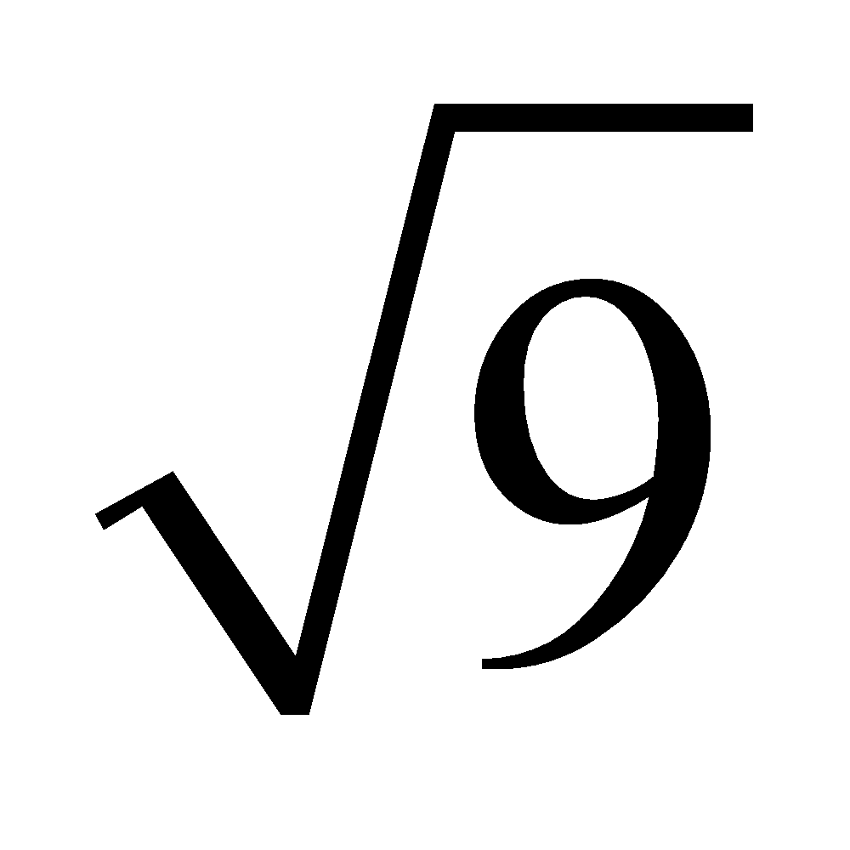
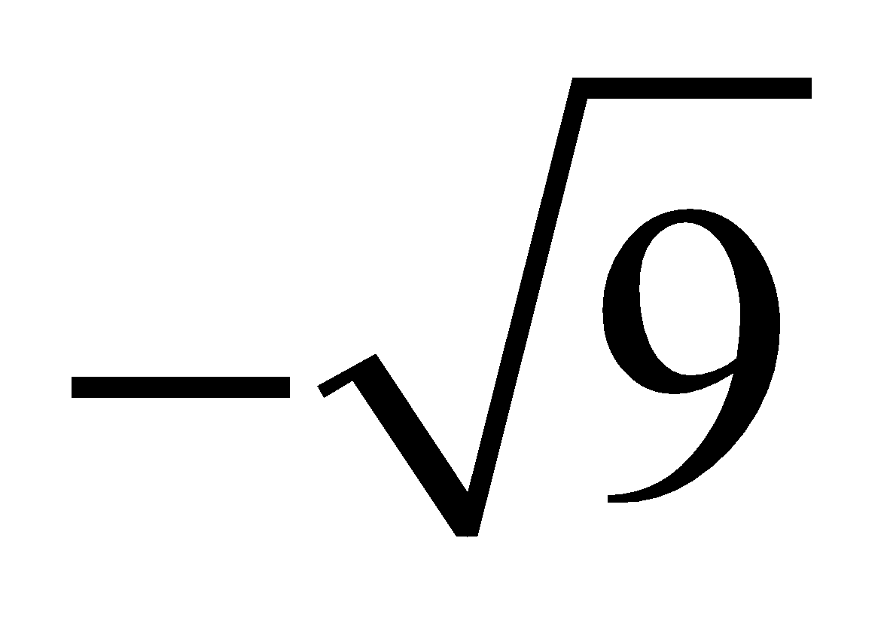
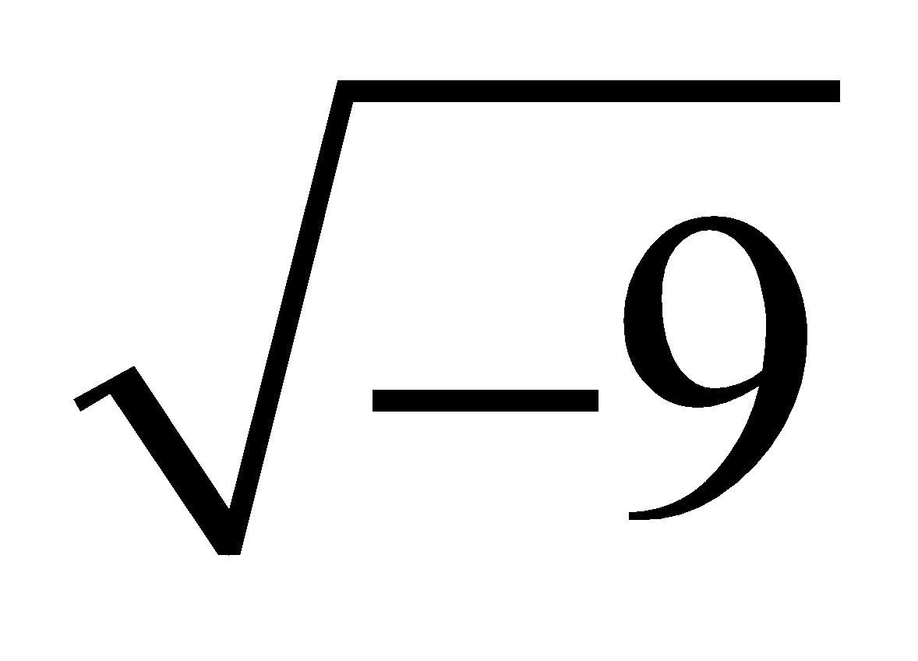
EXAMPLES
Examples
Simplify, unless the expression does not represent a real number.
1.
2.
3.

Slide 159
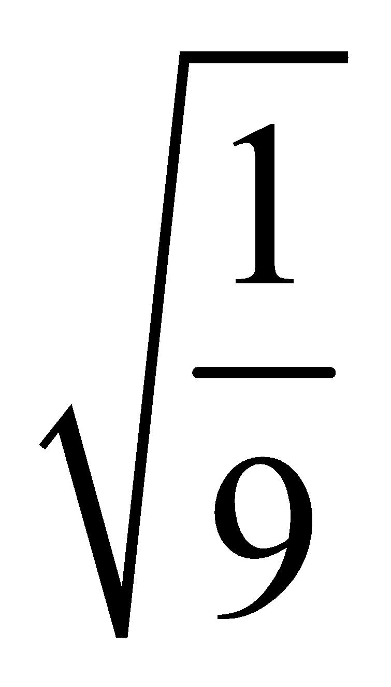
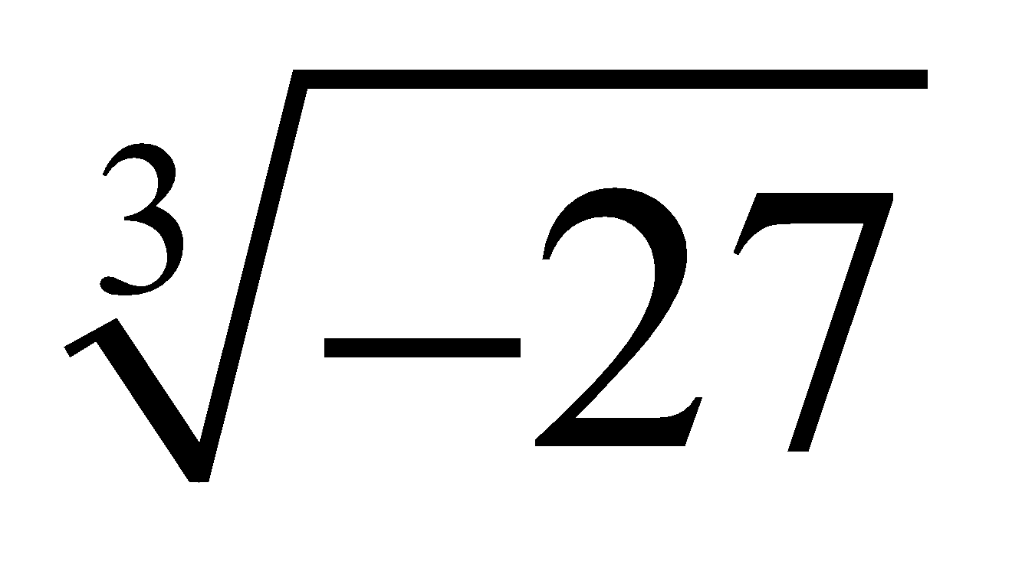
4.
5.

Slide 160
Give the real roots of each equation.
6. x² = 0.49
7. 3x² = 432
8. 5y² + 45 = 0

Slide 161
15-2 SIMPLIFYING RADICALS
Product and Quotient Properties of Radicals
If √a and √b are real numbers, then:
1. √ab = √a ·√b
2. On Board

Slide 162
STEPS TO SIMPLIFYING SQUARE ROOTS
To simplify square roots that do not have a natural number as the solution.
1. Find factors of the number inside the square root. (Preferably containing a factor that is a perfect square)
2. Replace the perfect square inside the radical with the square root of that number outside the radical.
Ex. Change √8 to √(4·2) to 2√2

Slide 163
PERFECT SQUARES REMINDER
Recall the list of perfect squares to use as factors.
4
9
16
25
36
49
64
81
100
121
144

Slide 164
EXAMPLES
Simplify
√12
√20
√18
√32
√48
√75
√98
√300

Slide 165
EXAMPLES(WITH VARIABLES)
√x³
√8x²
√x³y²
√200x⁴

Slide 166
15-3 SIMPLIFYING CUBE ROOTS
You use the same process in simplifying cube roots as you do with square roots.
One difference is that you look for perfect cube factors instead of perfect square factors.
Another difference is that you can take a cube root of a negative number unlike a square root.
Ex √-8 = -2

Slide 167
PERFECT CUBES
8
27
64
125

Slide 168
EXAMPLES

Slide 169
10-2 PYTHAGOREAN THEOREM
In a right triangle the shorter sides are legs, and the side opposite the right angle is the hypotenuse. The relationship between the lengths of the legs and the hypotenuse is called the Pythagorean Theorem.

Slide 170
In a right triangle, the sum of the squares of the measures of the two legs is equal to the square of the measure of the hypotenuse.
a² + b² = c²

Slide 171
EXAMPLE 1
An architect draws a right triangle, ΔDEF. On a blueprint. DE = 3 cm and EF = 5 cm. Find DF to the nearest tenth.
D
F
E

Slide 172
EXAMPLE 2
Find x to the nearest hundredth of an inch.
11 in.
x
9 in.

Slide 173
CONVERSE OF THE PYTHAGOREAN THEOREM
If the sum of the squares of the mearures of two shorter sides of a triangle is equal to the square of the measure of the third side, then the triangle is a right triangle.

Slide 174
EXAMPLE 3
Are triangles with the following lengths right triangles?
2 cm, 4√2 cm, 6 cm
4 in, 9 in, 10 in

Slide 175
10-3 SPECIAL RIGHT TRIANGLES
30-60-90 Triangle Theorem
In a 30- 60 -90 triangle, the measure of the hypotenuse is two times that of the leg opposite the 30° angle. The measure of the other leg is √3 times that of the leg opposite the 30° angle.

Slide 176
X√3
2x
x

Slide 177
EXAMPLE 1
A triangular support shown in a blueprint forms a 30 – 60 – 90 triangle. On the plans the leg opposite the 30° angle measures 4 cm. What are the measures of the other two sides?

Slide 178
EXAMPLE 2
In a 30 – 60 – 90 triangle, the hypotenuse measures 7 in. Find the measure of the other two sides to the nearest tenth.

Slide 179
45-45-90 TRIANGLE THEOREM
In a 45-45-90 triangle , the measure of the hypotenuse is √2 times the measure of a leg of the triangle.

Slide 180
x√2
x
x

Slide 181
EXAMPLE 3
Find the unknown measure.
3 in.
3 in.

Slide 182
14-1 BASIC TRIGONOMETRIC RATIOS
The three basic trigonometric ratios are the sine, the cosine, and the tangent. The three ratios are able to be used for RIGHT TRIANGLES ONLY.

Slide 183
sine A = length of side opposite angle A
length of the hypotenuse
cosine A = length of side adjacent to angle A
length of the hypotenuse
tangent A =length of side opposite of angle A
length of side adjacent to angle A
A memory device to use for the trig ratios is SOH CAH TOA.

Slide 184
Find the ratios of the sides of the triangles for the following
sin A
cos A
tan B
sin B
cos B
tan A

Slide 185
EXAMPLE 2
Use a calculator to find the following ratios.
Round the answer to the nearest ten-thousandth.
Sin 20°
Cos 50°
Tan 51°
Sin 75°
Cos 88°
Tan 9°

Slide 186
EXAMPLE 3
An angle has a cosine of 0.55. Find the measure of the angle to the nearest degree.

Slide 187
EXAMPLE 4
In this 30-60-90 right triangle, what would the ratio of the sin of the 30° angle be? (without using a calculator)

Slide 188
14-2 SOLVE RIGHT TRIANGLES
Solving a right triangle means to solve all missing parts of a right triangle(angles and sides).
3 methods to use
If you know the measure of one acute angle, subtract it from 90°to find the missing angle.
If you know two sides, find the third using the Pythagorean Theorem
*If you know the measure of an angle and the length of a side, you can use trig ratios and the first two rules to find the other parts of the triangle.

Slide 189
EXAMPLE 1
Find the following in ΔPQR.
PR to the nearest tenth
m ∠P
RQ to the nearest tenth
P
42
27°
R
Q

Slide 190
ANGLES OF DEPRESSION AND ELEVATION
An angle of depression is formed by a horizontal line and a line slanting downward.
An angle of elevation is formed by a horizontal line and a line slanting upward.
Angle of depression
Angle of elevation

Slide 191
EXAMPLE 2
A surveyor 550 ft from the base of the Howard Libbey redwood, the world’s tallest tree., in Humboldt County, CA. The tree is 362 ft tall. Find the angle of elevation of the top of the tree from the spot where the surveyor

Slide 192
EXAMPLE 3
Find the angle measures of a 3-4-5 right triangle.

Slide 193
2-7 DATA AND MEASURES OF CENTRAL TENDENCY
Statistics is a branch of math that involves the study of data.
The purpose of a statistical study is to reach a conclusion or make a decision about an entire group called a population.
A representative part of the population is called a sample.

Slide 194
Three measures of central tendency that can be calculated are the mean, median, and mode.
The mean is the arithmetic average of the data.
The median is the middle value of the data when arranged in numerical order. When the number of data items is even, the median is the average of the two middle numbers.
The mode is the number that occurs most in the set of data.

Slide 195
EXAMPLE 1
The SAT math scores for 8 high school students are listed below.
539 541 576 505 548 576 565 558
Find the mean.
Find the median
Find the mode

Slide 196
EXAMPLE 2
The following are the averages from two softball teams:
.190 .250 .275 .255 .267 .250 .333 .399
.288 .301 .287 .355 .198 .233 .255 .266
.234 .175 .300 .302 .289 .303 .309 .311
.401 .409 .213 .222 .244 .254 .387 .312
Insert the data into a list on a graphing calculator.

Slide 197
2-8 DISPLAY DATA
One type of visual data display is the stem- and- leaf plot. To construct a stem- and- leaf plot, first divide each piece of data into two parts: a stem and a leaf. The last digit of each number is referred as its leaf; the remaining digits comprise the stem.

Slide 198
EXAMPLE 1
For an article she was preparing for a women’s health magazine, Sharon recorded the cholesterol levels of the twenty women on the magazine staff.
185 234 208 197 259
177 192 188 208 200
215 199 209 234 208
146 216 201 232 186
Construct a stem-and leaf plot to display the data. Interpret the data using your plot.

Slide 199
An outlier is a piece of data that is significantly more or less than the bulk of the data.
What cholesterol levels are outliers?
There is a large cluster for cholesterol levels between 177 and 216, and a smaller cluster for levels in the lower 230s.
Gaps exist between these two clusters and between the outliers and the rest of the data.
A histogram is a type of bar graph used to display data.

Slide 200
CHAPTER 3 GEOMETRY AND REASONING

Slide 201
3-1 POINTS, LINES, AND PLANES
In Geometry, point, line, and plane are intuitive ideas. It is impossible to give a precise definition of these words, so they are undefined terms.
A point indicates a specific location. Although you use a dot picture a point, it actually has no dimensions.
A line is a set of points that extends without end in two opposite directions.
A plane is a set of points that extends without end in all directions along a flat surface.

Slide 202
Collinear points are points that lie on the same line.
Coplanar points are points that lie in the same plane.

Slide 203
POSTULATES
Postulate 1
The Unique Line Postulate Through any two points, there is exactly one line.
Postulate 2
The Unique Plane Postulate Through any three noncollinear points, there is exactly one plane.
Postulate 3 If two points lie in a plane, then the line joining them lies in that plane
Postulate 4 If two planes intersect, then their intersection is a line.

Slide 204
A ray is part of a line that begins in one point, called the endpoint, and extends without end in one direction.
A line segment is part of a line that begins at one endpoint and ends at another.

Slide 205
RULER POSTULATE
The distance between any two points on the line is equal to the absolute value of the difference of their coordinate.
The Segment Addition Postulate
If point B is between points A and C, then AB + AC = AC.

Slide 206
EXAMPLE 1
Using the number line, find the length of QS.

Slide 207
EXAMPLE 2
In the figure at the left, AC= 47. Find AB.

Slide 208
3-2 TYPES OF ANGLES
An angle is the union of two rays with a common endpoint. The endpoint is the vertex of the angle, and each ray is a side of the angle.
Protractor Postulate
The protractor postulate states that the measurement of an angle between two rays can be designated as a unique number, and this number would be between 0 and 180 degrees. This postulate enables the use of a protractor to measure angles.

Slide 209
Acute angles are less than 90°.
A right angle is exactly 90°.
An obtuse angle is greater than 90° and less than 180°.
A straight angle is equal to 180°.

Slide 210
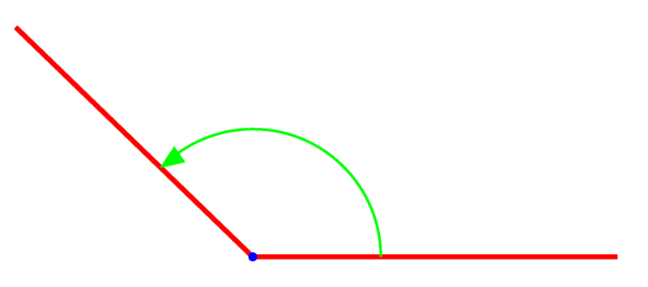
INTERIOR/EXTERIOR
An angle with a measure less 180° divides a plane into three sets of points; the angle itself, the points in the interior of the angle, and the points in the exterior of the angle.
interior
exterior

Slide 211
Two angles are complementary if the sum of their measures is 90°. Each angle is called the complement of each other.
Two angles are supplementary if the sum of their measures is 180°. Each angle is called the supplement of each other.

Slide 212
ANGLE ADDITION POSTULATE
If point B lies in the interior of ∠AOC, then :
m∠AOB + m∠BOC = m∠AOC
If ∠AOC is a straight angle, and B is any point not on line AC then:
m∠AOB + m∠BOC = 180°

Slide 213
Adjacent angles are two angles in the same plane that share a common side and vertex, but have no interior points in common.
The sides of the two adjacent angles that are not common to the adjacent angles are called exterior sides.

Slide 214
EXAMPLE 1
To make a decorative tile border, two tiles must be joined in the angle shown in the figure. The square bracket indicates that ∠UYW is a right angle. Find m∠UYV.

Slide 215
3-3 SEGMENTS AND ANGLES
The midpoint of a segment is the point that divides it into two segments of equal length.
A bisector of a segment is any line, segment, ray or plane that intersects the segment at its midpoint.
A theorem is a statement that can be proved true.

Slide 216
THE MIDPOINT THEOREM
If point M is the midpoint of line segment AB, then
AM = (1/2)AB and MB = (1/2)AB
Example 1
Use the figure on the board to find the midpoint of line segment SY.

Slide 217
The bisector of an angle is the ray that divides the angle into two adjacent angles that are equal in measure.
The Angle Bisector Theorem
If ray BX is the bisector of ∠ABC, then:
m∠ABX = (1/2)m∠ABC and m∠XBC = (1/2)m∠ABC

Slide 218
EXAMPLE 2
The figure shows a portion of the plans for adding angular supports to a bridge. In the figure, ∠JKL is a straight angle, and ray KH bisects ∠GKL. Find m∠HKL.

Slide 220
EXAMPLE 3
In the figure at the right, line AC and line DB intersect at point X. Find m∠DXA.

