Slide 1

The 2016 New York State
English Language Arts and Mathematics Tests

Slide 2
Overview
2016 Testing Updates:
Specific changes to the 2016 Grades 3-8 English
Language Arts and Mathematics Tests
Aspects of the tests that remain the same
Supporting Your Child’s Learning

Slide 3
2016 Testing Updates
Change to a new testing Vendor
Greater involvement of educators in the test development process
A shift to untimed testing
A decrease in the number of test questions

Slide 4


ELA Test Format
Book 1
multiple-choice questions only
Book 2
Book 3
short written responses
multiple-choice questions
1 extended response
short written responses
1 extended response

Slide 5
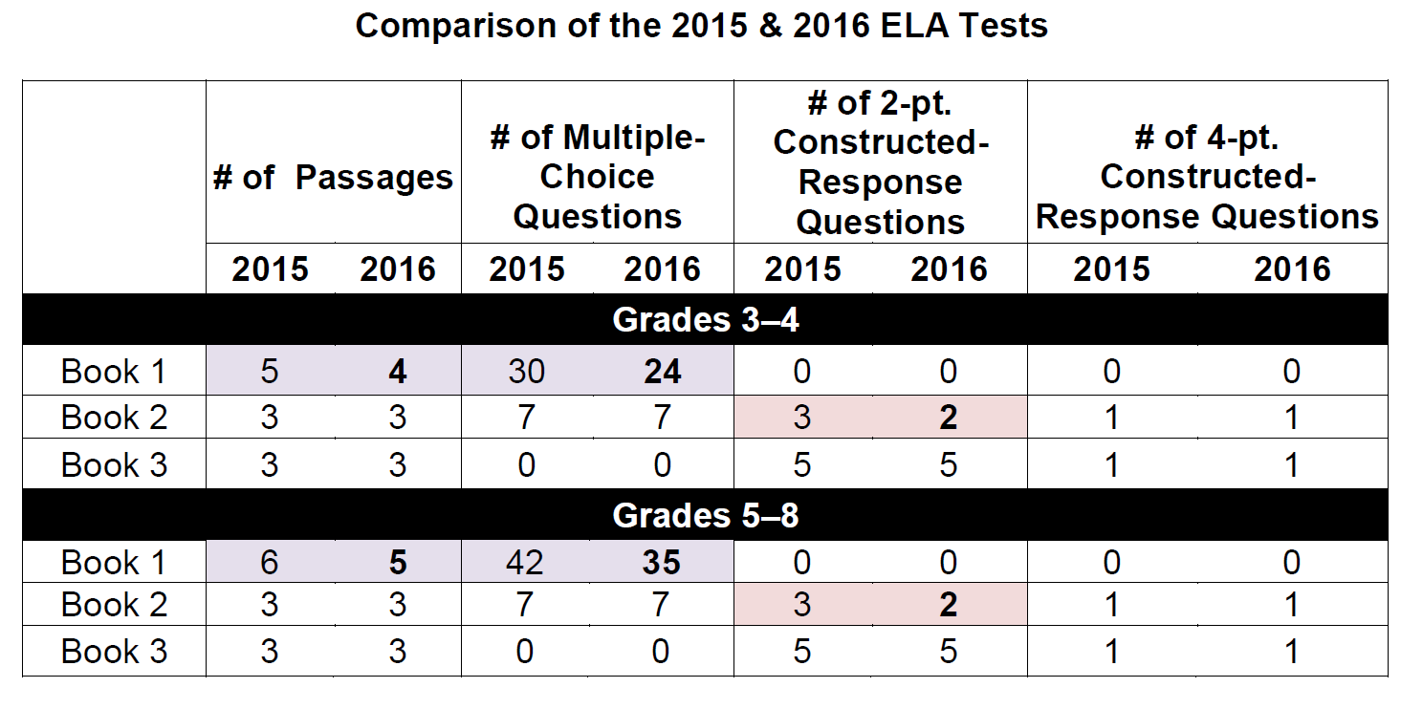
Comparison of the 2015 & 2016 ELA Tests

Slide 6


Math Test Format
Book 1
multiple-choice questions only
Book 2
Book 3
2-pt. and 3-pt. constructed response questions
multiple-choice questions only

Slide 7
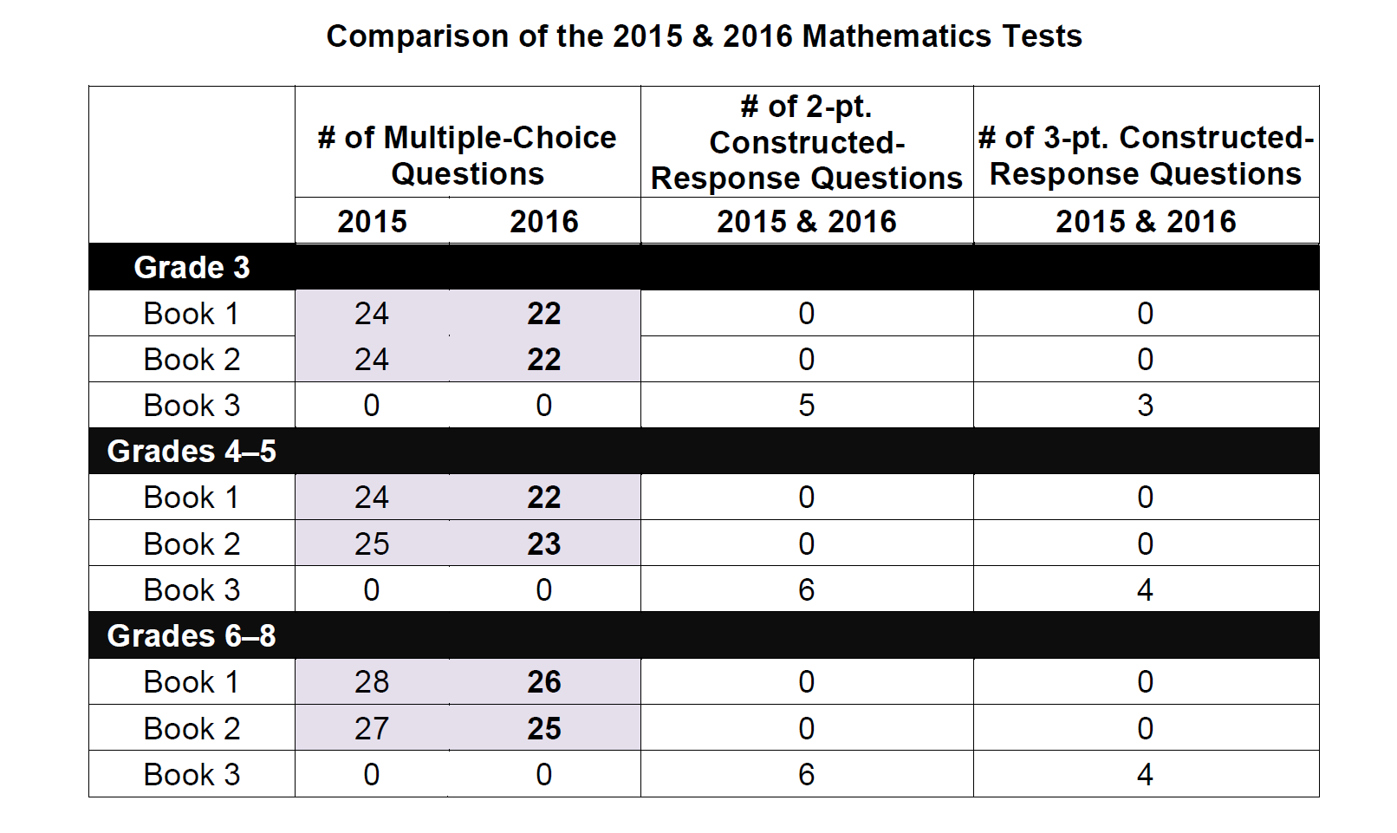
Comparison of the 2015 & 2016 Mathematics Tests

Slide 8
2016 ELA Testing Dates
Wednesday, April 6th
Tuesday, April 5th
Thursday, April 7th
ELA

Slide 9
2016 Math Testing Dates
Thursday, April 14th
Wednesday, April 13th
Friday,
April 15th
MATH

Slide 10
What remains the same …

Slide 11
Common Core Learning Standards: ELA
ELA
Read as much fiction as non-fiction
Learn about the world by reading
Read more challenging material
Talk about reading using evidence
Write about text using evidence
Know more vocabulary words

Slide 12

Supporting Your Child at Home:
ELA
Read often to, with and alongside your child
Keep track of the time your child spends reading daily
Expose your child to varying types of texts – fiction, non-fiction, poetry. Reading beyond books: newspaper articles; magazines; instructions; cookbooks; song lyrics
Read more challenging books with your child

Slide 13

Supporting Your Child at Home:
ELA
Discuss books with your child. Ask open-ended questions. Ask your child to support responses with “evidence from the text” or by simply asking, “How do you know that?”
Encourage writing at home – keeping a journal, writing letters, etc.

Slide 14

Common Core Learning Standards:
Mathematics
Learn more about less
Build skills across grades
Speed and accuracy
Really know it, really do it
Think fast AND solve problems
Use it in the real world

Slide 15
Supporting Learning at Home:
Mathematics
Be aware of what your child struggled with last year and how that will effect ongoing learning
Know what the priority work is for your child at their grade level
Help him/her know, understand and memorize basic math facts
Ask questions and review your child’s homework to see whether he/she understands why, as well as what the answer is
Ask your child to do the math that comes up in daily life

Slide 16
Parent Resources
Council of Great City Schools Parent Roadmap to the Common Core Standards http://www.cgcs.org/Domain/36
This publication on this site provides individual road maps for ELA and Mathematics for grades K-8. It includes timelines showing how selected standards change from year to year. The publication guides parents through what their child will be learning and how they can support their learning.
National PTA Guides for Student Success http://pta.org/parents/content.cfm?ItemNumber=2583
This site includes what students should be learning in each grade and activities parents can do at home to support their child’s learning.
Engage New York Parent and Family Resources http://engageny.org/parent-and-family-resources
This page links to resources that help parents better understand how New York is implementing Common Core Learning Standards and how they will look in the classrooms.

Slide 17

Questions/Comments

