Slide 1
Agenda
Homework (AP)
Pg.192 #51, 53, 55
Warm Up 10 min
Checkup time 5 min
  Check, copies
Window/Door 10 min
Gauntlet: “Wine & Heart Disease” 30 min
Project + practice test
  Look at course request forms
Exit Pass 5 min

Slide 2
Warm Up
Can an SAT Mathematics score be used to predict an SAT Critical Reading score?
Use your calculator to calculate the equation of the regression line.
I scored a 740 on the Math portion. Predict my Critical Reading score.
Let’s say my actual Critical Reading score was 720. What is the residual of my Critical Reading score?
Briefly interpret your slope and y-intercept (from #2) in context.
Math | Critical Reading
370 | 430
550 | 550
520 | 520
450 | 550
570 | 540
520 | 510
540 | 510
520 | 490
540 | 620
610 | 350
540 | 410
Notes:
Three outliers at 370, 450, 610.
y=100+0.7791x
676.534

Slide 3
Warm Up ANSWERS
Can an SAT Mathematics score be used to predict an SAT Critical Reading score?
Three outliers at 370, 450, 610. After deleting, y = 0.7791x + 100
I scored a 740 on the Math portion. Predict my Critical Reading score.
676.534
Let’s say my actual Critical Reading score was 720. What is the residual of my Critical Reading score?
720 – 676.534 = 43.466
Briefly interpret your slope and y-intercept (from #2) in context.
Math | Critical Reading
370 | 430
550 | 550
520 | 520
450 | 550
570 | 540
520 | 510
540 | 510
520 | 490
540 | 620
610 | 350
540 | 410
Notes:
Three outliers at 370, 450, 610.
y=100+0.7791x
676.534

Slide 4
Exit Pass data
Do you prefer milk chocolate or dark chocolate?
How many cats do you have?
What is your primary grocery store?
How many books do you typically read per month? (for fun)

Slide 5
Checkup time

Slide 6
Window/Door
Exercise | Fast food
0 | 14
0 | 18
1 | 2
3 | 2
3 | 47
3 | 0
3 | 7
4 | 2
4 | 0
4 | 2
5 | 14
5 | 0
5 | 2
5 | 0
7 | 7
7 | 10
7 | 1
7 | 1
7 | 14
7 | 0
7 | 1
7 | 2
On our 1st day, I asked you how many days in a typical week you exercise, and I asked you how many days it’d been since you ate fast food. Can you predict fast-food habits with exercise habits?
Comment on the scatterplot.
Interpret the coefficient of determination.
Summarize what the slope means.
Summarize what the y-intercept means.
Let’s say you exercise 3 days in a typical week, and it’s been 5 days since you ate fast food. Calculate your residual.
Let’s say you exercise 5 days in a typical week, and the residual of your eating habits is -2.45. How many days has it been since you ate fast food?

Slide 7
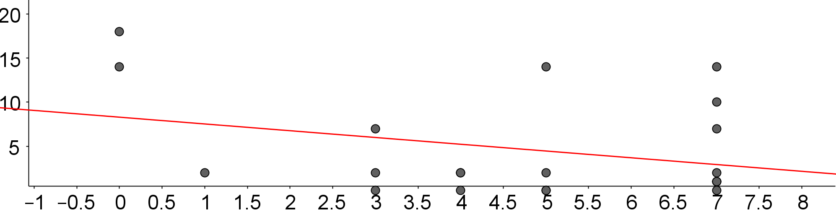
Window/Door
Exercise | Fast food
0 | 14
0 | 18
1 | 2
3 | 2
3 | 47
3 | 0
3 | 7
4 | 2
4 | 0
4 | 2
5 | 14
5 | 0
5 | 2
5 | 0
7 | 7
7 | 10
7 | 1
7 | 1
7 | 14
7 | 0
7 | 1
7 | 2
On our 1st day, I asked you how many days in a typical week you exercise, and I asked you how many days it’d been since you ate fast food. Can you predict fast-food habits with exercise habits?
r = -0.3121
r² = 0.0974
y = -0.77x + 8.3

Slide 8
GAUNTLET: “Wine & Heart Disease”
Groups of 3-4. Elect a Writer to do the worksheet.
After each problem (#1, #2, #3, #4, #5), show me.
  Thumb Up → Flawless.
  Thumb Down → At least one flaw. You get 1 point.
You get 2 Pointers. Can only be used in response to a mistake.
Winner = Group with least points.
  In case of tie, Winner = finished first.

Slide 9
Country | Alcohol from wine (liters/year) | Heart disease deaths (per 100,000)
Australia | 2.5 | 211
Austria | 3.9 | 167
Belgium | 2.9 | 131
Canada | 2.4 | 191
Denmark | 2.9 | 220
Finland | 0.8 | 297
France | 9.1 | 71
Germany | 2.7 | 172
Iceland | 0.8 | 211
Ireland | 0.7 | 300
Italy | 7.9 | 107
Netherlands | 1.8 | 167
New Zealand | 1.9 | 266
Norway | 0.8 | 227
Spain | 6.5 | 86
Sweden | 1.6 | 207
Switzerland | 5.8 | 115
United Kingdom | 1.3 | 285
United States | 1.2 | 199

Slide 10
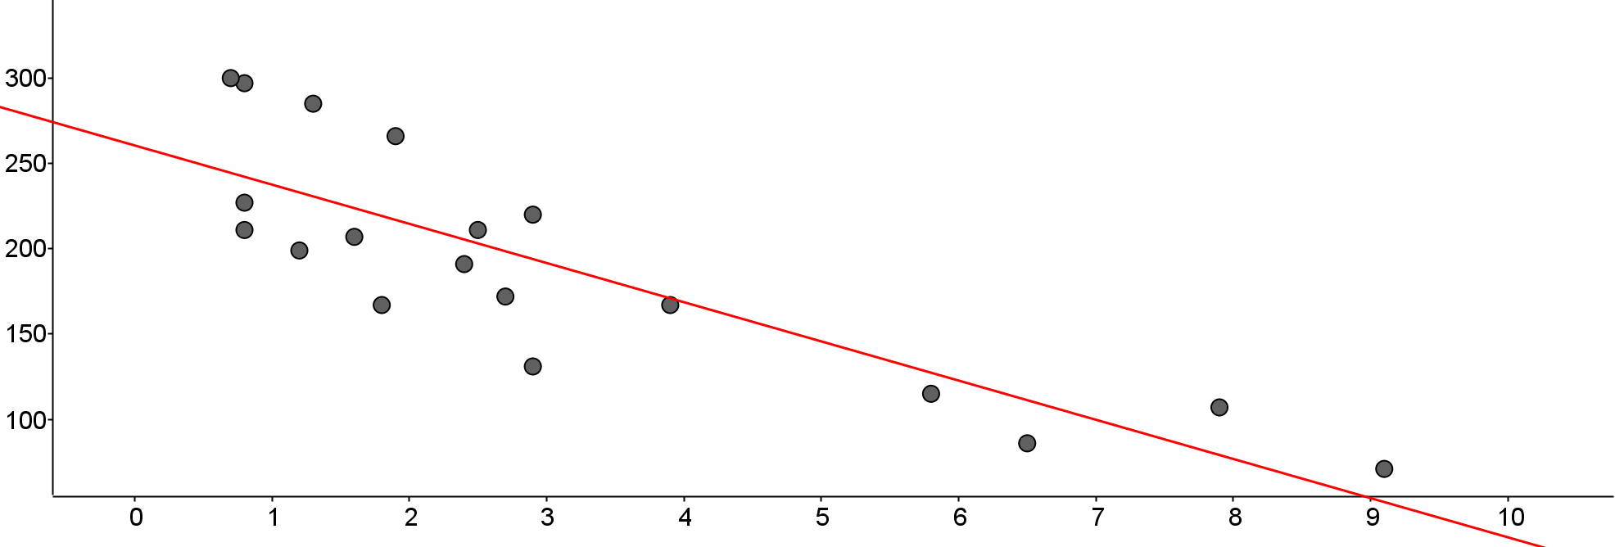
Wrong (forgot to check for outliers)
y = -22.97x + 260.56
r = -0.8428
r² = 0.7103

Slide 11
Correct
y = -24.64x + 263.99
r = -0.8095
r² = 0.6553

Slide 12
Course Request sheets
Counselors available both lunches today, tomorrow.
Important links:
  Department summaries → tinyurl.com/RCHS-catalog-summary
  Full course descriptions → tinyurl.com/RCHS-catalog-2020
  A-G catalog → tinyurl.com/RCHS-A-G-2020
Make sure to:
  Sign, and get your parent to sign.
  Read prerequisites.
  Choose backups carefully. Don’t leave them blank.
Bring to class TODAY, so I can check it.
Due to your period 2 teacher this Friday 2/7.

Slide 13
Study Hall
Work on your Project #2.
Work on your practice test.
I’ll be looking at your Course Request forms.

Slide 14
Exit Pass
Homework (AP)
Pg.192 #51, 53, 55
The regression equation y = 41.35 + 3.11x predicts a student’s height (y) based on their handspan (x).
Mr. Colligan’s handspan is 8.5 inches. Predict his height.
Mr. Colligan’s actual height is 75 inches. What is the value of his residual?
Notes:
67.785 inches
7.215

