Slide 1


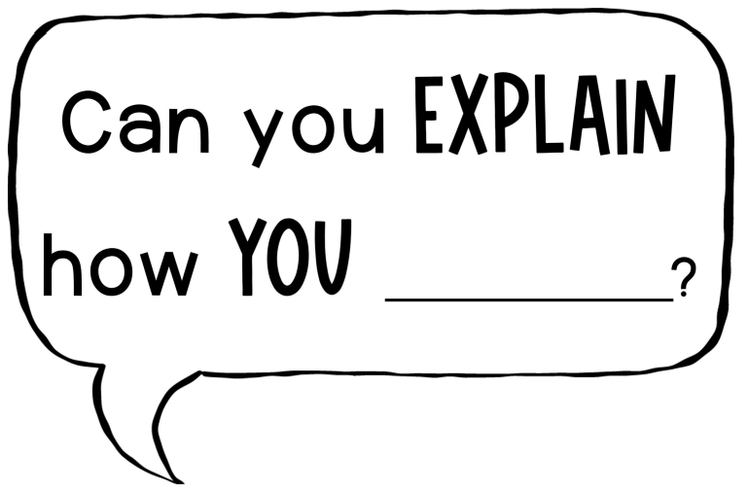

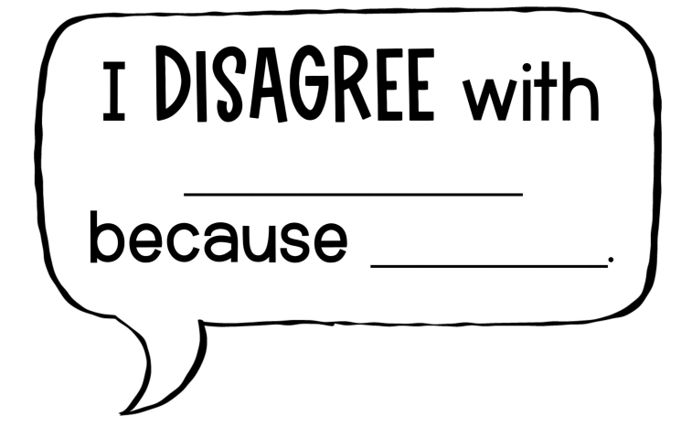





Notes:
Bubbles are borrowed from here: https://drive.google.com/file/d/1gpIM1QHJwl-sg9xQam2_4bWlTodL96Lg/view?usp=sharing

