Slide 1
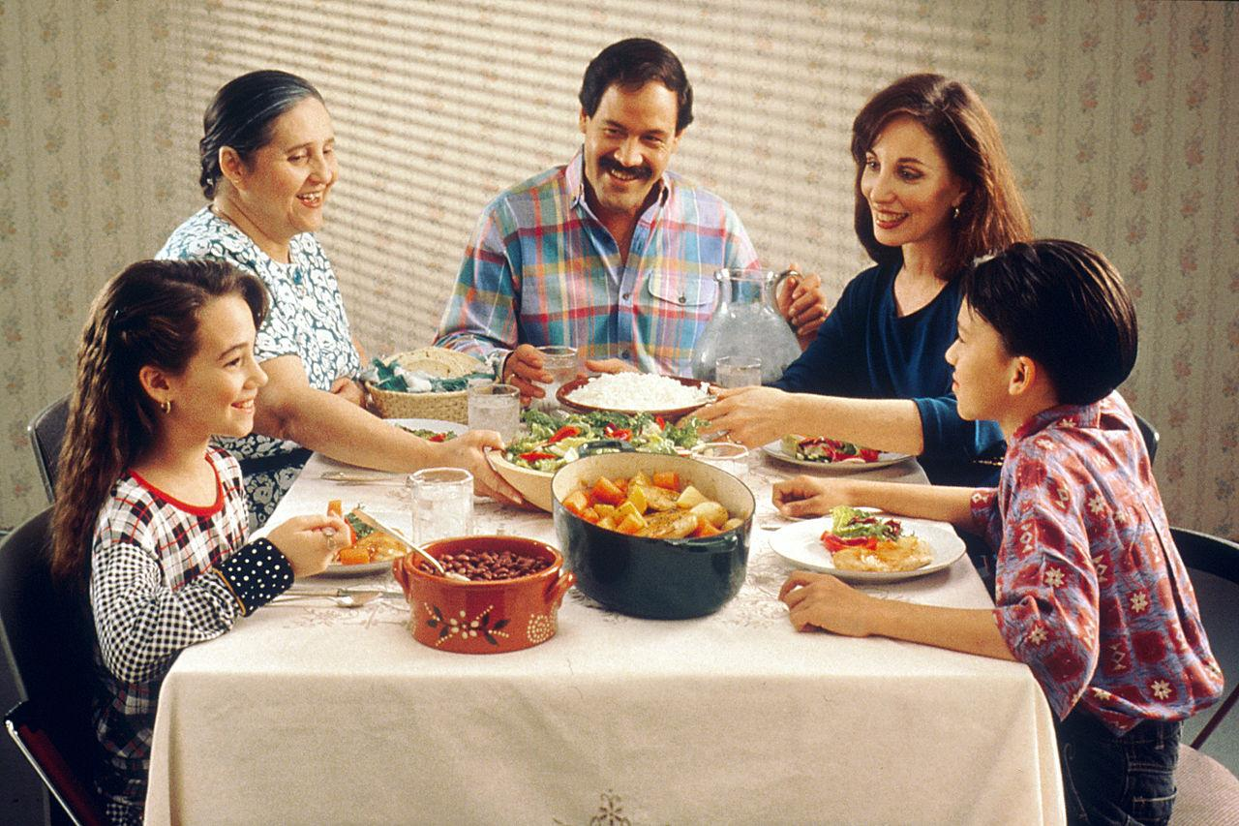
Kindergarten Weekly Newsletter
Week of March 21-25, 2022
Upcoming Events
3/22:Multi-Cultural Night @ 6:00 p.m.
3/22: Totally Tuesday-Silly Hair Day
3/24: Spirit Night at Papa Murphy’s
3/25: Report Cards go home
3/25: Spirit Night At Brusters 3 p.m.-7p.m.
3/28: Please sign report card and return Report of Learning Folder
March Challenge:
For the month of March please eat meals as a family. During this time, there should be no phones, TV, or technology. The focus should be on conversation skills.
Reading: Wonders Unit 8 Week 2
Phonological Awareness Skill: Changing in the last sound in a word to make a new word; ex: change the /t/ in pit to /g/ to make pig
Phonics: Identifying the letter Yy and Zz and applying the /y/ and /z/ sounds in words
Sight Word: what, words
Vocabulary Words: country, travel, careful, purpose, content
Comprehension: Identifying main topic and key details
Math:
Big Ideas Chapter 13
This week, the students will learn how to compare the height and length of objects. When we compare height, we use the words: taller and shorter. For example, the ladder is taller than the chair. The chair is shorter than the ladder. We use the words longer and shorter to compare length. For example, the table is longer than the placemat. The placemat is shorter than the table.
Important Information
Wow! It is hard to believe the Fourth Nine Weeks starts this week. The kids have come so far this year! I know it may seem like we are in the home stretch, but we still have several standards to master this school year. We will push hard until the final day of Kindergarten. The Third Nine Weeks Report Card will come home on March 25th. Reminder, please ensure your child gets a good night’s rest each night. We work hard each day and this will help your child successfully make it through the day.

