Slide 1
Mannerism
1527-1580

Slide 2
This time period’s style of art broke all the rules. It took fundamentals and ideas from the renaissance artists and enhanced them and exaggerated them.

Slide 3
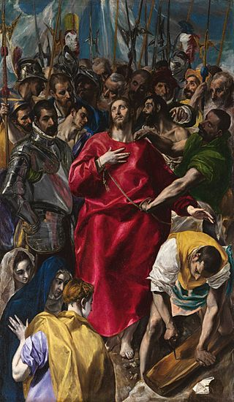
El Greco
His art was dramatic and expressive. It inspired works throughout the rest of this time period

Slide 4
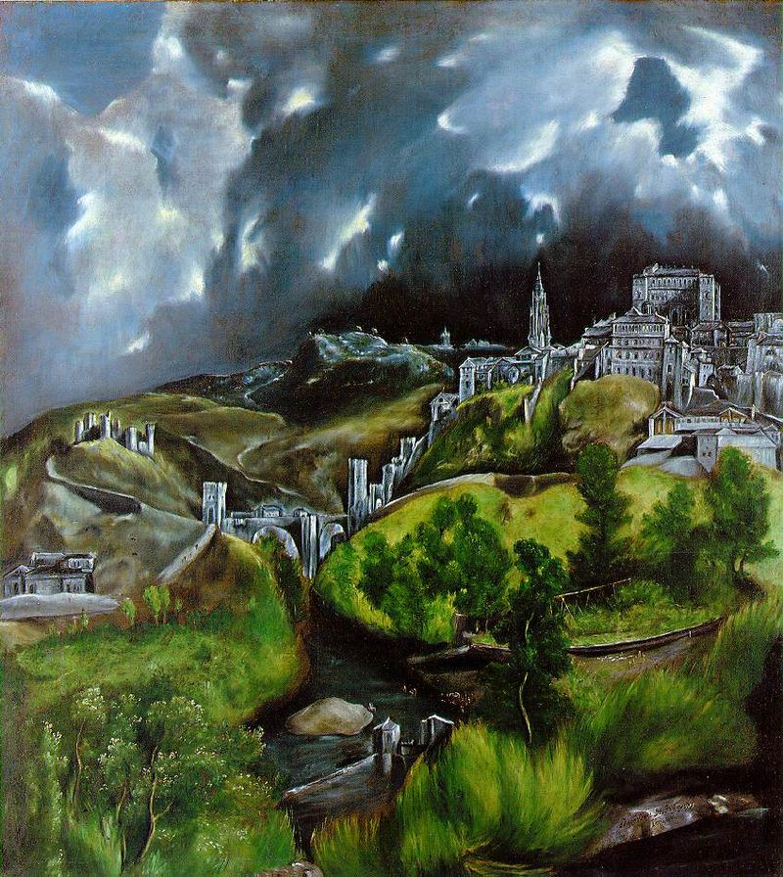

Slide 5
Pontormo
While renaissance painters liked balance and precision, Pontormo didn’t seem to care about it that much

Slide 6
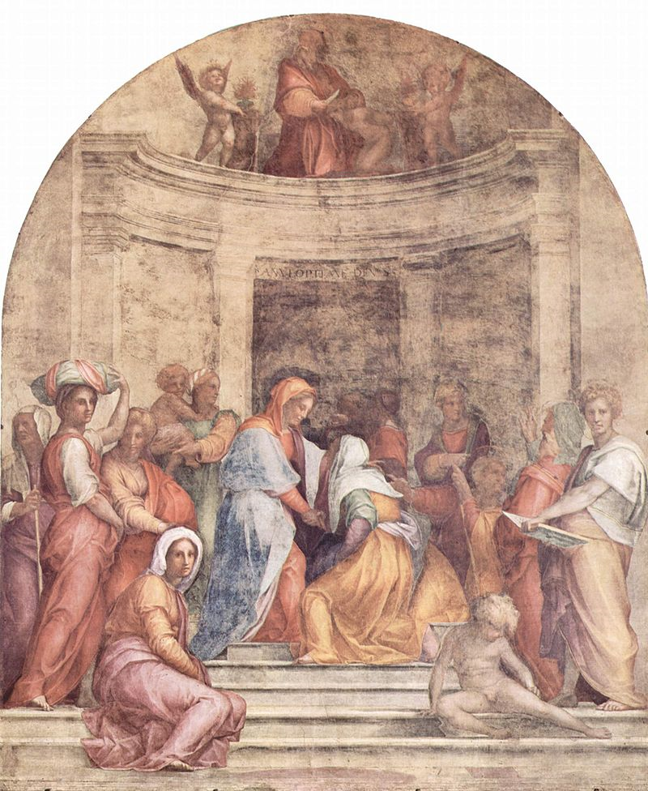

Slide 7
Bronzino
Worked as a portrait painter
Was inspired by Pontormo
Made his figures look relaxed and calm regardless of their true expressions

Slide 8
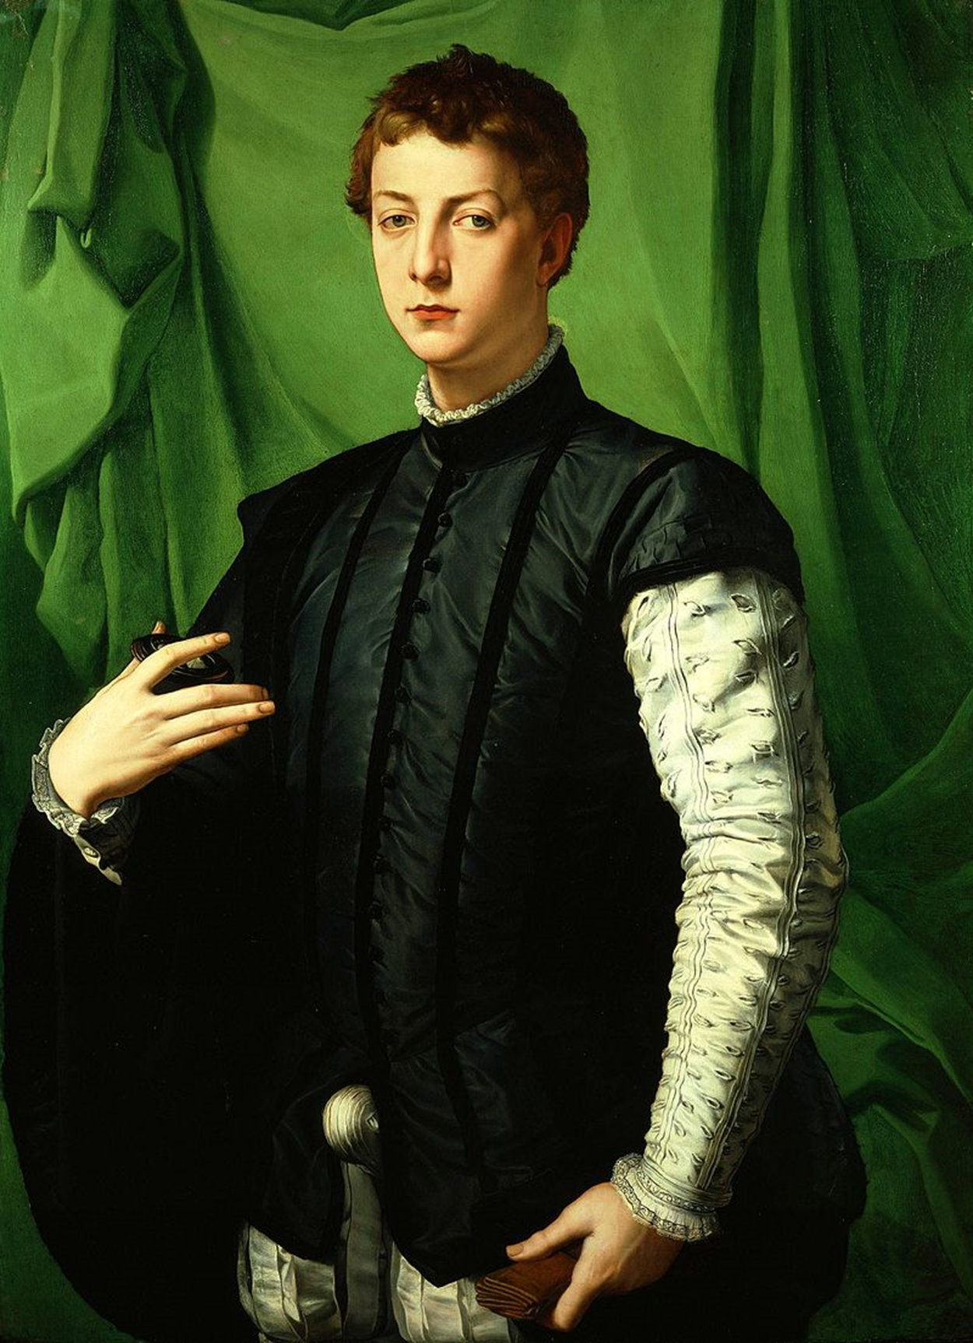

Slide 9
Cellini
Did a lot of sculptures
Was a goldsmith
One of the most important people from this time period

Slide 10
