Slide 1
Internet Safety
Grade 5

Slide 2
MAKE-UP Internet safety lesson
Directions:
Read the following presentation and watch the videos.
Write your name on your index card and answer the “Bob” questions at the end.
Turn your index card in to Mrs. Norton.

Slide 3

Tip #1: Guard your privacy.
Whenever possible, keep your personal information private.
  Name
  Home address
  Phone number
  Email address
  Photos
  Birthdate
  Passwords
  Etc.

Slide 4

Tip #1: guard your privacy, cont.
  Post-to-be-Private
  On social networking sites (Facebook, Instagram, etc.)…
  Set your profile to private.
  Only add friends you know in real life.

Slide 5
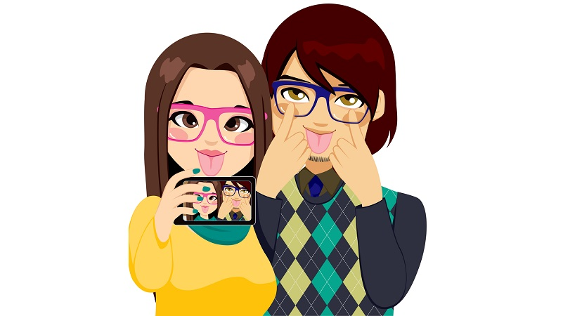
Tip #2: leave a positive digital footprint.
Profile Penalty
Post only information, photos, and videos that present your best self.

Slide 6

Tip #3: Apply the golden rule.
Terrible Text
Never respond back to rude or harassing comments.
Save the evidence.
Tell an adult you trust.

Slide 7

Tip #4: Be smart.
Friend or Fake
Do not agree to meet online friends face-to-face.

Slide 8

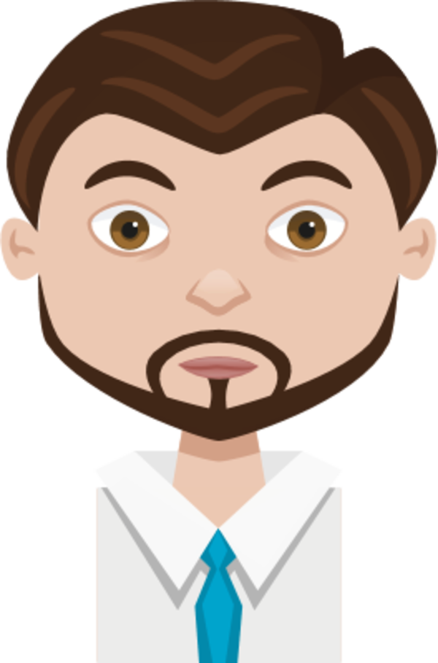

Tip #5: choose online activities wisely.
If you see or hear anything online that makes you feel uncomfortable, stop and tell an adult you trust.

Slide 9

Tip #6: watch the clock.
Don’t spend too much time online.
Get a real life!

Slide 10
“Bob” Questions:
When using social networking sites (Facebook, Instagram, etc.), you should use privacy settings. True or False?
Posting embarrassing photos or videos online is a good idea. True or False?
If you ever experience cyberbullying, you should pretend it isn’t happening. True or False?
It can be dangerous to agree to meet online “friends” in person. True or False?
If you see something online that makes you feel uncomfortable, talk to a trusted adult. True or False?

