Slide 1
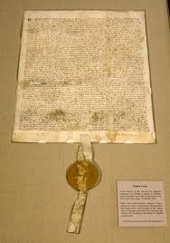
Magna Carta Close Read

Slide 2
Step One – Mark the Text
Number the paragraphs.
Circle key terms, names of people and places.
Highlight or box any unfamiliar words.
Underline the author’s claims, points, and relevant information.
At the end of your text, write your final impression on the impact of this historical text. Why does it matter?

Slide 3
Step Two – Complete the SMACCS Graphic Organizer
BELLWORK: As you come in, please take out your graphic organizer from Friday. If you were absent, please get a copy of the Magna Carta close read and SMACCS graphic organizer from the file in the back.
Take about 10-15 minutes to finish up the graphic organizer with your table groups.

Slide 4
Step Three – Compare the Magna Carta with the US Bill of Rights
*Use the copy of the Bill of Rights and complete a Venn Diagram or Double-Bubble Map.
*Include at least five items for all three parts of your graphic organizer.
*Also, include a brief response to these questions: How does this effect you, a normal American teenager? How is this important on a global scale?

