Slide 1
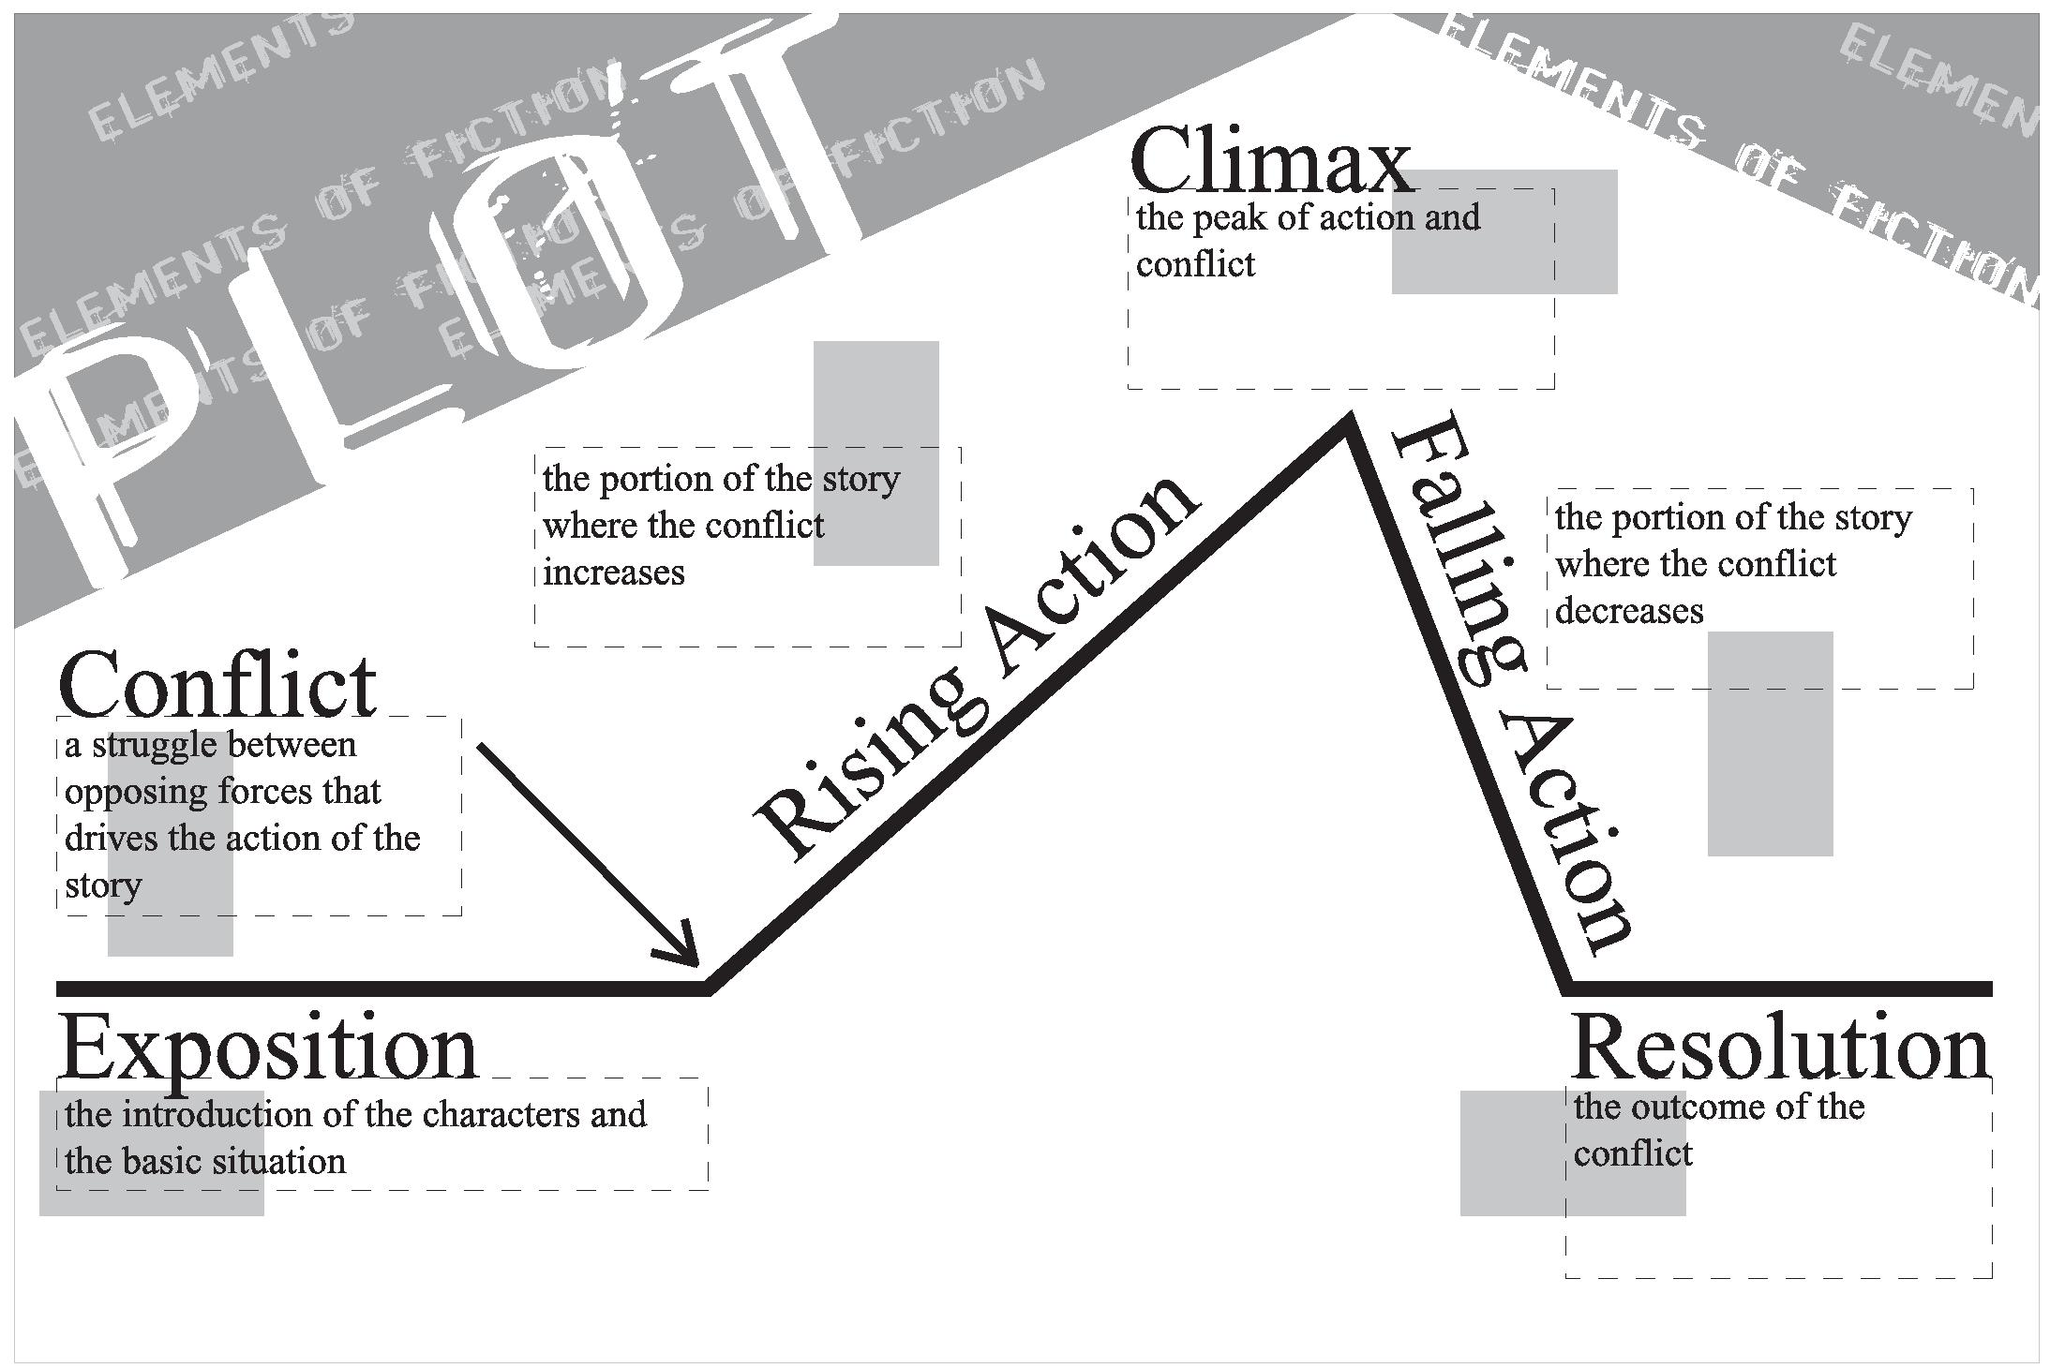

Slide 2
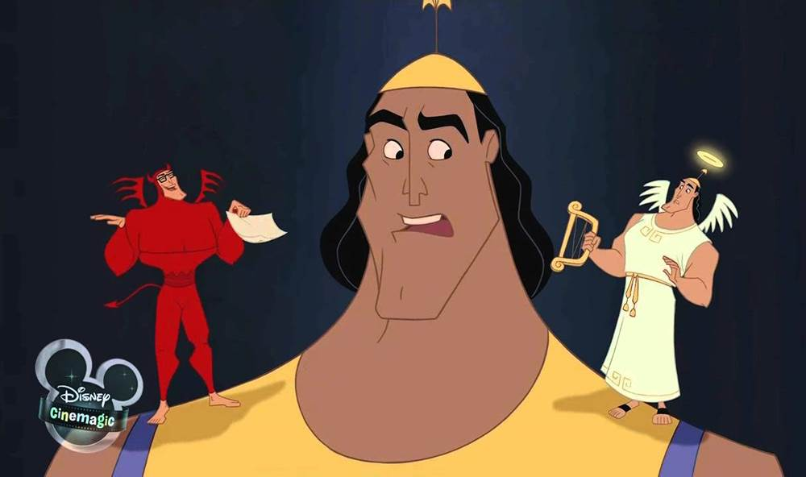
Conflict
Internal Conflict
  Person against self- a struggle that takes place within the mind of a character who is torn between opposing feelings or goals.

Slide 3
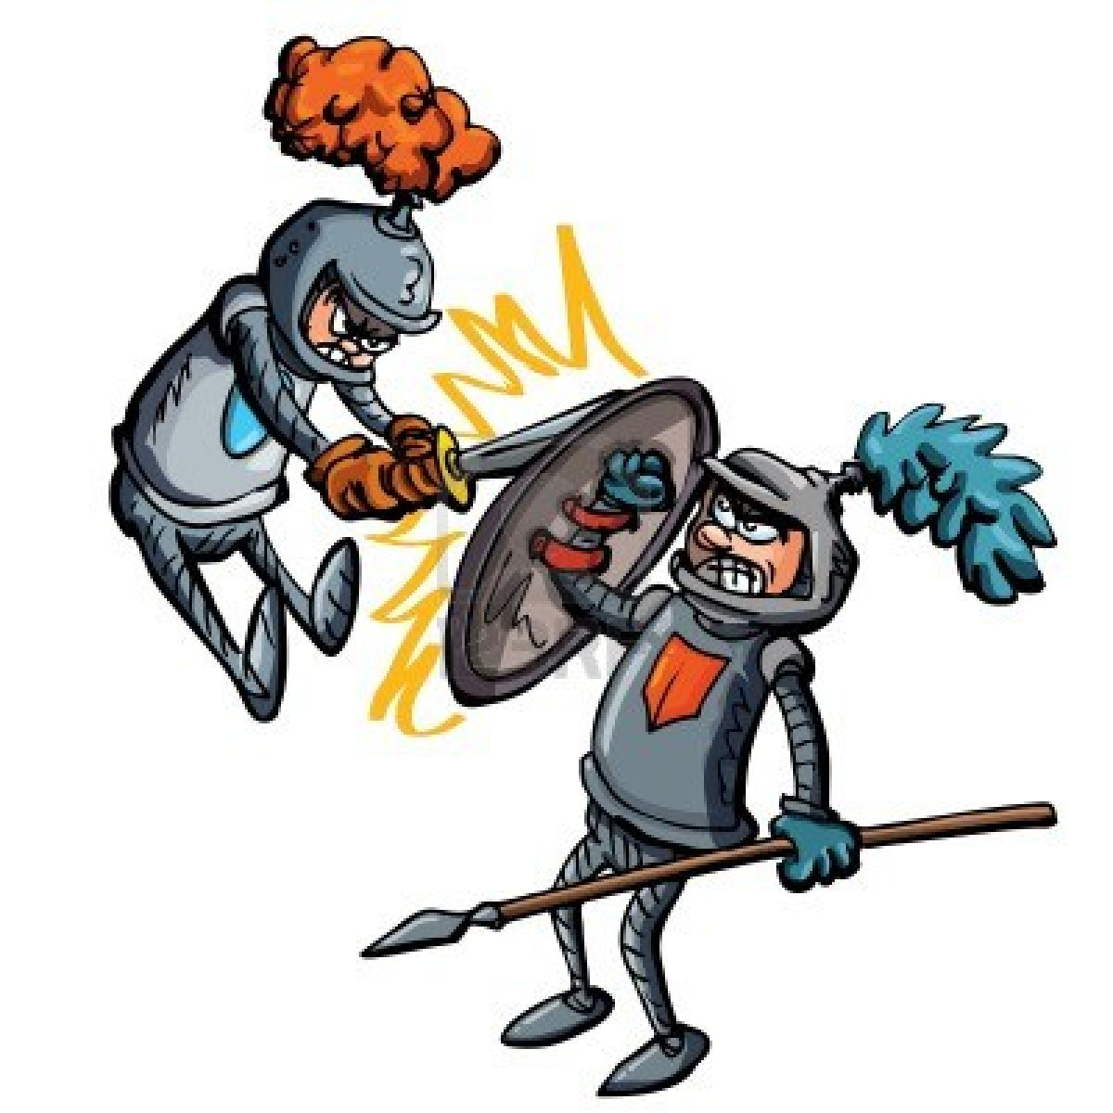
Conflict
External-exist when a character struggles against some outside force
  Person against person

Slide 4
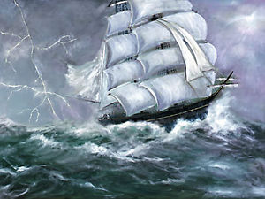
Conflict
External
  Person against nature- occurs when the main character is against the forces of nature

Slide 5

Conflict
External
  Person against society- takes place when the main character is opposing societies traditions or concepts

Slide 6

Conflict
External
  Person against Fate- occurs when the character attempts to break away from the path that has been made for them
https://www.youtube.com/watch?v=TrJJ6ncp1fc

Slide 7
Point of View
1st person
  First person narrative is a point of view (who is telling a story) where the story is narrated by one character at a time. This character may be speaking about him or herself or sharing events that he or she is experiencing

Slide 8

Point of View
3rd person
  3rd person limited- the narrator only knows the thoughts and feelings of a single character
  3rd person omniscient- the narrator knows the thoughts and feelings of all the characters in the story

Slide 9
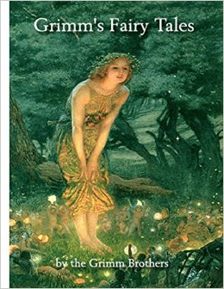
Theme
Theme is most important thing the author wants to communicate to the readers.
It is the general belief of how things are or how they should be.
The theme is the moral or lesson the story teaches.
https://www.youtube.com/watch?v=0heUJ5Q-skU

Slide 10
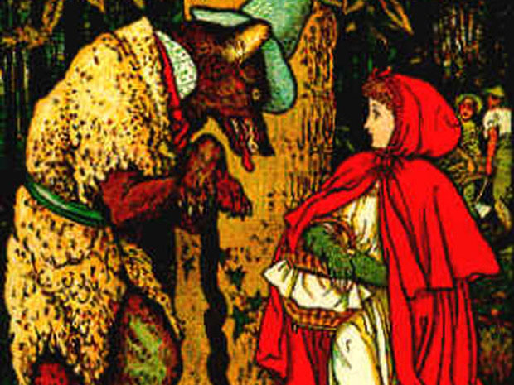
Theme Continued
A short story usually focuses on ONE theme. A novel can have multiple themes.
A theme can be specific to the story or it can be a theme found in many stories.
https://www.youtube.com/watch?v=Wyv5NnL2dcU

Slide 11
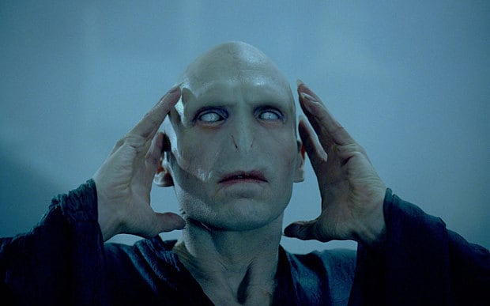
Flashbacks
Scenes that relate to events that happened in the past.
Often show what motivates a character, or reveal something important about a character’s past
https://www.youtube.com/watch?v=fassH-rsN5Q

Slide 12
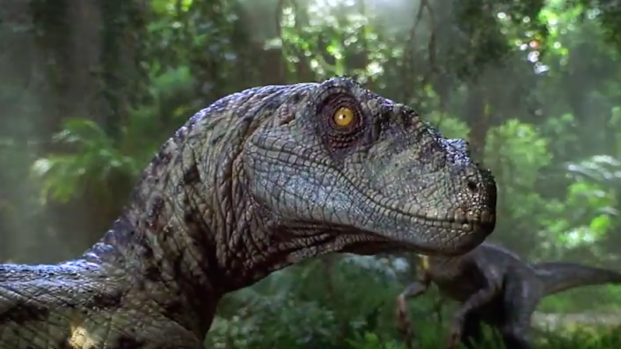
Foreshadowing
Through foreshadowing the author provides clues that hint at events to come.
Foreshadowing creates suspense by keeping a reader guessing what will happen
https://www.youtube.com/watch?v=imF-Ov1-Wfw

Slide 13
Tone
Tone is the attitude expressed in a work of writing.
Tone can be formal, informal, serious, comic, sarcastic, sad, cheerful, or any existing attitude
https://www.youtube.com/watch?v=317vQgEiNRE

Slide 14

Mood
The feeling or atmosphere that a writer creates for readers.
  Things that affect mood
    Setting
    Imagery (language that appeals to the senses: sight, smell, touch, hearing, taste)
    Characters’ Speech and Feelings about the situation
https://www.youtube.com/watch?v=SQq7XZ_Im34

