Slide 1
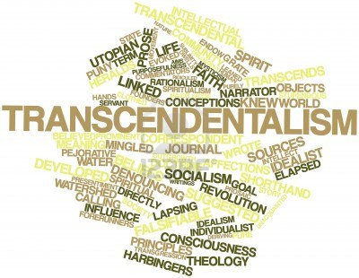
Transcendentalism

Slide 2
Literature Movements
Puritan and Early Settlement literature spoke mostly of:
  God and our role in society as His servants
  Factual information –
    what the land looked like
    how the Native American people acted
    what life in a strange new land was like

Slide 3
Balance of ideas in literature
Puritan/Early Settlement literature
GOD
MAN

Slide 4
Literature Movements
Rationalism and the Age of Reason Literature :
  Revolutionary Time Frame
  Still mostly fact-based literature
  Persuasive/Scientific in nature
  News articles were editorialized (LOTS and LOTS of opinions)
  Letters (LOTS and LOTS of letters)

Slide 5
Balance of Ideas in Literature
Revolutionary Literature
MAN
GOD

Slide 6
Literature Movements
Romanticism:
  Reaction to the Rationalism/Age of Reason movement
  In Europe and America
  Nature inspired the writers more than God
  Captured the energy and character of a new country whose frontier was expanding.

Slide 7
Literature Movements
Romanticism (cont.)
  Writers had a preoccupation with atmosphere, sentiment, and optimism
  Fascination with the Supernatural
  Washington Irving and Henry Wadsworth Longfellow were America’s most famous Romantic writers

Slide 8
Literature Movements
Transcendentalism:
  Distinctive to American Literature (imitations, but none as successful) and our most influential concept to modern writers
  Philosophy derived from German Romanticism
  “Transcendent forms of truth” existed beyond reason and experience

Slide 9
Literature Movements
Transcendentalism (cont.):
  The most famous transcendentalist writers were:
    Henry David Thoreau
    Ralph Waldo Emerson
    Walt Whitman
  Emerson said that every individual is capable of discovering this higher truth through intuition
  All of them turned their backs on material possessions to seek this “transcendent truth”

Slide 10
Balance of Ideas in Literature
Romanticism and Transcendentalism
MAN
GOD

Slide 11
The Concepts
Self-Reliance
Free Thought
Nonconformity
Confidence
Importance in Nature

Slide 12
Tenets of Transcendentalism:
Everything (Nature) is a reflection of God
A person’s instinct (intuition) can lead them to understand God’s spirit
Contemplating nature can allow you to transcend the real world and go to a higher, spiritual level (Expansion)
Individualism and self-reliance are better than following others or depending on tradition. (Contraction)
A person’s true feelings and intuition are more valuable than book knowledge.

