Slide 1
REALISM
&
NATURALISM
1865-1919

Slide 2
WHERE DID ROMANTICISM GO?
TRANSCENDENTALISM DARK ROMANTICISM
AMERICAN DREAM
NATURALISM

Slide 3
A BREAK FROM ROMANTICISM, REALISM IS AN EFFORT TO PORTRAY LIFE AS IT TRULY IS. WARRIORS, DEMONIC CATS, GHOSTS, AND MONSTERS GAVE WAY TO FARMERS, MERCHANTS, LAWYERS, LABORERS, AND BAKERS. WE SAW THIS WHEN WE READ WHITMAN’S “I HEAR AMERICA SINGING.” REALISM IN LITERATURE WAS A MOVEMENT TO FOCUS ON ORDINARY __________ AND __________.

Slide 4
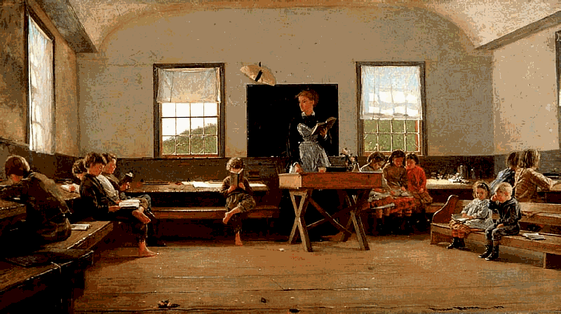
WHAT MAKES THIS A REALISTIC PICTURE?

Slide 5
CHARACTERISTICS OF REALISTIC FICTION
REALISTS TAKE THEIR SUBJECT MATTER FROM ORDINARY LIFE. _______ AND ______ CLASS CITIZENS WERE BECOMING INCREASINGLY IMPORTANT AND OFTEN WERE THE FOCUS OF MANY LITERARY WORKS (OF MICE AND MEN). _________ BECAME POPULAR TO REFELCT THE REGIONAL DIFFRENCES OF THE US.
REALISTS PLACED EMPHASIS ON ______________. AS INDIVIDUALS BECAME MORE IMPORTANT IN THE “REAL” WORLD, CHARACTERS BECAME IMPORTANT IN REALIST LITERATURE. CHARACTER, _________, IS THE ESSENCE OF REALISM LITERATURE.
REALISTS CONCERNED THEMSELVES WITH ETHICAL ISSUES. AS WITH ALL LITERATURE, THE CONFLICT OFTEN INVOLVES A ______________________ FACED BY ONE OF ITS CHARACTERS. THE DILEMMA IS PORTRAYED ACCURATLEY, HONESTLY, AND IN DETAIL.

Slide 6
TPQ: WHY DOES REALISM LITERATURE EVOKE SO MUCH INTEREST? WHY WOULD PEOPLE BE INCLINED TO READ REALIST WORKS AS OPPOSED TO ROMANTIC WORKS WRITTEN BY AUTHORS LIKE EDGAR ALLEN POE?

Slide 7
RAISE YOUR HAND IF YOU HAVE EVER MISSED A HOMEWORK ASSIGNMENT IN ANY OF YOUR CLASSES.
KEEP YOUR HAND RAISED IF THE REASON YOU FAILED TO TURN IN AN ASSIGNMENT WAS DUE TO CIRCUMSTANCES BEYOND YOUR CONTROL.

Slide 8
THOSE OF YOU WHO CONTINUED TO RAISE YOUR HANDS HAVE ALL JUST EXPERIENCED WHAT WE CALL NATURALISM!
TAKE A LOOK AT THE FOLLOWING POEM BY STEPHEN CRANE.
A MAN SAID TO THE UNIVERSE:
“SIR, I EXIST!”
“HOWEVER,” REPLIED THE UNIVERSE,
“THE FACT HAS NOT CREATED IN ME
A SENSE OF OBLIGATION.”
WHAT DOES THIS POEM SEEM TO SAY ABOUT HUMAN BEINGS’ RELATIONSHIPS TO THE UNIVERSE??

Slide 9
NATURALISM ‘S MAIN ASSUMPTION IS THAT EVERYTHING REAL EXISTS IN NATURE. LIKE REALISM, NATURALISM FOCUSES ON REALISTIC _________ AND __________. NATURALIST LITERATURE CONTAINS ORDINARY PEOPLE STRUGGLING AGAINST UNSEEN __________OVER WHICH THEY HAVE NO _______________.
ETHAN FROME IS CONSIDERED A NATURALIST PIECE! WHY?

Slide 10
HUMANS RESPOND TO THE NATURAL WORLD MUCH LIKE ________, REACTING TO NATURAL FORCES THEY NEITHER ________ NOR __________.
2. NATURALISM EMBRACES THE IDEA OF ____________, WHICH IS THE IDEA THAT HUMAN LIVES ARE CONTROLLED BY OUTSIDE FORCES.
3. HUMAN BEINGS ARE OFTEN PORTRAYED AS VICTIMS OF _____________ OR __________.
4. NATURALISTIC WRITERS PORTRAY NATURE AS _______________.
5. NATURALISTS STRIVE FOR OBJECTIVITY.
6. NATURALISTS ARE _____________ ABOUT HUMAN CAPABILITIES.
7/ LIFE IS A __________.
8. HUMANS ARE ANIMALISTIC AND DRIVEN BY PRIMAL INSTINCTS LIKE FEAR AND ________
WHO DO THESE NATURALISTS SOUND LIKE??

Slide 11
TPQ: WHY DO YOU SUPPOSE NATURALIST WRITERS WROTE OBJECTIVELY??

Slide 12
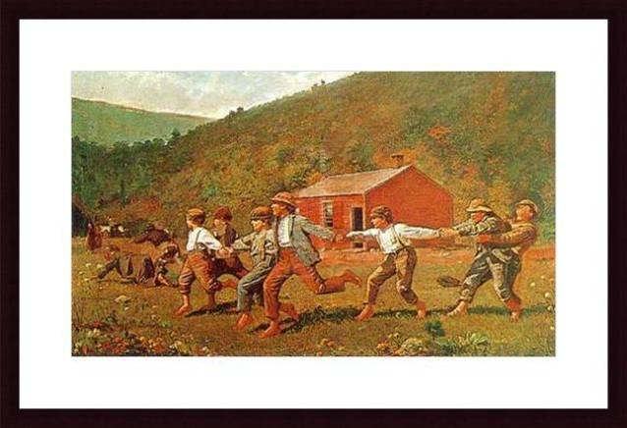

Slide 13
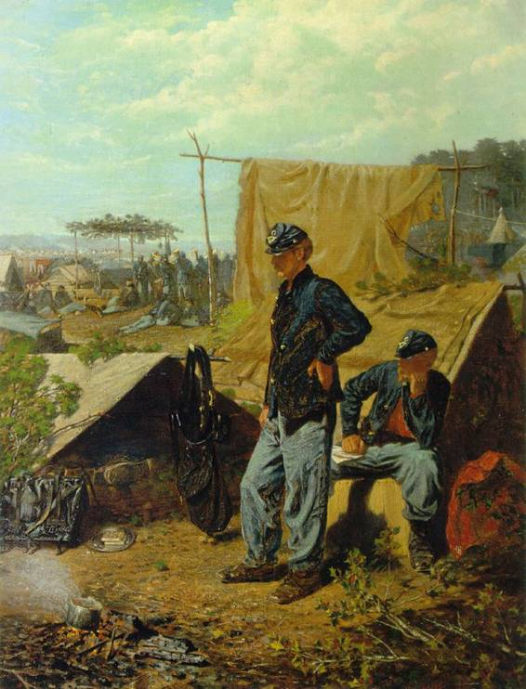

Slide 14
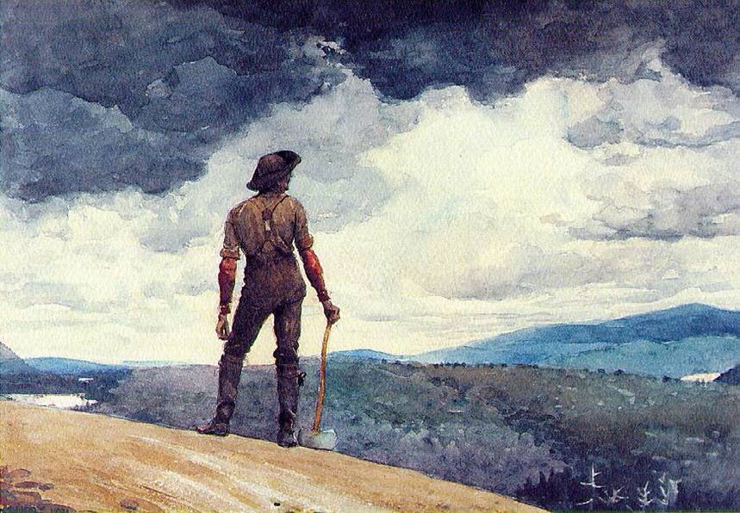

Slide 15
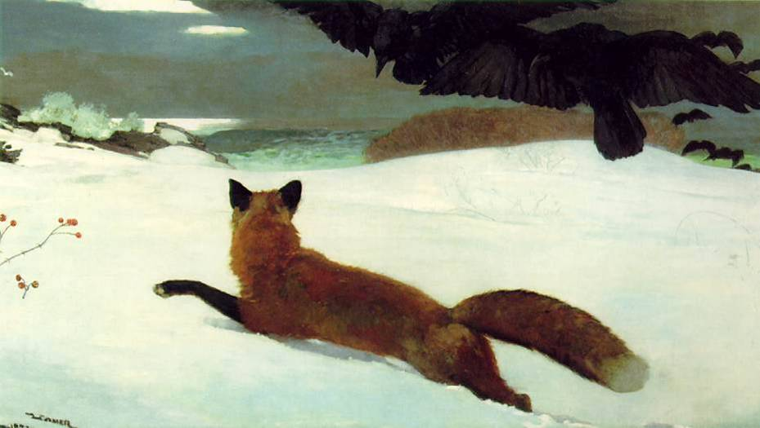

Slide 16
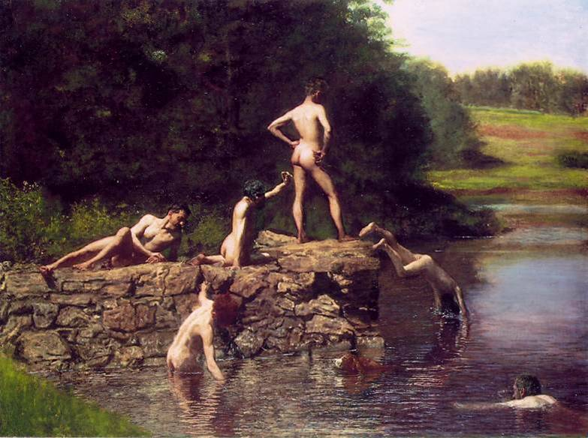

Slide 17
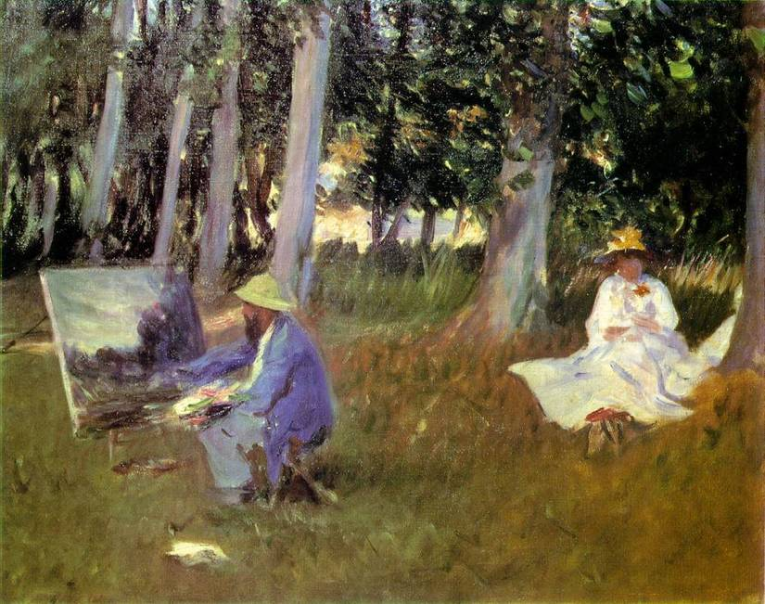

Slide 18
