Slide 1

f

Slide 2





Why Choose Sinclair?
ACCESSIBLE | 5 campus locations and online **Currently over 160 online courses
TRANSFERABLE | Over 100 transfer agreements with Ohio colleges and universities
PROGRAMS | Sinclair has over 220 Degree and Certificate Programs
SCHOLARSHIP | CCP Free to Finish! 24 completed credit hours at Sinclair with a overall 2.5 GPA.
Notes:
Accessible
We have 5 campus location in the Miami Valley/Greater Cincinnati Area: Downtown Dayton, Courseview in Mason, Englewood, Huber Heights and Centerville soon to open.
Transferable
We have two double degree partnerships with two area universities that will allow students to start at Sinclair and then transfer seamlessly. The established relationships are with Wright State and the University of Dayton, known as the UD Academy.
A number of the courses CCP students take fall under the Ohio Transfer Module (OTM) and will transfer to any 4-year state school in the state of Ohio
Programs
Sinclair offers over 200 Degree and Certificate programs. We offer both Career and Transfer degrees. Career degrees will allow students who complete them to enter the workforce in a skilled/technical field. A transfer degree allows a student to transfer to a 4 year school to finish their degree.
Scholarship
CCP students who complete 24 credit hours during their time as a CCP student and maintain a 2.5 GPA will receive the Free to Finish Scholarship. Students do not need to apply...it is automatically awarded and there is no limit to the number of students who can receive the benefit. The free to finish program is a last-dollar program - students will have all grant and scholarship monies applied to their accounts, and Sinclair will cover the rest of their tuition and fees.

Slide 3


New Sinclair CCP Student
STEP 1: APPLY
  ONLINE Sinclair CCP Application Apply at: apply.sinclair.edu
STEP 2: Determine ELIGIBILITY
  Accepted based on qualified scores OR high school GPA
  Need testing OR high school course completion information to determine course eligibility
Notes:
Our Application Process is 2-Fold
Students will need to complete their online CCP application
They will also need to complete a Parent and School Authorization Form
This will be completed by the parent and then by your school representative
After this information is received students/families will receive a letter detailing their next steps
Needs Testing- This will be a conditional admittance and students will still need to test college ready before registering
Accepted with information concerning registration and next steps

Slide 4
Am I Eligible For CCP?
Assessments at Sinclair
Statewide Test Scores
Cumulative HS GPA of 2.75 or above
HS English & Math course completion information for course placement
English & Social Sciences
• An ACT score > 18 in English or
SAT score > 480 in English, or
•WritePlacer > 5
Math & Science
An ACT score > 22 in math or
SAT score > 530 in math, or
• ALEKS > 46
Notes:
Discuss the testing requirements and what scores are considered college ready
Discuss that it is ok if you have not taken the ACT/SAT’s, we offer a placement test.
Standard Error of Measurement
Students who do not test “college-ready” still have options
ACT English 16-17
ACT Math 20-21
Writeplacer 4
ALEKS 40-45
Must have a 3.0 cum. GPA or a letter of recommendation from a counselor, administrator or career tech advisor
Discuss the 28 Steps to Really College Ready Student (on shared drive)

Slide 5

Next Steps
Registering for Courses
  Selecting Courses
Key Dates:
  Letter of Intent - April 1
  Application - May 1
APRIL
1
MAY
1
Notes:
Sinclair offers two in-person orientations and an online orientation. Students need to complete this orientation to ensure they are prepared for their college career. Parents can also go through the online orientation.
Once you have determined completed the application and admission process and tested for readiness, you will want to register.
Before Registering consider the following:
College advisors will help students know which courses they can take
Based on assessment scores
Based on course prerequisites
Courses can satisfy high school graduation requirements
School counselors can help students understand requirements and course substitutions
Courses must be college-level or non-remedial
Courses must be nonreligious

Slide 6

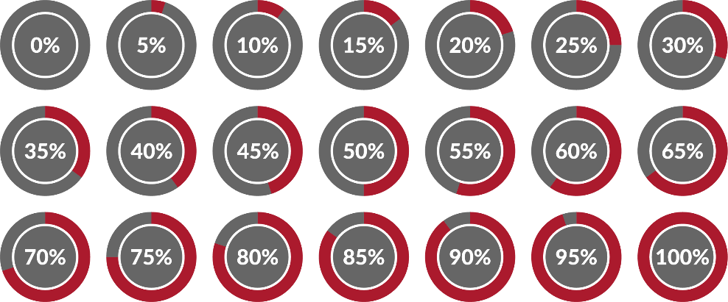


Sinclair CCP Students Succeed
Students graduated from Sinclair BEFORE graduating from high school in 2022.
Of CCP students receive passing grades and earn college credit.
70
91%
59,514
CREDIT HOURS
were awarded
AY 2021-2022
8,245 students enrolled
Notes:
Improved outcomes and student learning are central to what we do…
We want our high school students to do well and they are doing just that – 90% earned a passing grade and received credit
They are actually outperforming all other Sinclair students which signals to us that they have the academic, social and emotional skills to take on college level work.
They are graduating and continuing – 40 graduates this past year

Slide 7
Sinclair CCP at Eaton High School
Fall
BIO 1121 – Human Anatomy & Physiology I
ENG 1101 – English Composition I
LIT 2211 – American Literature I
Spring
BIO 1122 – Human Anatomy & Physiology II
ENG 1101 – English Composition II
LIT 2212 – American Literature II

Slide 8

Jillian Sacha • Phone (937) 512-4416 • Fax (937) 512-3310 jillian.sacha@sinclair.edu
College Credit Plus Office

