Slide 1

Welcome to Registration for 2023-2024
Please open Clever
Open Xello
Click the circle/emoji in the top right corner next to your name
Open the attachment in MESSAGES to see your credit check
Notes:
Any students interested in Running Start should attend the information meeting held at________

Slide 2
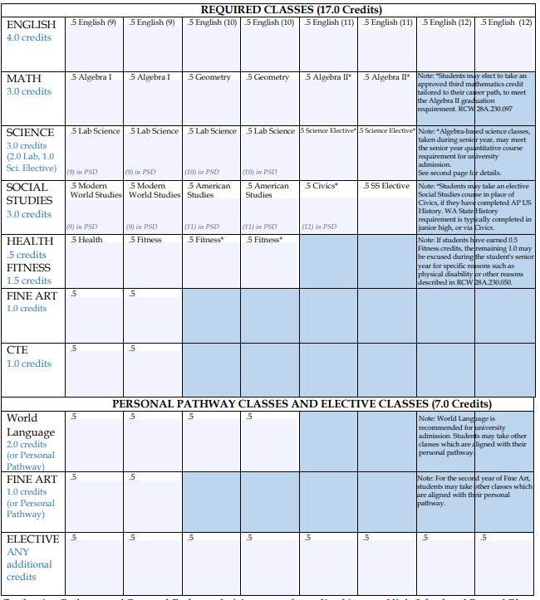
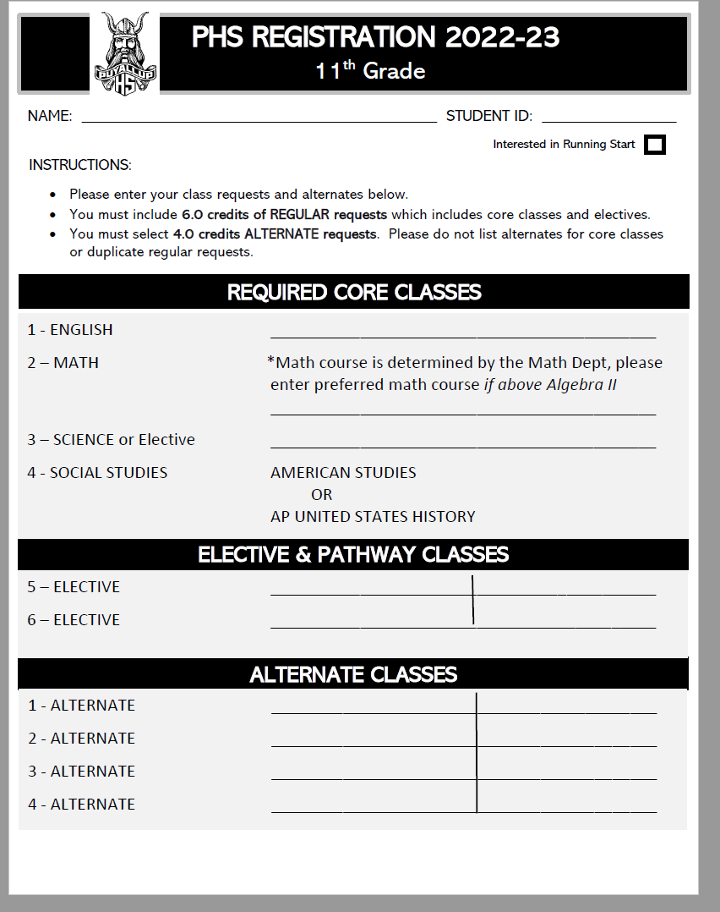

Slide 3
Physical Fitness (.5 credit)
.5 credit/ 1 semester of Fitness is required for all students – no exceptions
1.5 credits of Fitness is shown on the credit check. Students may replace 1.0 (2 semesters) of Fitness if they are not able to fit them into their schedule due to post high plan requirements.
In order to replace .5 or 1.0 credits of fitness, students must pass a Fitness CBA exam related to physical health and fitness. Students may take the CBA exams in Junior year. Visit Student Services for more information.

Slide 4
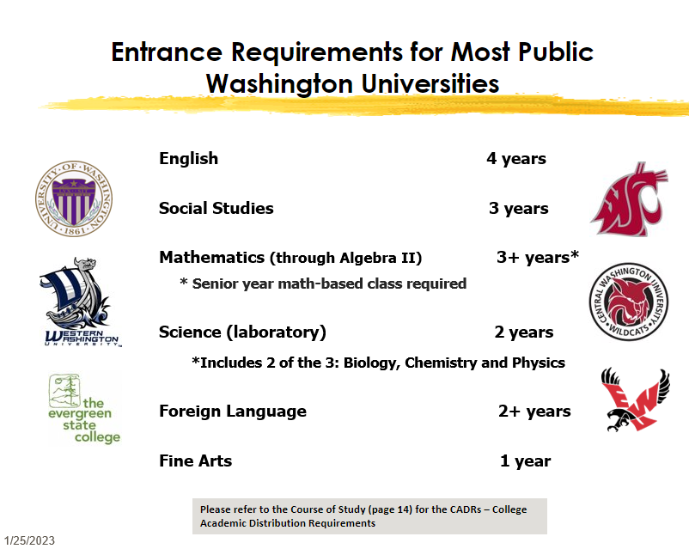

Slide 5

Open HAC (Home Access Center)
This video demonstrates how to add classes in HAC:
PSD Registration HAC Tutorial
If you cannot find a class, look in CTE

Slide 6

Select English
Select the English option that you plan to take next year.
  English IV (regular Senior English)
  AP English Literature
  Bridge English Language Arts
  Interested in AP Seminar? Select English IV, AP English Literature, or Bridge ELA and submit AP Seminar application by February 28th. Application available on the Registration page of the PHS website.
  AP Research *should only be selected by students who have successfully completed AP Seminar

Slide 7

Social Studies
All students must complete 3.0 credits of Social Studies
Seniors must take either:
  AP Government Politics US or
  Civics & .5 Social Studies elective
  (if you did not take or pass World Studies 9th grade – you must take CWP specifically)
Semester Social Studies electives:
CWP, Anthropology, Psychology, Social Justice, World Geography
Yearlong Social studies electives:
AP Psychology, AP World History, AP Macroeconomics
A.P. courses, including A.P. U.S. History and A.P. U.S. Government and Politics, require regular nightly reading and note-taking, but provide powerful growth opportunities, and that includes students who are new to A.P. courses

Slide 8

Mathematics –Year Long
You may take Financial Literacy or a CTE math course in place of Algebra II
Algebra II is required for admission to college
Math teachers place students in math through Algebra II
If you have completed Algebra II, you may choose to take:
AP Pre-Calculus (Accel. Alg II pre-req)
AP Calculus (Pre-calc pre-rec)
AP Stats (Algebra II pre-req)
Math in Society (Algebra II pre-req)
Math 152- Algebra III (Algebra II pre-req)
Financial Literacy (can be an alternate for Algebra II)
CTE Math options: Computer Science, STEM, Auto

Slide 9
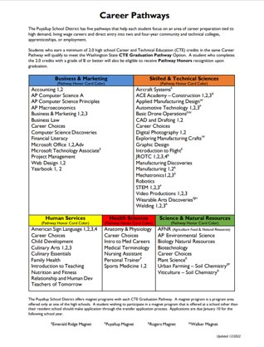
Graduation Pathway
Through homeroom, you should have checked your graduation pathway in Xello.
Must meet Grad Path in both ELA and Math.
Could meet through SBA, CTE path or other alternatives. If not met at this time, check for CTE Grad path option!

Slide 10

Raise your hand to check out with a counselor
You need to have a total of:
  Selected 6.0 credits of requests
  Selected in 3.0 credits of Alternates
Be sure you included:
  English
  Civics & .5 Social Studies elective or AP Government
  Math and/or Science if not completed
Review your grad check to see your remaining requirements
To make a class an Alternate – select the course then use the drop-down box to make it an Alternate to any course

