Slide 1
Bellringer
On the notetaking guide in the designated space, list as many types of figurative language that you can recall.
Use your list to create a definition
for figurative language.

Slide 2
Outcome
I can engage in table discussions by responding to my peers’ with:
  relevant ideas,
  observations,
  and evidence.

Slide 3
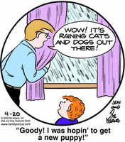
What’s the cause of confusion?

Slide 4
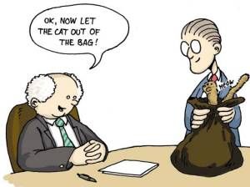
Figurative Language . . .
does not mean exactly what it says.
forces the reader to make an imaginative leap in order to comprehend an author's point.
Typically involves connections between dissimilar things.

Slide 5
Some Types of Figurative Language
Simile
Metaphor
Personification
Idiom
Symbolism
Allusion
Imagery
Alliteration
Oxymoron

Slide 6
So, what is an allusion anyway?
Definition:
A reference to a well known person,
event, or literary work for an
intended effect.

Slide 7
Identify Allusions
Text: “I don’t like to hang around with Byron. He’s such an Eeyore.”
Identify the allusion
Characteristics of what is being alluded to
Connect back to text
I can identify and analyze the impact of allusions within a text.

Slide 8
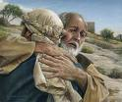
The allusion is to the prodigal son, a
Biblical parable [story] found in the
Bible.
Many stories in the Bible serve as
allusions in literature.
The prodigal son’s father welcomed
him home and gave him the best of
everything even though he asked for
his inheritance early, treated
his father with disrespect, and left home to
squander away his inheritance.
www.waysoflife.info

Slide 9
Identify Allusions
“Like the prodigal son, he returned to his hometown and was welcomed by all who knew him.”
Identify the allusion
Characteristics of what is being alluded to
Connect back to text
I can identify and analyze the impact of allusions within a text.

Slide 10
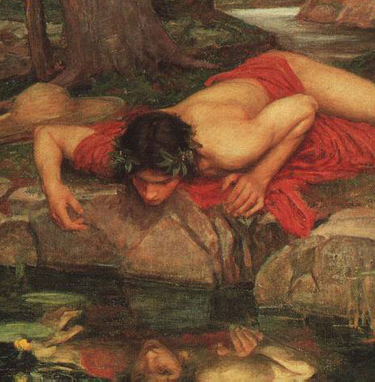
Identify Allusions
Text: Brooks’ poem “Narcissa”
Identify the allusion
Characteristics of what is being alluded to
Connect back to text
I can identify and analyze the impact of allusions within a text.

Slide 11
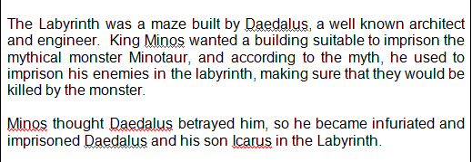
Daedalus and Icarus

Slide 12
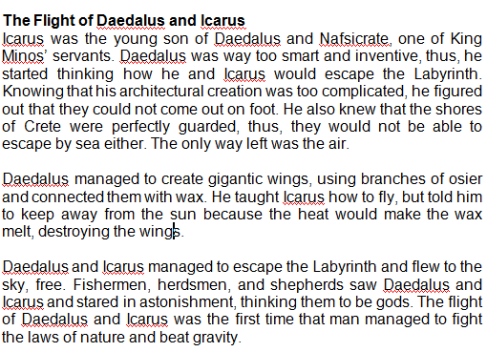

Slide 13
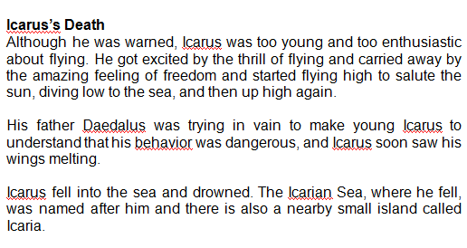

Slide 14
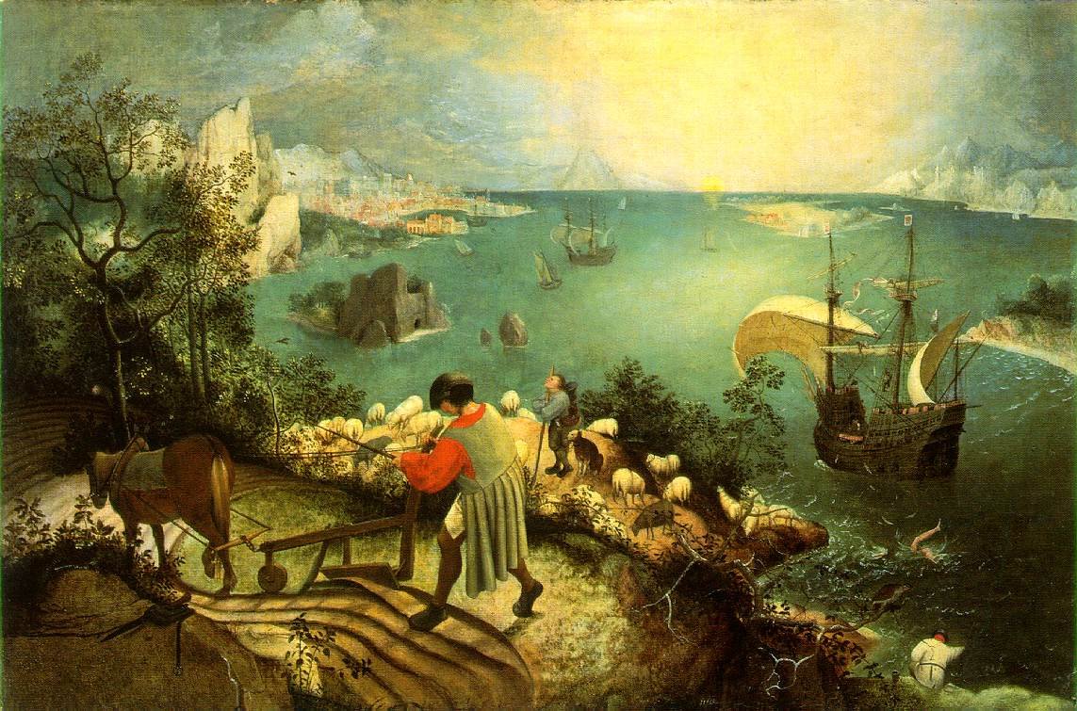
“The Fall of Icarus” by Pieter Brueghel, (1558)
I can identify and analyze the impact of allusions within an image or text.

Slide 15

Closure
1. Observe the image closely.
2. Record your connections between the myth and the image.
3. Analyze the impact of the allusion within the image

Slide 16
Independent Time
Complete closure ticket:
1. Observe the image closely.
  2. Record your connections between the myth and the image.
  3. Analyze the impact of the allusion within the image
Keep closure ticket with you to discuss at the end of class.
Check Powerschool or your Progress Reports to makeup missing work or quizzes
Read independently to practice the skills from class.

Slide 17
“The Fall of Icarus” by Pieter Brueghel, (1558)
I can identify and analyze the impact of allusions within an image or text.

