Slide 1

Groundwater Values and Biomonitoring in Minnesota
James Kelly, M.S.| Manager, Environmental Surveillance & Assessment
July 12, 2018

Slide 2
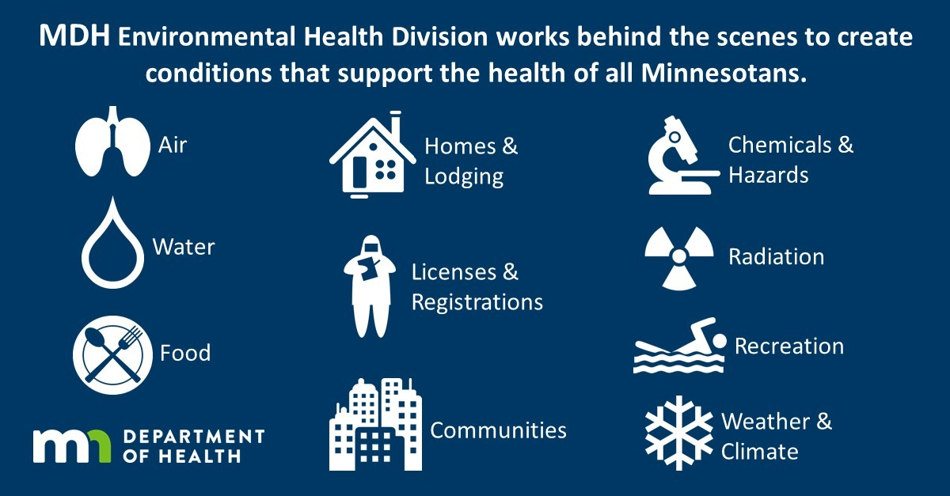

The MDH Mission - Protecting, maintaining, and improving the health of all Minnesotans.
Notes:
Why we do what we do in Minnesota – our approach is a result of mission, values of the health department.

Slide 3
MDH Water Guidance
1989 Groundwater Protection Act
  Requires MDH to protect public health by developing human health-based values for contaminants found in Minnesota’s groundwater as the result of human activity. Goal is to protect this resource as a potential source of drinking water.
    Health Risk Limit (HRL) – a concentration of a chemical, or mixture of chemicals, that is likely to pose little or no risk to human health.
    [Based solely on health effects & does not consider cost, technology, etc.]
HRLs are promulgated in rule. Application/use is not specified in rule but is determined by individual regulatory programs
Guidance values are derived between rule promulgations:
  Health Based Value (HBV): are ‘rule in waiting’- follows HRL derivation methodology
  Risk Assessment Advice (RAA) - ↑ uncertainty, use of surrogate, or different methods
Notes:
USE –
Used to inform well advisories on private wells
Used to inform cleanup goals at contaminated sites
Used to make recommendations at public water systems in the absence of USEPA MCLs

Slide 4
2017 PFAS Water Guidance
PFAS | Health Endpoints¹ | Water Guidance (µg/L) 2017 Previous
PFBA | Liver and Thyroid | 7 | 7
PFBS | Developmental, Female Repro system, and Thyroid [blood system & liver no longer listed] Kidney | 3 short-term & subchronic 2 chronic | 7
PFHxS | (see PFOS) | (see PFOS)
PFOA | Developmental, Liver, Immune, and Kidney | 0.035 | 0.3
PFOS | Developmental, Liver, Immune, Liver, and Thyroid | 0.027 | 0.3
¹Used in additivity (mixtures) assessments
More information can be found at: http://www.health.state.mn.us/divs/eh/risk/guidance/gw/table.html
Notes:
Guidance – all were re-evaluated in 2017 & all but PFBA were lowered due to new tox and/or expo information. Currently these are all HBVs, however, PFOA and PFBA are in a HRL rules revision effort and should be HRLs later this year. PFOS and PFBS will be taken through the next rules revision. PFHxS – may be in next rules revision, depending upon quality of data.
The drop in values was largest for PFOA and PFOS. I would like to briefly highlight the reasons for this large change. . . Using PFOA as the case example

Slide 5

MDH – Water Guidance
Standard HRL/HBV Equation:
$$\text{HBG}\left(\frac{μg}{L}\right)=\frac{\text{RfD} \left(\frac{mg}{kg∙day}\right) × \text{RSC} × 1000\frac{μg}{mg}}{\text{IR}\left(\frac{L}{kg∙day}\right)}$$
RfD (Reference Dose) – represents a dose at which there is little or no risk of health effects
(for PFOA and PFOS this dose is best represented by a serum concentration)
RSC (relative source contribution) – do not want total exposure to exceed RfD so you need to account for non-water sources of exposure (e.g., diet)
IR (Intake Rate) – how much water someone drinks
Notes:
First a bit of background to get everyone on the same page and familiar with terms
This is the standard equation that is used to derive water guidance for noncancer endpoints.
Three factors:
Measure of Toxicity – this is usually represented by a reference dose (RfD) – in the case of PFOS and PFOA – which are bioaccumulative chemicals, serum, a measure of internal dose, is used
Intake Rate - how much water someone drinks
RSC (relative source contribution) – to account for non-water ingestion sources of exposure

Slide 6
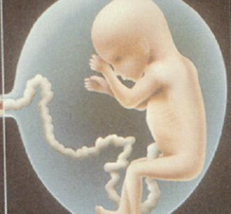

Multiple Exposure Concerns
Impact of Bioaccumulation Potential
  Long half-life results in exposures, even short duration, to stay in body for years beyond period of external exposure
  Repeated exposures lead to accumulation (build-up) within the body
  Water concentrations in ppt result in serum concentrations in ppb
  Much higher intake rates in early-life
  Accumulated levels can be transferred to offspring
    Placental transfer* (PFOA ~60 to 200%)
    Breastmilk transfer* (PFOA ~2.6 - 12%)
* Empirical Cord:Maternal serum ratios reported in literature
** Empirical Breastmilk: Maternal serum ratio reported in literature

Slide 7
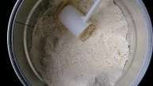
Toxicokinetic Model Scenarios
Formula-Fed Infant
Breast-Fed Infant
Maternal Serum Concentration
(steady –state)
Clearance (t½)
Maternal Serum Concentration
(steady –state)
Placental Transfer
(42% PFOS/87% PFOA)
Placental Transfer
(42% PFOS/87% PFOA)
Clearance (t½)
Neonatal Serum Concentration
(birth)
Neonatal Serum Concentration
(birth)
Breastfeeding
(1.3% PFOS/5.2% PFOA)
Formula Fed
Contaminated Water
Contaminated Water
Infant Serum Concentration
(>birth to 1 yr)
Offspring Serum Concentration
(>birth to steady state)
Clearance (t½)
Offspring Serum Concentration
(>1 yr to steady state)
Clearance (t½)
Clearance (t½) (t½ 5.4 yrs)
Notes:
We identified two exposure scenarios for evaluation – # formula-fed infant and breast-fed infant
# -both scenarios start the same way - - mother drinking contaminated water and serum levels at steady-state levels when she gives birth
# –At birth the infant serum level is a portion of the maternal serum concentration as a result of placental transfer
#- the formula fed infant is exposed to contaminated water starting at birth and continuing through life.
#5 – the breast-fed infant consumes breast-milk for the first year of life, followed by consuming contaminated water through life
**NOTE: the transfer values identified here represents ~mean values, based on published studies
And
Model was developed with feedback from external experts

Slide 8
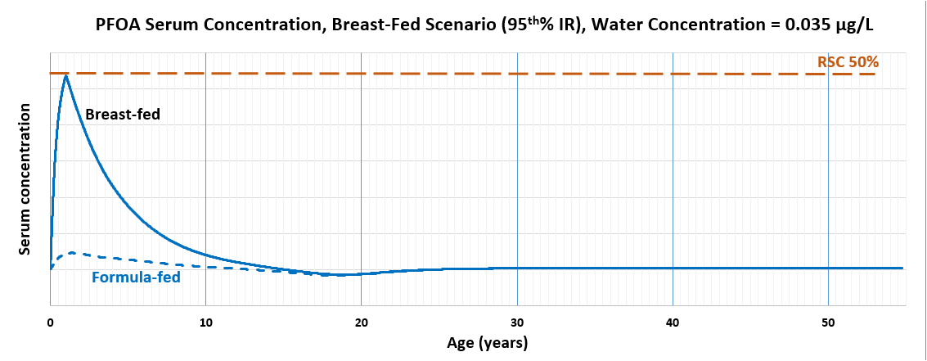
Incorporation of Exposure via Placental & Breastmilk Transfer
(Serum ~ 65 μg/L)

Slide 9
MDH Guidance Summary
Based on protection of susceptible & highly exposed populations
Protective for tap water used for drinking, cooking, showering, and other uses
Cumulative – additivity assessment of chemicals with similar health endpoints
  e.g., Liver
  XX µg PFBA/L* + XX µg PFHxS/L* + XX µg PFOA/L* + XX µg PFOS/L* = Health Risk Index
  PFBS HBV PFHxS ‘HBG’** PFOA HBG PFOS HBG
* Detected drinking water concentration
**Currently using PFOS as an interim substitute
Reassessing new PFOS information (e.g., half-life)
Breastfeeding can be a significant exposure pathway for PFHxS, PFOS, and PFOA.
However, breastfeeding is important for the short and long term health of both a mother and infant.
MDH recommends that women currently breastfeeding, and pregnant women who plan to breastfeed, continue to do so.

Slide 10
Biomonitoring Investigations
Funded by the 2007 Minnesota Legislature
Measured blood levels of 8 PFAS chemicals in two groups of East Metro residents:
  149 long-term residents of Oakdale, Lake Elmo, and Cottage Grove who were exposed to PFAS in drinking water before the intervention and participated in past studies, and
  156 new Oakdale residents who moved to the area after the intervention.
Levels were highest in those who lived longest in the area before treatment was installed

Slide 11
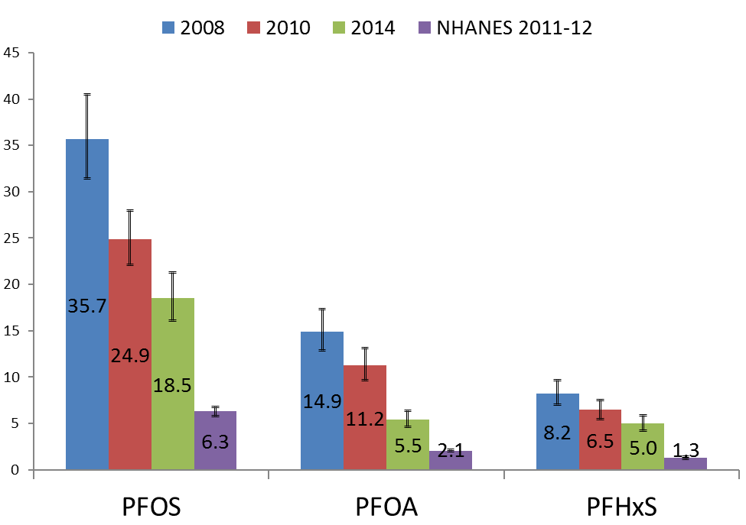
Biomonitoring Data Shows Interventions are Working
Notes:
A picture is in some cases worth a 1000 words. This study shows that while we can’t answer questions about health effects, we can demonstrate the work we are doing to reduce exposures has paid off. We have a ways to go, but will get there.

Slide 12
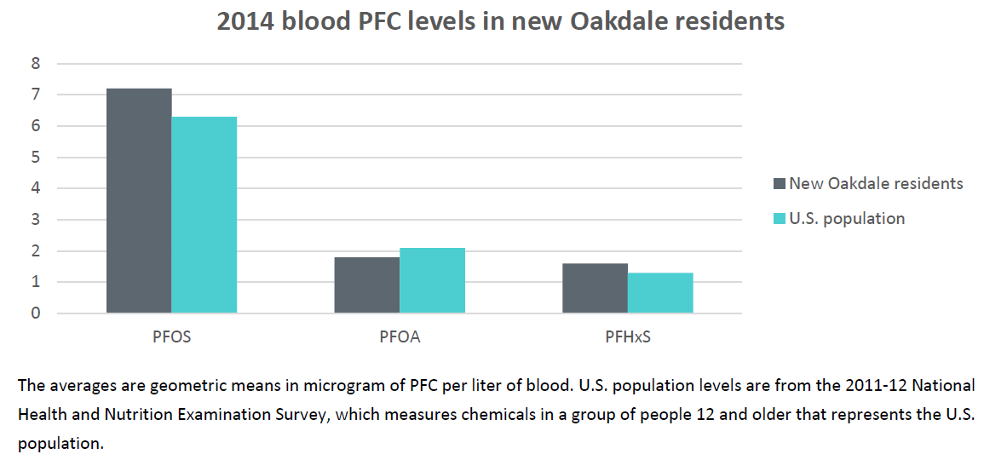
PFAS levels in new Oakdale residents are similar to the U.S. population

Slide 13
Thank you!
James Kelly, M.S.
James.kelly@state.mn.us
651-201-4910
http://www.health.state.mn.us/divs/eh/hazardous/topics/pfcs/current.html

