Slide 1
“Harrison Bergeron”
By: Kurt Vonnegut

Slide 2
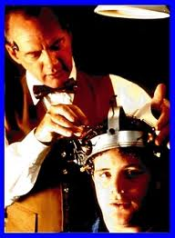
Dystopia
Dystopia:
A futuristic universe in which oppressive societal control and the illusion of a perfect society are maintained through corporate, bureaucratic, technological, moral, or totalitarian control.
Dystopias criticize a current trend, societal norm, or political system.

Slide 3
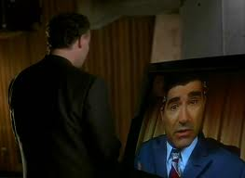
Characteristics
Propaganda - controls the citizens of society.
• Independent thought, is restricted.
• A figurehead or concept is worshipped by the citizens.
• Under constant surveillance.
• Fear of the outside world.
• Dehumanized
• Citizens conform
• The society is an illusion of a perfect utopian world.

Slide 4
Types of Dystopian Controls
• Corporate control: Large corporations control society through products, advertising, and/or the media. Examples include Minority Report.
• Bureaucratic control: Society is controlled by a mindless government through, relentless regulations, and incompetence
• Technological control: Society is controlled by technology—through computers, robots, and/or scientific means. Examples include The Matrix, The Terminator, and I, Robot.
• Philosophical/religious control: Society is controlled by philosophical or religious ideology often enforced through a dictatorship or theocratic government.

Slide 5
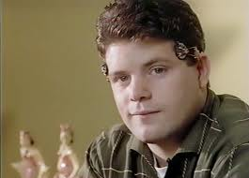
The Dystopian Protagonist
• often feels trapped and is struggling to escape.
• questions the existing social and political systems.
• believes that something is terribly wrong with the society
• helps the audience recognize the negative aspects of the dystopian world through his or her perspective.

Slide 6
SATIRE
Satire - the use of humor and wit with a critical attitude, sarcasm, or ridicule for exposing or denouncing the frailties and faults of mankind’s activities and institutions. Moral judgment and a desire to help improve a belief or tradition.

Slide 7
Text Info:
‘‘Harrison Bergeron’’ is set in the future, when Constitutional Amendments have made everyone equal. The agents of the Handicapper General (H-G men, an allusion to the practice in the 1940s and 1950s of referring to Federal Bureau of Investigation and Secret Service officers as G-men, the G standing for government) enforce the equality laws.
People are made equal by devices which bring them
down to the normalcy level in the story, which is
actually below-average in intelligence, strength, and
ability.
These devices include weights to stunt speed
and strength; masks, red rubber clown noses, or thick glasses to hide good looks and to make seeing difficult; and radio transmitters implanted in the ears of intelligent people, which emit sharp noises two or three times a minute to prevent sustained thought.
Thematic ideas: equality, freedom, power.
Published October 1961 in a Science-Fiction magazine
Became popular in the 1980’s

Slide 8
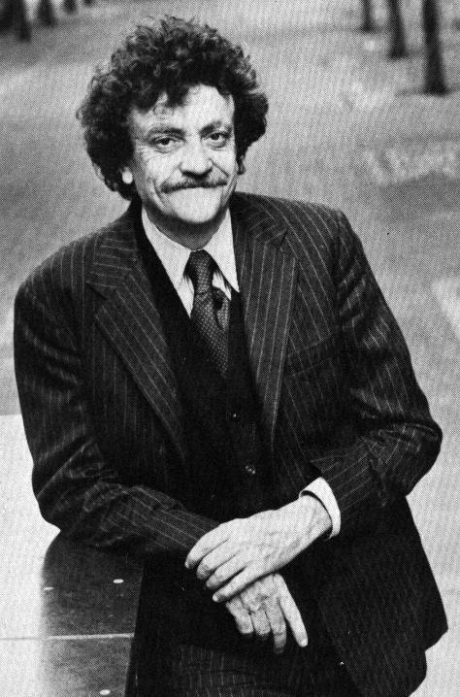
KURT VONNEGUT JR.
Born in Indiana in 1922
Was the editor of his high school newspaper
Joined the Army during WWII
    Taken captive -POW
    Earned a Purple Heart
Later worked as a police reporter
Died April, 2007

Slide 9
VOCABULARY
OPPRESSION - To harsh dominate
CALIBRATED - To mark measurements or a scale on something
CONSTERNATION-A feeling of alarm or confusion caused by something unexpected
COWER-To cringe or move backward as if from fear
LUMINIOUS-Startlingly bright or clear and easy to see

Slide 10
VOCABULARY Pg. 2
SYNCHRONIZING - To make something happen at the same time as another
VIGLANCE-Being watchful or alert , especially to lookout for danger
WINCE-To make an expression of pain with the face

Slide 11
Setting
Setting the story 120 years in the future allows readers to more easily accept some of the more absurd events in ‘‘Harrison Bergeron.’’ The actual physical location of the story does not matter and, therefore, is unknown

Slide 12
Point of view
Point of View
The story is told in the third-person-limited point of view;
the narrator is not a character in the story, but he is privy to the thoughts of one character.
The events in "Harrison Bergeron'' are related by an objective narrator. The narrator does not draw conclusions, make decisions, or make judgments about the events. The objectivity of the narrator suggests a distancing from the hostile world of the story.

Slide 13
Satire
Satire, ridiculing a person, place, or idea with the notion of effecting change, always involves morality.
Vonnegut satirizes the notion of handicapping people to enforce equality, the failure of rebellion, the apathy engendered in people who watch television, and authoritarian government.

Slide 14
Satire
The story uses satire and a kind of humor known as black humor. The humor mostly involves George and Hazel, although the appearance of Harrison (red rubber nose, artificially snaggle-toothed, three hundred pounds of handicaps) can be seen as comical.

Slide 15
Satire Continued
The humorous dialogue between Hazel and George Bergeron could be considered black humor, which has proved difficult to define. Related to
Sick humor (making fun of, say, a person's disability) and
Gallows humor (people laughing in the midst of helplessness), as well as the
Absurd (so far-fetched as to be nearly implausible),
It can be defined as the juxtaposition of pain and laughter, unusual fact and calmly inadequate reactions, and cruelty and tenderness. The ending dialogue between Hazel and George juxtaposes all three of those pairs, as Hazel and George have just witnessed the killing of their son.

Slide 16
Allusion
Vonnegut uses several allusions—references to people, historical events, and other literature outside the text—in ‘‘Harrison Bergeron.’’ The month of April, which ‘‘still drove people crazy by not being springtime,’’ is doubly allusive, initially referring to the first line of T. S. Eliot's 1922 poem, "The Waste Land":

Slide 17
Allusion Continued
The abbreviation of the Handicapper-General agents, "H-G men,’’ ironically alludes to the abbreviation ‘‘G-men’’ (for government agents; i.e., Secret Service agents, FBI agents). Generally, these government agents were held in high esteem, unlike the H-G men, until the 1960s and 1970s, when their activities came into legal and ethical question.

Slide 18
More Allusion
The allusion of Diana Moon, the Handicapper General's first and middle names, refers to the Roman goddess of the hunt, Diana, who is associated with the moon. Diana was known for her vengeance, which could explain the ruthless killing of Harrison Bergeron in the story.
Thor, identified in the story as the god of thunder, was, in Norse mythology, the oldest and most powerful son of Odin, king of the gods. He possessed great strength and skill in fighting. This allusion serves to underscore Harrison's strength without his handicaps.

Slide 19
Last Allusion!
The final allusion is to the comedy team of George Burns and Gracie Allen, and to their television show. The dialogue at the end of the story reflects similar dialogues at the end of the "Burns and Allen’’ television show. Gracie, who played a scatterbrain, would indeed repeat lines when George used the phrase, ‘‘You can say that again,’’ just as Hazel Bergeron does in the story.

