Slide 1

Life Science
S7CS9. Students will investigate the features of the process of scientific inquiry.
Agenda: 8/04/15
Scientific Method/Inquiry
Learning Target:
I can describe what scientific inquiry involves and describe
how to develop a hypothesis and design an experiment.
Warm- up:
Create a definition for science.
What types of problems can science help solve?
What types of problems can science not help solve?
Success Criteria:
Why is it important that scientists have a procedure for investigations?

Slide 2
Life Science
S7CS9. Students will investigate the features of the process of scientific inquiry.
Agenda: 8/05/15
Scientific Method/Inquiry
Learning Target:
I know what is involved in each step of scientific
inquiry including how to develop a hypothesis and design
an experiment.
Warm- up:
List the steps of the scientific method in order.
Why do you think is it important to use the steps in the correct sequence?
Success Criteria:
I can identify the steps of scientific inquiry in the correct sequence.
Closing:
Use the manipulatives to put the steps of scientific inquiry in the correct order.

Slide 3
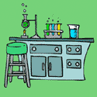
Steps of
the
Scientific Method

Slide 4
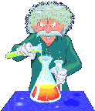
The Scientific Method or Scientific Inquiry are a series of steps that are used to investigate a natural occurrence.

Slide 5
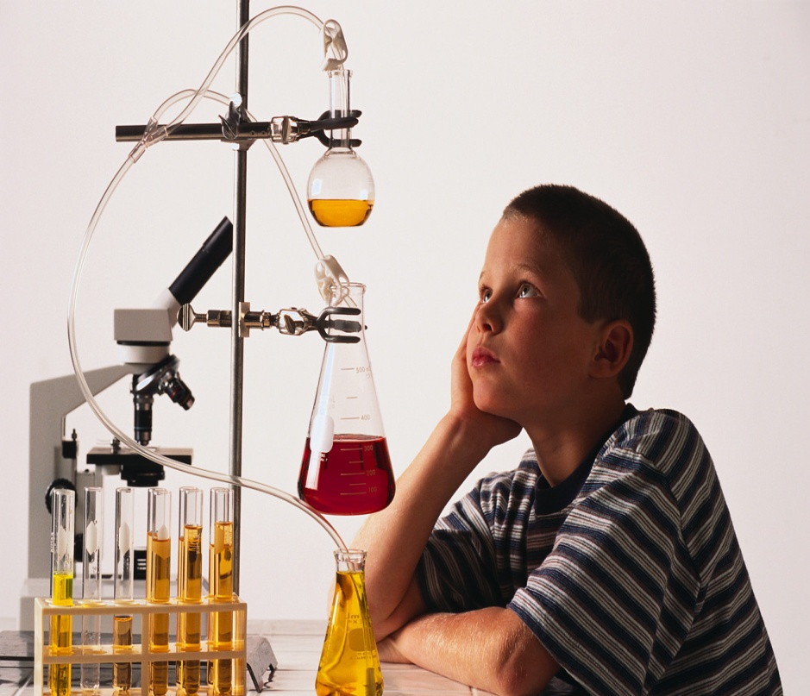
Let’s take a closer look at these steps and the terminology (vocabulary) you will need to understand before you start a science investigation.

Slide 6
Scientific Method
Problem/Question
Observation/Research
Formulate a Hypothesis
Experiment
Collect and Analyze Results
Conclusion
Communicate the Results

Slide 7
Steps of the
Scientific Method
Problem/Question: Develop a question or problem that can be solved through experimentation.
What problem are you trying to solve?
What question in the natural world are you trying to answer?

Slide 8
Steps of the
Scientific Method
2. Observation/Research: Make observations and research your topic of interest.
You must know something about a problem or question before formulating a hypothesis.
Review the most current research on the topic.
Make observations and look for patterns.

Slide 9
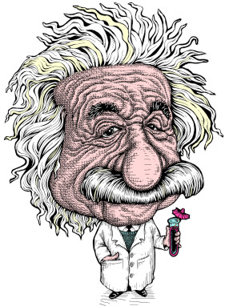
Do you remember the next step?

Slide 10
Steps of the
Scientific Method
3. Formulate a Hypothesis:
Predict a possible answer to the problem or question.
Example: If soil temperatures rise, then plant growth will increase.

Slide 11
Steps of the
Scientific Method
4. Experiment: Develop and follow a procedure.
The experiment must be detailed enough for other scientists to replicate (retest).
The outcome must be measurable.
Include a detailed materials list.

Slide 12
Steps of the
Scientific Method
5. Collect and Analyze Results:
Modify the procedure if needed.
Confirm the results by retesting.
Include tables, graphs, and photographs.

Slide 13
Steps of the
Scientific Method
6. Conclusion: Include a statement that accepts or rejects the hypothesis.
A hypothesis is not wrong or right. It is simply supported or unsupported.
Make recommendations for further study and possible improvements to the procedure.

Slide 14
Steps of the
Scientific Method
7. Communicate the Results:
Be prepared to share the project with an audience.
Scientists share their findings.
Expect questions from the audience.

Slide 15
Think you can name all seven steps?
Collect and Analyze Results
Formulate a Hypothesis
Communicate the Results
Observation/Research
Problem/Question
Experiment
Conclusion

Slide 16

Let’s put our knowledge of the Scientific Method to a realistic example that includes some of the terms you’ll be needing to use and understand.

Slide 17

Problem/Question
Juan watches his grandmother bake bread. He asks his grandmother what makes the bread rise.
She explains that yeast releases a gas as it feeds on sugar.

Slide 18
Problem/Question
Juan wonders if the amount of sugar used in the recipe will affect the size of the bread loaf?

Slide 19
Life Science
S7CS9. Students will investigate the features of the process of scientific inquiry.
8/06/15
Agenda: Making a Testable Hypothesis
Learning Target:
I know what makes a hypothesis testable.
Success Criteria: I can create an example of a testable hypothesis.
Warm- up:
Define: variables
2. What steps do scientists need before developing a hypothesis?

Slide 20
Life Science
S7CS9. Students will investigate the features of the process of scientific inquiry.
8/07/15
Agenda: Applying the Scientific Method
Learning Target:
I know how to apply the scientific method.
Success Criteria: I can apply the scientific method.
Warm- up:
Complete the information on handout about the scientific method.

Slide 21
Caution!
Be careful how you use effect and affect.
Effect is usually a noun and affect, a verb.
“ The effect of sugar amounts on the rising of bread.”
“How does sugar affect the rising of bread?”

Slide 22

Observation/Research
Juan researches the areas of baking and fermentation and tries to come up with a way to test his question.
He keeps all of his information on this topic in a journal.

Slide 23

Juan talks with his teacher and she gives him a Experimental Design Diagram to help him set up his investigation.

Slide 24
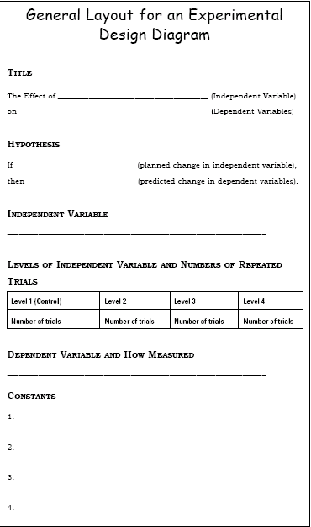

Slide 25

Formulate a Hypothesis
After talking with his teacher and conducting further research, he comes up with a hypothesis.
“If more sugar is added, then the bread will rise higher.”

Slide 26
Hypothesis
The hypothesis is an educated “guess” (prediction) about the relationship between the independent and dependent variables.
Note: These variables will be defined in the next few slides.

Slide 27
Do you know the difference between the independent and dependent variables?

Slide 28
Independent Variable
The independent, or manipulated variable, is a factor that’s intentionally varied by the experimenter.
Juan is going to use 25g., 50g., 100g., 250g., 500g. of sugar in his experiment.
“I” = I the scientist
“I” = If ____ (independent variable)
“I” = I, II, III (only 1 ind. variable)

Slide 29
Dependent Variable
The dependent, or responding variable, is the factor that may change as a result of changes made in the independent variable.
Think, “The whole experiment depends on the results.”
In this case, it would be the size of the loaf of bread.

Slide 30
Experiment
His teacher helps him come up with a procedure and list of needed materials.
She discusses with Juan how to determine the control group.

Slide 31
Control Group
In a scientific experiment, the control is the group that serves as the standard of comparison.
The control group does not include the independent or manipulated variable.

Slide 32
Control Group
The control group is exposed to the same conditions as the experimental group, except for the variable being tested.
All experiments should have a control group.

Slide 33
Control Group
Because his grandmother always used 50g. of sugar in her recipe, Juan is going to use that amount in his control group.

Slide 34
Constants
Juan’s teacher reminds him to keep all other factors the same so that any observed changes in the bread can be attributed to the variation in the amount of sugar.

Slide 35
Constants
The constants in an experiment are all the factors that the experimenter attempts to keep the same.
Think, “The parts that remain constant.”

Slide 36
Can you think of some constants for this experiment?

Slide 37
Constants
They might include:
Other ingredients to the bread recipe, oven used, rise time, brand of ingredients, cooking time, type of pan used, air temperature and humidity where the bread was rising, oven temperature, age of the yeast…

Slide 38
Experiment
Juan writes out his procedure for his experiment along with a materials list in his journal. He has both of these checked by his teacher where she checks for any safety concerns.

Slide 39
Trials
Trials refer to several groups that are exposed to the same conditions in an experiment.
Juan is going to test each sugar variable 3 times.

Slide 40
Collect and Analyze Results
Juan comes up with a table he can use to record his data.
Juan gets all his materials together and carries out his experiment.

Slide 41
Size of Baked Bread (LxWxH) cm³
Size of Bread Loaf (cm³)
Trials
Amt. of Sugar (g.) | 1 | 2 | 3 | Average Size (cm³)
25 | 768 | 744 | 761 | 758
50 | 1296 | 1188 | 1296 | 1260
100 | 1188 | 1080 | 1080 | 1116
250 | 672 | 576 | 588 | 612
500 | 432 | 504 | 360 | 432
Control group

Slide 42
Graphing
What would a graph of Juan’s results look like?

Slide 43
Collect and Analyze Results
Juan examines his data and notices that his control worked the best in this experiment, but not significantly better than 100g. of sugar.

Slide 44
Conclusion
Juan rejects his hypothesis, because the data does not seem to support it.
However, he decides to re-test using sugar amounts between 50g. and 100g.

Slide 45
Experiment
Once again, Juan gathers his materials and carries out his experiment.
Here are the results.

Slide 46
Can you tell which group did the best?

Slide 47
Size of Baked Bread (LxWxH) cm³
Size of Bread Loaf (cm³)
Trials
Amt. of Sugar (g.) | 1 | 2 | 3 | Average Size (cm³)
50 | 1296 | 1440 | 1296 | 1344
60 | 1404 | 1296 | 1440 | 1380
70 | 1638 | 1638 | 1560 | 1612
80 | 1404 | 1296 | 1296 | 1332
90 | 1080 | 1200 | 972 | 1084
Control group

Slide 48
Conclusion
Juan finds that 70g. of sugar produces the largest loaf.
His hypothesis is accepted.

Slide 49
Communicate the Results
Juan tells his grandmother about his findings and prepares to present his project in Science class.

Slide 50

Closing:
If weight is added to the wings of a paper airplane, then it will fly farther.
Identify which part of this hypothesis is the independent variable.
Identify which part of this hypothesis is the dependent variable.
Describe an appropriate control group.
Closing:
If weight is added to the wings of a paper airplane, then it will fly farther.
Identify which part of this hypothesis is the independent variable.
Identify which part of this hypothesis is the dependent variable.
Describe an appropriate control group.

Slide 51
Observe your
world and come
up with a question
to answer using the
Scientific Method!

Slide 52
Life Science
S7CS9. Students will investigate the features of the process of scientific inquiry.
Agenda:
Scientific Method/Inquiry Cont.
Essential Question:
What is scientific inquiry, and what makes a hypothesis testable?
Warm- up:
1. Without consulting your notes or the textbook, try to list as many steps of The Scientific Method/Inquiry as you can remember from last class.
2. Now, check your notes or your textbook. Which did you forget? Add them here.
3. Why do you believe that you forgot those? Why are these important?
Closing:
Why is it important that scientists have a procedure for investigations?

