Slide 1
Ecology
Life Science

Slide 2
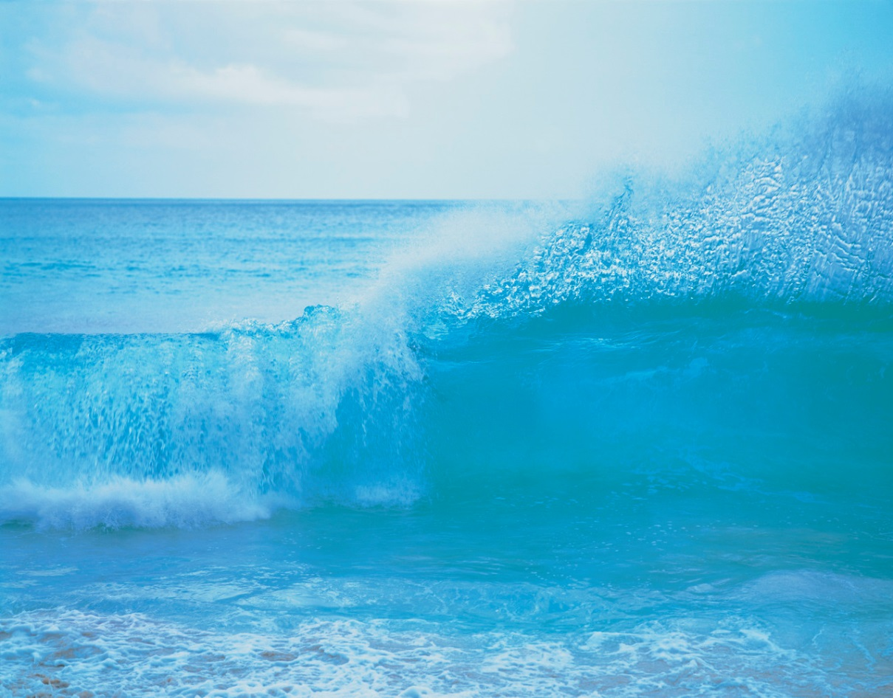
Bell Work:
Why do you think tropical waters usually look so blue?

Slide 3
Answer:
While water can look blue because of nonliving matter in the water and atmospheric gases that influence sunlight, the blueness of water is also caused by the way sunlight (or any white light) is absorbed by water. Water absorbs light at the red end of the spectrum and reflects blue light, some of which is reflected back toward a person looking at the water.

Slide 4
What is an ecosystem?
An ecosystem is all the living things and nonliving things in a given area.
Biotic comes from the Greek word meaning "fit for life.“
How does that meaning relate to the word biotic?
  Biotic factors are living things, "fit for life."

Slide 5
http://connected.mcgraw-hill.com/media/repository/protected_content/COMPOUND/50000020/30/72/Ecosystems/00076707.htm?mghCourseID=J3B3WWJLT82D2DYG587957LKB4

Slide 6
Lesson 1
Abiotic

Slide 7
Lesson 1: Abiotic Factors
A. What is an ecosystem?
1. All living and nonliving things in an area make up a(n) ecosystem.
2. The living things in an ecosystem are the biotic factors.
3. Sunlight and temperature are examples of nonliving factors, or abiotic factors, in an ecosystem.

Slide 8
Lesson 1: Abiotic Factors
B. What are the nonliving parts of an ecosystem?
1. Almost all energy on Earth originally came from the Sun.
a. Sunlight is used by plants to make food.
b. Two other abiotic factors affected by sunlight are temperature and climate.

Slide 9
Lesson 1: Abiotic Factors
2. If you describe the average weather conditions of an area over time, you describe the area’s climate.
a. Wind, temperature, and moisture influence the daily weather conditions.
b. A lizard might live in a hot, dry desert climate.

Slide 10
Lesson 1: Abiotic Factors
3. Temperature is how warm or cold something is.
a. Animals that have thick fur live in climates that have cold temperatures.
b. Tropical birds are adapted to warm temperatures.
4. Most organisms are made mostly of water.
a. Organisms need water to grow and reproduce.
b. Ecosystems must contain water to support life.

Slide 11
5. The layers of gases that surround Earth make up the atmosphere.
a. Earth’s atmosphere is mainly nitrogen and oxygen.
b. Earth’s atmosphere protects organisms from harmful rays from the Sun.

Slide 12
Lesson 1: Abiotic Factors
6. Soil covers much of Earth’s surface. It is made up of rock, water, air, minerals, and the remains of once-living things.
a. Soil provides water and nutrients for plants that grow in it.
b. Bacteria recycle nutrients by breaking down dead organisms.

Slide 13
What are the nonliving parts of an ecosystem?
Look at Figure 1 in your text of fallen tree.
  Is it is abiotic OR biotic?
    biotic factors include things that were once alive, so the fallen tree is biotic.

Slide 14
1 &2.The Sun and Climate
Most living things on Earth get their energy from the Sun.
Climate varies a great deal from one region to another.

Slide 15
How do living things use the Sun's energy?
Living things get warmth and light from the Sun. Photosynthetic organisms use energy from the Sun and make food.

Slide 16
What is climate?
Climate is an area's average weather conditions over time.

Slide 17
Temperature
most plants and animals in a particular area are adapted to living within a specific range of temperatures.
Why wouldn't a polar bear living in the wild survive in the tropics?
  A polar bear is adapted for cold climates. It has thick fur and would overheat and die in the tropics.

Slide 18
3. Water
life on Earth could not exist without water.
What do you do when you are thirsty?
  Students should indicate that they get something to drink.

Slide 19
4. Atmosphere
What would happen to humans if there were no atmosphere?
  humans would not be able to survive.

Slide 20
5. Soil
soil is considered an abiotic factor, even though it contains living things, such as insects, worms, and bacteria.

Slide 21
List the nonliving things in ecosystems.
the Sun, climate, water, atmosphere, and soil

Slide 22
How does the jaguar in Figure 1 interact with the abiotic factors in its ecosystems?
The jaguar drinks water, walks on soil, gets warmth from sunlight, and breathes oxygen in the atmosphere.

Slide 23
Lesson 1: Abiotic Factors
How do abiotic factors affect life in an ecosystem?

Slide 24
Answers might include that abiotic factors are needed for life to exist. Organisms need such
things as water, sunlight for energy, and certain gases in the atmosphere.

