Slide 1
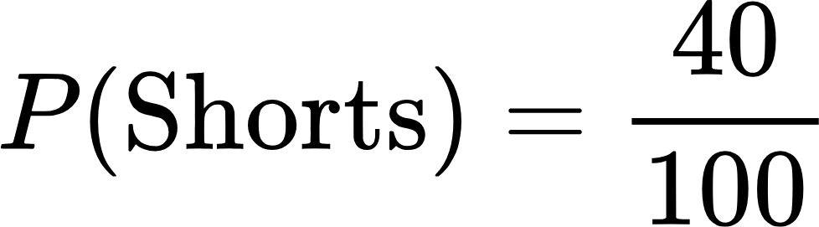
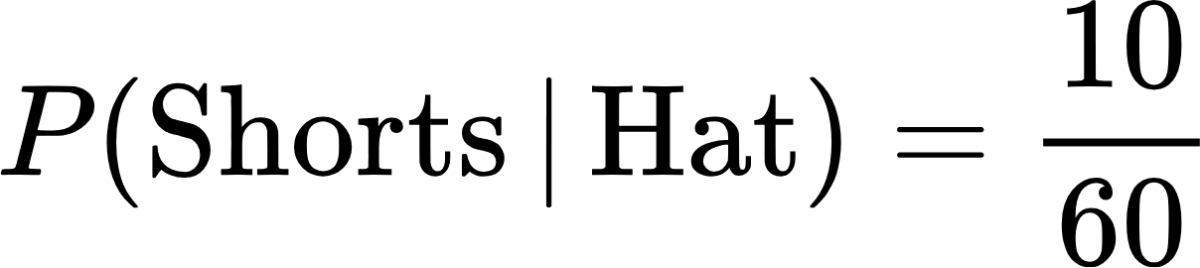
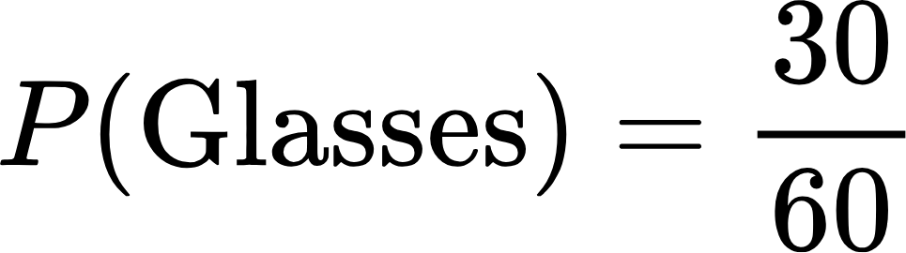
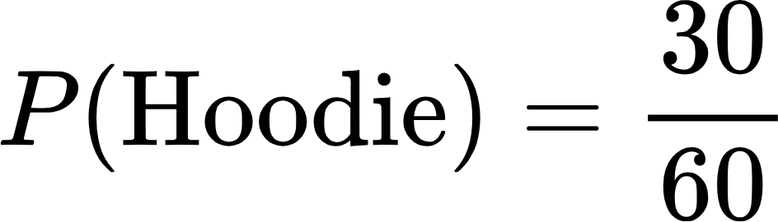
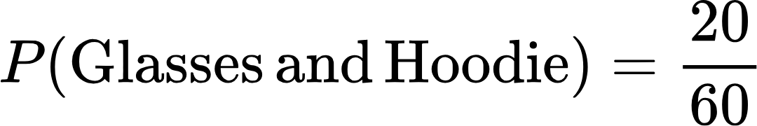
2 tests for independence (notes page 5)
how to test whether 2 outcomes are independent by using the definition of independent | example: Are Shorts and Hat independent?
how to test whether 2 outcomes are independent by using the multiplication rule | example: Are Glasses and Hoodie independent?

