Slide 1
5.7 Proving That Figures Are Special Quadrilaterals
Objective:
After studying this section, you will be able to prove that a quadrilateral is:
A rectangle
A kite
A rhombus
A square
An isosceles triangle

Slide 2
Proving that a quadrilateral is a rectangle
E
H
F
G
Show that the quadrilateral is a parallelogram first then use one of the methods to complete the proof.
1. If a parallelogram contains at least one right angle, then it is a rectangle (reverse of the definition).
2. If the diagonals of a parallelogram are congruent, then the parallelogram is a rectangle.
You can prove that a quadrilateral is a rectangle without first showing that it is a parallelogram
3. If all four angles of a quadrilateral are right angles, then it is a rectangle.

Slide 3
K
Proving that a quadrilateral is a kite
E
I
T
To prove that a quadrilateral is a kite, either of the following methods can be used.
1. If two disjoint pairs of consecutive sides of a quadrilateral are congruent, then it is a kite (reverse of the definition).
2. If one of the diagonals of a quadrilateral is the perpendicular bisector of the other diagonal, then the quadrilateral is a kite.

Slide 4
Proving that a quadrilateral is a rhombus
J
O
K
M
Show that the quadrilateral is a parallelogram first then apply either of the following methods.
1. If a parallelogram contains a pair of consecutive sides that are congruent, then it is a rhombus (reverse of the definition).
2. If either diagonals of a parallelogram bisects two angles of the parallelogram, then it is a rhombus.
You can prove that a quadrilateral is a rhombus without first showing that it is a parallelogram
3. If the diagonals of a quadrilateral are perpendicular bisectors of each other, then the quadrilateral is a rhombus.

Slide 5
Proving that a quadrilateral is a square
N
S
P
R
The following method can be used to prove the NPRS is a square.
1. If a quadrilateral is both a rectangle and a rhombus, then it is a square (reverse of the definition).

Slide 6
Proving that a trapezoid is an isosceles
A
D
B
C
1. If the nonparallel sides of a trapezoid are congruent, then it is isosceles (reverse of the definition).
2. If the lower or the upper base angles of a trapezoid are congruent, then it is isosceles.
3. If the diagonals of a trapezoid are congruent, then it is isosceles.

Slide 7































What is the most descriptive name for quadrilateral ABCD with vertices
A = (-3, -7), B = (-9, 1), C = (3, 9), and D = (9, 1)?
$$Slope:$$
$$Rectangle or Rhombus?$$
$$\frac{1−(−7)}{−9−(−3)}$$
$$=\frac{8}{−6}$$
$$=−\frac{4}{3}$$
$$no opposite reciprocal slopes,$$
$$AB:m=$$
$$so not a rectangle$$
$$\frac{9−1}{3−(−9)}$$
$$=\frac{8}{12}$$
$$=\frac{2}{3}$$
$$If a rhombus, diagonals ⊥$$
$$BC:m=$$
$$\frac{9−(−7)}{3−(−3)}$$
$$=\frac{16}{6}$$
$$=\frac{8}{3}$$
$$Slope AC:m=$$
$$\frac{1−9}{9−3}$$
$$=\frac{−8}{6}$$
$$=−\frac{4}{3}$$
$$CD:m=$$
$$\frac{1−1}{9−(−9)}$$
$$=\frac{0}{18}$$
$$\frac{1−(−7)}{9−(−3)}$$
$$=\frac{8}{12}$$
$$=\frac{2}{3}$$
$$Slope BD:m=$$
$$=0$$
$$DA:m=$$
$$not opposite reciprocals, not⊥$$
$$Opposite sides are parallel (same slopes)$$
ABCD is a
parallelogram
$$so at least a parallelogram$$

Slide 8











Proof o
Method #2
for Rhombus!
A
D
Given: ABCD is a parallelogram
Prove: ABCD is a rhombus
B
C
$$1. ABCD is a parallelogram$$
$$1. Given$$
$$2. ∠ADC≅∠ABC$$
$$2. {Opp. ∠}^{′}s of parallelogram are ≅$$
$$3. \overline{BD} bisects ∠ADC \& ∠ABC$$
$$3. Given$$
$$4. ∠ABD≅∠ADB$$
$$4. If ∠^{′}s are ≅, their like divisions are ≅$$
$$5. \overline{AB}≅\overline{AD}$$
$$5. If ∠^{′}s ≅ ⟹sides ≅$$
$$6. ABCD is a rhombus$$
$$6. If a parallelogram contains a consecutive$$
$$pair of sides that are ≅, it^{′}s a rhombus$$

Slide 9




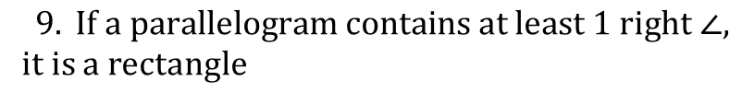


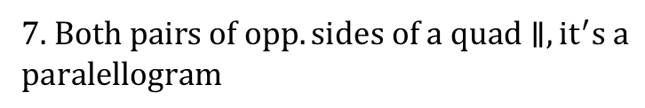










Given: GJMO is a parallelogram
O
M
$$\overline{OH}⊥\overline{GK}$$
$$\overline{MK} is an altitude of ∆MKJ$$
Prove: OHKM is a rectangle
G
H
J
K
$$1. GJMO is a parallelogram$$
$$1. Given$$
$$2. \overline{OM}∥\overline{GK}$$
$$2. Opp. sides of a parallelogram are∥$$
$$3. \overline{OH}⊥\overline{GK}$$
$$3. Given$$
$$4. \overline{MK} is an alttitude of ∆MKJ$$
$$4. Given$$
$$5. \overline{MK}⊥\overline{GK}$$
$$5. Def. Altitude$$
$$6. \overline{OH}∥\overline{MK}$$
$$6. Coplanar lines ⊥to 3rd line → ∥lines$$
$$7. OHKM is a parallelogram$$
7. $Both pairs of opp. sides of a quad∥, {it}^{′}s a$
$$paralellogram$$
$8. ∠OHK is a right ∠$
$8. ⊥segments form a right ∠ (def. ⊥)$
$$9. OHKM is a rectangle$$
$$9. If a parallelogram contains at least 1 right ∠,$$
it is a rectangle

Slide 10
Summary
Write a description of each of three special quadrilaterals without using the names of the quadrilaterals. Each description should include sufficient properties to establish the quadrilateral’s identity.
Homework: worksheet

