Slide 1
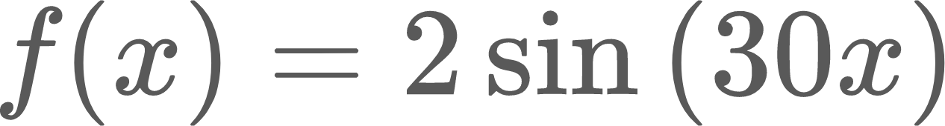
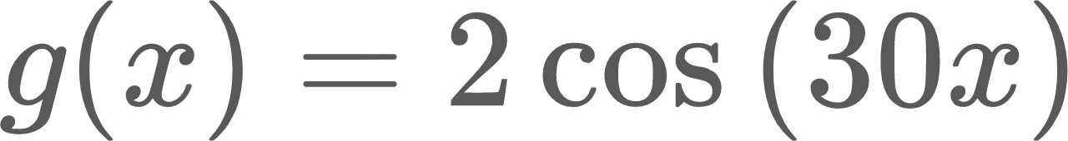
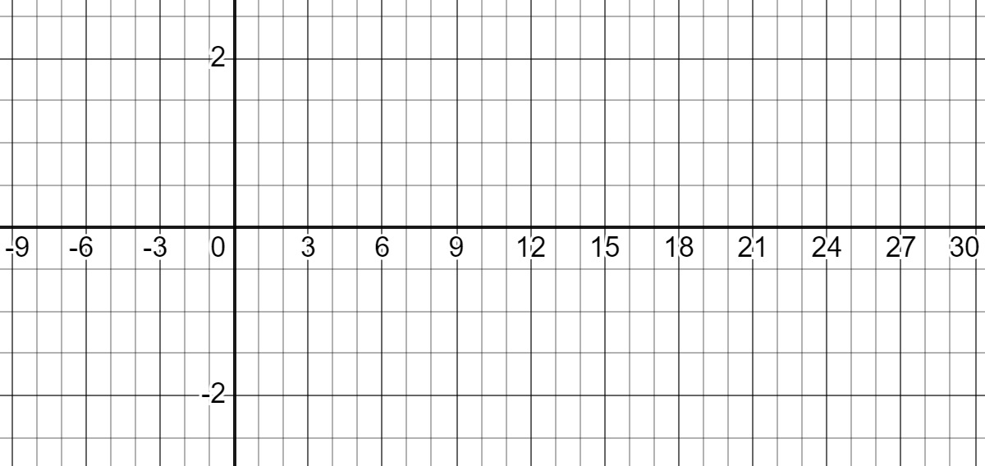
Lesson 5 exit ticket Name:
Carefully graph and on the same grid.
(x is in degrees.)

