Slide 1
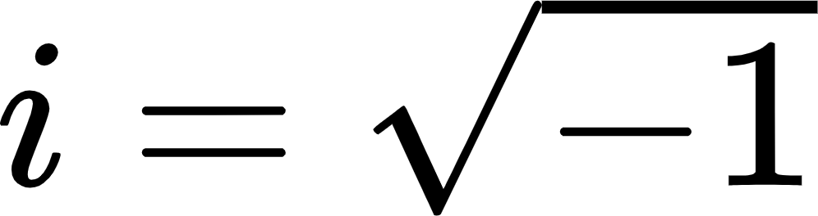

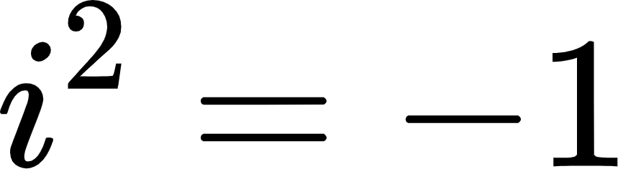
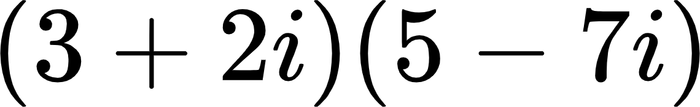
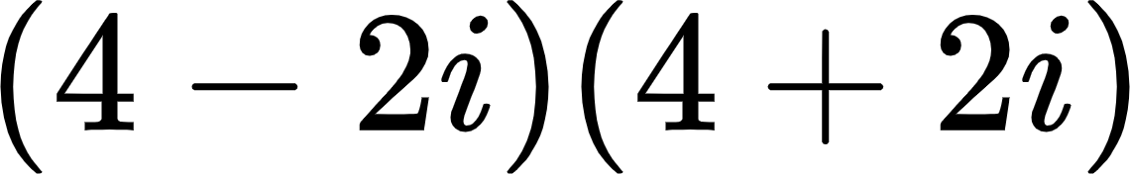
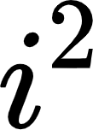
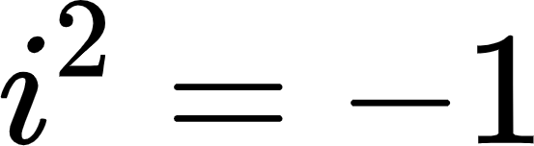
Time for a new number!
The number is defined as:
So this is also true:
Multiply the following:
Hint: Your final answers should not have in them, because

Slide 2
Time for a new number!
The number is defined as:
So this is also true:
Multiply the following:
Hint: Your final answers should not have in them, because

