Slide 1
Welcome Staff
Binder Organization & Goal Setting
Please take the “Binder Contents” handout from the desk near the door.
Go through your binder and confirm that your binder contains all of the necessary supplies.
Replenish any missing items from the supplies on the counter.
New staff – You will be building your binder from scratch! Ask a veteran staff member if you need any assistance.

Slide 2

Today’s Agenda
Assemble Binders
Binder/Planner Schedule
Review Binder Contents
Binder/Planner Rubric
Sample Friday Agenda
  Binder Check Form
Brainstorm ideas for binder check day
SMART Goals
Resources
Learning Target:
I can apply the Claggett Creek expectations for goal setting, planner use and binder organization in my own classroom.

Slide 3

Claggett Creek Middle School
Binder Check/Goal Setting Schedule
1st Six Weeks Language Arts
2nd Six Weeks Science (8th)
Science/Social Studies (6^{th/}7th)
3rd Six Weeks Math
4th Six Weeks Social Studies/Health (8th)
Science/Social Studies (6^{th/} 7th)
5th Six Weeks Language Arts
6th Six Weeks Math

Slide 4
Binder Contents:
(In this order)
Pencil Pouch
Pencil
Pen
Eraser (can be attached to pencil)
Highlighter (optional)
Page Protector
Planner
Notebook Paper
Labeled Dividers
Pouch Contents

Slide 5
Binder Requirements |  |  | ☑
 | 3-Ring Binder
 | Pencil Pouch
 | Pouch Contents | Pencil
 |  | Pen
 |  | Eraser
 | Notebook Paper
 | Labeled Divider Tabs
 | Planner/Calendar
 | Planner Items | Recorded info for EACH class
 |  | Homework/To-Do List
 |  | Goals are On Track
Total ☑

Slide 6


Welcome!
Tuesday, September 1, 2015
Agenda:
Bell Work: Go through your binder – clean, organize and replenish supplies. Make sure it will pass the shake test.
Binder Check: Trade binders with your neighbor. Add up your total ☑, and your total planner stamps. Turn in binder check form.
Reading Zone – 15 Minutes
Analyze zone book for theme
Read “Ambush” By Tim O’Brien
Today You Need:
INB
Binder
Binder Supplies
Binder Packet
Planner:
Binder Clean/Check
Zone book theme
“Ambush” theme

Slide 7
Binder/Planner Check Form
Name: _______________________ Date: _________________
Total Planner Stamps ____________ Total Binder ☑ _________

Slide 8
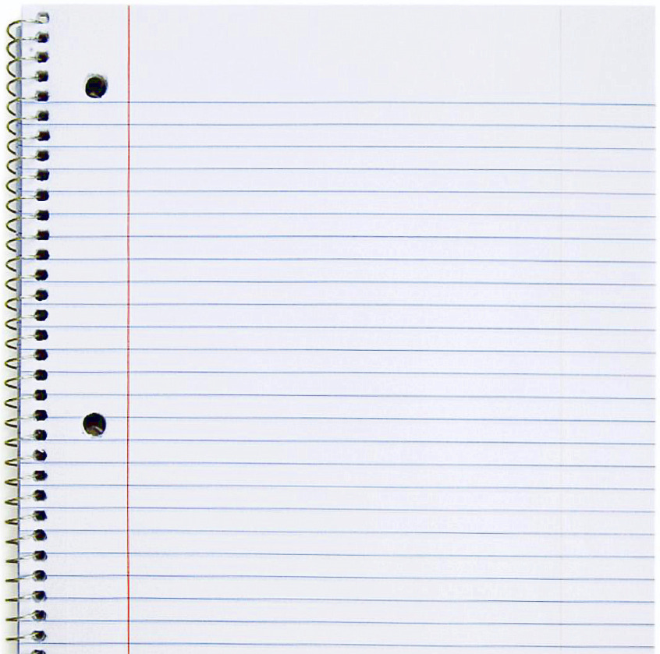
In INB
Brainstorm ways to conduct weekly binder checks
Discuss at your table:
Ideas for making binder checks more efficient in your classroom.
Share out your best idea!
Ideas for Weekly Binder Checks:

Slide 9
S
Specific
Know exactly what you are wanting to accomplish.
M
Measurable
How will you know you met your goal?
Goals
A
Your goal should not be too far to reach, but far enough to be challenging.
Achievable
R
Relevant
Is this goal appropriate to this place/time? To your needs as a student?
T
Timely
When will your goal be met?

Slide 10
S
Specific
Know exactly what you are wanting to accomplish.
Not Specific
I want to get good grades.
Example:
Specific
I will turn in all of my Language Arts Assignments.

Slide 11
M
Measurable
How will you know you met your goal?
Not Measurable
I’ll turn in all of my language arts assignments.
Example:
Measurable
I will turn in 100% of my Language Arts Assignments, based on a weekly grade print-out from my teacher

Slide 12
A
Your goal should not be too far to reach, but far enough to be challenging.
Achievable
Not Achievable
I’ll turn in all of my language arts assignments, and get an A+ on every single one.
Example:
Achievable
I will turn in 100% of my Language Arts Assignments, and will re-do anything earning less than 70%, based on a grade print-out from my teacher

Slide 13
R
Is this goal appropriate to this place/time? To your needs as a student?
Relevant
Not Relevant
(I always earn an A+ in Language Arts), I will do that again this grading period.
Example:
Relevant
(Because I’ve struggled in Language Arts in the past), I will turn in 100% of my Language Arts Assignments, and will re-do anything earning less than 70%, based on a weekly grade print-out from my teacher.

Slide 14
T
When will your goal be met?
Timely
Not Timely
I’ll turn in all of my Language Arts assignments this year.
Example:
Timely
Throughout the first six week grading period, I will turn in 100% of my Language Arts assignments, and will re-do anything earning less than a 70% based on a weekly grade print out from my teacher.

Slide 15
S
Specific
Throughout the first six week grading period, I will turn in 100% of my Language Arts assignments, and will re-do anything earning less than a 70%, based on a weekly grade print- out from my teacher.
M
Measurable
Goals
A
Achievable
R
Relevant
T
Timely

Slide 16
SMART Goals Power Point can be found at:
Q: Staff: Staff Development: Smart Goal Presentation

