Slide 1

Sharing, multiple groups, equivalence, and comparison problems.
Fractions of length, area and set.

Slide 2
Teacher notes.
The Restaurant is split into three main parts: The Orders, The Service, and The Payments. There is also a final challenge called “The Accounts”.
The sequence of tasks within each part has been chosen so that there are opportunities for students to make connections between the problems and use what they have already learnt to solve new problems.
We used the Thinking Classroom model by Peter Liljedahl: randomized groups of three working at vertical whiteboards. After a few tasks, we would consolidate from the most frequently used strategies to more elegant ones, making connections as we went. We moved through one part in a block, then continued the following day. This could form a week-long unit, with the odd mini-lesson in-between sessions to help consolidate and extend the learning.
Each part includes a sequence of “check your understanding questions” which were done individually by students. The questions are related to the main tasks in that section, and the answers were made available to the students so they can check as they went. Students choose their starting difficulty and then complete that column before moving on to the right. There is no expectation that they would finish them all, but 10-15 minutes worth of focused practice should be enough.
The problems themselves are inspired by “Extending Children’s Mathematics” (Cognitively Guided Instruction) - the numbers within the problems can be adapted to suit the needs of your class, as can the individual questions at the end of each section.

Slide 3
The context.
You are taking over the family restaurant.
You will be busy as there are many tables and it is a popular restaurant!
You will have to complete orders, deal with complaints, and make sure people pay their bills fairly.
At the end of the day, you get to see how much money you made!
Visuals will help you see how many people are sat at each table. This table has 6 people around it.

Slide 4
The Orders.
Sharing problems, multiple groups problems, comparison problems

Slide 5
Order up!
White table have ordered 1 pizza
How much pizza will each person get on their plate?
Warm up

Slide 6
Order up!
Pink table have ordered three pizzas.
How much pizza will each person get on their plate?
A

Slide 7
Order up!
Yellow table want a third of a sub sandwich each.
How many subs should they order?
B

Slide 8
Order up!
Blue table have ordered 6 waffles.
How much waffle will each person get?
C

Slide 9

Order up!
Green table have one bag of popcorn to share.
Orange table want to have the same amount of popcorn for each person.
How many bags do they need to order?
D

Slide 10
Order up!
We use ¼ of a block of cheese to make a toasty.
We have 2 ½ blocks of cheese left in the kitchen.
Can everyone on blue table order a toasty each?
E

Slide 11
Order up!
½ of this table ordered burgers.
¼ of them ordered pepsi max
¾ of them ordered water
⅙ of them ordered hot dogs.
⅚ of them ordered chips.
What is their order?
F

Slide 12

Order up!
Purple table share 8 bottles of juice fairly.
Black table want the same amount of juice per person as the purple table.
How many bottles should you serve?
G

Slide 13


Check your understanding questions
Mild | Medium | Spicy
1 cake shared between… | 3 waffles shared between… | 5 subs shared between…
2 people = _____ each | 2 people = _____ each | 3 people = ____ each
4 people = ____ each | 4 people = ____ each | 6 people = ____ each
2 cakes shared between… | 5 waffles shared between… | 8 subs shared between…
4 people = ____ each | 4 people = ____ each | 3 people = ____ each
8 people = ____ each | 8 people = ____ each | 6 people = ____ each

Slide 14
Check your understanding answers
Mild | Medium | Spicy
1 cake shared between… | 3 waffles shared between… | 5 subs shared between…
2 people = ½ each | 2 people = 1 ½ each | 3 people = 1 ⅔ each
4 people = ¼ each | 4 people = ¾ each | 6 people = ⅚ each
2 cakes shared between… | 5 waffles shared between… | 8 subs shared between…
4 people = ½ each | 4 people = 1 ¼ each | 3 people = 2 ⅔ each
8 people = ¼ each | 8 people = ⅝ each | 6 people = 1 ⅓ each

Slide 15
The Service

Slide 16
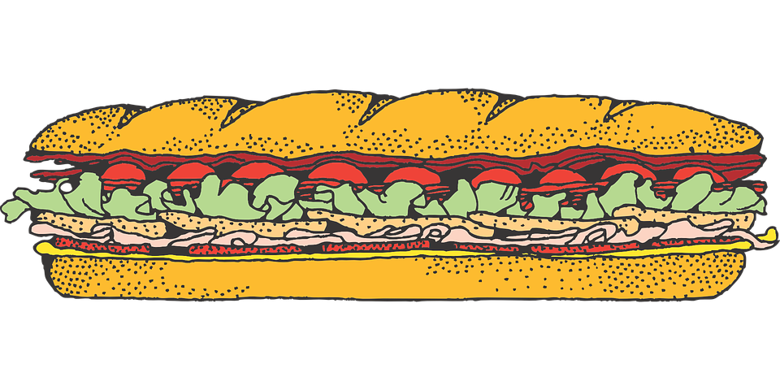
“Excuse me?!”
“We ordered the MEGA SUB.”
“Where should we cut it so we all get the same amount?”
“How many cm of sub will we each get?”
A
1m

Slide 17
“Excuse me?!”
Sorry, us again!
If three of us put our pieces together, how long would it be in total?
B
1m

Slide 18
Excuse me?!
“We ordered 40 sushi pieces.
What fraction of them do we get each?
How many pieces is that?”
C

Slide 19
Excuse me?!
“We ordered 80 sushi pieces.
What fraction of them do we get each?
How many pieces is that?”
D

Slide 20
COMPLAINT!
Red table are NOT happy. They have been given 2 cakes to share, but the table next to them has 4 cakes.
They don’t think it's fair.
What should you do?
E

Slide 21
COMPLAINT!
F
The blue table complain that the people on the table next to them get more brownie each.
What do you do?

Slide 22
Check your understanding questions
Mild | Medium | Spicy
½ of 100 = | 1/10 of 40 = | ⅛ of 32 =
¼ of 100 = | 1/10 of 80 = | ⅜ of 32 =
¾ of 100 = | 6/10 of 80 = | ⅜ of 64 =
Circle the largest | Circle the largest | Circle the largest
¼ or ½ | ¾ or ½ | ⅔ or ⅞
⅕ or ⅓ | ⅝ or ¾ | ⅘ or 7/10

Slide 23
Check your understanding answers
Mild | Medium | Spicy
½ of 100 = 50 | 1/10 of 40 = 4 | ⅛ of 32 = 4
¼ of 100 = 25 | 1/10 of 80 =8 | ⅜ of 32 = 12
¾ of 100 = 75 | 6/10 of 80 = 48 | ⅜ of 64 = 24
Circle the largest | Circle the largest | Circle the largest
¼ or ½ | ¾ or ½ | ⅔ or ⅞
⅕ or ⅓ | ⅝ or ¾ | ⅘ or 7/10

Slide 24
The Payments.

Slide 25


Bill, please!
21
Green table’s bill came to 21 Euros and they want to split it evenly. How much should each person pay?
A

Slide 26
Bill, please!
21
Pink table’s bill came to 21 Euros and they want to split it evenly. How much should each person pay?
B

Slide 27
100
Bill, please!
Gold table’s bill came to 100 Euros and they want to split it evenly. How much should each person pay?
C

Slide 28
10
Bill, please!
Pink table’s bill came to 10 Euros and they want to split it evenly. How much should each person pay?
D

Slide 29
160
Bill, please!
Purple table’s bill came to 160 Euros and they want to split it evenly. How much should each person pay?
E

Slide 30
Bill, please!
120
Blue table’s bill came to 120 Euros.
What fraction of the bill should each person pay?
How many euros per person?
F

Slide 31
Bill, please!
240
Green table’s bill came to 240 Euros. The lady in red wants to pay for herself and her two children. How much should she pay?
How much should each of the other
guests pay?
G

Slide 32
Check your understanding questions
Mild | Medium | Spicy
⅓ x 21 | ½ x 10 | ⅓ x 120
⅔ x 21 | ¼ x 10 | ⅙ x 120
½ x 48 | ¾ x 10 | ⅚ x 120
¼ x 48 | ¼ x 100 | ¼ x 1000
⅛ x 48 | ⅛ x 100 | ⅛ x 1000
⅜ x 48 | ⅜ x 100 | ⅞ x 1000

Slide 33
Check your understanding questions
Mild | Medium | Spicy
⅓ x 12 = 4 | ½ x 10 = 5 | ⅓ x 120 = 40
⅔ x 12 = 8 | ¼ x 10 = 2.5 | ⅙ x 120 = 20
½ x 48 = 24 | ¾ x 10 = 7.5 | ⅚ x 120 = 100
¼ x 48 = 12 | ¼ x 100 = 25 | ¼ x 1000 = 250
⅛ x 48 = 6 | ⅛ x 100 = 12.5 | ⅛ x 1000 = 125
⅜ x 48 = 18 | ⅜ x 100 = 37.5 | ⅞ x 1000 = 875

Slide 34
The Accounts

Slide 35
Income
Food | 320
Drinks | 125
Tips | 35
Profits
You must pay one eighth of your income to cover the electricity costs.
Three tenths of the income covers costs of food and drink.
One fifth of the income pays workers wages.
How much profit did you make?
What fraction of your income was this?

Slide 36
Check your understanding questions
Mild | Medium | Spicy
¼ x 32 | 1/10 x 125 | ⅓ x 1200
⅛ x 32 | 1/5 x 125 | ⅙ x 1200
⅜ x 32 | 3/5 x 125 | ⅚ x 1200
1/10 x 120 | ¼ x 480 | ⅛ x 4800
3/10 x 120 | ⅛ x 480 | ⅜ x 4800
9/10 x 120 | ⅜ x 480 | ⅞ x4800

Slide 37
Check your understanding answers
Mild | Medium | Spicy
¼ x 32 = 8 | 1/10 x 125 = 12.5 | ⅓ x 1200 = 400
⅛ x 32 = 4 | 1/5 x 125 = 25 | ⅙ x 1200 = 200
⅜ x 32 = 12 | 3/5 x 125 = 75 | ⅚ x 1200 = 1000
1/10 x 120 = 12 | ¼ x 480 = 120 | ⅛ x 4800 = 600
3/10 x 120 = 36 | ⅛ x 480 = 60 | ⅜ x 4800 = 1800
9/10 x 120 = 108 | ⅜ x 480 = 180 | ⅞ x 4800 = 4200

