Slide 1


SCOPE UNIVERSAL PRE-K PROGRAM AT
SACHEM CENTRAL SCHOOL DISTRICT
Building a Strong Foundation For Kindergarten

Slide 2
REGISTRATION INFORMATION AND UPK TIMELINE
UPK applications are now available on line. Find the Google Document at www.sachem.edu, under Announcements
Lottery Application is due back by Friday, March 26 @ 3:00 pm. No exceptions will be made for late applicants
Lottery will take place week of April 12. All names will be selected at this time. Placements are done in the order that you are selected in the lottery
Families notified approximately week of May 3rd
Letter will come in the mail. Adherence to deadlines in letter is required or spot is forfeited

Slide 3
REGISTRATION INFORMATON AND UPK TIMELINE
Sachem UPK lottery recipients are required to register with SCOPE in addition to the Sachem School District. Select Lottery Recipients. You will not be charged a fee
SCOPE tuition program registration becomes available after the week of May 3rd. Placement is on a first come, first served basis. Monthly fee is $237.50 plus a one-time, non-refundable $40 registration fee. Please select Sachem Tuition when registering
For questions or further information please contact SCOPE at dingarozza@scopeonline.us or 631-360-0800 ext 133

Slide 4
What is SCOPE Education Services?
SCOPE is a not-for-profit organization
Services include Pre-school Programs, UPK Programs, Before and After School Care, Enrichment Programs and Professional Development for teachers throughout Long Island
All teachers are NYS Certified. All assistants are NYS Teacher Assistant Certified
Maximum number of students is 18. Each classroom has one teacher and one teacher assistant
SCOPE has been the provider of the Sachem UPK Program since its inception in 2008

Slide 5
WHAT IS UPK?
UPK stands for Universal Pre-Kindergarten. It is a New York State grant that is given to a district for the purpose of providing Pre-K only. It cannot be allocated to any other program
The grant is limited and can only be used on a pre-determined amount of students. State guidelines do not allow for the grant to be used in any other manner
Participants are chosen through a lottery system, to be held in April. Any family who applies will have a number assigned that will be placed in the lottery. All numbers will be selected. When the spots for the UPK have been drawn, the remaining numbers will be placed on a waiting list. These families will have the opportunity to enroll in the tuition based program. The availability of the program is contingent on space in the district
The waiting list remains active throughout the year. As students move throughout the program, you may still be called to take part in the UPK
For eligibility students must turn 4 by December 1^{st.}

Slide 6
WHAT SCOPE UPK/PRE-K HAS TO OFFER
A curriculum based on the NYS Learning Standards for pre-school age children.
A balance of academic and social learning
Music, movement, purposeful play and hands on activities integrated throughout the day
Instruction delivered in individual, small and large groups.
Teacher and child guided instruction.
Differentiated learning styles for all children

Slide 7
COVID 19 PROTOCOLS
Families are required to fill out and sign an attestation form
Students are required to wear masks with occasional mask breaks
Students are seated 6 feet apart
Frequent hand washing
Daily temperature checks
SCOPE follows Sachem School District , the Department of Health and CDC (Centers for Disease Control and Prevention) protocols

Slide 8
A DAY IN THE LIFE OF A UPK/PRE-K CHILD
Daily schedule:
Arrival
Morning/Afternoon Meeting
Center Time
Snack Time
Whole Group Learning
Read Aloud
Outdoor/Indoor Play
Closing Activity
Dismissal
Programs are in session Monday through Friday
Morning and Afternoon sessions available.
Hours for the UPK/PRE-K program generally run from 9:45 – 12:15 for the AM session and 1:15 – 3:45 for the PM session, depending on location.
Locations may vary year to year.

Slide 9
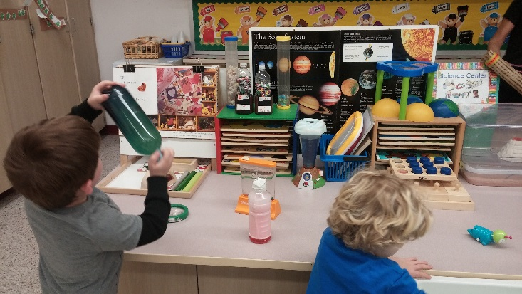
Preparation for Kindergarten
The SCOPE UPK/PRE-K program enhances a child’s readiness skills to support a smooth transition into Sachem Kindergarten classrooms.
ASPECTS OF THE CURRICULUM
Letter and sound recognition
Language and Listening Skills
STEAM skills
Social/Emotional skills
Development of fine/gross motor skills

Slide 10

Parent Involvement
Parents are an important part of the team at SCOPE UPK/PRE-K. Our teachers provide several opportunities for parents to be involved in their child’s learning environment.
Parent/Teacher Conferences
Meet and Greet
Evening Open House
Mystery Reader
Class Sing Alongs
Helping Hands
Special Occasions

Slide 11
IN ADDITION….
Progress reports are distributed twice per year.
Monthly Newsletters keeps families informed.
Every classroom is supplied with a SCOPE cell phone.
Guardians are required to sign student in and out each day. Photo ID is required at dismissal time.
Classrooms are peanut free.
Please discuss any medical concerns or student allergies requiring an Epi-pen with classroom teacher prior to the start of the school year.
Teacher and teacher assistants are CPR/FA certified

Slide 12
Registration Requirements
Students should be fully immunized upon entrance, according to state guidelines.
Physicals should be up-to-date.
Two proofs of residency required upon registration. A list of acceptable documents will be provided.
All families must agree to parking and attendance guidelines as explained in the beginning of the school year.

