Slide 1
Oregon Kindergarten Assessment
Hood River County School District
August 14, 2013

Slide 2
Background
In 2012, House Bill 4165 directed the Early Learning Council and the Department of Education to develop the Oregon Kindergarten Assessment (OKA) in order to answer the following questions:
Are Oregon’s children arriving at kindergarten ready for school?
Is the level of school readiness improving or declining over time?
Are there disparities (geographical, cultural, racial, and socio-economic) between groups of children?
Are there particular domains of school readiness that Oregon should target?

Slide 3
What is it?
The OKA includes measures of early literacy, early math, social-emotional development, approaches to learning, and self-regulation.
The OKA is an operational field test. No individual student results will be reported back to schools or parents.
The district will be rated by participation, not by results. Participation is defined as the student attempting to answer one early literacy question OR one math question.

Slide 4
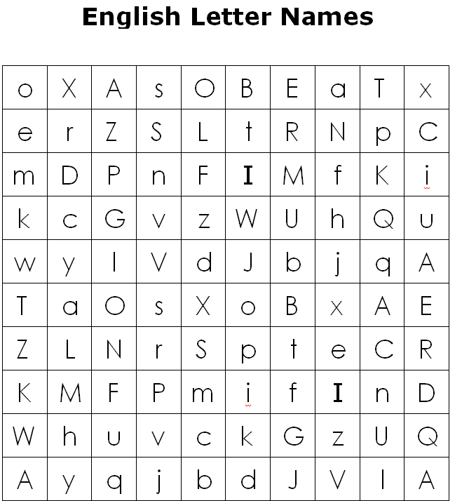
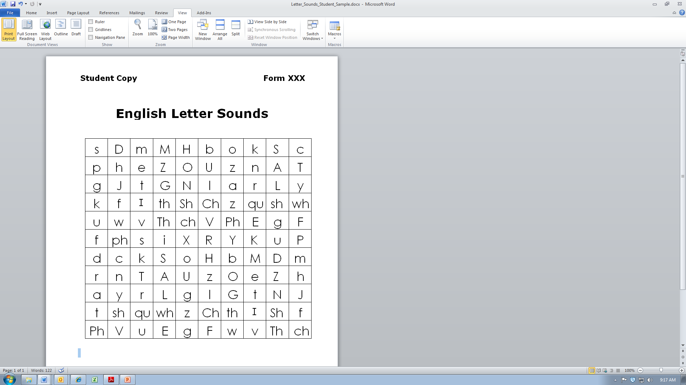
What does it look like?
Early Literacy
SAMPLE
SAMPLE

Slide 5
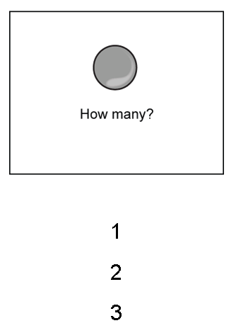
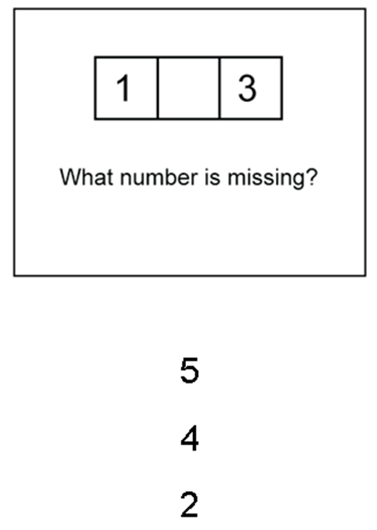
What does it look like?
Early Numeracy

Slide 6
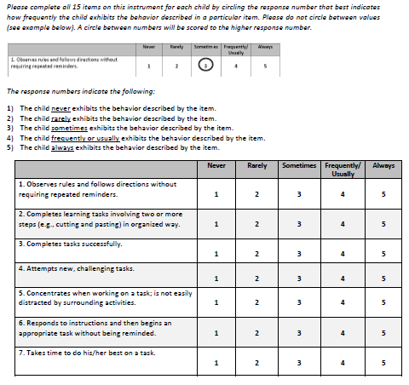
What does it look like?
Approaches to Learning

Slide 7
When does it take place?
Starting this fall, all school districts in the state will administer the OKA to entering kindergarteners during the first six weeks of school.
The Approaches to Learning portion is completed by the student’s teacher at some point during the last three weeks of the assessment window. The student need not be present when this portion is completed.

Slide 8
How will we do it?
Kindergarten teachers will receive training in the OKA during their regular inservice activities before the start of the school year.
The administration of the OKA will be embedded into the usual and customary activities of new kindergarteners on a rolling start.

