Slide 1
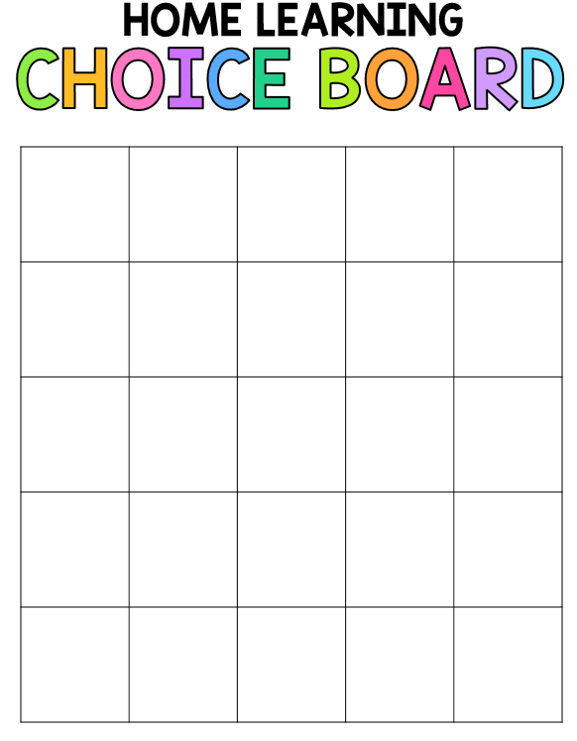
Writing
Make a list of your favorite foods
Journal
Write a sentence using your sight words
Write a sentence about a book you have read
Write 5 words that describe you
JournalFree Write
Complete 3 pages of your handwriting book
Write two sentences about the weather
Write a Short poem
Write about your favorite animal
How many times can you write your name in a minute?
Write about how you celebrate the 4th of July
Journal
How can you help the Earth?
Free Choice
Complete 3 pages of your handwriting
book
Make a list of things in your bedroom
Journal
What do you see in the clouds?
Make a list of words that rhyme
cat-hat
Write an email to your teacher
Write about what the President does
Write about a non-living thing
Make a list of insects
Write about a living thing
Journal
Write a sentence using your sight words
Write a letter to someone you care about
Journal
What are the signs of Spring?

Slide 2
Math
Find the coin that’s worth
1 cent
5 cents
10 cents
25 cents
Draw a picture using different shapes
Show the # of pennies equal to nickel
dime, quarter
Play a board game
play outside
Use a recipe to cook/bake something with a family member
Use objects to create patterns AB, AABB, and AABB
Draw a number line 1-20
Count to a Sibling/Pet/stuffed animal
Create a “Minute to Win It” game
Create a weather graph for April
Make a paper airplane
Free Choice
Sort a handful of coins
Complete
the 100’s chart mystery picture
Complete the Earth Day mystery picture
Complete “I Can Subtract Up to 10”
Count backwards
from 20-1
Create a weather graph for May
Complete ”I Can Write Numbers to 100”
Count by 2’s, 5’s, 10’s to 100
Complete “Positional Words”
measure things in your house
Use tally marks to show how many rolls of toilet paper you have
Go on a shape hunt
Find a circle, square, triangle, rectangle

Slide 3
Reading
Find objects around the house that rhyme
Read your sight words while doing jumping jacks
Go on a letter hunt in a magazine
Make letters with play-doh
Read a story with an adult
Read a recipe to cook/bake something with a family member
Read your sight words to a stuffed animal
Read a book under the covers with a flashlight
Spell the words sun, cat, dog, lip, net
Play memory with your sight words
Flashlight Game:
1. Turn off lights
2. Tape sight words on the wall
3. Shine a flashlight on the words your read
Record yourself reading
Free Choice
Find things outside that start with all of the letters A to Z
Write a letter to someone you love
Lay on a blanket outside and read your favorite book
Call a family member
Read all of your sight words as fast as you can
Spell the words bag, top, hut, bit, peg
Take a nature walk and find things that rhyme
Write your sight words with sidewalk chalk
Make letters with cereal, beans, noodles, etc.
Hunt for sight words in your favorite book
Practice reciting your address and phone number
Tell the beginning, middle, and end of your favorite story

