Slide 1
K’4 Clanship
Kindergarten: Maternal Clan

Slide 2
Din4 Culture
Kindergarten Student Friendly Objective:
I will identify and name kinship term for Mother.

Slide 3
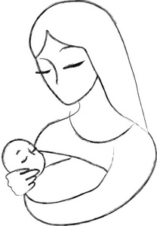
Din4 Clanship
Shim1
Notes:
Students will draw and trace the word shima on their worksheet.

Slide 4
Din4 Culture
Kindergarten Student Friendly Objective:
I will identify and name kinship term for Mother and her clan.

Slide 5
Din4 Clanship
Shim1 Ma’iiDeeshgiizhnii nil9.
Notes:
Students will draw and trace the word shima on their worksheet.

Slide 6
