Slide 1

Welcome to
Heritage Elementary!
2022-2023

Slide 2
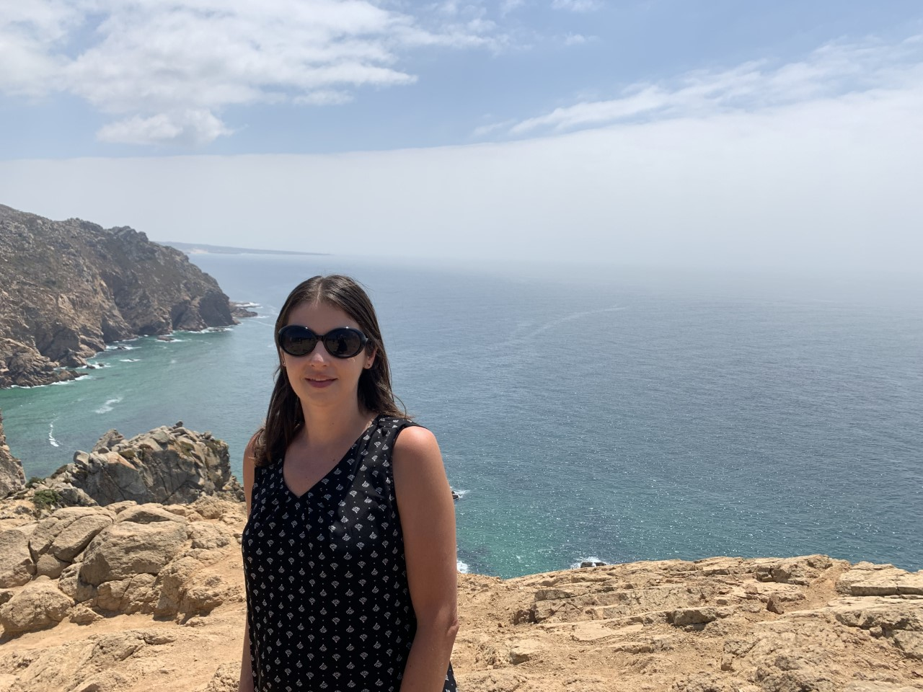
Ms. Huffman
My name is Michelle Huffman. This will be my 19th year of teaching. I have been at Heritage Elementary for 15 years. My experience is 12 years in kindergarten, 5 years in first grade, and one year as a Reading Specialist. I am so excited to be back in kindergarten this year!
I graduated from UNCW with a Bachelor’s Degree and Master’s Degree in Elementary Education. I am also a National Board Certified Teacher.
Things I like: traveling, going to the beach

Slide 3

Nightly Routine
Every night your child will bring home their folder.
Please put money in an envelope in the front pocket (lunch, field trips, etc.- please write a note indicating what the money is for).
You will write any notes to me/other school officials and place inside the pocket as well.

Slide 4

Homework and Newsletters
Homework should take less than 30 minutes
Newsletters: Will come home periodically to review material covered.

Slide 5
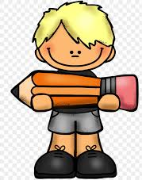
Behavior Policy
Please sign my behavior policy.
It will be kept in the Homework Folder.
Thank you!

Slide 6

Bus and Pickups
For the first two weeks of school, your child must wear their tags that identify if they are bus riders or pickup. Any changes to their afternoon routine must be accompanied by a note that states:
Child’s name
Teacher’s name
Bus #
Address
No bus changes by phone or e-mail (only written notes or a fax will be accepted).

Slide 7

Pick Up Procedure
Pick-up will begin at 3:00 in the pick- up line. Please be punctual but not early.
If you have an older sibling, they will be picked up with my class every day !
**There will be no check-outs after 2:45 p.m.

Slide 8

Morning Routine
You may bring your child in the first week to walk him/her through the morning routine.

Slide 9

Lunch
Cost of Lunch is
  full price $2.50
  Reduced price $0.40
Milk .50
Cost of Breakfast is
  Full price $1.25
  Reduced price - free
Online meal payments are available at www.k12paymentcenter.com
Free and Reduced applications are available at https://www.lunchapplication.com/

Slide 10

Snack
Please send in a snack daily.
We will have a snack time designated daily.

Slide 11

Enrichment Schedule
Wave Days
9:00- 9:45
A-No Special
B-PE
C-Music
D- Art
E-Media and Community Leadership
A calendar with letter days will be placed in your child's red folder.

Slide 12

Tentative Daily Schedule
8:15-8:30: Morning Time
8:30-9:00: Math
9:00-9:45 Specials
9:45-10:15 Math
10:15-11:15 CKLA
11:15-11:45 Lunch
11:45—12:00 Flex
12:00-1:00 CKLA
1:00-1:30 Interventions
1:30-2:00 Recess
2:00-2:45 Science and Social Studies
2:45-3:15 Flex

Slide 13

School Fees
The Art and Instructional Fees have been waived for this year.
Each student will need to pay a Technology Fee which is $25.00.
This fee can be paid online or you can send the money in.
https://onslow.schoolcashonline.com/

Slide 14
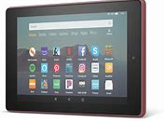
Tablets
*Fully Charged Tablets must come to school every day when they are sent home.

Slide 15
Supply List
***Please label all of your child's school supplies.
1 large backpack (no wheels please)
1- 1 inch 3 Ring Binder (white, hard cover with sleeve on cover)
1 small pack of sheet protectors
4 wide ruled spiral notebooks (blue, green, red, and yellow)
2 pocket folders (blue and red)
4 packs of glue sticks
4 boxes of 24 count crayons
24 pencils (not mechanical)
1 Pair of child safety scissors (blunt tip)
1 set of headphones with a straight plug in (no earbuds)
2 flat zippered pencil pouches
1 pack of 3x5 index cards
4 pack of expo markers (skinny black)
1 water bottle
**Change of clothes in a gallon zipper bag to keep at school in case of an accident.

Slide 16
Donations
Donations are greatly appreciated. Items that are constantly needed are:
Baby Wipes
Clorox and Lysol Wipes
Tissues
Zip-lock Bags

Slide 17

Email/ Remind Messaging
I will be using Remind as a communication tool this year.
https://www.remind.com/join/c9ahc9
Text @c9ahc9 to the number 81010
You will receive a welcome text from Remind.
If you have trouble with 81010, you can try texting @@c9ahc9 to (571) 364-6571.
My email is michelle.huffman@onslow.k12.nc.us

Slide 18
I look forward to working with your child this year. I am excited to see them grow and learn so much this year. It is going to be a great school year!

