Slide 1


Welcome to the
2022-2023
School Year!
We Bloom Where We’re Planted…
Let’s GROW Together.
It’s GROW Time!!

Slide 2

Introductions
SCHOOL COLORS SCHOOL MOTTO SCHOOL MASCOT
Navy and White Expect More...Achieve More Tiger Cub
Carol Bowie-Cotton, Principal
Brian Gough, Assistant Principal, Grades 2 & 3
Jennifer Carter, Assistant Principal, Grades Prek, K, 1
Diondra Reynaud, Assistant Principal, Grades 4 & 5
School Office Specialists School Nurse Counselors
Shanice Hill Chrissy Rockefeller Frank Clavelle, Jr.
Kara Matherne Xylina Eyemaro
Victoria Ford
Behavior Interventionist Mental Health Professional
Valerie Rogers Britany Wright

Slide 3
All about Kindergarten and Mrs. Vicknair
WELCOME TO KINDERGARTEN AND TO OUR CLASS!
Teaching is my absolute love, joy, and passion! Kindergarten is truly the most amazing place to be! It amazes me each year to see each student’s growth and progress! I have been in education for 12 years! I have taught kindergarten at Luling Elementary school for 11 years! I spent one year as an instructional coach for the district, but I quickly learned that my heart will always be in the classroom! I love Luling Elementary school! I love all my families and students that I have the honor of teaching and learning with! This year will be an amazing one! I am so honored and thankful to be your child’s kindergarten teacher! I look forward to an amazing learning journey that is filled with success and growth!
Please don’t hesitate to contact me if you need anything or have any questions!

Slide 4
All about Kindergarten and Mrs. Albert
WELCOME TO KINDERGARTEN AND TO OUR CLASS!
Welcome families!!! I have been teaching as a Special Education teacher for 6 years! I had the opportunity to co-teach in the Kindergarten classroom last year at LES and absolutely loved it! Prior to teaching, I was an ABA (Applied Behavior Analysis) Therapist and worked with many kids of various ages ranging from 2 years old up to 18! As an ABA therapist, I found my passion for teaching, as I would go to many of my client's schools to conduct their therapy. I was able to help support many teachers with the students who received ABA therapy, but ultimately felt I could make a greater impact becoming a Special Education teacher. My goal as a teacher every year is to help support all students, and have a lasting, positive impact on your child. I am so excited to begin a new journey this year with all of our students and can't wait to see them grow academically, socially, and all around throughout the year!
Please feel free to contact me via School Status or e-mail with any questions or concerns that may arise throughout the school year!

Slide 5
School Hours for Students
Arrival – 7:40-7:50 AM
Tardy Bell – 7:50 AM
Dismissal – 2:50-3:00 PM
Dismissal for Early Dismissal Days – 11:55 AM-12:05 PM

Slide 6
Attendance
According to state law, elementary school students must be in attendance a minimum of 167 days per school year. Students’ absences cannot exceed 10 days for the school year. Exceptions can be made only in the event of personal illness or circumstances as approved by the Parish Supervisor of Child Welfare and Attendance. The supervisor requires documented excuses for each and every day of absence.
All absences must be excused within 3 days of the absence by parent note (2 days per nine weeks), medical note from physician or state-licensed nurse practitioner, or extenuating circumstance approval. Refer to the District Code of Conduct for additional information.

Slide 7
Truancy
Notification sent by School Office Specialist(SOS) if a student misses 3 days whether they are excused or not excused(this includes; tardies and early check out)
Notification sent by School Office Specialist (SOS) if a student misses 5 days(this includes; tardies and early check out) and this is reported to Child Welfare & Attendance(CWA) and the Louisiana Department Educational reporting system

Slide 8
Responsive Classroom:
Luling Elementary Behavioral Philosophy
Responsive Classroom is an evidence-based approach to teaching that focuses on engaging academics, positive community, effective management, and developmental awareness. (Responsiveclassroom.org)
Builds community amongst classroom teacher and students through daily Morning Meeting. (Includes greeting, sharing, team-building activity, and a message.)
Proactive strategies include interactive modeling, creating rules with students, and effective teacher language.
Logical consequences used as needed, related to the behavior.

Slide 9
Dress Code Expectations
As part of SCPPS Dress Code Policy, students are to not wear hoods on their heads on the school campus. Parents are highly encouraged to send their children to school with jackets and/or sweaters without hoods to remove the temptation of a student putting a hood on their head during the school day. Students will receive consequences for having a hood on their head during the school day on the LES campus.
Blue school spirit shirts can be worn Monday through Friday.
Club shirts may only be worn at designated times and will be communicated to families in advance.
School spirit shirts must be purchased from the school office.
Students may wear jeans every Friday only if it is worn in conjunction with a navy blue collared shirt, white collared shirt, or blue school spirit shirt. Jeans must be free of rips, tears, frays, and holes.
Students cannot wear pullover hoodies; only jackets that open the entire front may be worn with hoods.
Students are discouraged from open-toe sandals and heels to school due to potential hazards during physical activities. Shoes must have foot restraints for the entire foot. Backless shoes and crocs are not allowed (ex. flip-flops, backless sandals, etc.) Shoes that are deemed unsafe by administration will not be allowed at school.

Slide 10
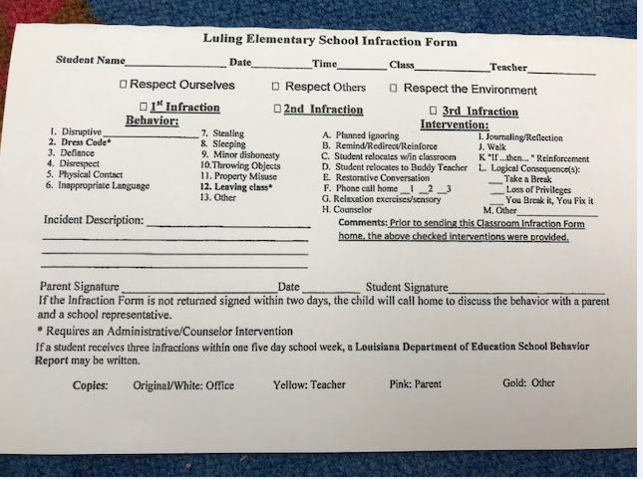
Responsive Classroom Intervention Form:
Luling Elementary Behavioral Philosophy
What is the Responsive Classroom Intervention form?
It is a form used as a means of communication between teachers and parents.
The form notifies parents of incidents that have occurred in the classroom, as well as interventions that have been used to redirect the misbehavior.

Slide 11
LES School Expectations
Luling Elementary School We are a FAMILY. We will treat each other with respect and kindness.
 | TAKE CARE OF YOURSELF | TAKE CARE OF OTHERS | TAKE CARE OF LULING

Slide 12
Cell Phones &
Other Electronic Devices
The use of cell phones and other electronic devices are prohibited during school hours or at any school sponsored activity. If heard or used during school hours, the device will be confiscated and held by administration according to the timeline noted in our Student Code of Conduct: District Handbook, if violations occur. School hours are from 7:40 AM to 3:05 PM.

Slide 13
Housekeeping
Please make sure to send a snack daily! It needs to be consumed in 5-10 minutes. Also, you can send daily, weekly, or a box that I store. They can also have a bottle full of water. If it has juice, it will be dumped and filled with water. This is for their health purposes.
Please pay the supply and technology fee. The supply fee is $8.00 and the technology fee is $20.00. If you are writing a check, it needs to be two separate checks made out to Luling Elementary.
Please send an extra set of clothes. This needs to include a top, bottom, undergarments, and socks. It does not have to be a uniform!

Slide 14
Assessments & Grading
This year grading will be different.
Your child will be scored on a 1, 2, or 3.
Please be on the lookout for a form that will go into more detail about the new grading system.
I will be in constant contact regarding your child’s progress.
The assessments will be a combination of paper/pencil and anecdotal notes.

Slide 15
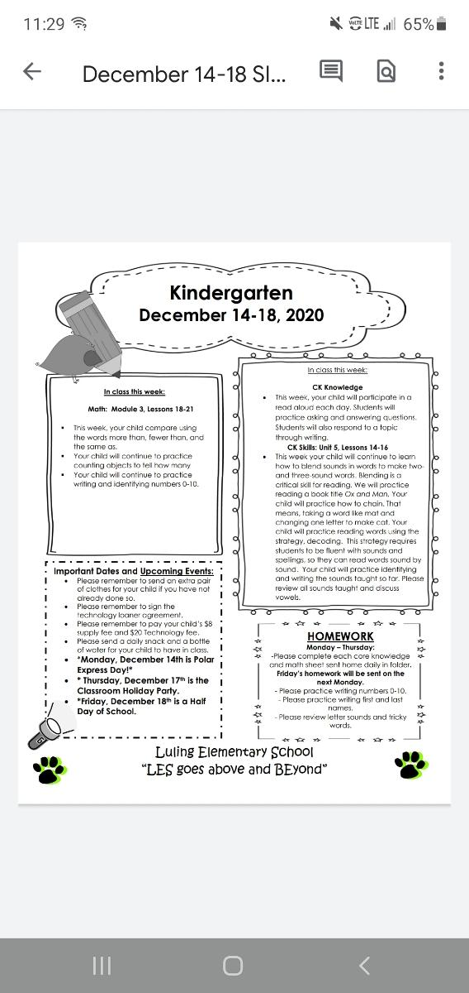
Stakeholder Information Sheet
This will be posted to our Google Classroom and my teacher webpage every Monday morning by 7:40 a.m.
It will be kept on the front cover of your child’s homework folder for the ENTIRE week!
If you need to send any notes or money, please place it in the money and notes pouch that will be at the front of your child’s folder. each week.

Slide 16
Wednesday Folders
Folders are sent home weekly on Wednesdays.
Wednesday folders include work for the week, important documents, flyers, and other important information.
Be sure to check your child’s Wednesday folder and sign that you reviewed it.
It is important to review all the work because it gives you insight to what we are learning and how your child is preforming.

Slide 17
Parent Communication/School Status
I am always available if you need me. Please contact me through school status.
The number to school status is the one I call and text on.
If you try and call back, it is important for you to leave a voicemail so I know you called. If you are not comfortable leaving a voicemail then send a text asking me to return your call. The APP for some reason does not ring.
School Status is a parish wide App that is used to communicate. It records our phone calls and text messages.

Slide 18
Emergency Cards
These must be updated if there are any changes.
      Address—must have provided two proofs of residency to SOS
      Phone numbers
      List of people that can pick up in case of emergency
      ****Note: If a person is not listed on a student’s emergency card, they can not pick up the student**

Slide 19
Cafe
We will not have any lunch visitors for the first six weeks of school to help our students adjust and learn the routines of the cafeteria. When we begin having lunch visitors, we will need parents/legal guardians to contact Ms. Valerie Rogers at 985-786-6086 or vrogers@stcharles.k12.la.us at least 24 hours prior. You will receive a confirmation email from Ms. Valerie Rogers confirming your visit. You must receive a confirmation email in order to have lunch with your child. Please only sign up one time in the month to allow for all parents to have an opportunity to eat with their child. Due to capacity, we must limit five parents per grade level per day. In order to eat lunch with students, the person must be on the child’s emergency card.
Parents/legal guardians wishing to eat lunch with their child must first check in at the office with identification to receive a visitor’s pass and special lunch date form. Parents/legal guardians will present the form to cafeteria monitors and sit with their child in the designated area on the stage. Students may not invite friends to join them. Parents must return the visitor pass to the office immediately after lunch.
If you are planning to eat lunch with your child and will need a school lunch, you must notify Ms. Valerie Rogers in email when requesting to come to eat lunch with your student that you will be eating(purchasing) a cafeteria lunch. If you have not pre ordered a cafeteria lunch, one may not be available, but you are welcome to stay and sit with your child while he/she eats at a designated table.

Slide 20
Luling Elementary School &
Federal Programs
St. Charles Parish Public Schools
Outcome
Become familiar with Title I
      Services
      Requirements

Slide 21
Federal Programs

Slide 22
Purposes of Title I
To provide funding to assist at-risk students in becoming more successful.
Funding is determined by the level of poverty at the school
Services are provided to students who are academically in need.
Title 1 services are provided above that of the district.

Slide 23
Title I Funding
K-5 Literacy Interventionists
Family Center Literacy Teacher
Technology
Homeless Student Support
Materials & Supplies for teachers to support teaching and learning

Slide 24
Title I Requirements
The district and school must have a written parent involvement policy that is reviewed annually.
Parent’s right to know – teacher and paraprofessional qualifications
Parent’s right to know – student achievement
Parent’s right to know – non-highly qualified teachers
School/Parent/Child Compacts

Slide 25
Contacts for Title I
Director of Federal Programs
    Patricia Smith
Title I Coordinator
    Lacey Powers

Slide 26

We look forward to “GROWing” together this school year.

