Slide 1
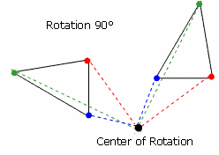
Transformation
Rotation
8th Math
Presented by Mr. Laws

Slide 2
Standard
8.G.3 - Describe the effect of dilations, translations, rotations, and reflections on two-dimensional figures using coordinates.

Slide 3
Essential Question
How can I describe the effect of rotating a two-dimensional figure on a coordinate plane?

Slide 4
Target Statement
I CAN rotate a two-dimensional figure counterclockwise or clockwise 90⁰, 180⁰, or 270⁰ around a coordinate plane.

Slide 5
Rotation
A rotation is a transformation that is performed by "spinning" the object around a fixed point known as the center of rotation.
You can rotate your object at any degree measure, 90° and 180° are two of the most common but the object can rotate at 270⁰.
Also, rotations are done clockwise or counterclockwise!(about the origin)

Slide 6
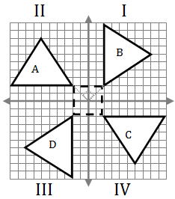
Orig. Image
90⁰
Clockwise
Counterclockwise
Center of Rotation
Counterclockwise
Clockwise
270⁰
180⁰

Slide 7
Rotating Figure on a Coordinate Plane
Example # 1: Rotate the following coordinates 90⁰ Counterclockwise on a coordinate plane. .
A (2,5), B (2, 1), C (8, 1)
4. Identify what Quadrant the coordinates are located on the coordinate plane.
5. Find the quadrant the rotating figure will be moving to. Ex. “rotate figure 90⁰ counterclockwise” will move the figure in the quadrant II on the coordinate plane. To move the object “about the origin” is to move clockwise.
Write out the coordinates for quadrant II as follows and graph them.
Ex. A’ (-5, 2), B’ (-1, 2), C’ (-1,8),
What do you notice about the new coordinates?

Slide 8
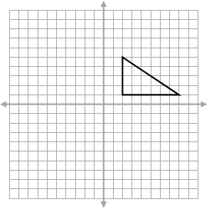
Example# 1 Rotate image 90⁰ Counterclockwise
C’
Quad II
90⁰
A’ (-5, 2)
B’ (-1, 2)
C’ (-1, 8)
Quad I
Orig. Image
A (2, 5)
B (2, 1)
C (8, 1)
A
A
B’
A’
B
C
C’
B’
Quad III
180⁰
A’ (-2, -5)
B’ (-2, -1)
C’ (-8,-1)
B’
A’
Quad IV
270⁰
A’ (5, -2)
B’ (1, -2)
C’ (1, -8)
A’
C’

Slide 9
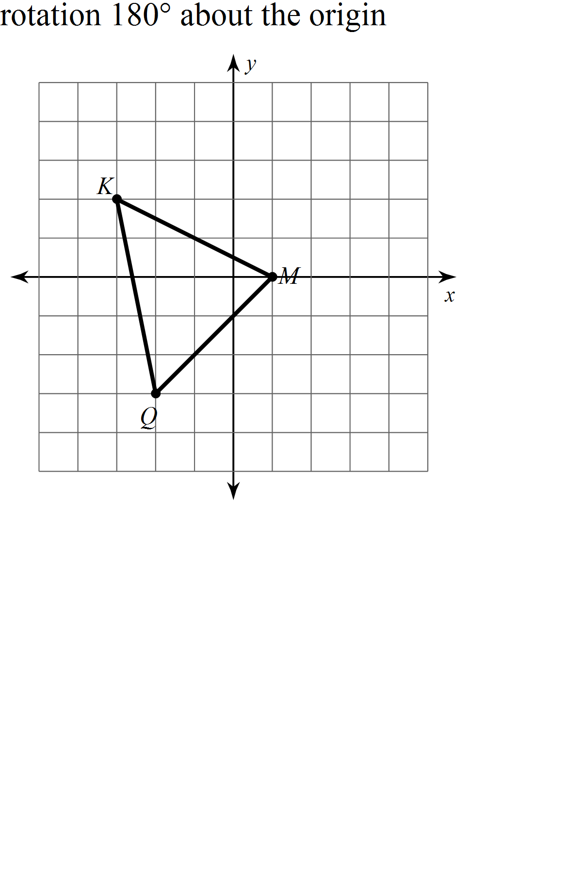
Example # 2
Original
M (1, 0)
K (-3, 2)
Q (-2,-3)
New Figure
M’ (-1, 0)
K’ ( 3, -2)
Q’ (2, 3)
Q’
M’
K’
Notice that each point moved 180⁰ counterclockwise into a different quadrant.

Slide 10
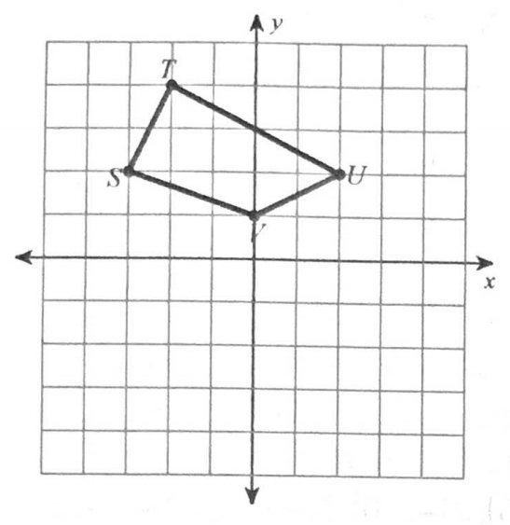
Example # 3
rotation 90⁰ clockwise about the origin.
Original
S(-3, 2)
T(-2, 4)
U(2, 2)
V(0, 1)
S’
T’
New Figure
S’(2,3)
T’(4, 2)
U’(2, -2)
V’(1, 0)
V’
U’

Slide 11
Summary
What are some important steps to remember about rotating a figure around the coordinate plane?

