Slide 1


Slide 2
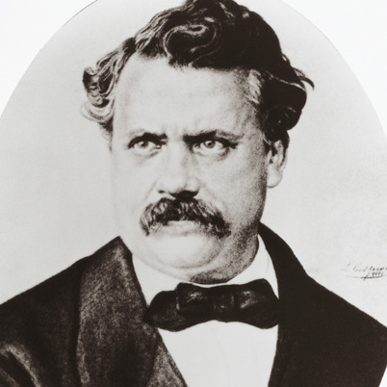
Louis Vuitton
French Entrepreneur
and
Designer

Slide 3
The Goal of This Activity
Read like a detective
Write like a journalist

Slide 4
Your Mission
Read your designated paragraph and pick out important points.
Organize the points on your computer or a separate piece of paper.
Write a paragraph that presents all of the important points in what you read in your own words and style.
Reminders
  Don’t forget to put your name at the top of your paper.
  You’re the detective and the journalist!

Slide 5
Read this like a Detective:
The trunks proved an immediate commercial success, and advances in transportation and the expansion of travel placed an increasing demand for Vuitton's trunks. In 1859, to fulfill the requests placed for his luggage, he expanded into a larger workshop in Asnieres, a village outside Paris. Business was booming, and Vuitton received personal orders not only from French royalty but also from Isma'il Pasha, the Khedive of Egypt.

Slide 6
Read this like a Detective:
The trunks proved an immediate commercial success, and advances in transportation and the expansion of travel placed an increasing demand for Vuitton's trunks. In 1859, to fulfill the requests placed for his luggage, he expanded into a larger workshop in Asnieres, a village outside Paris. Business was booming, and Vuitton received personal orders not only from French royalty but also from Isma'il Pasha, the Khedive of Egypt.
Write this like a Journalist:
By 1859 business was so good that Vuitton had to move his workshop to a small village outside of Paris. The reason his business became a commercial success was because of advances in transportation and the expansion of the travel industry. The trunks Vuitton made were so popular that he received personal orders from French and Egyptian royalty.

Slide 7
Read this like a Detective
In 1870, however, Vuitton's business was interrupted by the outbreak of the Franco-Prussian War and the subsequent siege of Paris, which gave way to a bloody civil war that destroyed the French Empire. When the siege finally ended on January 28, 1871, Vuitton returned to Asnieres to find the village in ruins, his staff dispersed, his equipment stolen and his shop destroyed.

Slide 8
Read this like a Detective
In 1870, however, Vuitton's business was interrupted by the outbreak of the Franco-Prussian War and the subsequent siege of Paris, which gave way to a bloody civil war that destroyed the French Empire. When the siege finally ended on January 28, 1871, Vuitton returned to Asnieres to find the village in ruins, his staff dispersed, his equipment stolen and his shop destroyed.
Write this like a Journalist
In 1870, Vuitton's career was stopped by the beginning of the Franco-Prussian War and the later siege of Paris, which resulted in a bloody civil war that put an end to the French Empire When the siege completely ended on January 28, 1871, Vuitton went back to Asnieres to discover the village badly damaged, his workers disappeared, his work things stolen and his shop demolished.

