Slide 1
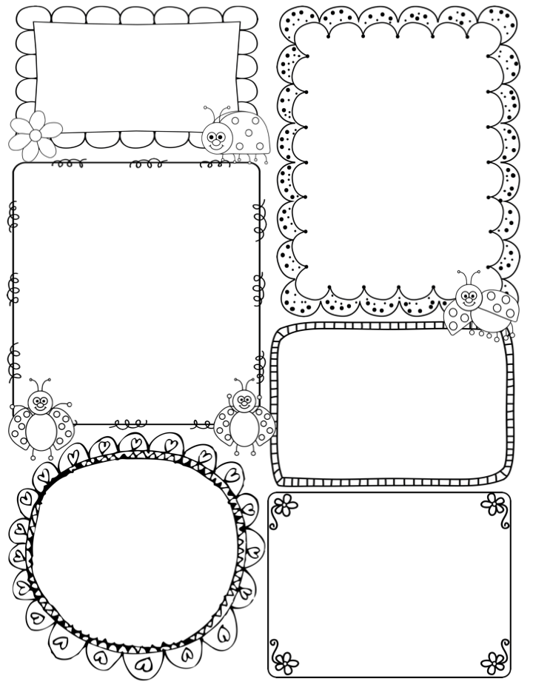
Clark’s Tidits
April 10th-14th
Upcoming Items:
April 10th – Report Cards sent home in red folders
April 14th – Focused on Friends… wear your green shirts
April 20th: Lowry Nature Center Field Trip 9:05 – 3:30
April 20th : First Grade Music Program 7p.m. at Red Oak
April 21st – Crazy Clothes Day!
April 27th:EL Family Book Making Event at 6:45 in Hawk Cluster
April 28th: Focused on Friends… wear your green shirts
May 4: Focused on Friends… wear your green shirts
May 18th: Last Focused on Friends
May 19th: Track and Field Day
May 25th: Last Student Day!
Math: We will start learning more about money. We will learn how to add groups of coins together and will learn how to add 2 digit numbers!
Book Reviews: We will continue working on writing fiction book reviews. After reading a book with your child, have your child tell you a book review of it!
Science: We will be getting our baby chick eggs on Monday and will keep them in the incubator and learn all about their life cycle. Hopefully in about 21 days we will have some fuzzy little chicks to look at and hold!
Specials:
Mon: Day 9 Media
Tues: Day 10 Gym
Wed: Day 1 Music
Thurs: Day 2 Gym
Fri: Day 3 Music
-ou- words
found
ground
how
house
plow
Contact Information:
Email: jclark@shakopee.k12.mn.us

