Slide 1
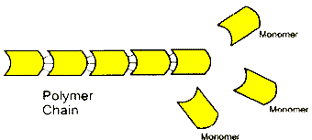
Macromolecules
Biological Macromolecules are large molecules made of small subunits that are essential for all living organisms
  These macromolecules can also be called polymers
    Polymers are made of smaller, repeating molecules
    The smaller molecules are called monomers
    Polymers are created and broken down by chemical reactions: Hydrolysis and Condensation

Slide 2
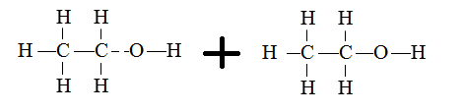
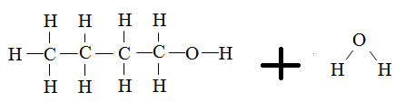
1. Condensation Reaction (aka: Dehydration Synthesis)
Joins monomers together to create a polymer by removing a water molecule from the monomers
  Water is produced
This is the process by which larger molecules are created or built
Example :
  Parts of water (OH & H) are removed from each monomer
  The remaining pieces of the monomer join together to make a polymer
  OH & H come together to form water (H₂O)

Slide 3
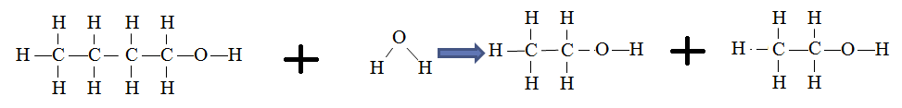
2. Hydrolysis
Hydro = Water ; lysis = to cut/split
Hydrolysis reactions use water to cut or break down polymers into smaller pieces
This is how large molecules are broken into smaller parts
  Digestion of food
  Example:
    Water splits the polymer in half
    The “parts” of water are added to each monomer where the bond was broken
    2 separate monomers are formed

Slide 4
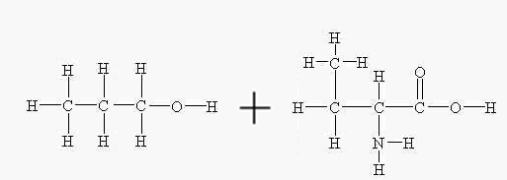
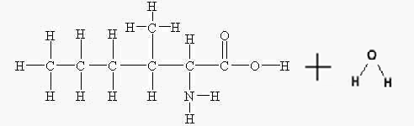



If hydrolysis, a reaction will start with a polymer and water and end with 2 monomers:
If condensation, a reaction will start with 2 monomers and end with a polymer and water:

Slide 5
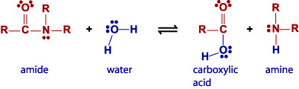
Identify the reaction
Hydrolysis

Slide 6
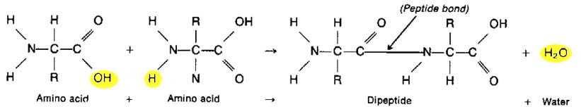
Identify the reaction
Condensation

Slide 7
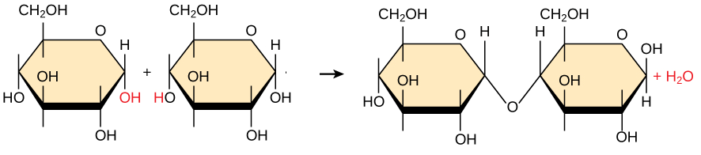
Identify the reaction
Condensation

Slide 8
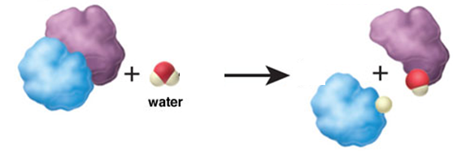
Identify the reaction
Hydrolysis

