Slide 1
Register
http://wvde.state.wv.us/training
  Click “Sign Roster”
  Choose “O365….with Mark Moore”
  Complete until it says “Thank You for Registering”
  Help your neighbor
  If you are not in the database
  http://tinyurl.com/kcgu4p7

Slide 2
Office 365 in West Virginia
Mark Moore

Slide 3
What is it?
New Email
New Storage
New Software
New Communications
New Calendars
All for free

Slide 4
The numbers
20,000 Teachers and Administrators
280,000 K12 students
50 GIG of email storage AND
1 TERABYTE of cloud storage…
PER PERSON

Slide 5
Who gets an account?
YES | NO! | Unknown
K12 Students | Parents | Other Agencies such as:
K12 Teachers | Grandparents | CPD
K12 Administration | Higher Education | Education and the Arts
County Staff
Support Staff (bus, cooks, etc)

Slide 6
New Email Address
mramoore@access.k12.wv.us
mramoore@k12.wv.us
Forward your OLD to your NEW when you are READY
fllll0003@stu.k12.wv.us

Slide 7
Where Do I Find Information?
http://wvde.state.wv.us/office365

Slide 8
Single Sign On
We aren’t there yet….however
Single Sign on to Office 365, WVEIS, Grade Books, Edline, etc.
Individualized filtering!! HELLO PINTEREST!!

Slide 9
What about Snow Days?
OneNote to store all the material needed for the course
Lync to communicate with the instructor
Works online and offline
The possibility exists for “home days” to be “instructional days”

Slide 10
What About my Personal iPad?
Works on all modern devices
5 free installs at home
Works on the Mac
Works on Android
Works on Tablets
Works on whatever tomorrow brings

Slide 11
Best Practices
Do you really want to import your old stuff? Old @access emails? 10 year old emails?

Slide 12
Encryption
Email and OneDrive are encrypted.
Strong Enough for Student Data??

Slide 13
Changes
TechSteps
Common Sense Media
WVEIS
Microsoft IT Academies

Slide 14
West Virginia First in the Nation
First in the nation to have this type of contract with Microsoft. We are their #1 K-12 client

Slide 15
How do I log in?
http://wvde.state.wv.us/office365
or
http://portal.microsoftonline.com
User name = your new email address
Password = you webtop password

Slide 16
Technical Stuff
Office 365

Slide 17
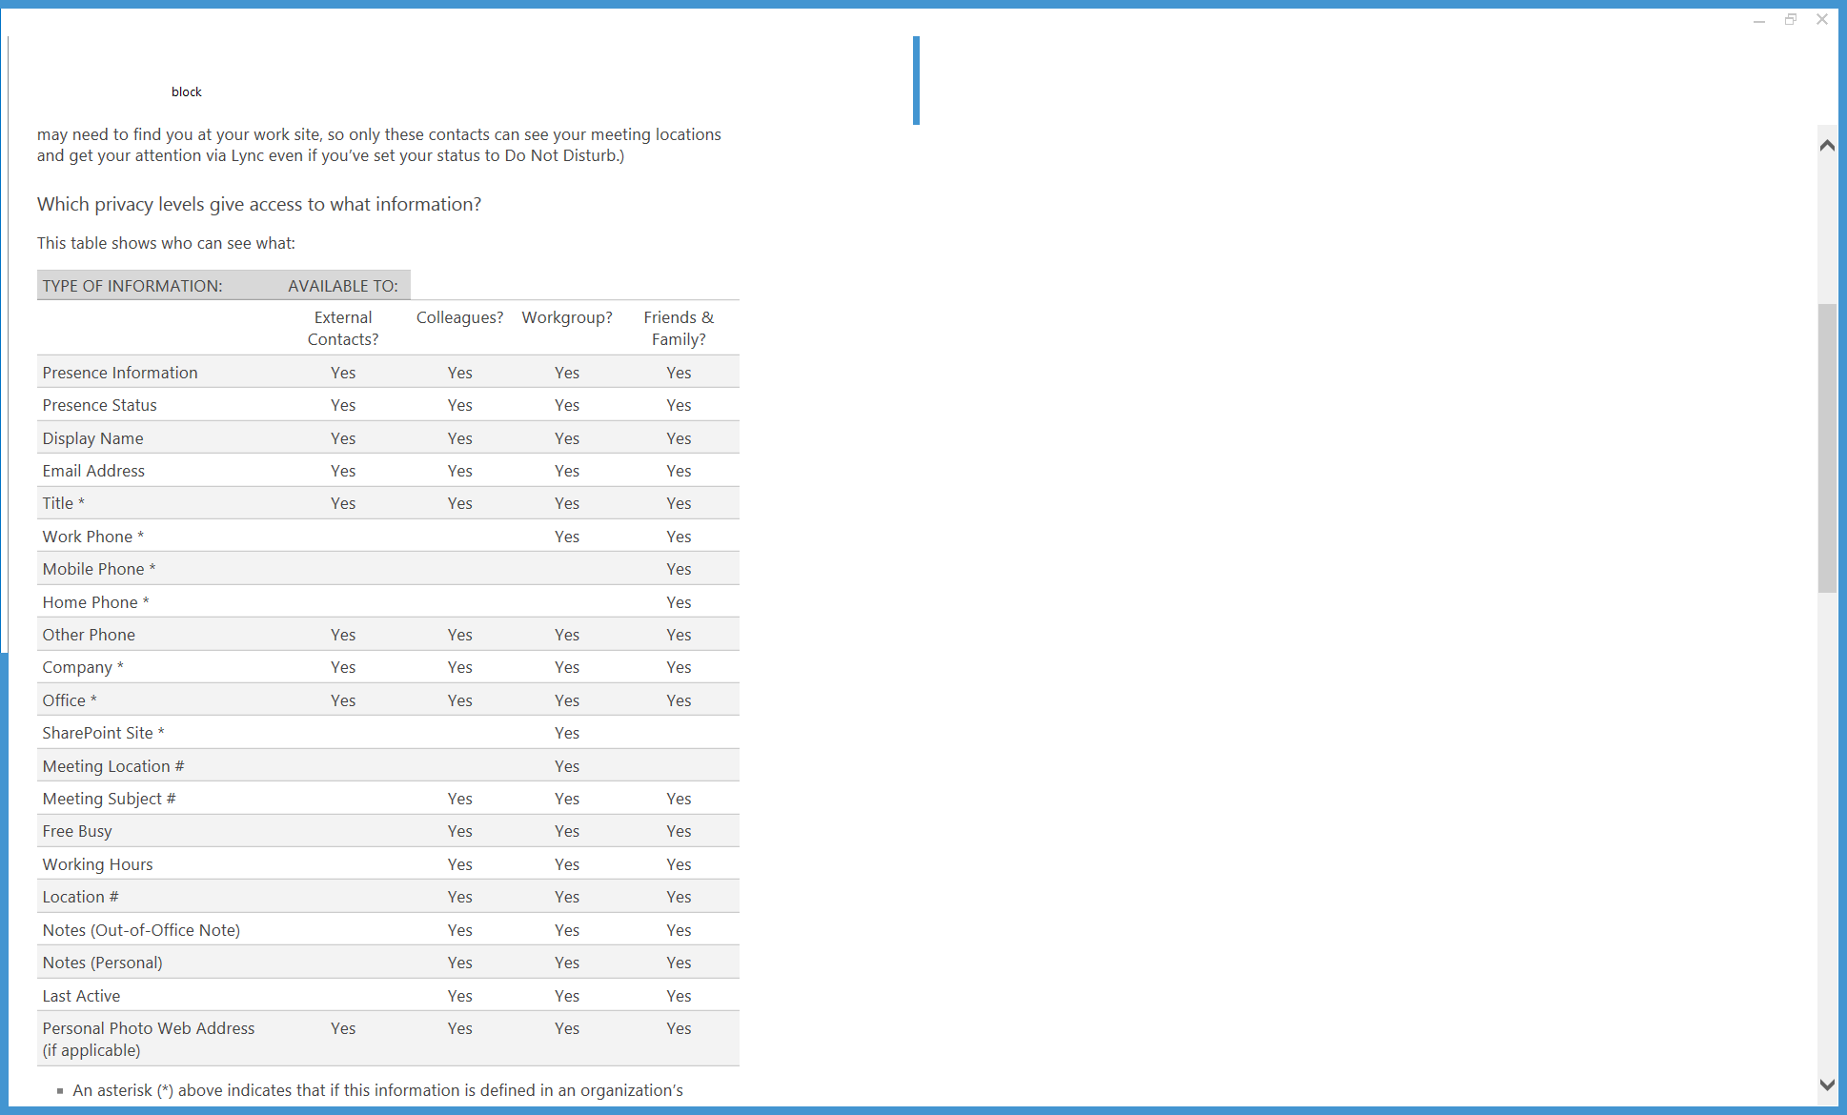
Relationships in Lync

Slide 18
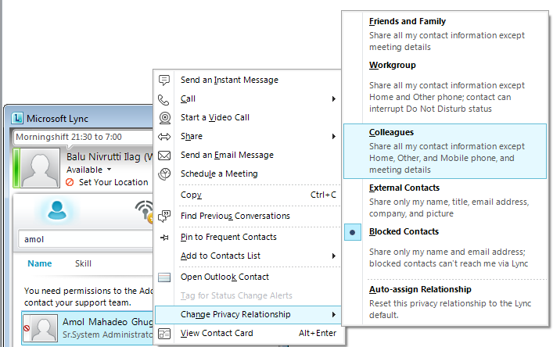
Blocking Someone in Lync

Slide 19
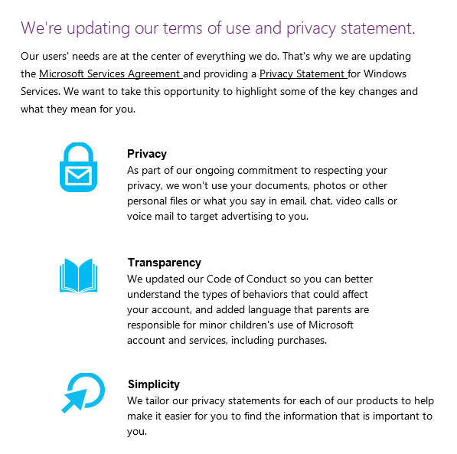
Privacy

