Slide 1
Ish.
Students will be given a visual prompt and asked to estimate how many/much, using the term ish.
The estimates start big and then drill down to smaller place values, gradually getting closer to the exact amount.
For each stage in the sequence, groups should describe the lowest possible answer, the greatest possible answer, and their estimate.
The next slide reveals the previous place value amount, and prompts the next.

Slide 2
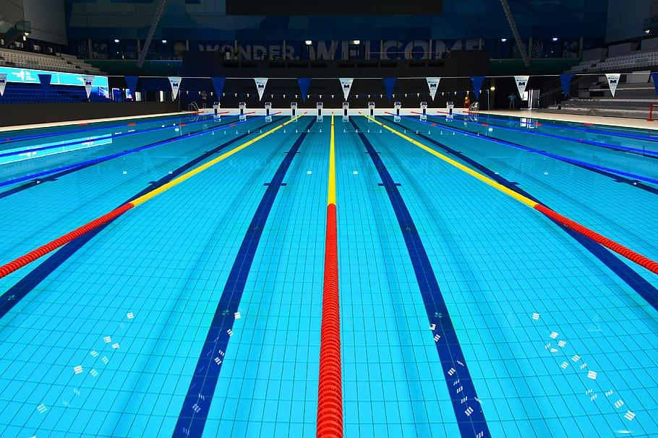
Esti
This pool has __________(ish) liters of water in it.
What could be a reasonable estimate? What’s your best?

Slide 3
A
This pool has 3 million(ish) liters of water in it.
3,000,000
This pool has _____ish liters of water in it. (hundred-thousand)
What could be a reasonable estimate? What’s your best?

Slide 4
B
This pool has 2,500,000(ish) liters of water in it.
2,500,000
This pool has _____ish liters of water in it. (ten-thousand)
What could be a reasonable estimate? What’s your best?

Slide 5
C
This pool has 2,540,000(ish) liters of water in it.
2,540,000
This pool has _____ish liters of water in it. (thousand)
What could be a reasonable estimate? What’s your best?

Slide 6
D
This pool has 2,542,000(ish) liters of water in it.
2,542,000
This pool has _____ish liters of water in it. (hundred)
What could be a reasonable estimate? What’s your best?

Slide 7
E
This pool has 2,541,700(ish) liters of water in it.
2,541,700
This pool has _____ish liters of water in it. (ten)
What could be a reasonable estimate? What’s your best?

Slide 8
F
This pool has 2,541,690(ish) liters of water in it.
2,541,690
This pool has _____ish liters of water in it. (one)
What could be a reasonable estimate? What’s your best?

Slide 9
This pool has 2,541,691 liters of water in it.
2,541,691

