Slide 1

Introduction to
Economic Development

Slide 2

Triple Helix: Partnering in Economic Development
Introduction to Economic Development
Wanetta Ayers
Community and Economic Development Practitioner
(907) 230-2284
wayers@gci.net
@wayers
linkedin.com/in/wanettaayers
Notes:
Economic Development is a team sport. Your team today includes:
Mike Catsi, who is the Business Development Officer with the Alaska Industrial Export and Development Authority or AIDEA. Mike will be playing clean up. His presentation will focus on the process of developing project funding, the financing programs offered at AIDEA, and recent legislative changes that continue to refine the mission and programs of one of our state’s most important assets when it comes to funding development projects.
Rick Wolk is an Assistant Professor of Marketing & Entrepreneurship and the director of the MBA program at the University of Alaska Southeast at the Juneau Campus. Rick will describe the University’s role in economic development, including some of the specialized operating units and programs that are aimed at connecting the University, its faculty, students, and research with the economic development process.
My name is Wanetta Ayers, I am director of the Alaska Division of Economic Development. I will lead off with some foundational information about economic development, the triple helix approach to economic development, and an overview of the Division of Economic Development and how the State’s approach to economic development has been evolving in recent months.
After our initial presentations, we will discuss several examples of the triple helix approach to economic development to illustrate how the approach is or could be used to accelerate the economic development process.
We will leave time at the end of the presentation to address any questions.

Slide 3
Introduction to Economic Development
What is Economic Development?
a program, group of policies, or activity that seeks to improve the economic well-being and quality of life for a community by creating and/or retaining jobs that facilitate growth and provide a stable tax base.
Notes:
According to the International Council on Economic Development, the definition of economic development is:

Slide 4
Introduction to Economic Development
What is Economic Development? It:
takes a long time
requires a lot of resources
requires a lot of human capital
requires consistency and stick-to-itiveness
requires planning, coordination, and doing

Slide 5
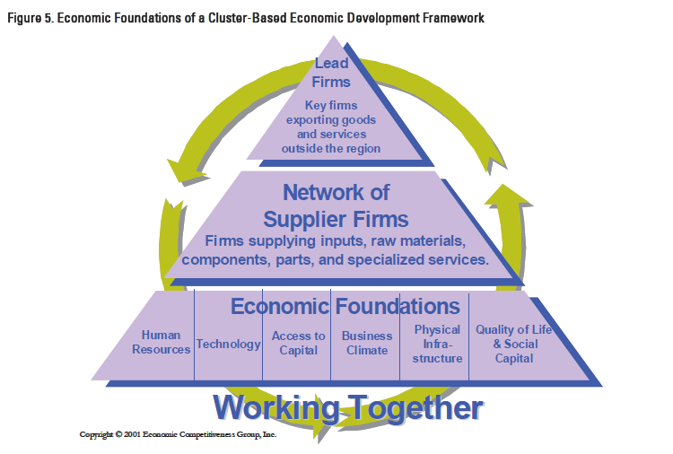
Introduction to Economic Development

Slide 6
Introduction to Economic Development
Notes:
Human Resources
Technology
Access to Capital
Business Climate
Physical Infrastructure
Quality of Life and Social Capital

Slide 7
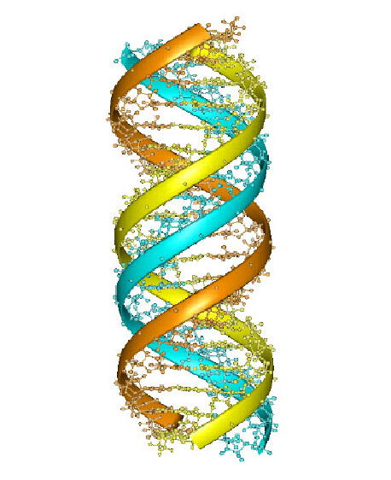
Triple Helix: Partnering in Economic Development
Introduction to Economic Development
Economic Foundations:
Human Resources
Human Resources
K-12 Education
Post Secondary Education
Career and Technical Education
OJT & Apprenticeship
NGOs
USDOL
AKDOLWD
Unions

Slide 8
Triple Helix: Partnering in Economic Development
Introduction to Economic Development
Economic Foundations:
Technology
Technology
Broadband
Research and Development
Commercialization and Technology Transfer
Research Institutions
Skilled Workforce
Incubators & Business Networks
Intellectual Property
Industry-specific Technology

Slide 9
Triple Helix: Partnering in Economic Development
Introduction to Economic Development
Economic Foundations:
Access to Capital
Access to Capital
Fiscal and Monetary Policies
Private Lenders
Leveraged Lending
Development Finance
Venture Capital
Angel Investors
Direct Lending
Other Public Financing

Slide 10
Triple Helix: Partnering in Economic Development
Introduction to Economic Development
Economic Foundations:
Business Climate
Business Climate
Taxes
Regulations
Workforce
Energy Costs
Real Estate Costs and Availability
Market Size
Cost of Living
Quality of Life
Permitting, Licensing, and Reporting
Infrastructure
Incentives

Slide 11
Triple Helix: Partnering in Economic Development
Introduction to Economic Development
Economic Foundations:
Physical Infrastructure
Physical Infrastructure
Surface Roads
Airports
Ports & Harbors
Railroads
Intermodal Cnx
Community Facilities
Utilities

Slide 12
Triple Helix: Partnering in Economic Development
Introduction to Economic Development
Economic Foundations:
Quality of Life &
Social Capital
Quality of Life and Social Capital
Healthiness
Family Life
Community Life
Political Stability & Security
Climate & Geography
Political Freedom
Gender Equality
Arts, Amenities, Mojo

Slide 13
Triple Helix: Partnering in Economic Development
Introduction to Economic Development
Economic Development Functions and Disciplines
Economic Analysis
Economic Development Planning
Place Marketing
Market Development
Business Retention and Expansion
Real Estate Development and Reuse
Development Finance
Entrepreneurial and Small Business Development
Technology-Led Development
Neighborhood Economic Development

Slide 14
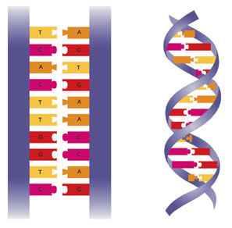
Triple Helix: Partnering in Economic Development
Introduction to Economic Development
The Double Helix:
In molecular biology, the term double helix refers to the structure formed by double-stranded molecules of nucleic acids such as DNA and RNA. The double helical structure of a nucleic acid complex arises as a consequence of its secondary structure, and is a fundamental component in determining its tertiary structure.
-Wikipedia

Slide 15
Introduction to Economic Development
The Triple Helix:
The Triple Helix approach characterizes the relationships between Education, Industry and Government to generate new knowledge, innovation and economic development. Innovation results from a complex and dynamic process of partnering between Education, Industry and Government in a spiral of endless
transitions.
http://triplehelix8.org/about-triple-helix.html

Slide 16
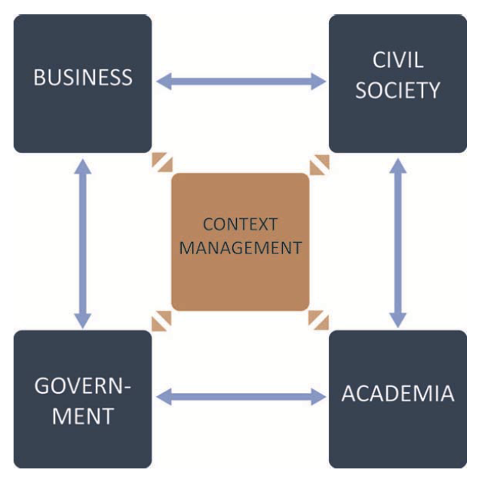
Introduction to Economic Development
The Quad Helix:

Slide 17

Introduction to Economic Development
In the Absence of the Helix:

Slide 18
Introduction to Economic Development
Economic Development is a coordinated investment strategy to achieve economic well-being and improved quality of life.
Economic Foundations are the factors that are the focus of the practice of economic development
Economic Development Functions and Disciplines include analysis, planning, marketing, financing, and technical assistance.
Economic Development Practitioners must master a complex and dynamic process of partnering between Education, Industry, Government, and Society in a spiral of endless transitions.

