Slide 1
Haverford Middle School
Parent Orientation
School Overview

Slide 2
Administrative team
Mr. Daniel J. Horan – Principal
Mr. Matthew Crater – 6th grade administrator
Ms. Ricki White – Guidance Counselor

Slide 3
MIDDLE SCHOOL!@#$%
  Friends
  Teaming
  Exploratory
  Preparing for high school
  Drama
  Independence
  New challenges
  Athletics
  Impulsive
  Tough choices
  Academics
  Self-identity
  Decision-making
  Problem solving
  Sleep patterns
  Relationships
  Activities / clubs
  Changing brains
  Music and the arts
  Social media
  Lockers
  Individual restrooms
  It is all good!!!

Slide 4
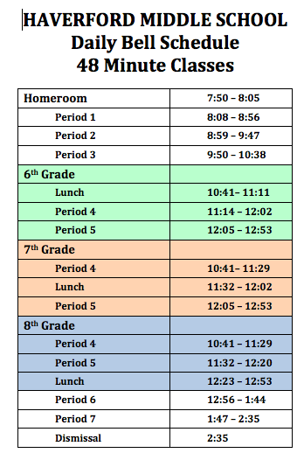
Daily SCHEDULE

Slide 5
FIRST DAY OF SCHOOL
Tuesday, September 3, 2019
We will welcome students and make them feel comfortable ☺
Please have your child bring a combination lock on the first day of school
We will show students how to read their schedules and explore the school
We will hand out student planners and teach students how to use them
Please check out the 6th grade newsletter posted on the HMS website (Academics>6th grade) prior to the first day of school

Slide 6
Leveled classes
Language arts and math classes are leveled by ability and performance.
Science and Social Studies classes are not leveled by ability and performance.
Levels are determined by the use of multiple data points (historical data, predictive data, formative assessments, and summative assessments) and professional input from teachers, curriculum coordinators, and administrators.

Slide 7
Core classes
The core content classes develop literacy, numeracy, and other content specific skills essential for a well rounded academic base.
  48 minute class periods
  Language Arts - 2 periods per day
  Math - 1 period per day
  Science – 1 period per day
  Social Studies – 1 period per day

Slide 8
UNIFIED ARTS
The unified arts classes support the core content area classes and provide an exploratory experience.
Quarter classes – 1 period per day /1 class per quarter
  Art
  Health
  Information Technology
  Spanish & Latin
Daily Classes – 1 period per day
  Physical Education (2 days)
  Music (2 days)
  Developmental Guidance (1 day)

Slide 9
Special Programs
The Pupil Services Department supports students who have special needs.
  Individualized Education Plan (IEP)
  Gifted Individualized Education Plan (GIEP)
  504 Accommodation Plan (504)
Student support team
  Guidance counselor – Ricki White
  Social worker – Mrs. Jocelyn Drucis
  School Psychologist – Mrs. Shukura Monroe
  Case manager for students who have an IEP, GIEP, and/or a 504
  Teaching team
  Parents

Slide 10
PowerSchool
PowerSchool is a web-based teacher grade book that all of our teachers use. You can view PowerSchool at any time to see the grade your child earned for an individual assignment or assessment. PowerSchool will also report an overall grade for each class.
PowerSchool features:
  Student access
  Parent/guardian access
  View current assignments and grades
  Email link to teachers

Slide 11
Notification
June 19th - Leveling letters emailed home
August 2nd – Student schedules will be emailed home
August 8th, 9th, 19th, and 20th - Opportunity to discuss schedules / self-guided tour / 10:00-2:00 PM
September 3rd – First day of school for students

Slide 12
initiatives
School Safety
Relationships, Belonging, and Teaching Tolerance
Academic initiatives in content areas
Student Wellness
Summer Reading & Math
Bring Your Own Device (BYOD) to school and teaching good digital citizenship
Increasing club and community service opportunities

Slide 13
Keys to Success
Encourage and support your child to be actively involved in their middle school experience
Communicate with school and the teaching team
Visit the school, team, and teacher websites on a weekly basis
Visit PowerSchool with your child on a weekly basis
Stay actively involved in your child’s middle school experience
Be available for your child, but recognize when they need to learn on their own

Slide 14
Thank you
Our staff is looking forward to working with you, your family, and your child next year.

