Slide 1
BOISE COUNTY
PUBLIC BUDGET HEARING
TUESDAY
AUGUST 30th, 2022
1:30 P.M.

Slide 4
FY 2022 vs. FY 2023

Slide 5
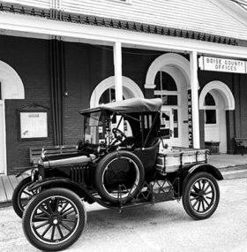
FY 2023
Property Taxes & Levy
Board of County Commissioners chose NOT to levy for a total of $55,348 in property tax budget available for FY2023.

Slide 6
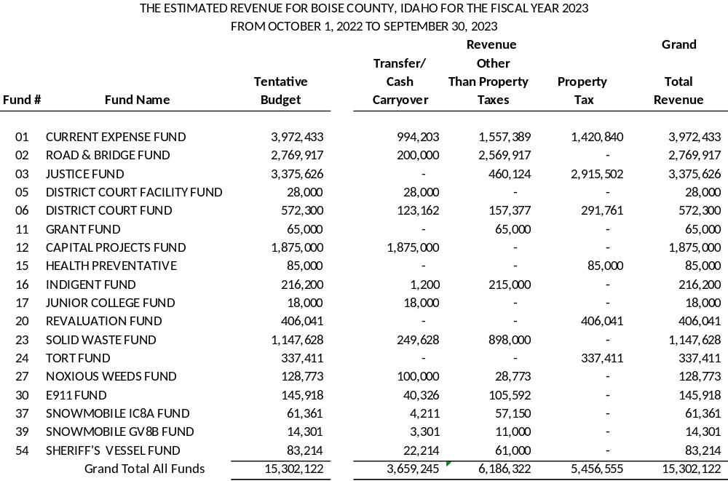

Slide 7
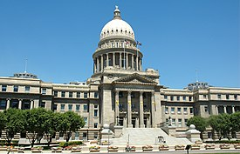

MAJOR CHANGES FROM FY2022
BUDGET
Legislative Action
=
=
=
Law

Slide 8
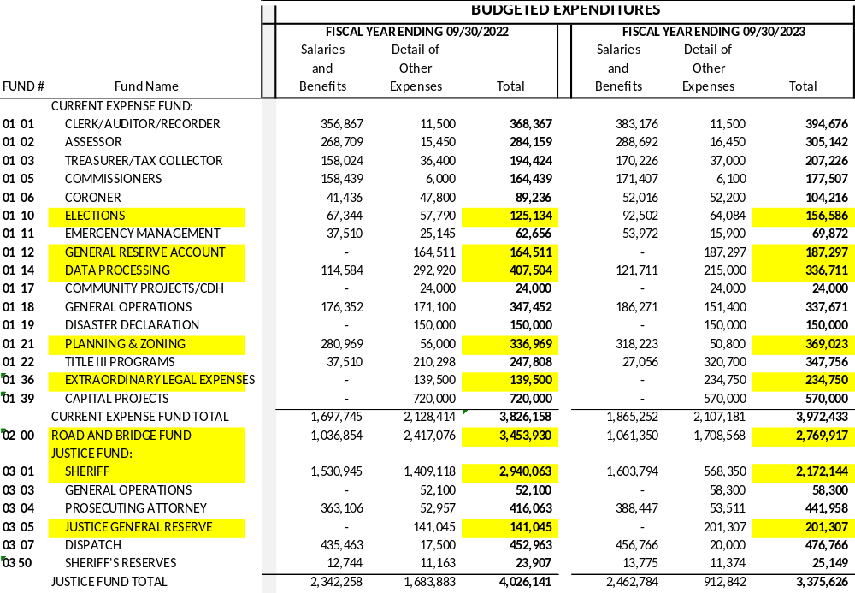

Slide 9
GENERAL/CURRENT FUND
Elections Department: Election staff position previously split with Indigent Program (75/25 in FY22, 100% elections in FY23). Change due to legislative action eliminating Indigent Program/Levy combined with the increased nation-wide emphasis on elections due to technology and media focus on elections.
Information Technology: FY2022 budget was amended for the acquisition of replacement computers County-wide. Originally budgeted/ordered in FY2021, the supply chain delays created need to amend the FY2022 budget for delivery.
Planning & Zoning Department: FY2022 budget per financial system does not reflect budget amendment of Resolution 2022-23 which increased salary/benefits budget by ~$19K for mid-year staffing changes and adjustments for unforeseen workloads.
Extraordinary Legal: Increase in FY2023 budget is primarily due to an additional $100K appropriation for potential outside legal counsel needs.

Slide 10
ROAD & BRIDGE FUND
New Funding Stream-Legislative Change: Effective for State fiscal year 2023, Idaho Code 63-3638, Sales Tax Distribution, was amended, providing for continuous appropriation for transportation purposes at local government level. Two components at State level: base appropriation of 4.5% (not less than $80M) and excess appropriation (collections at 4.5% and greater than $80M).
Compensate/Recruit/Retain: FY2023 budget reflects increased wages (above the COL 8%) for equipment operators in order to competitively recruit employee candidates and retain existing employees. This was made possible via the new revenue stream.
Reduction – Capital Paving Projects: FY2023 budget focuses on dust abatement, using County owned equipment, as a more cost effective alternative to paving, which has become extremely expensive.

Slide 11
JUSTICE FUND/CONTINGENCIES
Cash Carryover: FY2022 budget included $749K of cash carryover (accumulated cash) to fund debt payoff of Motorola/Spillman software suite and vehicle leases. FY2023 Justice Fund budget includes $0 use of cash carryover.
Justice General Reserve/General Fund Reserve: Each of these amounts are provided for by law:
Justice: Idaho Code 63-805, appropriation cannot exceed 5% of the Justice Fund budget as finally adopted (uses previous FY budget amount)
General: Idaho Code 31-1605, appropriation cannot exceed 5% of the General Fund budget as finally adopted (uses previous FY budget amount)

Slide 12
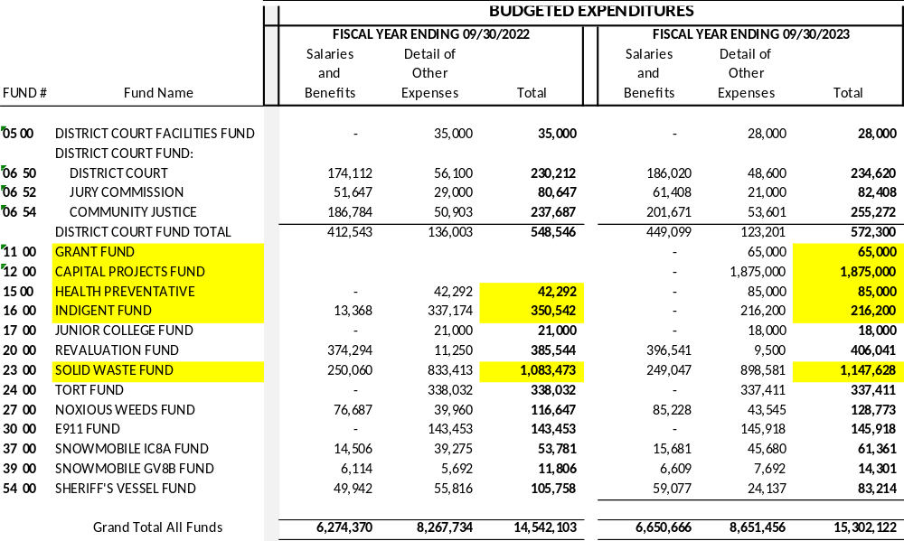

Slide 13
GRANT FUND/CAPITAL PROJECTS FUND: NEW IN FY2023
Grant Fund: New fund created in FY2023 budget for the purpose of 1) tracking and managing new grants within the County’s financial system; and 2) establishing a County wide source of funding for grant awards requiring a matching contribution. Initial funding of $65,000 is from estimated revenues for FY2023.
Capital Projects Fund: New fund created in FY2023 budget for the purpose of accumulating/saving toward future land and/or facility construction for County operations. Initial funding of $1,875,000 is a transfer of General Fund cash reserves (accumulation of revenue over expense in prior years).

Slide 14
HEALTH PREVENTATIVE FUND/INDIGENT FUND
Impact of Legislative Action
Health Preventative: County’s fund used for the Central District Health Department annual contract contribution. Legislation from the 2021 session (H316) shifted funding from State to Counties, for the regional health districts. FY2023 is the first full County fiscal year of impact from this legislation. Bill passed with knowledge of H735 which significantly shifted indigent (medical and public defense) funding from counties to State.
Indigent Fund: Holds both the Indigent Program (covering emergent medical care) and the majority of public defense services. H735 from the 2022 legislative session, eliminated the Indigent Program at the county level (and eliminated the levy as well) and also shifted the funding of public defense to the State. FY2023 reflects estimated public defense cost, offset by estimated State funding of ~$168K.

Slide 15
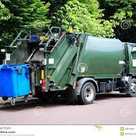
SOLID WASTE
FUND
Compensation increases (COL) were offset by change in staffing structure (FT to PT)
Other expense increase due primarily to contractual increases for hauling and fuel

Slide 16

SALARY/BENEFIT CHANGES

Slide 17
COMPENSATION & THE CONSUMER PRICE INDEX
Tentative Budget vs. Final Budget:
Tentative included up to a 10% cost of living increase for all employees and Elected Officials, Final Budget provides for up
to an 8% COL for employees and elected.
Cost of living (COL):
Percentage increase based on data obtained from the Idaho Department of Labor website, statistics provided by the U.S. Department of Labor.
COL increase:
Increase from July 2021 to July 2022 = 8.5%

Slide 18

BOISE COUNTY
PAID BENEFITS
County pays 100% of employee premiums. Employees pay 100% dependent and spousal premium. Health Insurance includes Medical/Dental/Vision coverage.
County is self-insured through the GEM Plan, a pooling of 22 Idaho counties. 9.5% increase for FY 2023, increase in medical only.
PERSI (Public Employee Retirement System): County contributes 11.94% for Regular Employees, and 12.28% for Public Safety.
State Unemployment Rate: County is self-insured through the Idaho Association of Counties. Rate of contribution for FY2022
equaled 0%.
FY2023 SUTA = .10%

Slide 19
Discussion
& questions

