Slide 1
The Money Market

Slide 2
Objectives
What is the money demand curve?
How does the liquidity preference model determines the interest rate in the short run?

Slide 3
The Demand for Money
M1 consists of currency in circulation (cash), plus checkable bank deposits, plus traveler’s checks
M2 consists of M1 plus deposits that can easily be transferred into checkable deposits

Slide 4
Opportunity Cost of Holding Money
Most economic decisions involve trade-offs at the margin
Individuals decide how much of a good to consume by determining whether the benefit they’d gain from consuming a bit more of any given good is with the cost
Same applies to deciding how much money to hold

Slide 5
Opportunity Cost of Holding Money
Individuals and firms hold some of their assets in the form of money because of the conveniences money provides
  Money can be used immediately for purchases, assets can’t
Opportunity cost exists because money held in your wallet earns no interest

Slide 6
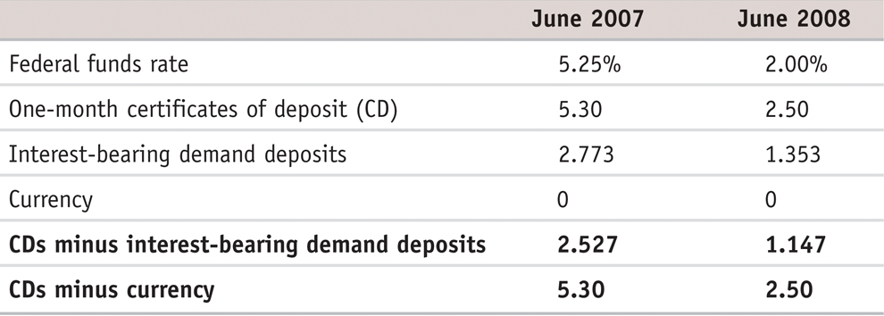
Opportunity Cost of Holding Money
Show the opportunity cost of holding money at one point in time when the overall level of interest rates change
When the overall level of interest rates falls, the opportunity cost of holding money falls, too

Slide 7
Opportunity Cost of Holding Money
Short-term interest rates are the interest rates on financial assets that mature within six months or less.
Long-term interest rates are interest rates on financial assets that mature a number of years in the future.
The short-term rates rather than long-term rates affect money demand, because the decision to hold money involves trading off the convenience of holding cash versus the pay off from holding assets that mature in the short term – a year or less

Slide 8
Fear and Interest Rates
Treasury bills generally pay a slightly lower interest rate than other short-term assets in normal times.
In the third week of October 2008, one-month CDs were paying 4.04% interest, but one-month Treasury bills were paying only 0.26%.
The reason: fear. A sharp plunge in housing prices had led to big losses at a number of financial institutions, leaving investors nervous about the safety of many non-government assets.
On December 10, 2008, in fact, three-month Treasury bills paid 0% interest for a brief period.

Slide 9
The Money Demand Curve
The money demand curve shows the relationship between the quantity of money demanded and the interest rate.
Money demand curve slopes downward because, other things equal, a higher interest rate increases the opportunity cost of holding money, eluding the public to reduce the quantity of money it demand

Slide 10
The Money Demand Curve
Interest rate, r
Money demand curve, MD
Quantity of money
Notes:
Figure Caption: Figure 15-1: The Money Demand Curve
The money demand curve illustrates the relationship between the interest rate and the quantity of money demanded. It slopes downward: a higher interest rate leads to a higher opportunity cost of holding money and reduces the quantity of money demanded.

Slide 11
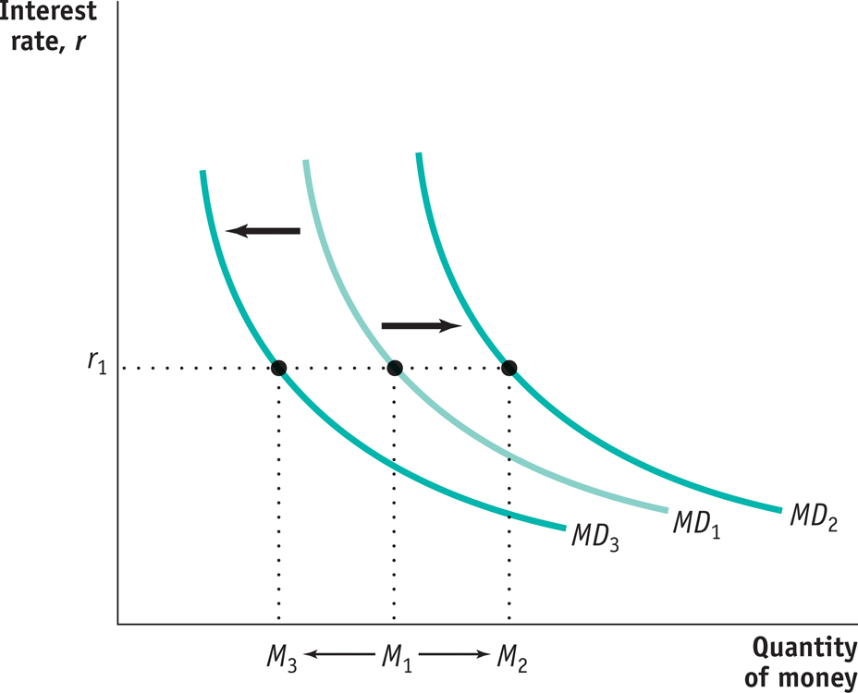
Shifts of the Money Demand Curve
A fall in money demand shifts the money demand curve to the left..
A rise in money demand
shifts the money demand
curve to the right.
Notes:
Figure Caption: Figure 15-2: Increases and Decreases in the Demand for Money
A rise in money demand shifts the money demand curve to the right, from MD1 to MD2, and the quantity of money demanded rises at any given interest rate. A fall in money demand shifts the money demand curve to the left, from MD1 to MD3, and the quantity of money demanded falls at any given interest rate.

Slide 12
Shifts of the Money Demand Curve
Four reasons that the money demand curve shifts:
Changes in Aggregate Price Level
Changes in Real GDP
Changes in Technology
Changes in Institutions

Slide 13
1. Changes in Aggregate Price Level
Higher prices increases the demand for money (rightward shift of the MD curve)
Lower prices reduce the demand for money (leftward shift of the MD curve)
Stated another way:
  Other things equal, the demand for money is proportional to the price level
  If the aggregate price level rises by 20%, the quantity of money demanded at any given interest rate, also rises by 20%

Slide 14
2. Changes in Real GDP
An increase in real GDP, the total quantity of goods and serves produced and sold in the economy– shifts the money demand curve rightward
A fall in real GDP shifts the money demand curve leftward

Slide 15
3. Changes in Technology
Advances in information technology have tended to reduce the demand for money by making it easier for the public to make purchases without holding significant sums of money
Example: ATMs

Slide 16
4. Changes in Institutions
Can increase or decrease the demand for money
Example: Before Regulation Q in 1980, banks were not allowed to offer interest on checking accounts, once they did, demand for money rose and shifted the demand curve to the right

Slide 17
Money and Interest Rates
The federal funds rate is the rate at which banks lend reserves to each other ot meet the required reserve ration
The Federal Open Market Committee sets the target value for the federal funds rate
How does the Federal Reserve go about achieving a target federal funds rate?

Slide 18
The Equilibrium Interest Rate
The liquidity preference model of the interest rate is the interest rate determined by the supply and demand for money
The money supply curve shows how the nominal quantity of money supplied varies with the interest rate.

Slide 19
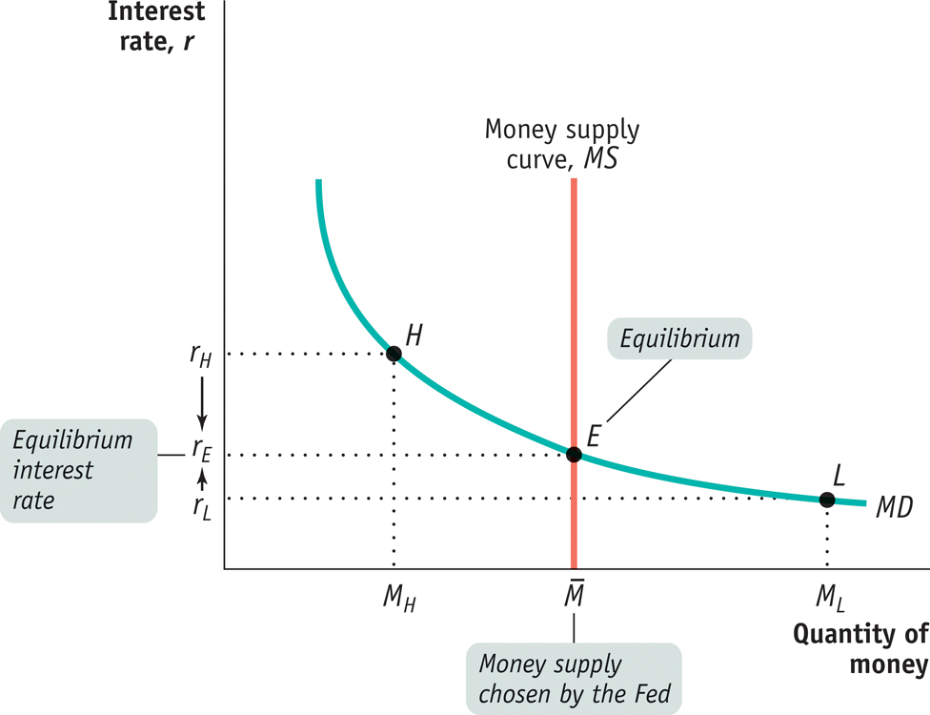
The Equilibrium Interest Rate

