Slide 1

Term Introduction by Mrs. Holm and Mr. Adamson
High School
Registration

Slide 2
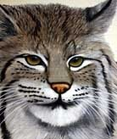
Are you ready for high school?
Class of 2020 planning schedule
Put important dates in your assignment book.
READ/KEEP BHS Class of 2020 Career Planning Guide (Always USE PENCIL)

Slide 3
Grade Level Status/Terms
1st year = 9th grade = Freshman
2nd year = 10th grade = Sophomore
3rd year = 11th grade = Junior
4th year = 12th grade = Senior

Slide 4
CREDITS are what you earn (p.7)
22 credits are needed to graduate
.5 (1/2) credit = passing 1 semester of 1 class
There are 7 class periods in a day
Most earn 6-7 credits in a year
6 X 4 years = 24 credits
Lunch does not count as a period
No credit is earned in study hall

Slide 5
2 SEMESTERS each year-example of freshmen year
1st SEMESTER | 2nd SEMESTER
English | English
Math | Math
Science | Science
Computer Applications | Health Wellness
Social Studies (W.Hist) | Wellness Activities (PE)
World Language | World Language
Study Hall/Elective | Study Hall/Elective

Slide 6
Required classes to graduate (p.6)
English (4 credits)
Social Studies (3 credits)
Math (3 credits)
Science (3 credits)
Fine arts (1 credit)
Wellness (1.5 credits)
Personal finance or Econ (.5 credits)
Computer studies (.5 credits)
16.5 required
CTE--depending on college-maybe World Language

Slide 7
ELECTIVES-classes you get to pick/count towards graduation (Career Planning Guide pgs.3-6)
Agriculture, Food & Natural Resources
Architecture & Construction
Arts, A/V Technology & Communication
Business Management & Administration
Education & Training
Finance
Government & Public Administration
Health

Slide 8
ELECTIVES-continued
Hospitality & Tourism
Human Services
Information Technology
Law, Public Safety, Corrections & Security
Manufacturing
Marketing, Sales & Service
Science & Technology, Engineering & Math
Transportation, Distribution & Logistics

Slide 9
“AP” Classes (Advanced Placement)
College level class taken at high school
Need special approval
Credits count toward graduation
Count as college credit if you pass the “college test” and pay about $100 (3 cr.)
Normal college class costs about $130 (1 credit)/$6000 a semester at SDSU

Slide 10
ACT (American College Testing)
College entrance exam
Taken during or after your 3rd year
Assess students’ educational development
Ability to complete college-level work
4 Parts-English, Reading, Math, Science
Cumulative score of 18-36

Slide 11

GPA (Grade Point Average p.9)
A+ 4.00 100-98
A 4.00 97-95
A- 3.67 94-92
B+ 3.33 91-89
B 3.00 88-86
B- 2.67 85-83
C+ 2.33 82-80
C 2.00 79-77
C- 1.67 76-74
D+ 1.33 73-71
D 1.00 70-68
D- 0.67 67-65

Slide 12
GPA continued (Sample)
English C 2.00
Math B+ 3.33
Science B 3.00
Computer A- 3.67
PE Wellness A 4.00
Spanish B 3.00
19.00 / 6 = 3.17

Slide 13
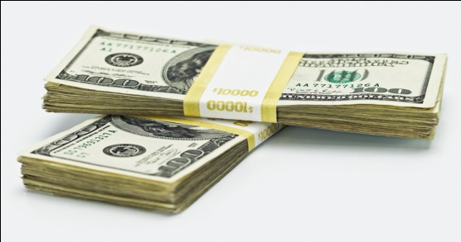
SD Opportunity Scholarship p.11
Up to $5000 of free money to go to a South Dakota college
$1000+$1000+$1000+$2000 = $5000
Tech Institutes = $1000 + $1000
ACT of 24 or SAT of 1090
Indicate on 4 year plan if pursuing
GPA 3.0 and no grade lower than a C

Slide 14
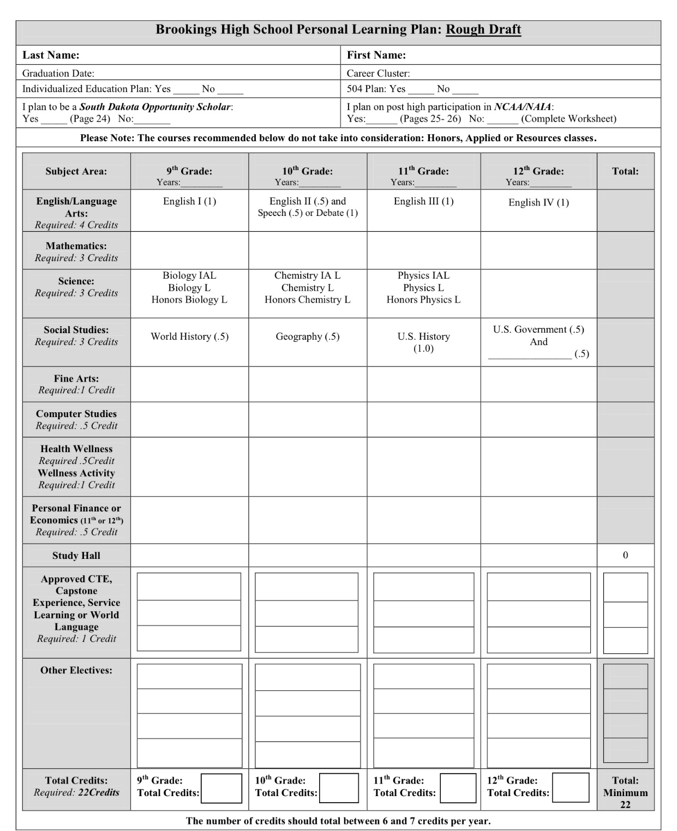
Four Year Plan/PLP
(-use pencil! P.6)

Slide 15
SdMyLife!
  Login
  Welcome _________(Your name appears)
    GO TO MY PORTFOLIO
  Note: Portfolio Completion Status on Top.
  Click on “view details”

Slide 16
Click Matchmaker Tab
Start “New matchmaker” session button
Answer likes and dislikes
  BE OPEN MINDED
If you don’t like your careers, you may ANSWER MORE QUESTIONS
Save all information
  Optional after everything is done: MY SKILLS

Slide 17
Pick 3 Favorite Careers that interest you.
Click on each career in your top 3 and SAVE TO PORTFOLIO everytime
Click each career again and save to your portfolio!
You may have to backspace to view more suggested careers.
Click on “review & revise” on bottom

Slide 18
Go to top Portfolio Status Bar
Click on Career that Interest Me.
See if you have a check for complete.
If so, go to Career Clusters Interests
Add your favorite careers behind the cluster names
SAVE & Review and Revise!

Slide 19
Go to Portfolio Completion Status again
  Go to last group “Awards and Certificates
  Click on “add awards”
  Add as many (try 3) as you can think of from middle school.
  (e.g. Student of the Month, Pro Awards, Scouts, Band Honor, Fitness Award, Good Citizen, community or church awards)
  SAVE—Review and Revise

Slide 20
Now you should be at 80% on Portfolio Completion Status.
Go back and redo anything that needs to be done to get you at 80%. You can finish at home.
We will showing you how to do the Personal Learning Plan (we hope!)

Slide 21

Great Job!
SAVE & LOGOUT
All Criteria will be Completed by the time YOU GRADUATE

