Slide 1
Town of Westborough
FY2024 Budget and Capital Plan
An innovative Town Government TRUSTED to provide high-quality municipal and educational services that enhance quality of life and provide an inclusive and positive experience for the community.
Kristi Williams
Town Manager
January 24, 2023

Slide 2
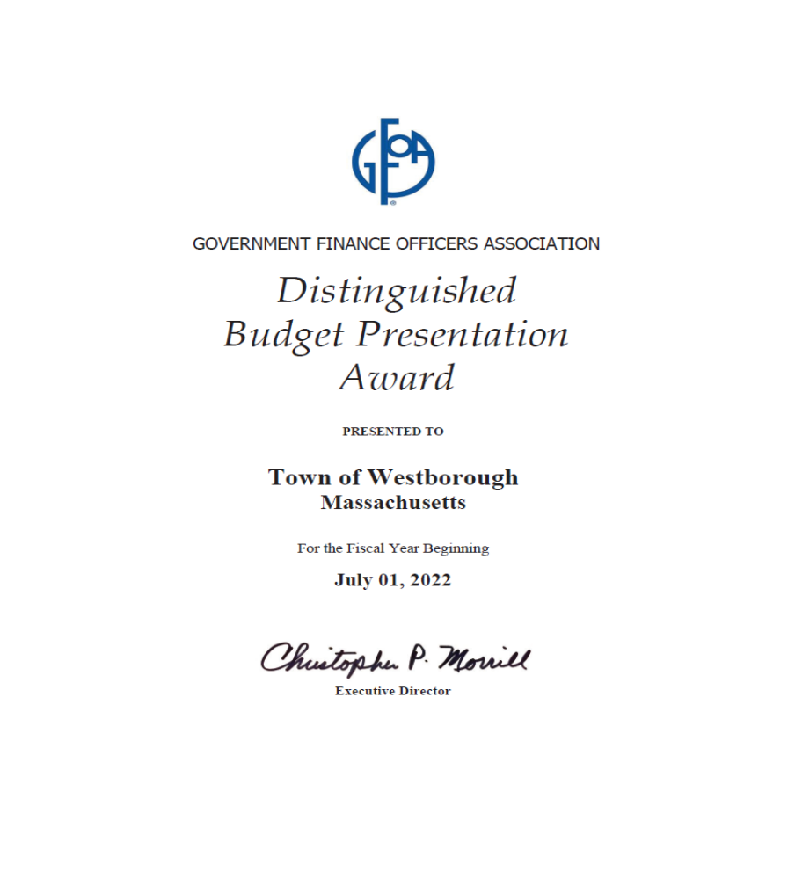

Slide 3
FY2024 Budget Process
September 29, 2022 | Tri-Board Meeting of Select Board, School Committee and Advisory Finance Committee
October 11, 2022 | Capital Requests Due
October 14, 2022 | Departmental Budgets Initially Requested/Budget Meetings Scheduled
November 8, 2021 | Budgets and Program Improvement Requests Due
November 15-16, 2022 | Review Departmental Budgets with Town Manager and Finance Director
November 23, 2022 | Budget Narratives Due
December 21, 2022 | Budget Document Completed and Sent to SB and AFC
January 24, 2023 | Budget Hearing
January 26, 2023 | Budget Summit

Slide 4
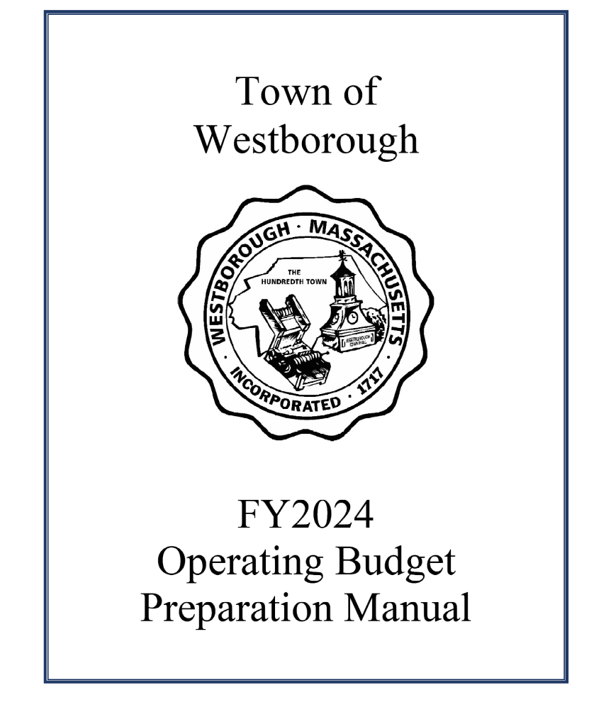
FY2024 Budget Manual
Information on creating a Level Service Budget
Introduction of Program Improvement Request Forms
Location of Budget Forms
Guidelines for Budget Narratives
Deadline and Meeting Dates

Slide 5
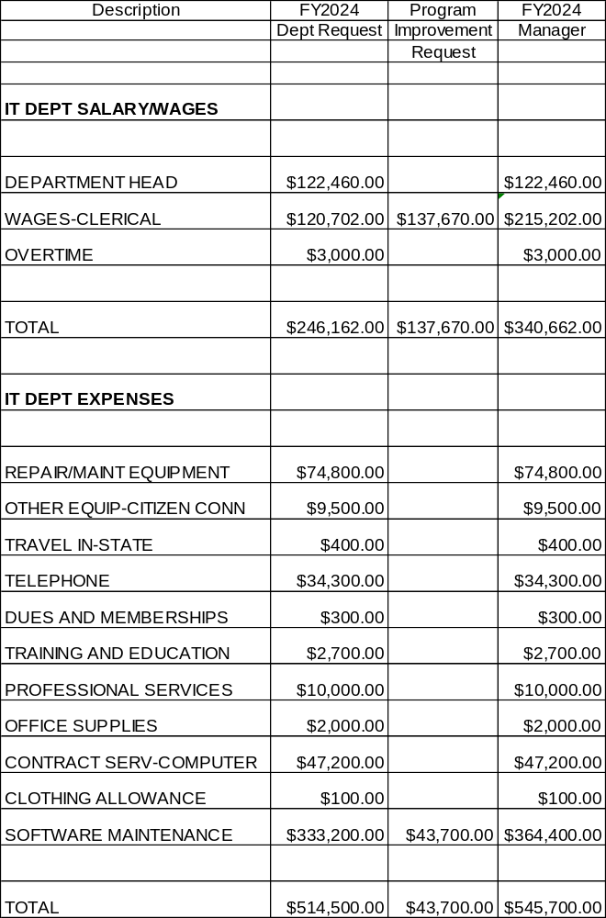
Program Improvement Request
A Level-Service Budget Request reflects the costs of providing the same level of service provided by your department in the previous fiscal year (including budgeted-for personnel) while also accounting for any fixed cost increases (e.g., contractual services, contractually obligated step increases, etc.) In other words, this is the cost of maintaining your department’s operational status quo.
A Program Improvement Request (PIR) is for additional funds that will add some new capacity to your department’s operations, enhancing the level of service it provides. This may be in the form of a new hire, a substantial equipment acquisition not qualifying for a capital request, or anything else that goes beyond maintaining your department’s status quo.
EXAMPLE

Slide 6
Average Single Family Tax Bill Increase

Slide 7
FY2023 Comparison Communities
Average Single Family Tax Bill

Slide 8
Excess Levy Capacity

Slide 9
Budget Items Outstanding
Insurance Budget
Assabet Valley Regional Technical High School Assessment
State Aid
Union Contracts
Landfill Budget

Slide 10
Estimated Increases
 | FY2023 % Increase | FY2024 Estimated % Increase | FY2024 Increase | FY2024 Tax Impact
Town Budgets* | 3.13% | 2.97% | $619,250 | $80
School Budget | 4.33% | 4.10% | $2,499,966 | $323
Fixed Costs | 4.33% | 12.24% | $2,810,174 | $363
Worcester Regional Retirement | 10.46% | 11.07% | $618,070 | $80
Assabet Valley Assessment | 9.32% | 2.50% | $22,013 | $3
*Number does not include adjustments for 4 union contracts.

Slide 11
Town Department Increases
 | FY2024 % Increase | FY2024 $ Increase | Tax Impact to Average Single Family
Salary/Wages* | 1.49% | $243,259 | $31
Expenses | 9.87% | $390,700 | $50
*Number does not include adjustments for 4 union contracts.

Slide 12
Salary/Wages Increases
Department | Position | Budget Impact ($) | Tax Impact to Average Single Family
Animal Control | Part Time Animal Control Officer 12 hours per week Provide coverage for weekends and as needed | $13,061 Grafton funds 38% of this entire budget | $1
Community Development | Sustainability Coordinator/Community Development Assistant 40 hours per week Responsible for achieving sustainability goals Supports Community Development Department Recommended by Climate Action Plan/Staffing Study | $70,179 Budget increase is $40,179 plus $30,000 Grant | $5
Council on Aging | Additional Hours Per Week: Outreach Case Manager: 5 hours Administrative Assistant: 5 hours Asian Outreach Worker: 4 hours Homemaker: 2 hours Handyman: 8 hours | $33,950 Additional Hours Fully Funded by State Formula Grant | $0

Slide 13
Salary/Wages Increases
Department | Position | Budget Impact ($) | Tax Impact to Average Single Family
Department of Public Works | Maintenance Craftsperson - Tree 40 hours per week Maintain Town’s tree canopy Additional Staffing recommended through Staffing Study | $64,057 90% funded through General Fund 10% of this position is funded through the Water Enterprise Fund | $8
 | Maintenance Craftsperson - Sewer 40 hours per week Maintain Town’s sewer infrastructure Additional Staffing recommended through Staffing Study | $64,057 90% funded through Sewer Enterprise Fund and 10% funded through the Water Enterprise Fund | $0
Fire Department | Firefighter/Paramedic 42 hours per week Recommended additional staffing by Fire Department Organizational Assessment | $82,465 | $11

Slide 14
Salary/Wages Increases
Department | Position | Budget Impact ($) | Tax Impact to Average Single Family
Information Technology | Network Systems Administrator 40 hours per week Departmental projects, upgrades, migrations and network security. Additional Staffing recommended through Staffing Study and Information Technology Assessment | $94,500 | $12
Police Department | Three Patrol Officers 40 hours per week Additional Staffing recommended through Police Staffing Study. Positions added 7/1/2022 using ARPA Funds. Costs incrementally added to budget through FY2026. | $234,946 Budget increase is $75,061 Plus $159,885 in ARPA Funds | $10
Library | Circulation Outreach Assistant Currently benefit eligible at 21 hours per week. Add 3 hours per week for a total of 24 hours per week. Increase offsite programs. | $4,371 | $0.56

Slide 15
Expenses
Department | Budget Item | Budget Impact ($) | Tax Impact to Average Single Family
Board of Health | Hazardous Waste Day Removed from Budget and added to Regularly Recurring Articles as Raise and Appropriate to be maintained at $30,000 | $30,000 | $4
Community Development | Expansion of Permit Pro PermitPro module (online permitting software) for land management Planning Board permits including Special Permits, Site Plan and other Planning Board permits | $3,900 in FY2024 $1,200 Annual Fee | $0.50
Information Technology | Microsoft 365 This migration will streamline email operations and improve security. | $23,700 Total Cost is $40,000 but implementation of this product creates a savings in the level service budget. | $3

Slide 16
Expenses
Department | Budget Item | Budget Impact ($) | Tax Impact to Average Single Family
Police Department | Body Worn Cameras Program Digital Storage | $13,000 | $2
Youth and Family Services | Interface Referral Service Helpline that matches residents with mental health services | $12,000 Total is $24,000 but School Department pays half. | $2

Slide 17
Fixed Costs
 | FY 2024 % Increase | FY2024 $ Increase | Tax Impact to Average Single Family
Insurance | 8.7% | $1,285,799 | $166
Electricity | 32.4% | $109,025 | $14
Landfill | 26.4% | $191,800 | $25

Slide 18
Health Insurance
The estimated increase to the health insurance budget is 7% in FY2024 or $875,799. This represents an increase to the average single family tax bill of $113.

Slide 19
Insurance:
History of Plan Design Changes
2010: Increase co-pays, institute HRA Program, Opt Out Programs, Flexible Spending Account, and Dental
2014: Change Carriers to Tufts, increased Opt Out Program, added deductibles
2017: Increased OV Copays, increased deductibles
2018: Move Medical and Dental Insurance for Active Employees to Blue Cross Blue Shield
2019: Moved Retirees from Tufts Supplement Plan to Blue Cross Blue Shield Supplement Plan
2021: Created Criteria for Future Enrollment in PPO Plan
2022: Add High Deductible Plan Option with lower premiums and Town contribution to Health Savings Account (HSA) for two years.

Slide 20

Electricity
The Town’s electric supply contract expires on June 30, 2023.
The electricity budget reflects a 30% estimated increase for FY2024 based on current increases in that market.
As a member of the Massachusetts Municipal Association, Westborough has access to the MunEnergy Program which includes:
Competitive energy prices
Flexible, customized energy plans
Fixed-rate, multi-year contracts
MMA-approved contract language
Knowledgeable, dedicated energy representatives
Customer service excellence

Slide 21
Landfill
The Town has been informed that Waste Connections, formerly EL Harvey’s, does not intend to continue operating the transfer station after June 30, 2024.
The quote for the contract beginning July 1, 2023 is $85 per ton. The budget book includes a cost of $50 per ton based on the initial quote received. The town recently received an increased quote of $85 per ton, or $175,000 more than was included in the budget book.
WASTE MANAGEMENT EXPLORATORY COMMITTEE (WMEC)
WMEC was established by the Select Board with a goal of proposing a waste management program for approval at the October 2023 Special Town Meeting.

Slide 22
Managing Reserves

Slide 23
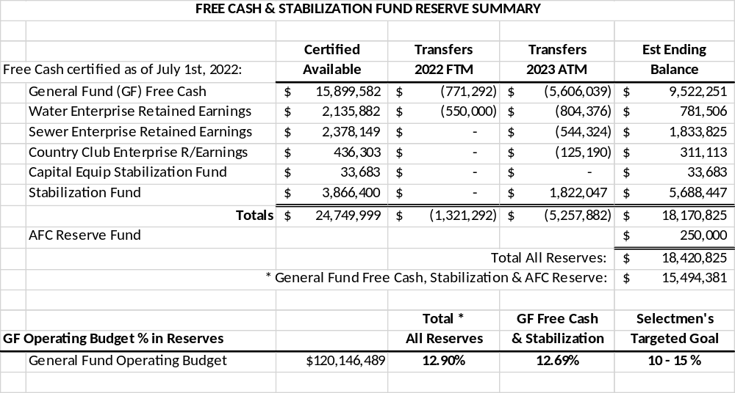
Reserve Summary

Slide 24
Free Cash
*FY2022 includes known requests for use in FY2023.

Slide 25
Stabilization Fund Goal
An article, currently Article 6, is included on the warrant to transfer of $1,822,047 of Free Cash to Stabilization in order to meet the 5%-7.5% stated goal for this fund.
 | Current Amount | Current % | Proposed Balance | Proposed %
Free Cash | $15,128,290 | 12.59% | $9,522,951 | 7.93%
Stabilization | $3,866,400 | 3.22% | $5,688,447 | 4.73%

Slide 26
Comprehensive Fiscal Management Policy
The combined balance of Free Cash and Stabilization Fund should be maintained at 10%-15% of the General Fund.
Free Cash in excess of the Town’s goal should be used for non-recurring or emergency expenditures, used to lower the tax rate, fund unfunded liabilities such as retirement or OPEB (Other Post Employment Benefits), or appropriated to a stabilization fund for future capital projects and equipment purchases.

Slide 27
Free Cash to Lower Tax Rate
The FY2024 Budget Document recommends that $450,000 of Free Cash be used to Lower the Tax Rate.
 | Average Single Family Without Free Cash | Free Cash Used | Average Single Family Increase Using Free Cash
FY2021 | $327 | $770,000 | $228
FY2022 | $325 | $0 | $325
FY2023 | $792 | $471,259 | $731
FY2024 | $954 | $450,000 | $896
The Town will continue to work toward incrementally decreasing it’s use of Free Cash to lower the tax rate in order to address this structural deficit.

Slide 28
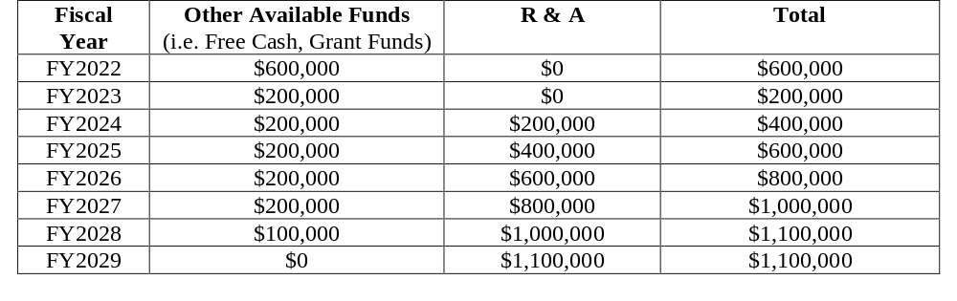
Fund Unfunded Liabilities
The Comprehensive Fiscal Management Policy was updated on February 8, 2022 to include use of Free Cash to fund Other Post Employment Benefits (OPEB) over an 8 year period.

Slide 29
Total Town Reserves
Reserve | Goal % of General Fund | Current
Free Cash | 5%-7.5% | 7.93%
Stabilization | 5%-7.5% | 4.73%
Combined Free Cash / Stabilization | 10%-15% | 12.69%
* This slide assumes approval of all warrant articles that propose use of Free Cash.

Slide 30
Other Financial Resources
 | Balances | Recent Use of Funds
Sale of Real Estate | $1,682,953 | Purchase of Belknap Street, Despres Property and Ruggles Property
Open Space | $14,615 | Purchase of Belknap Street, Despres Property and Ruggles Property
Walkup Robinson Trust | $1,705,452 | Purchase of Belknap Street, Despres Property and Ruggles Property
OPEB (Restricted) | $9,653,547
American Rescue Plan (ARPA) | $193,000 | Capital Projects, Emergency Repair and Police Personnel
FY2022 Total Town wide Grant Awards $4,853,046

Slide 31
Capital Plan

Slide 32
Capital Planning Policy
The FY2024-FY2028 CIP was developed based on continued implementation of the Town’s updated Capital Policy that expanded the planning process to identify and include all capital projects across all departments.
The FY2024-FY2028 CIP includes a long-range capital outlook that identifies significant capital projects anticipated to occur in the 10-year period beginning in FY2029.
Developing this long-range project list will be critical in raising the level of understanding about the larger capital needs of the Town and School Department.
Capital Projects Fund Should equal 1%-1.5% of General Fund Operating Budget
Notes:
CIP included in its entirety in the Budget Document

Slide 33
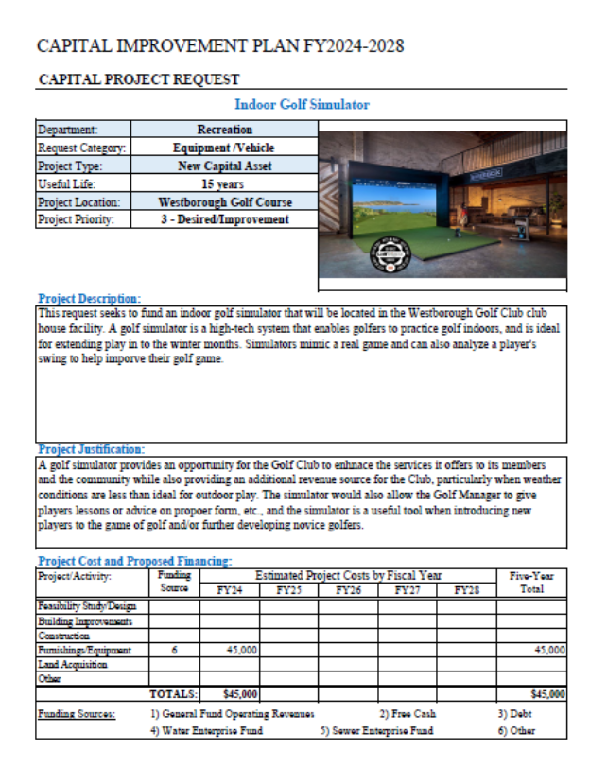
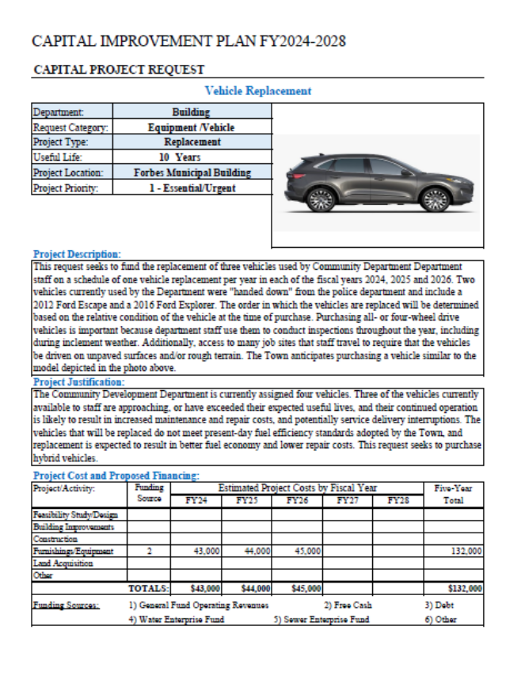
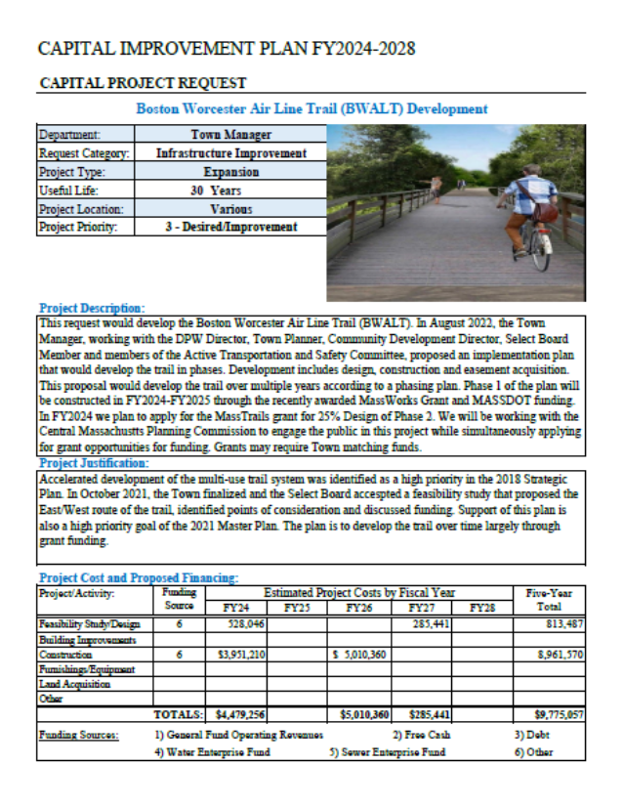
FY2024 – FY2028 Capital Plan

Slide 34
FY2024 Proposed Capital Budget
Department | Proposed Project | Funding Request | Funding Source(s)
Community Development | Vehicle Replacement | $43,000 | Free Cash
Fire Department | Security System Upgrades | $91,608 | Free Cash
Fire Department | Diesel Exhaust System Replacement | $97,000 | Free Cash
Information Technology | Network Upgrade | $35,000 | Free Cash
Information Technology | Office 365 Migration | $50,000 | Free Cash
Information Technology | Infrastructure Update | $195,000 | Free Cash
Police Department | Cruiser Replacement (4 Vehicles) | $265,000 | Free Cash
Public Works | Buildings and Grounds Capital Maintenance | $130,000 | Free Cash
Public Works | Administrative Vehicle Replacement (2 Vehicles) | $75,000 | Free Cash/SRE/WRE
Public Works | Wood Chipper Replacement | $85,000 | Free Cash/SRE/WRE
Public Works | Bucket Truck Replacement | $170,000 | Free Cash/SRE/WRE
Public Works | Six Wheel Dump Truck Replacement | $265,000 | Free Cash
Recreation | Indoor Golf Simulator | $50,000 | Golf Retained Earnings
Recreation | Utility Tractor Replacement | $65,000 | Golf Retained Earnings
Westborough Public Schools | Mill Pond School Roof Restoration - Design | $132,000 | Free Cash
Westborough Public Schools | Hastings School Roof Replacement - Design | $504,000 | Other
Westborough Public Schools | Hastings School ADA Construction | $5,000,000 | Other
Select Board | Multi-Use Trail Design | $110,000 | Free Cash
Westborough Public Library | Library Building Improvements and Design | $TBD | Other
 | Total: | $7,362,608
 | Total Free Cash: | $1,533,608
FY2024 Capital Budget Free Cash Funding Requests =
1.3% of the General Fund Operating Budget

Slide 35













How Will Your Property Tax Dollars Be Spent Locally?
Health
$105.80| 0.9%
Debt
$1,117.54| 9.4%
Community Services
$76.83| 0.6%
Insurance & General
$2,265.83| 19.0%
Average Home in Westborough
($732,762 x 16.31/1,000 = $11,955)
Schools
$6,409.21|53.7
Community Development
$95.74| 0.8%
Town Hall
$296.06| 2.5%
Police
$442.50| 3.7%
Fire
$571.03| 4.8%
Public Works
$407.17| 3.4%
Recreation
$21.33| 0.2%
Library
$122.96| 1.0%

Slide 36
Town of Westborough Vision:
Westborough – a vibrant, inclusive, safe, attractive, connected, and engaged community – for a lifetime.

