Slide 1

Transit Agency Status
FY 2011-12
Current Financial Position
Current Operations
Service Statistics/Trends
Funding Statistics/Trends
Capital Status Review
Notes:
Today I will go over the current financial position of FACT
Review operations for fixed route and shared ride service
Give statistics for the past year, projection for current year and projections for next 3 years
Finally, review FACT’s capital needs

Slide 2
Current Financial Position
Reserves
Level of Short-Term Debt/Loans—Identify each line of credit—not applicable
Source | Balance
PTAF
ASG
BSG
Section 1513
Local | 376,924
Other
Notes:
At this time, FACT has a local fund reserve of $376,924. This funding is used for local match requirements of fixed route and capital programs. It could also be used for shared ride deficit.
Fayette County has always provided a match in excess of what is required.

Slide 3
Current Financial Position
Accounts Payable – Past due 90 days and over
Accounts Receivable – Past due 90 days and over
Vendor | Amount Past Due | Estimated Pay Date
none
Program/Agency | Amount Past Due | Date Requisitioned | Estimated Pay Date
none
Notes:
FACT has no issues with accounts receivable or payable exceeding 90 days.

Slide 4
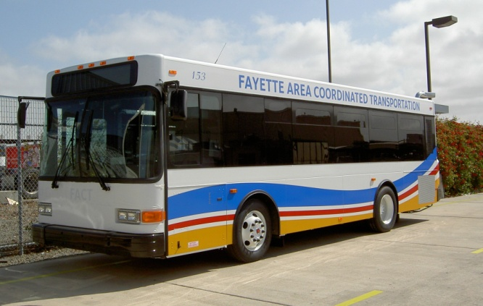
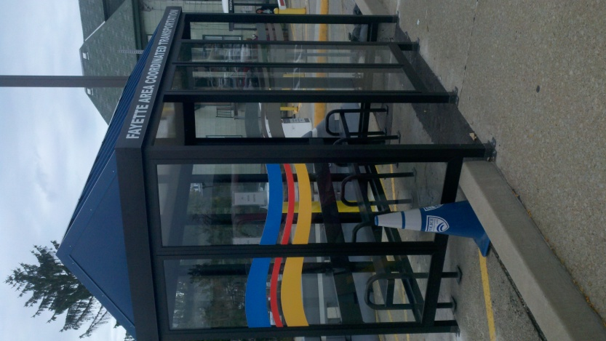
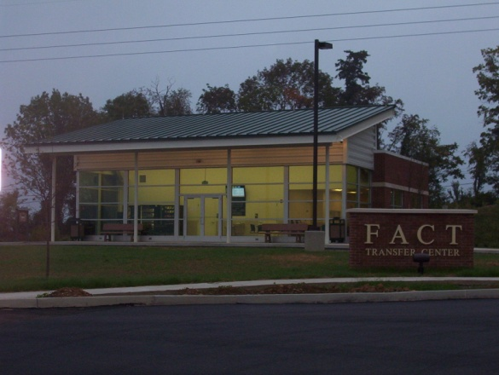
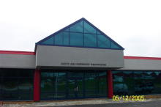
Current Operations
Staffing Level
Contract Provisions
Healthcare
Pension
Fuel
Fares
Cost Savings Initiatives
Notes:
I’ve provided pictures of what the majority of our fixed routes look like, a picture of our newly completed bus shelters and both buildings, including the transfer center project built with ARRA funds.

Slide 5
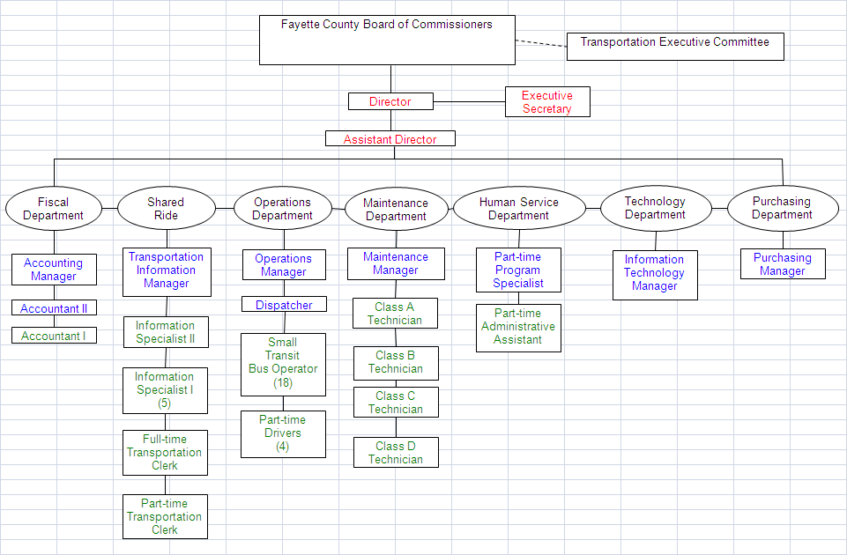
Staffing Level/Org Chart
(8)
Current vacancies: Assistant Director, Executive Secretary, 1 Information Specialist, Maintenance Manager, Class B Technician, Class C Technician, Part-time Administrative Assistant, Information Technology Manager, Purchasing Manager, 4 part-time driver positions
Notes:
This is our current organizational chart separated by departments. The positions listed in red and blue are nonunion and green are union positions. At this time there are numerous vacancies including Assistant Director, executive secretary, one transportation information specialist (call center), maintenance manager, class b and c technicians, part-time administrative assistant, information technology manager, purchasing manager and 4 part-time driver positions.
The only positions from the list that we will be filling in the near future area the class b and c technicians and 1 or 2 part-time driver positions for fixed route.

Slide 6
Contract Provisions
Term of current union contract 1/1/10-12/31/13
Drivers | Current | 2012-13
Starting wage | 10.75 | 11.07
Top wage | 10.75 | 11.07
Average wage | 10.75 | 11.07
Contract wage increase |  | 3%
Job Classification | Number- Full Time | Number-Part Time
Drivers | 18 | 4
Mechanics | 2
Dispatchers | 1 (non-union)
Clerical (clerks, schedulers) | 6 | 1
Fiscal | 3 (2 non-union)
Notes:
Our drivers and call center staff belong to the Service Employees International Union. The current contract is for 3 years ending in December 2013. There is a 3% pay increase for each of the 3 years.

Slide 7
Important Contract Provisions
Use of part-time employees
  Currently 4 for fixed route (4 vacancies)
  Transportation Clerk
Number/percent of “split shift” drivers
  2 full time
Overtime
Outsourcing
    No employment agency use
    Use subcontractors for SR and FR
Notes:
We use part-time employees on fixed routes mainly for evening and weekends to reduce overtime. Use part-time transportation clerk to cover lunches, call offs and vacations.
Currently have 2 split shift drivers.
Overtime is approved for drivers only by commissioners. Paid for any hours over 8 in a day. We have developed a rotating scheduled for drivers to reduce overtime pay.
We have 2 subcontractors for fixed route service and 3 subcontractors for shared ride service. Currently paying between $45-49 for fixed routes per hour.

Slide 8
Healthcare
Rates above are for employee only
County became self-insured in 2011.
 |  | Union | Non-Union
Basic Coverage | Current | 546.35 | 546.35
 | FY 2012-13 | 575.57 | 588.78
Employee Contributions | Current | 0 | 19.64
 | FY 2012-13 | 20.00 | 19.64
Co-Payment | Current | 15.00 | 15.00
 | FY 2012-13 | 15.00 | 15.00
Notes:
Fayette County is self-insured up to $175,000 per person. There are 2 plans offered to employees: basic and premium. I’ve listed the basic plan for employee only. Non-union has always had a small contribution for basic and premium. Beginning in 2012 union employees will also have a small contribution for basic insurance as well.
We have not yet realized a savings with the self-insurance; however we did not have the large increase of staying with regular insurance.

Slide 9
Pension
Mandatory 5% deduction, can contribute up to 15%
County match when vested (5 years)
Age 55 with 20 years of service
Age 60 with any years of service
With poor economic conditions, FACT has had to contribute $50,000 the past 2 years into the retirement.

Slide 10
Fuel
Current Cost per Gallon $3.206
  Contract rate or market rate? contract
  Terms of contract (if applicable) 1 year
Projected Cost per Gallon and Basis for Projection—projected 2% increase in total expenses
  Contract rate or market rate? Contract that county bids each year
  Terms of contract (if applicable) 1 year
Notes:
County annually bids fuel. Currently the bid is for __________.

Slide 11
Fixed Route Fares
Fare Type | Date of Last Increase | Current Amount | Date of Planned Increase | Amount After Planned Increase
Base Fare | 7/1/2008 | 1.40 | 7/1/12 | 1.50
Transfers |  | 0 |  | 0
Zone Fares |  | .50 |  | .50
Monthly Pass Local Routes Pittsburgh 10 trips Morgantown 10 trips |  | $45.00 $45.00 $45.00 |  | same $60.00 Same
Provide average fare:
  Current Amount 1.90
  Future Amount 2.00
Describe fare policy
  Seniors and children under 12 ride for free. Students and disabled ride ½ fare.
Notes:
Current fares for fixed route are $1.40. There is $.50 charge for additional zones. Unlimited trip monthly passes for local routes are available for $45.00 and 10 trip passes for Pittsburgh and Morgantown are $4.50.
FACT is planning a fare increase in July 2012. 2012 increase planned at $.10 which is about 7%. Passes will remain the same except Pittsburgh which was originally priced too low.

Slide 12
Shared Ride Fares
Date of Last Fare Increase
7/1/2008
Current
  Average fare $14.06
  Sponsorship arrangements
    15% AAA, St Theresa, Blind Association, Uniontown Hospital
    Full fare AAA, Blind Association, ARC
Planned Changes-increase $.50 per trip
  Date of planned increase –July 1, 2012
  Estimated average fare $14.56
  Sponsorship arrangements same
  Mileage based fare structure
Current Fare Structure
Trip Length Fare
0-2.9 miles $10.00
3-5.9 miles $12.00
6-10.9 miles $14.00
11-15.9 miles $19.00
16-19.9 miles $24.00
20-24.9 miles $30.00
25-30 miles $36.00
30+ miles $40.00
Notes:
Also planning a fare increase of $.50 per trip for shared ride fare structure trips. For subsidized programs client copays of 15% now range from $1.50 to 6.00; with increase it will range from $1.58 to 6.00.

Slide 13
Other Major Factors Producing Cost Increases Beyond Inflation
Factors | Current Amount | Projected Future Amount | Explanation
Subcontractors | $45-49/hr |  | Contracts expire 6/30/13
Employee Retention |  | 3% annual increases | Union contract Commissioner approval
Notes:
FACT does not have control over pay increases. Commissioners approve all hiring and increases for union and nonunion.
Will be bidding transportation operations contracts in 2013.
Employee retention: hard to keep part time drivers, some of our salaries are competitive, especially in maintenance area.

Slide 14
Cost Savings Initiatives
Initiative | Current Cost | Planned Action and Implementation Date | Projected Savings
Eliminating after hour service-subcontractor | $40.00 per hour | 10/22/11 | $115,000
Eliminating after hour service-directly operated | $16.12 per hour | 10/22/11 | $20,000
Reducing mileage reimb rate to .12 | .25 | 10/16/11 | $125,000
Not filling vacancies |  |  | $66,300 + benefits
SR/FR coordination |  | 7/1/11 | $15,000
Notes:
Cost savings initiatives mainly have effected medical assistance program.

Slide 15
Fixed Route Funding
 | FY 2010-11 | FY 2011-12 | FY 2012-13 | FY 2013-14 | FY 2014-15
Total Operating Expenses | 1,904,121 | 1,810,106 | 1,842,994 | 1,876,654 | 1,911,108
Total Operating Revenue | 247,533 | 269,229 | 291,275 | 292,731 | 294,195
Total Operating Deficit | 1,656,588 | 1,540,877 | 1,551,719 | 1,583,923 | 1,616,913
Subsidies:
Federal | 695,522 | 670,000 | 769,438 | 791,961 | 801,906
State | 561,034 | 578,254 | 584,037 | 586,957 | 589,892
Local | 386,212 | 279,907 | 185,401 | 198,519 | 212,014
Total Funding | 1,904,121 | 1,810,106 | 1,842,994 | 1,876,654 | 1,911,108
Notes:
I have projected a 2% increase in costs overall. Payroll and benefit costs have been projected at 3% increase. There is a big change in operating expenses from 10-11 to 11-12 due to service changes and directly operating 2 additional routes.
In 10-11 we used a lot more local funding than normal due to loosing WIA funding that was unexpected. The service that WIA funded has been cut back such as evening hours on all routes, Saturday on 2 routes and combining 2 Sunday routes into 1.
Also planning on using more 5307 funding for operations as capital needs are lessening.

Slide 16
Fixed Route Service Statistics/Trends
Fixed Route | FY 2010-11 | FY 2011-12 | FY 2012-13 | FY 2013-14 | FY 2014-15
Rev. Veh. Miles | 581,787 | 534,864 | 534,864 | 534,864 | 534,864
Rev. Veh. Hours | 31,192 | 27,072 | 27,072 | 27,072 | 27,072
Passenger Trips | 169,423 | 171,117 | 172,828 | 173,693 | 174,561
ACT 44 PERF. MEASURES
Pass. Trips/Hour | 5.43 | 6.32 | 6.38 | 6.42 | 6.45
Op. Cost/Hour | 61.05 | 66.86 | 68.08 | 69.32 | 70.59
Op. Rev./Hour | 7.94 | 9.94 | 10.77 | 10.81 | 10.87
Op. Cost/Trip | 11.24 | 10.58 | 10.66 | 10.80 | 10.95
Describe Any Proposed Changes
FY 11-12 Uniontown B route eliminated, Morgantown route added, evening hours cut from Connellsville and Brownville; Saturdays cut from Masontown; Sunday hours reduced for Uniontown; 1 Route to Pittsburgh eliminated
Projected to meet Act 44 performance goals in 3 areas
Notes:
You can see a significant change in revenue miles and hours in 11-12 due to service changes. For the next 3 years we predict that service will remain fairly constant but will review ridership on each route per time of day annually.
In 10-11 we can began counting transfer passengers. Also, predicting to see an increase in fixed route trips due to changes in MATP program.

Slide 17
Passengers Per Hour
Projecting to exceed goal set by PennDOT during Act 44 review
Goal-increase 3% annually

Slide 18
Operating Cost/Revenue Hour
Projecting to exceed goal set up PennDOT during Act 44 review
Goal-Increase no more than 3% annually

Slide 19
Operating Revenue/Revenue Hour
Not projected to meet PennDOT goals of increasing 3% annually.

Slide 20
Cost/Passenger trip
Projecting to exceed PennDOT goal
Goal-increase 0% annually

Slide 21
Shared Ride Funding
 | FY 2010-11 | FY 2011-12 | FY 2012-13 | FY 2013-14 | FY 2014-15
Operating Expense | 1,914,007 | 1,939,223 | 1,977,853 | 2,017,446 | 2,058,029
Passenger Revenue | 52,022 | 65,112 | 65,438 | 65,765 | 66,094
Lottery/PWD/WTW | 630,974 | 657,724 | 661,013 | 664,318 | 667,639
MATP (only SR) | 1,038,749 | 1,036,750 | 1,041,934 | 1,047,143 | 1,052,379
Other/Interest/Third Party Sponsorship | 210,162 | 182,468 | 185,030 | 185,955 | 186,885
Balance | 17,900 | 2,831 | -24,438 | -54,265 | -85,032
Will apply for fare increase effective July 1, 2012 of .50 per trip
Notes:
Mainly a 2% across the board increase in shared ride expenses. Again salaries are projected at 3% annual increase. From 10-11 to 11-12 there is a larger increase in passenger revenue due to the MATP and PWD programs growing.
We have realized a small profit in shared ride program for the past 3 years, as you can see a loss is projected in 12-13; therefore the fare increase will be necessary.

Slide 22
Shared Ride Statistics/Trends
Shared-Ride | FY 2010-11 | FY 2011-12 | FY 2012-13 | FY 2013-14 | FY 2014-15
Total Veh. Miles | 849,148 | 857,639 | 866,216 | 870,547 | 874,900
Cost per Mile | 2.25 | 2.26 | 2.28 | 2.32 | 2.36
Total Veh. Hours | 48,785 | 49,273 | 49,766 | 50,014 | 50,264
Cost per Hour | 39.23 | 39.36 | 39.74 | 40.34 | 40.94
Total Pass. Trips | 127,134 | 128,405 | 129,689 | 130,338 | 130,990
Cost per Trip | 15.06 | 15.10 | 15.25 | 15.48 | 15.71
Rev. per Trip | 15.20 | 15.12 | 15.06 | 15.06 | 15.06
Trips per Hour | 2.6 | 2.6 | 2.6 | 2.6 | 2.6
Notes:
Share ride service has been projected to increase about 1% annually. In reality we should experience a higher increase with additional PWD clients registering for service. The only way shared ride should decrease if is DPW cuts funding for the MATP program.

Slide 23
Other Information/Assumptions:
Fixed-Route
  Rate increase July 1, 2012 and July 1, 2014
  Service review annually
Shared Ride
  Rate increase July 1, 2012 and July 1, 2014

Slide 24
Capital Status Review
Fixed-Route
  No fixed route buses due to be replaced through 2015
  May purchase spare bus if funds are available
Shared Ride
FY 11-12 7 buses 1 staff car
FY 12-13 5 buses 1 accessible van
FY 13-14 5 buses 1 accessible van, 1 van
FY 14-15 4 buses 1 van, 1 staff car

