Slide 1

Arizona Criminal Justice Commission
March 2018 DGVCC grantee Meeting

Slide 2
Today’s Goals
EDGE Report Highlights
DGVCC Strategy 2020-2023 Plan
ACJC Reporting System Update
Drug Control (Byrne Grant) Program Information and Updates
Task Force Evaluation Update

Slide 3
EDGE Highlights
Annual summary of funded projects activity
$9,679,186 total awarded to 35 grantees in FY17
  $1.1 million decrease in funding from FY16
Project Areas:
  Apprehension
  Prosecution
  Forensic Drug Analysis
  Adjudication
  Civil Forfeitures-Attorney General’s Office
  Medicaid Fraud-Attorney General’s Office
  CJRIP

Slide 4
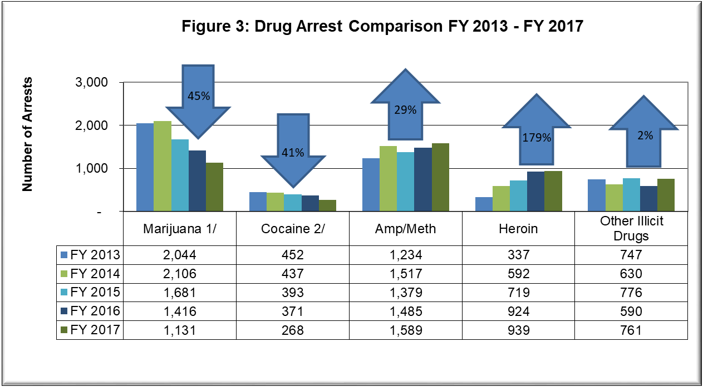

EDGE Highlights: Apprehension

Slide 5
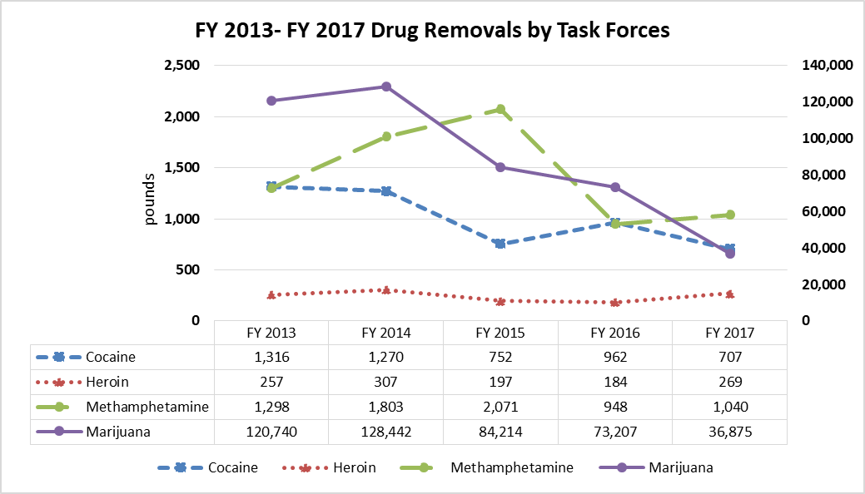
EDGE Highlights: Apprehension
51 pounds of Fentanyl removed
1,019 Fentanyl pills removed
6,712 marijuana plants removed, an 185% increase from FY16

Slide 6
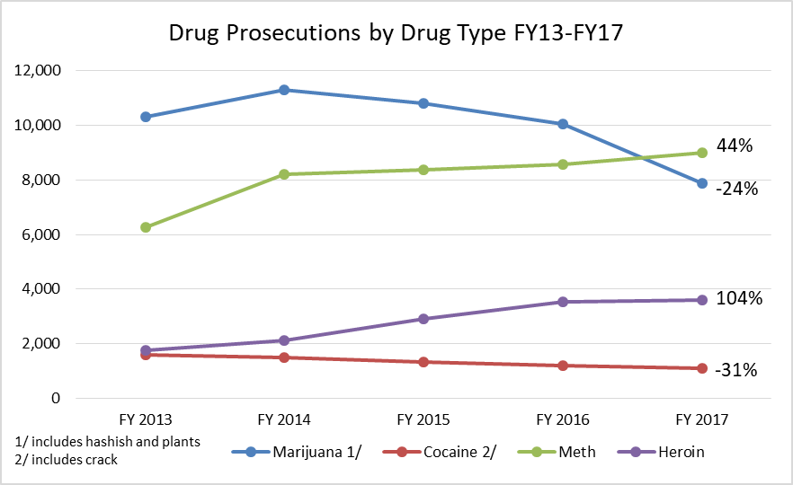
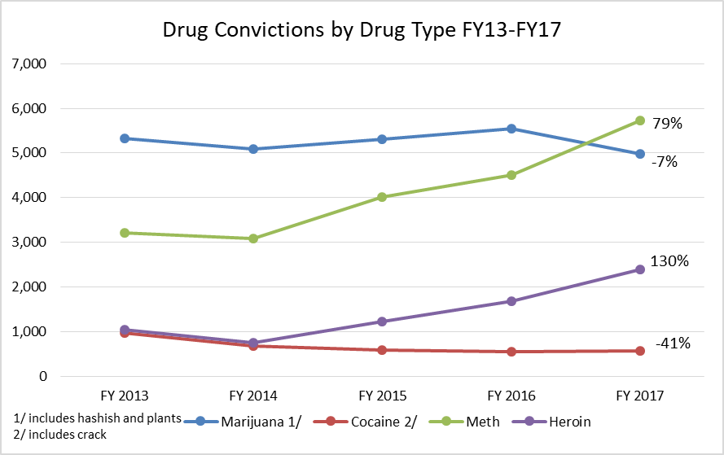
EDGE Highlights: Prosecution

Slide 7
EDGE Highlights: Prosecution
28,834 prosecutions involved drug crime
Resulted in 26,614 convictions
More than 60% sentenced to probation
21% sentenced to prison
14% split sentence

Slide 8
EDGE Highlights: Adjudication
Drug Courts:
  2,074 participants
  95% did not recidivate
  Highest number of participants who obtained employment
Probation:
  3,163 probationers served
Indigent Defense Services:
  919 indigent defendants served in FY17
  76% decrease from FY17 to FY13

Slide 9
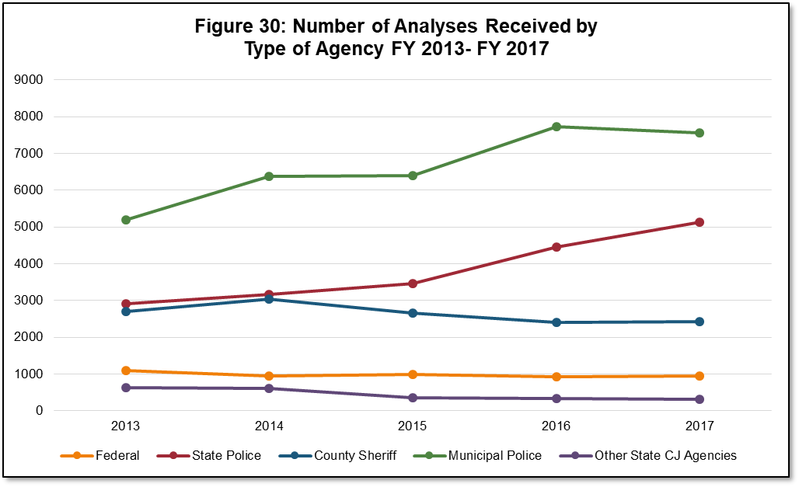
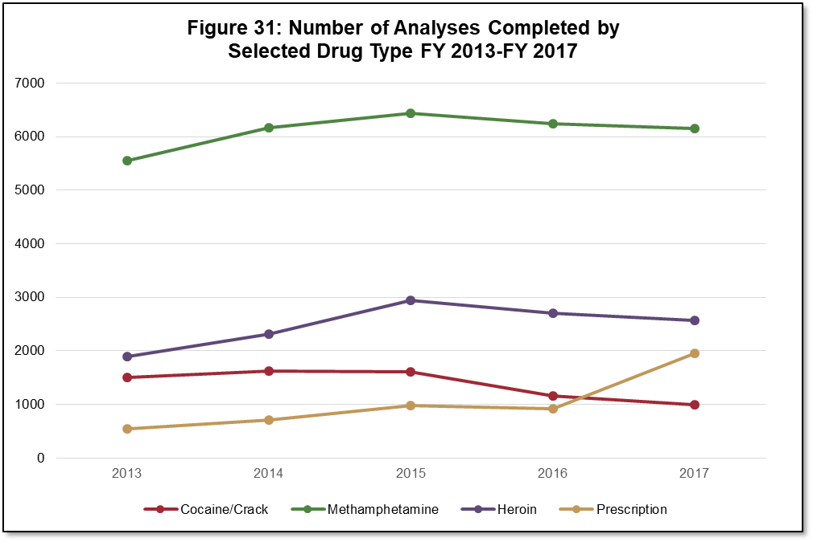
EDGE Highlights: Forensic Support

Slide 10
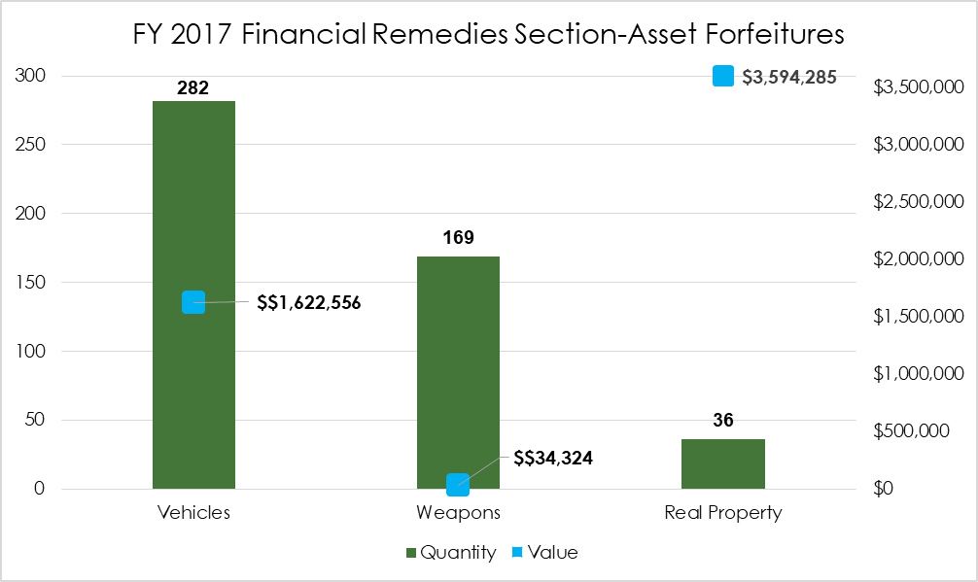
EDGE Highlights: Civil Forfeitures

Slide 11
EDGE Highlights: Medicaid Fraud
34 case referrals
Resulted in 388 total charges
Removed a total of 171,781 doses of prescription drugs with a value of over $1.6 million

Slide 12
DGVCC Strategy 2020-2023
Current Strategy 2016-2019
New strategic planning requirements for Byrne/JAG Grant:
  Judges, prosecutors, law enforcement personnel, corrections personnel, providers of indigent defense services, victim services, juvenile justice delinquency prevention programs, community corrections, and reentry services
  Describe how state will allocate funding
  Describe process used for gathering evidence-based data and developing/using evidence-based approaches in funding decisions
  Describe barriers accessing data and implementing evidence-based approaches
Regional Meetings for criminal justice stakeholder input will be held

Slide 13
ACJC Reporting System Update
Updates to system
Any pressing/reoccurring issues
Survey will be sent to grantees for input
Long term direction for ACJC reporting system

Slide 14
FY19 Cycle 32 Funding Update

Slide 15
Projected FY 2019 Grant
FY 2019 program is facing an estimated $636,400 reduction from FY 2018 (includes 25% match)
About $8.6 M program size – 6.9% reduction
  Lowest program size in program history
  Reductions in 8 out of the last 9 years
$3 M in Byrne JAG funds
  $194,267 less than previous fiscal year
$3.4 M in State DEA funds
  $283,067 less than previous fiscal year
$2.15 M in local matching funds
  $159,111 less than previous fiscal year
  Maintains a 25% match
Assuming position costs stayed the same: a reduction of about 9.95 FTE Positions
Number of projects where less than 1 FTE Position is funded is growing

Slide 16
DGVCC Grant Program Size

Slide 17
Federal Byrne JAG Funding
Evidence-based and data-driven projects, Strategic plan requirement
SORNA penalty 10% until State is compliant
  FFY 2017 penalty is $136,638
5% PREA penalty is no longer applied
Possible penalties for Deaths in Custody Reporting Act compliance
NIBRS 2% or 3% mandatory allocation
5% set-aside for CJRIP

Slide 18
DC Grant Program Updates
8 U.S.C 1373 certification
Additional certification requirements related to immigration:
  1. Recipient permit access to U.S. DHS to access any detention facility in order to meet with an alien and inquire as to his or her right to be or remain in the US
  2. Provide at least 48 hours advance notice to DHS regarding the scheduled release date and time of an alien in the jurisdiction’s custody when DHS requests such notice in order to take custody of the alien
Agency’s Chief Legal Officer and Chief Executive Officer may need to sign certification
If agencies are required to certify and there is non-compliance. Agencies cannot receive the Federal portion of the grant.

Slide 19
Grant Program Updates
Federal FY17 Byrne/JAG Award to ACJC is delayed
  Federal lawsuit related to sanctuary cities
  Impacts all DC grantees, including State Award only grantees
New GMS: Ecivis
  ACJC’s GMS is slowly malfunctioning
  Tentatively scheduled to begin in January 2019
  In person training and recorded webinars will be held in late 2018 for grantees

Slide 20
Multi-Jurisdictional Task Force Evaluation Update

Slide 21
Background
Purpose
  To understand the depth and breadth of task force efforts
  To understand the relationship between processes and impacts of the task force side, with the outcomes of the prosecution side
  To assess if and how task force activity is related to broader outcomes (e.g., public health, public safety, and criminal justice overall)
Evaluation Components
  Process
  Impact
  Outcome
Myths - Debunked

Slide 22
Status
Quantitative Analyses
  ACCH Data ✔
  Public Health Data ✔
  UCR Data ✔
  AYS Data ✔
  Process and Impact Data (quarterly reports) ✔
Qualitative Analyses
  Content Analyses (first round) ✔
  Round 2 of Interviews ✔
Data cleaning in process; Analyses will begin when data is prepared
  Final Report – March 2018

Slide 23
Obstacles
Data Quality
  Categorical inconsistencies
    Extended timeline to add another year of data to the model
Staffing Changes
  Senior Research Analyst turnover
    Cara Stevens to take over and complete project
Low Response Rate (Qualitative)
  Solution – Conducted a second round of interviews to strengthen the qualitative component and add context to quantitative findings

Slide 24
Next Steps
Complete Qualitative Analyses
Complete Quantitative Analyses
  2017 ACCH data tables
Impact and Outcome Analyses
Draft Final Report
Proposed Completion Date: 3/31/2018

Slide 25

ACJC Staff
Drug, Gang, and Violent Crime Control Program:
Tony Vidale, Deputy Director
Anna Haney, DGVCC Program Coordinator
Information Technology:
Matt Bileski, Applications Developer
SAC Staff:
Catie Clark, SAC Director
Cara Stevens, Senior Research Analyst

